Slide 1

17 April 2013
“Reduce Continuing CFIT Accidents by Training Constant Descent Final Approaches
Using Distance-Altitude Tables to Follow the
Glideslope Angle to an Accuracy of 30ft”
Including LOC-DME Accident 14 Aug 13
of UPS A300-600F into Birmingham, Alabama
Hugh DIBLEY FRAeS, FRIN, CMILT
formerly BOAC/BAW , Airbus Toulouse
RAeS: Flight Simulation Group, ICATEE,
Flight Operations Group, Chairman Toulouse Branch

Slide 2
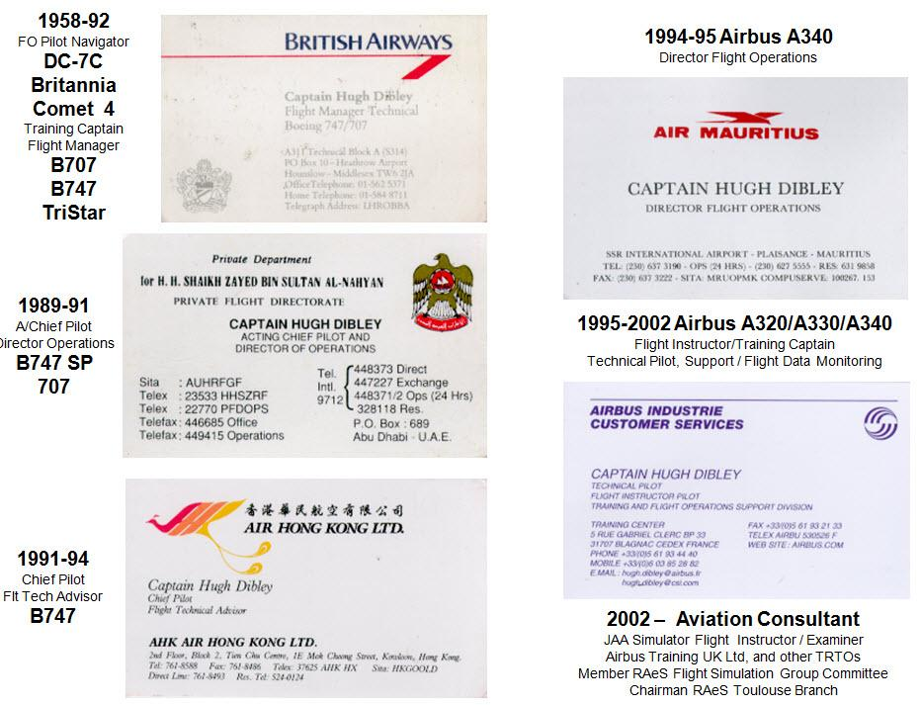

Slide 3
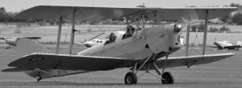
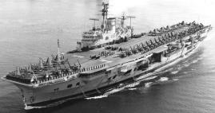

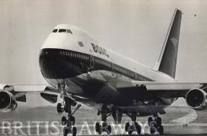
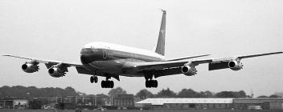
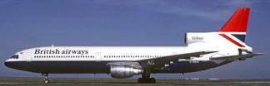

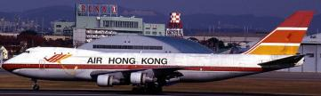



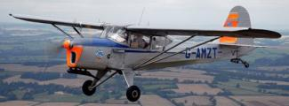
Hugh Dibley’s Main Aviation Activities

Slide 4
Reduce Continuing CFIT NPA Accidents
Overview of Approach Development
Reminder of Stepped NPA Issues
Constant Angle NPAs Using DME
Accidents from Stepped Descents
Use of Distance-Altitude tables all types
Improvements to approach charts
Crew training/competence
Summary – after WATS UPS Accident KBMH

Slide 5
Overview of Approach Development
Actual distance from runway only known at Beacon crossings therefore
Descents and Approaches had to be Step Downs.
ILS Approaches on 3 degree glideslope transmitted from ground 5 times
safer than Step Down/”Dive & Drive” Non Precision Approaches.
1970s - DMEs installed worldwide, Descents and Approaches could be
based on distances accurate to 0.1 nautical mile.
Constant Angle 3 degree Non Precision Approaches possible to 30ft
accuracy using DME-Altitude tables on approach charts or simple aids.
1980s - Airbus policy to fly Constant Angle NPAs flown automatically by the
FMGS or selecting Flight Path Angle & crosschecking profile from tables.
Step Down/Dive & Drive NPA Accidents continued despite GPWS.
2000 - FAA required aircraft to be capable of flying CANPAs using on board
navigation systems within 10 years.
2010 - US operators started CANPA implementation requiring FMS/GPS.
2011 - FAA AC 120-108 introduced Continuous Descent Final Approach but
Distance-Altitude tables to monitor the glideslope not emphasised.
Some large operators’ policy remains to use Dive & Drive.

Slide 6
Reason for Frequent CFIT Accidents up to 1970s -
Where No Ground Radar, Descents Made in Steps,
Continuing Descent Passing Radio Beacons
Radio Beacon
Mountain
The same principle
had to apply for
Non Precision Approaches

Slide 7
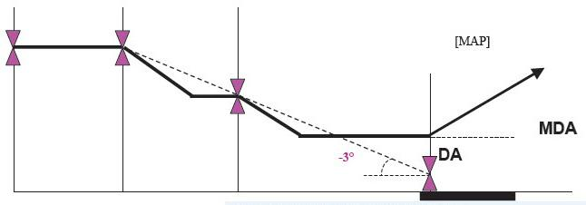
Before DME / reliable distance information
NPAs Had to be Step Down or “Dive and Drive
“Dive” to next Minimum Altitude
Fix
such as
NDB
Beacon
Fix
such as
Flashing Light

Slide 8
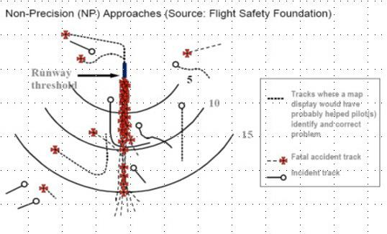
Lateral Navigation was not the Main Problem
Accidents sites were mainly in line with runway

Slide 9
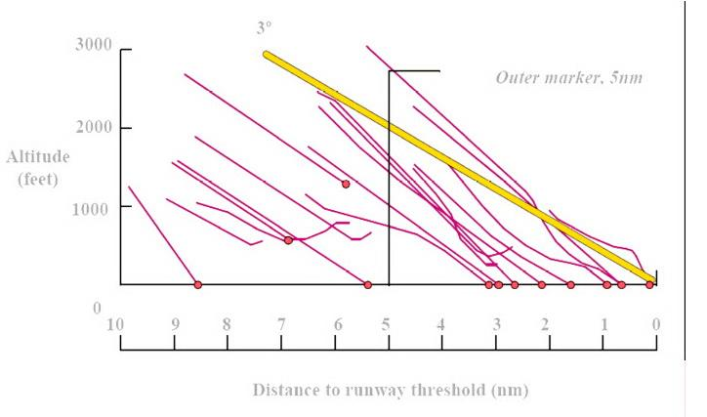
The Difficulty was in Vertical Navigation - Flying below the 3º glide path to crash short of the runway

Slide 10
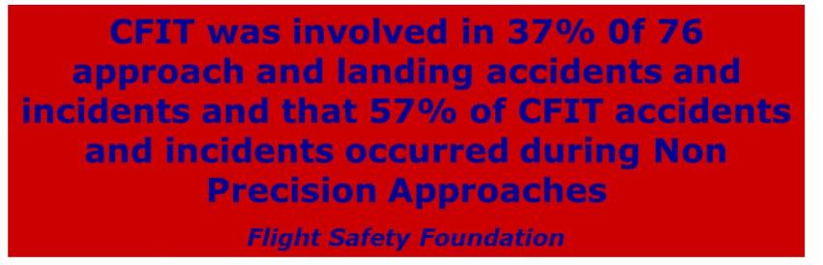
The Majority of CFIT Accidents have involved NPAs

Slide 11
Hazards of a “Dive & Drive” NPA Profile
Unstable profile
Approach Unstable – needing pitch, thrust & flap changes
Unstable profile leading to unstable approaches

Slide 12
Hazards of a “Dive & Drive” NPA Profile
Missed step or late stabilisation causes accidents
Crew missed a step, stabilised late, or failed to monitor DME-Altitude glideslope
01 Dec 1974 TWA 727 VOR DME approach into Washington Dulles
08 Feb 1989 Flying Tigers 747 VOR DME approach accident into Kuala Lumpur
12 Nov 1995 American MD82 VOR DME approach into Windsor Locks Conn, USA
06 Aug 1997 Korean 747 LOC No Glidepath DME approach accident into Guam
24 Nov 2001 Crossair RJ 100 VOR DME approach accident into Zurich R/W 28 14 Aug 2013 UPS A300-600F LOC-DME into Birmingham Alabama?
Above a small sample – many other accidents/near misses, eg at old HKG Kai Tak IGS Glidepath out approach, a 747 missed a step and descended early towards a hill, but error advised by Hong Kong Approach Radar.

Slide 13
Hazards of a “Dive & Drive” NPA Profile
Chance of hard landing or runway over-run
Approach Unstable – needing pitch, thrust & flap changes
Flying level pitched up at MDA obtaining visual reference causes late “dive” at the runway with hard or deep landing and runway over-run.
Runway safety related accidents are ICAO’s highest accident cause
Late final configuration means checklists being read at low altitude

Slide 14
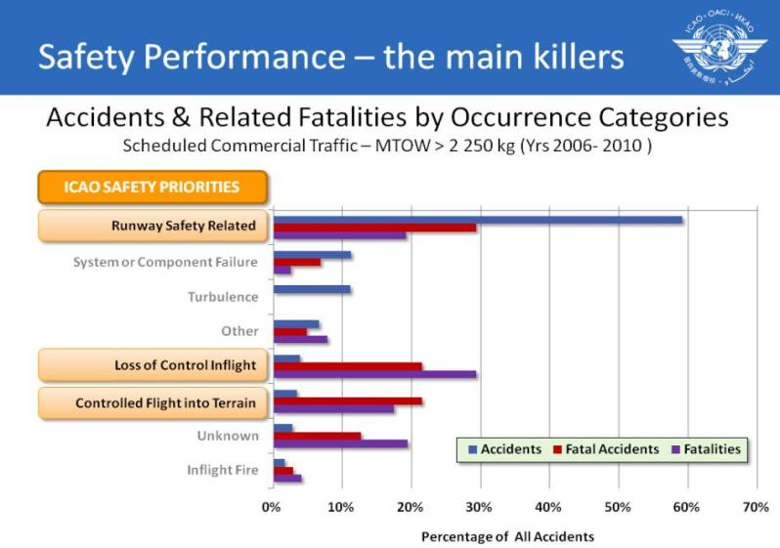

Slide 15
Despite this Some Operators Are Still Flying
Dive and Drive Non Precision Approaches
2 airlines trained recently still using D &D
Pilot with US A320 Type Rating trained for D&D
Any aircraft can fly Constant Angle Approaches using a DME in line with the runway
No need for any FMS/GPS equipment
Reports of some Authorities reluctant to approve
NPA Approach charts with clear Distance-Altitude checks for checks/monitoring essential even for the latest aircraft.

Slide 16
Descent Path Calculated from DME
Altitude on continuous 3º descent path can be calculated from a DME in line with the runway
as in example given later
GUAM No Glide Path approach at 5 nm DME –
Approach Altitude = (5+3.3) x 300 + 310 = 2,800ft
Best by using
Direct DME – Altitude Display
Otherwise crews tend to descend early

Slide 17
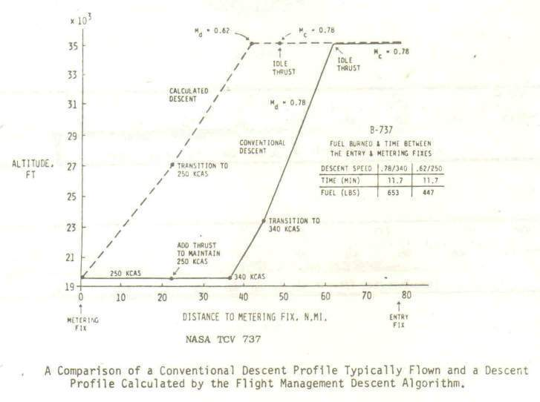
Similar Calculations Needed for Accurate ATC
Descent Clearance to DME Crossing Altitude
NASA found crews descended early rather than on optimum profile
Mentally computed descent profiles are usually not optimum

Slide 18
Similar Calculations Needed for Accurate ATC
Descent Clearance to DME Crossing Altitude
NASA found crews descended early rather than on optimum profile
US ATC made good use of DME during descent when moving to next ATC sector –
Descend to 8000’, cross 23 DME of XYZ at 8000’ (and at 250kts IAS).
Mentally computed descent profiles are usually not optimum

Slide 19
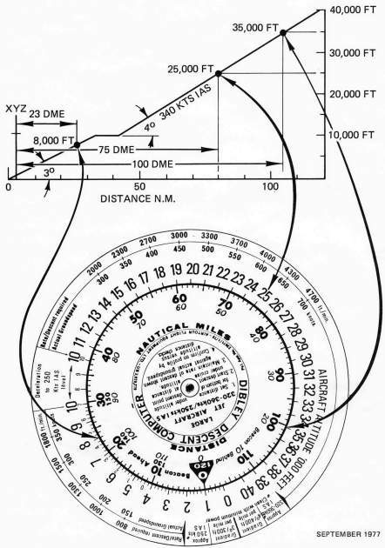
Crews can easily fly efficient descents with simple aids
Circular slide rule primarily designed to help crews follow an efficient flight idle descent profile to comply with an ATC clearance such as to cross 23 DME XYZ at 8,000ft at 250kts.
Profile easily followed by flying Sink Rate required for actual Groundspeed shown on the outer scale.
DME-Altitude checks to confirm on profile immediately available and Sink Rate adjusted accordingly if high or low.
Checking the profile mentally, normally by 300ft per mile, less accurate for this profile, requires regular computation of an equation, such as at 50 DME:
(50-8-23) x 300 = 5,700 + 8,000 = 13,700ft
Calculating the profile efficiently and regularly diverts mental capacity from other important tasks, increases fatigue, etc.

Slide 20
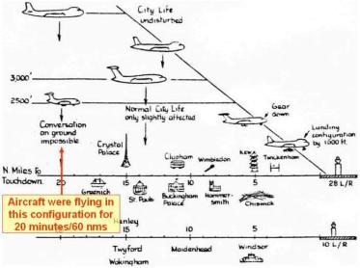
Crews can easily fly efficient descents with simple aids
Fuel efficient quiet Constant Descent Approaches from the holding fix altitude were introduced into London Heathrow in 1975 using ATC distance to run & DME distance from the runway for guidance.
Besides minimising fuel burn and noise, following this profile improves safety by keeping the aircraft well clear of the ground into nearly all airfields.

Slide 21
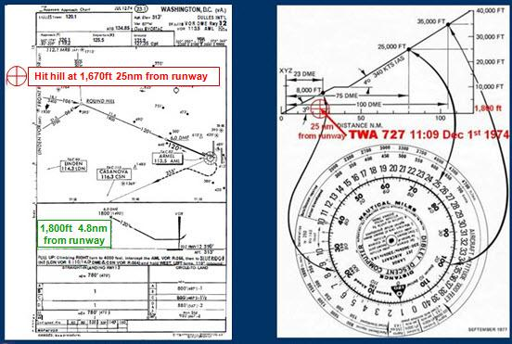
Use of such an aid might have saved the FO flown TWA Flt 514
B727 CFIT VOR DME Accident in to Washington Dulles in 1974

Slide 22
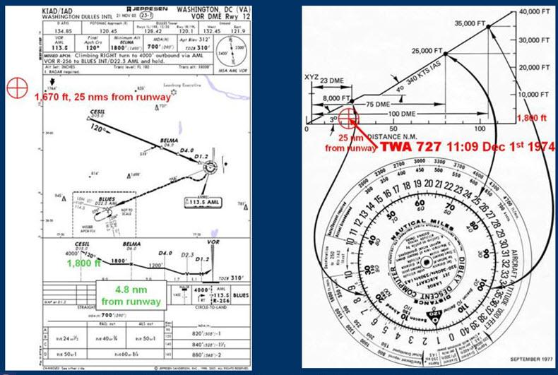
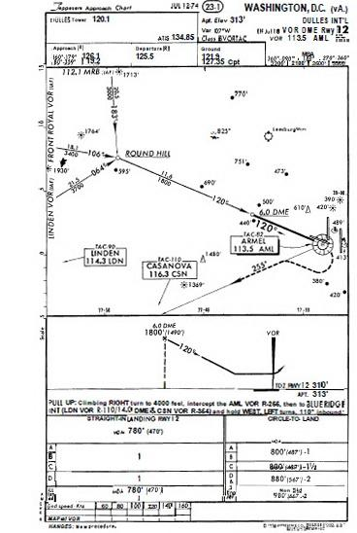
Use of such an aid might have saved the FO flown TWA Flt 514
B727 CFIT VOR DME Accident in to Washington Dulles in 1974
The aircraft diverted due to strong cross winds from Washington National to Dulles International for a VOR DME NPA to runway 12. The captain gave control to the FO and read the approach chart. ATC gave descent clearance to 7,000ft and then for the approach. The crew concluded this allowed descent to the FAF at 1,800ft and the FO started descent immediately at 44nm DME when 25nm would be more efficient for fuel and noise. The aircraft levelled off over 20nm early and below the 3,400ft minimum altitude for the sector. Due to high winds and turbulence the aircraft descended below 1,800ft and hit the ground at 1,670ft.
Hit hill at 1,670ft 25nm from runway
1,800ft 4.8nm
from runway
The FAA then mandated GPWS to be fitted to all US registered aircraft

Slide 23
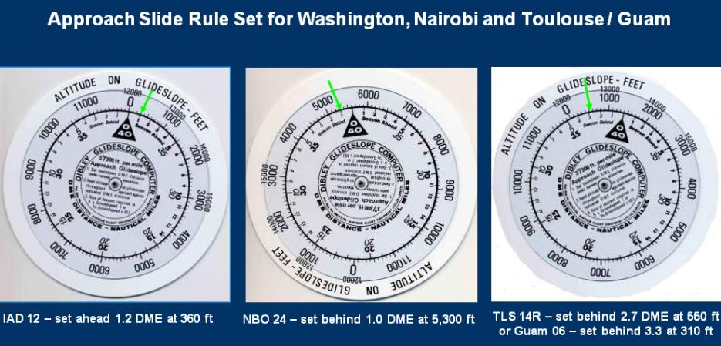
An expanded scale can show a
3º Constant Angle Approach glide path
Table on approach chart can give similar guidance

Slide 24
The sliderule/tables give similar help vertically as the RMI did laterally – nobody wanted to keep RBIs!
Aids for crews not skilled in mental arithmetic – like bookmakers’ clerks calculating betting odds

Slide 25
The sliderule/tables give similar help vertically as the RMI did laterally – nobody wanted to keep RBIs!
Aids for crews not skilled in mental arithmetic – like bookmakers’ clerks calculating betting odds
Similar to using the improved
ADF RMI (Radio Magnetic Indicator) versus an old
RBI (Relative Bearing Indicator)
to which Magnetic Heading must be added to calculate the Magnetic course to the beacon – no longer in use!

Slide 26
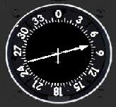
The sliderule/tables give similar help vertically as the RMI did laterally – nobody wanted to keep RBIs!
Aids for crews not skilled in mental arithmetic – like bookmakers’ clerks calculating betting odds
RBI – Fixed Card
Heading
345º Magnet
What is QDM
(Direction º M)
to the NDB?
= 075+345=420
-360 = 60º M
Similar to using the improved
ADF RMI (Radio Magnetic Indicator) versus an old
RBI (Relative Bearing Indicator)
to which Magnetic Heading must be added to calculate the Magnetic course to the beacon – no longer in use!

Slide 27
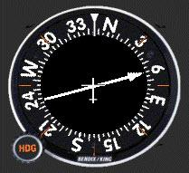
The sliderule/tables give similar help vertically as the RMI did laterally – nobody wanted to keep RBIs!
Aids for crews not skilled in mental arithmetic – like bookmakers’ clerks calculating betting odds
RBI – Fixed Card
RMI Heading Mag
Similar to using the improved
ADF RMI (Radio Magnetic Indicator) versus an old
RBI (Relative Bearing Indicator)
to which Magnetic Heading must be added to calculate the Magnetic course to the beacon – no longer in use!

Slide 28
The sliderule/tables give similar help vertically as the RMI did laterally – nobody wanted to keep RBIs!
Aids for crews not skilled in mental arithmetic – like bookmakers’ clerks calculating betting odds
Nobody wanted to keep RBIs!
RBI – Fixed Card
RMI Heading Mag
Similar to using the improved
ADF RMI (Radio Magnetic Indicator) versus an old
RBI (Relative Bearing Indicator)
to which Magnetic Heading must be added to calculate the Magnetic course to the beacon – no longer in use!

Slide 29
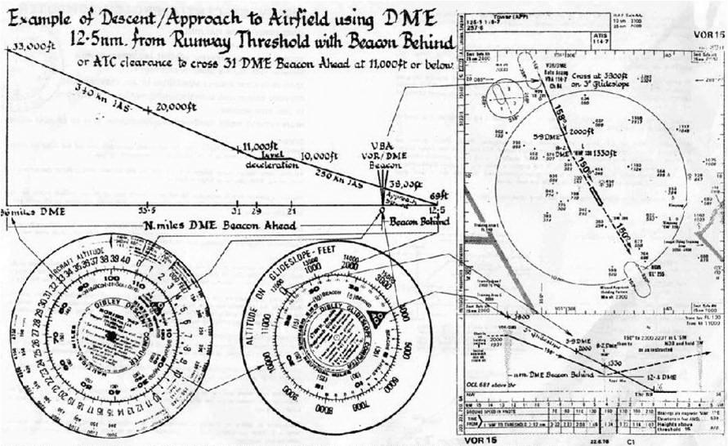
In 1976 Close Call to BAOD 747 flying NPA with 1.5º glidepath
Published Approach started at 2000ft at 12.5nm, 2000ft below 3º glide path

Slide 30
In 1976 Close Call to BAOD 747 flying NPA with 1.5º glidepath
The “Black Hole” approach over forest with no visual cues started from the VOR DME at 2000ft,
12.5nm from the runway 2000ft below a 3º glide path.
The aircraft brushed trees in a Go Around from MDA.
The approach procedure was revised
to follow a 3º path with DME-Altitude checks tables,
being incorporated on all BA Aerad charts.
BA had no similar NPA incidents thereafter.
Published Approach started at 2000ft at 12.5nm, 2000ft below 3º glide path

Slide 31
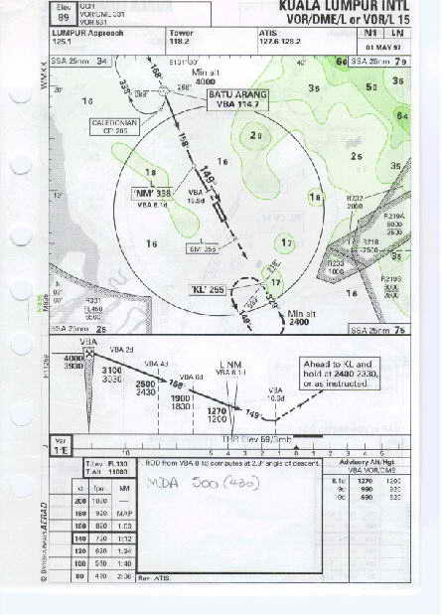
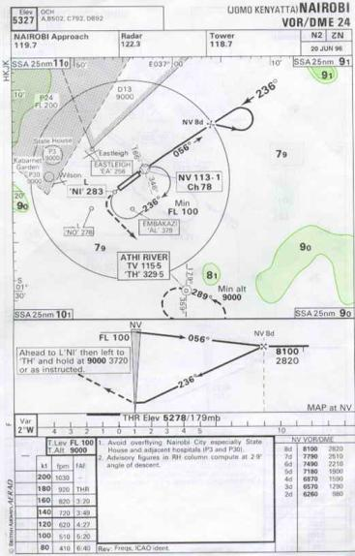
BA/Aerad Provided DME-Altitude Tables
Permitting Constant Angle NPAs starting in 1975
Constant Angle Approach with DME-Altitude table
Constant Angle Approach with DME-Altitudes & table

Slide 32
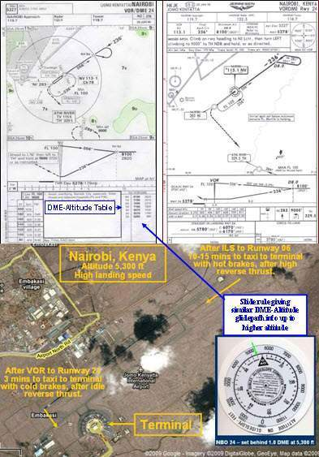
20 min Time Saving Flying VOR-DME NPA NBO 24 vice ILS 06

Slide 33
20 min Time Saving Flying VOR-DME NPA NBO 24 vice ILS 06
A VOR DME on runway 24 became a simple matter using a slide rule or DME-Altitude table.
This could save 20 mins over an ILS on 06, which required back tracking the runway, arriving with hot brakes due to landing at max landing weight from fuel tankering.
Some who said altitude calculations could be done mentally so no need for any aid – would choose an ILS as a VOR DME considered too difficult!

Slide 34
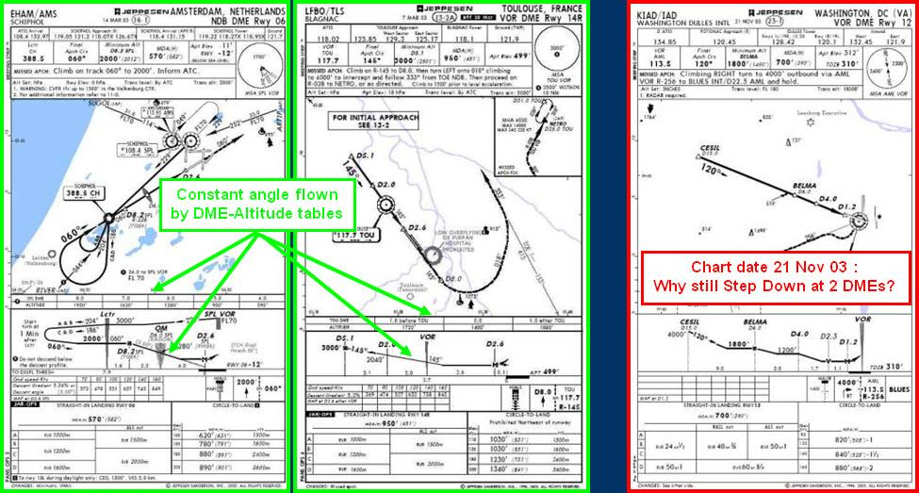
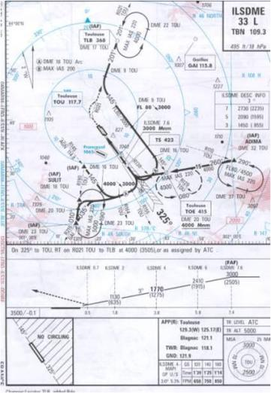
By the 1980s Most European Authorities provided DME-Altitude Information for Constant Angle NPAs,
DME-Altitude checks

Slide 35
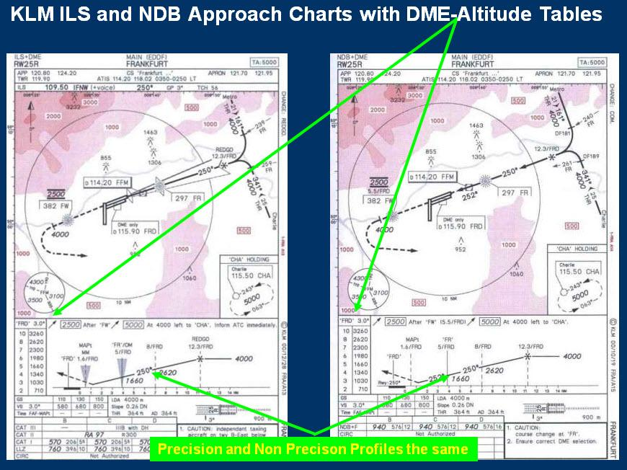
ILS/LOC DME Approach
NDB DME Approach

Slide 36

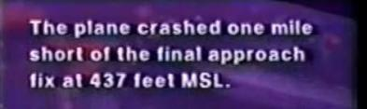
In 1989 Flying Tigers B747 Crashed with the FO
flying a VOR-DME Approach in to Kuala Lumpur
Hit hill at 427ft - Final Approach Fix Altitude 2400ft
GPWS “Pull Up, Pull Up” ignored for 25 seconds
(13 years after BAOD’s close call into same airfield)

Slide 37
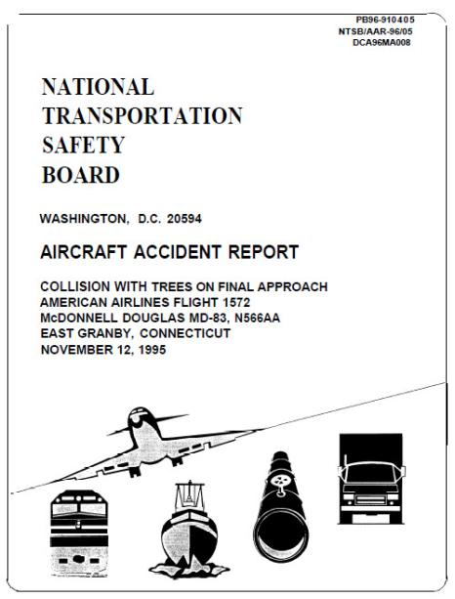
12 November 1995 American Airlines 1572 MD 82
Hit trees on VOR DME Approach into Bradley Connecticut
``

Slide 38
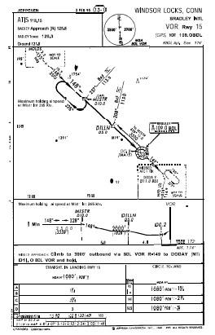
12 November 1995 American Airlines 1572 MD 82
Hit trees on VOR DME Approach into Bradley Connecticut
``
Step Down Profile
No DME Altitude table

Slide 39
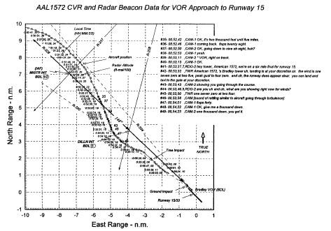
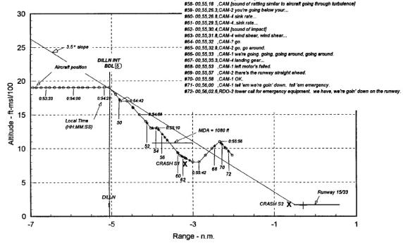
12 November 1995 American Airlines 1572 MD 82
Hit trees on VOR DME Approach into Bradley Connecticut
``
Horizontal track
Vertical profile

Slide 40
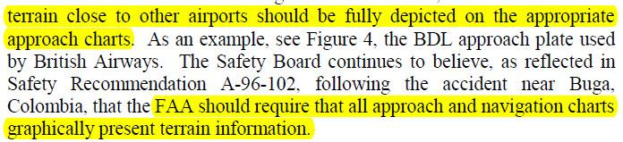
NTSB Analysis AA 1572 MD82 12 Nov 95

Slide 41
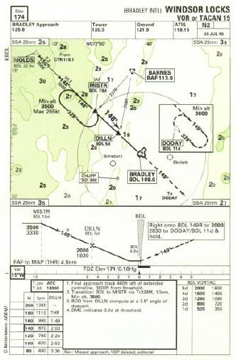
NTSB Analysis AA 1572 MD82 12 Nov 95
Example given of British Airways chart showing terrain information –
But why no emphasis given to the Constant Angle Approach checked by DME-Altitude table which keeps the aircraft above terrain?
Constant Angle Approach
DME –Altitude Tables to fly
Constant Angle Approach
of primary assistance

Slide 42

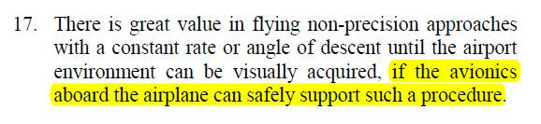
NTSB Conclusions AA 1572 MD82 12 Nov 95
No additional avionics required.
Just DME-Altitude Cross checks on 3º profile
by tables or slide rule –
as used on hand flown CANPAs since 1970s
on aircraft such as B707s with no FD or autopilot.

Slide 43
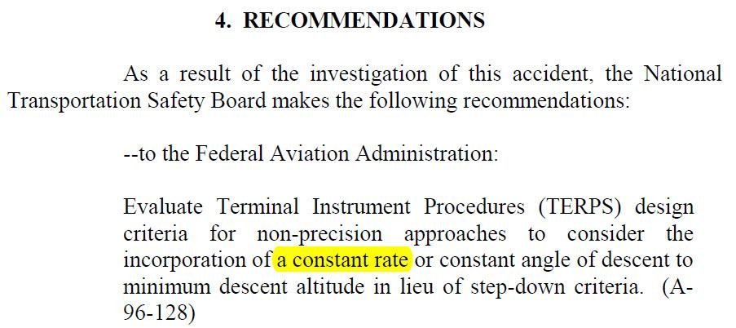
NTSB Recommendations - 13 Nov 1996
Required descent angle can be followed by flying sink rate for indicated groundspeed – allowing for airspeed wind component changes –
adjusted if checks show deviation from profile.

Slide 44
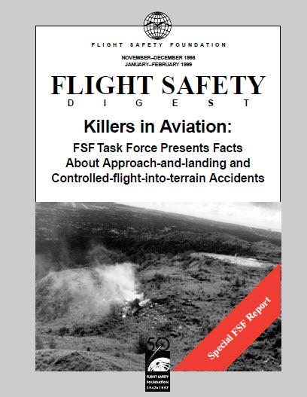
Ability to fly DME-Altitude CANPAs not stressed

Slide 45
Ability to fly DME-Altitude CANPAs not stressed
FSF 278 page Nov-Dec 1998 CFIT Task Force Report
only reference?
Aircraft Equipment Working Group Page 93
“Operators should furnish crews with charts depicting
constant-angle profiles and recommended altitudes along the glide path for nonprecision approaches;”

Slide 46
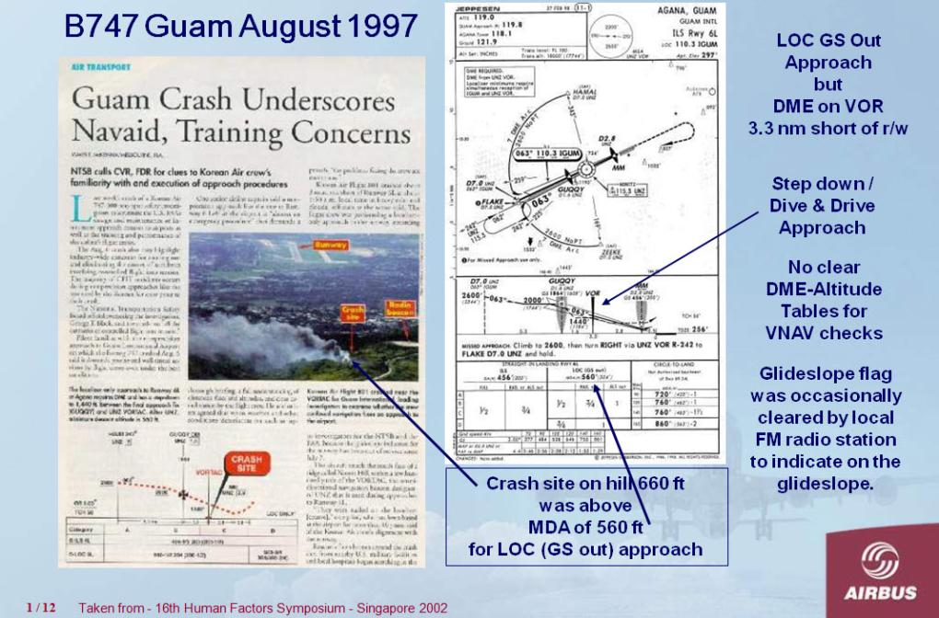
KAL B747-300 CFIT Accident into Guam 6 Aug 1997

Slide 47
KAL B747-300 CFIT Accident into Guam 6 Aug 1997
A confusing situation for the crew as the profile of the LOC GS out approach was Dive & Drive although in the same area as the normal ILS Glide Slope –
and a false signal was causing the GS to indicate correctly.
The aircraft descended early and before reaching MDA hit the ground having started to Go Around.

Slide 48
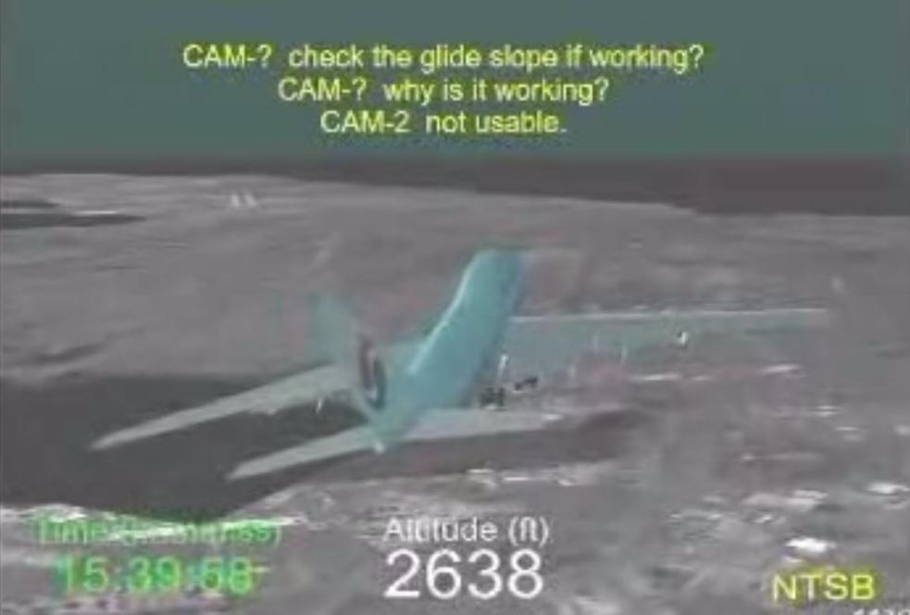
KAL B747-300 CFIT Accident into Guam 6 Aug 1997

Slide 49
KAL B747-300 CFIT Accident into Guam 6 Aug 1997
With the Glide Slope transmitter out of service, a radio signal was clearing the GS Fail flag giving an indication of on Glide Slope to the pilots.
This was a surprising/confusing distraction.
The captain asks if the glide slope is working and the FO confirms it is not.

Slide 50
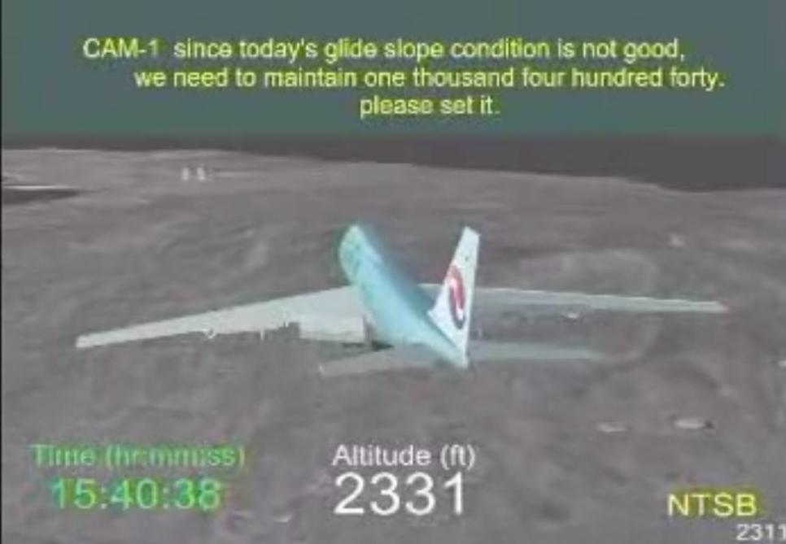
KAL B747-300 CFIT Accident into Guam 6 Aug 1997
Having briefly thought the aircraft was on a serviceable glideslope, the captain has to switch back mentally to the lower Dive & Drive profile.
He correctly asked the FO to set the next step of 1440ft to be maintained to the VOR, adding considerably to their workload –
On a Constant Angle approach this change of profile and new altitude setting is not made.

Slide 51
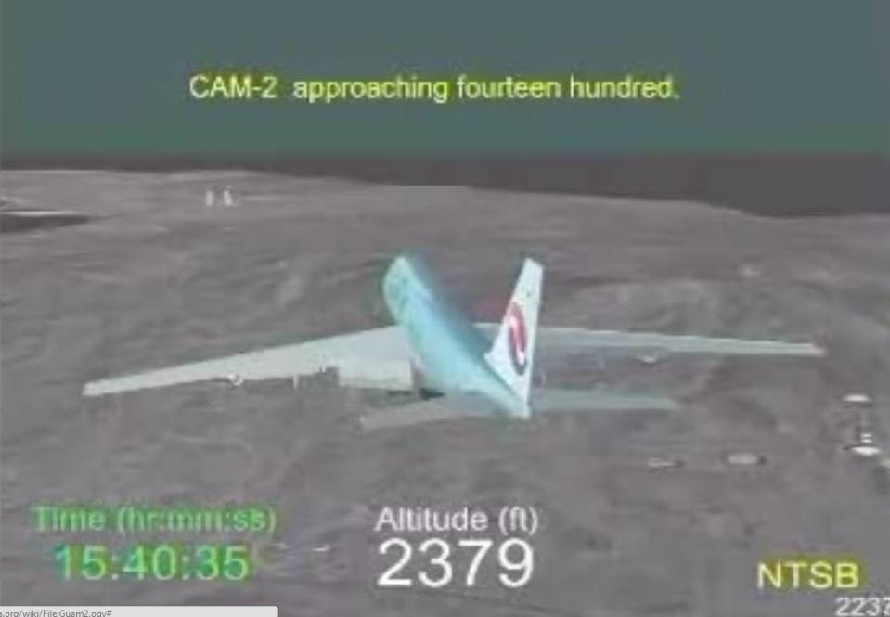
KAL B747-300 CFIT Accident into Guam 6 Aug 1997

Slide 52
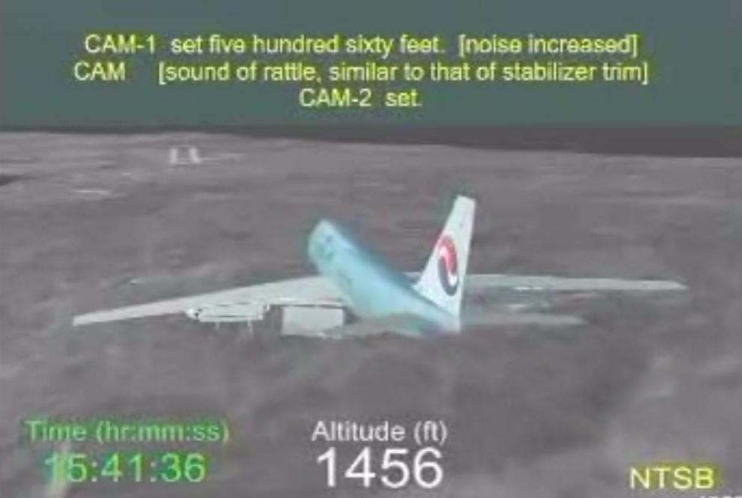
KAL B747-300 CFIT Accident into Guam 6 Aug 1997
When the FO warns Approaching 1400ft the captain asks him to set the MDA of 560ft.
But continues descending rather than flying level until the VOR.
Perhaps forgetting that the DME was not at the airfield but 3 miles closer at the VOR, although he had mentioned the 3 miles in his briefing while at cruise altitude?

Slide 53
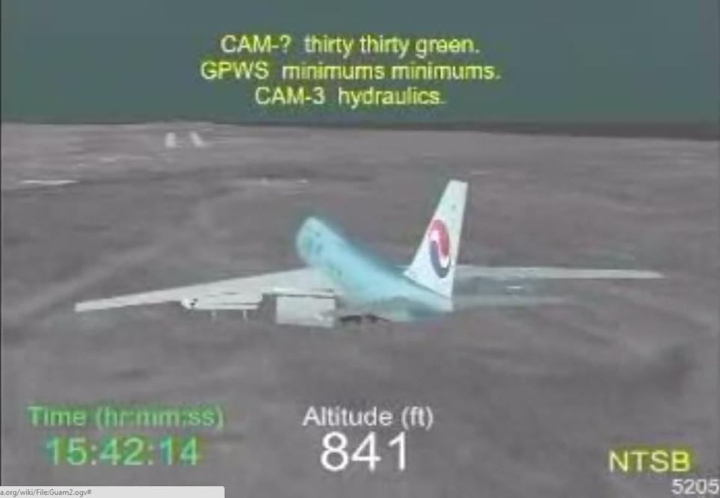
KAL B747-300 CFIT Accident into Guam 6 Aug 1997
The Flight Engineer was still reading the Landing Checklist at 600ft above the airfield altitude causing further distraction to the pilots.
A disadvantage of the Dive and Drive approach is that the landing configuration is achieved later than during a Constant Angle Approach

Slide 54
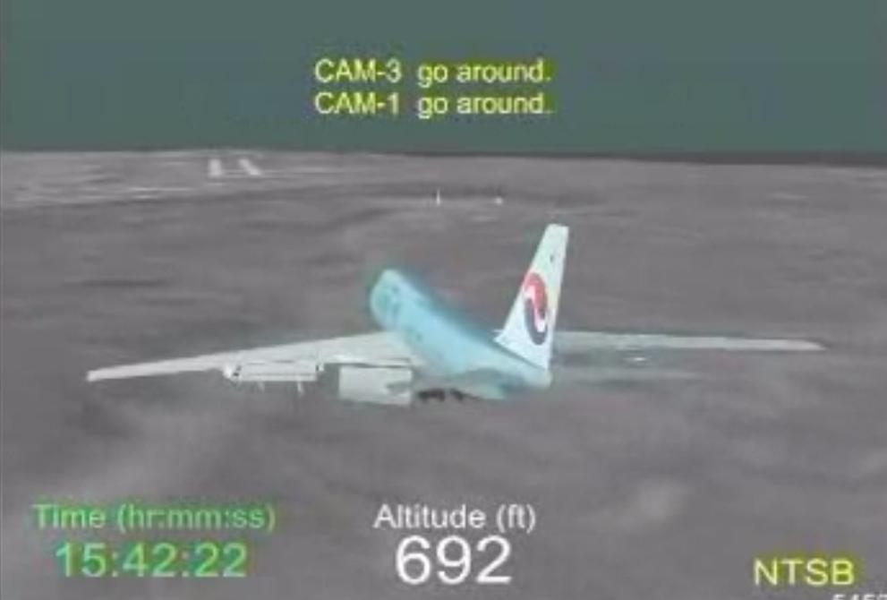
KAL B747-300 CFIT Accident into Guam 6 Aug 1997
The captain started a Go Around at 692ft amsl, 130ft above the 560ft MDA, but did not pitch up quickly enough and the aircraft hit the hill of 660ft close to the VOR site.

Slide 55
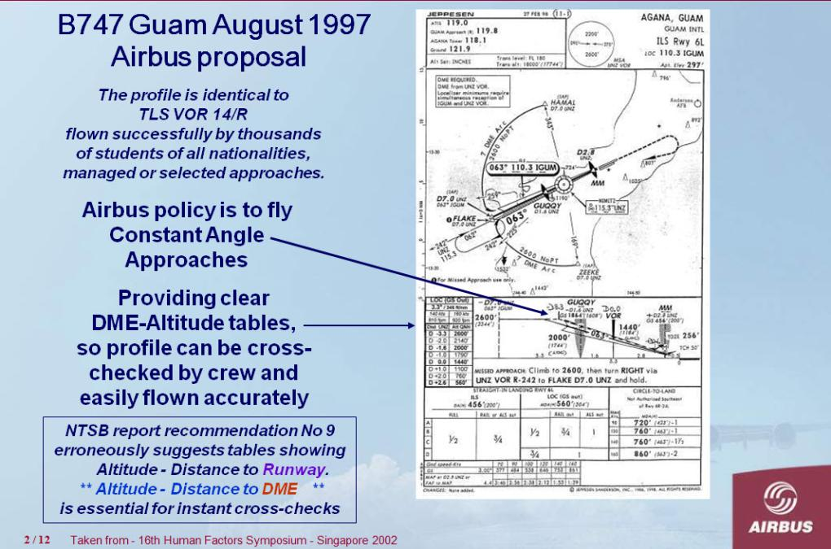
KAL B747-300 CFIT Accident into Guam 6 Aug 1997

Slide 56
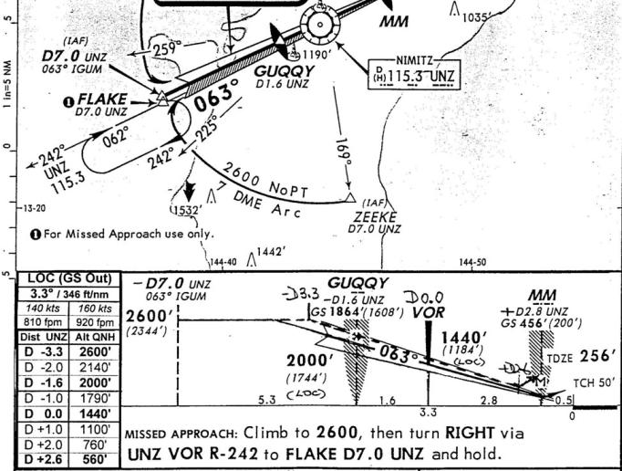
KAL B747-300 CFIT Accident into Guam 6 Aug 1997

Slide 57
KAL B747-300 CFIT Accident into Guam 6 Aug 1997
Constant angle from 2600ft

Slide 58
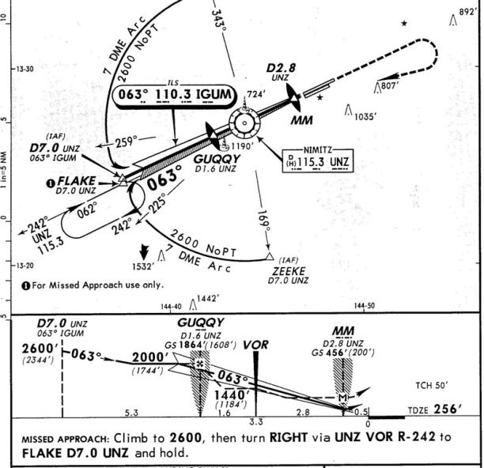
KAL B747-300 CFIT Accident into Guam 6 Aug 1997

Slide 59
KAL B747-300 CFIT Accident into Guam 6 Aug 1997
Compared to step down from 7.0 DME UNZ at 2600ft
to fly level at 2000ft until 1.6 DME before UNZ,
step down to fly level at 1440ft until the VOR/0 DME,
step to fly level at MDA 560ft to 2.8 DME after UNZ

Slide 60
KAL B747-300 CFIT Accident into Guam 6 Aug 1997
If the LOC GS out approach profile has been a Constant Angle like the normal ILS glideslope,
with a clear DME-Altitude table for the crew to check the aircraft to be on the correct profile,
and the crew trained to use this procedure, being stabilised in the landing configuration before starting the final descent.....
would the accident have still occurred?

Slide 61
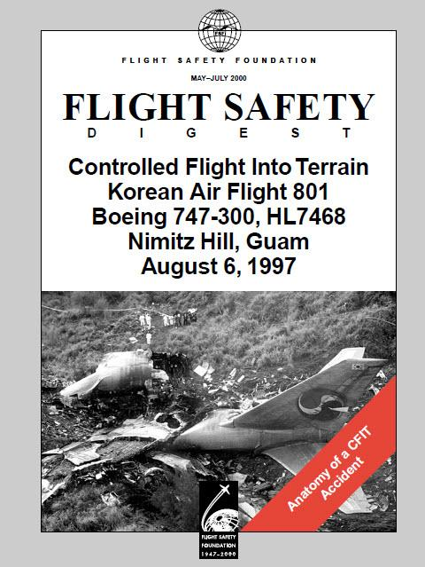
NTSB Report of KAL 747 Accident Guam 8 Aug 1997

Slide 62
NTSB Report of KAL 747 Accident Guam 8 Aug 1997
NTSB report in FSF May-Jul 2000 FS Digest made 12 recommendations – Aircraft with suitable systems required to provide vertical flightpath guidance for constant angle nonprecision approaches, and all air carriers’ aircraft to be so equipped in 10 years.
– “Tabular information to allow Constant Angle of Descent by cross referencing distance from the airport and barometric altitude.”
But distance from airport is only available from FMS/GPS equipped aircraft so the distance reference must be the local DME when FMS/GPS is not available.

Slide 63

July 2000 ANZ Erroneous GS Capture Resolved by DME-Altitude Checks

Slide 64

ANZ Erroneous GS Capture Resolved by DME-Altitude Checks

Slide 65
ANZ Erroneous GS Capture Resolved by DME-Altitude Checks
Aircraft captured and flew an erroneous GS signal flying well below the correct glidepath.
The Third Pilot called Go Around when he calculated from the DME the aircraft was 1000ft low.
(NTSB report commented that use of the chart DME-Altitude tables would have detected the error sooner.)

Slide 66

ANZ Erroneous GS Capture Resolved by DME-Altitude Checks
Chart in use had DME-Altitude table

Slide 67

ANZ Erroneous GS Capture Resolved by DME-Altitude Checks
Third pilot’s mental calculations were 300ft in error

Slide 68

ANZ Erroneous GS Capture Resolved by DME-Altitude Checks
VOR DME procedure illustrates
anomalies in charting profiles –
Many still exist today.

Slide 69

ANZ Erroneous GS Capture Resolved by DME-Altitude Checks

Slide 70

ANZ Erroneous GS Capture Resolved by DME-Altitude Checks

Slide 71

CFIT NPA Accidents Continued –
In 2002 Don Bateman, father of GPWS/EGPWS,
published 9 NPA CFIT accidents which could have been saved if EGPWS had been fitted
Described on following slides
But 5 had DME available but no DME-Altitude tables on the charts which could have avoided an accident.

Slide 72

Crossair RJ 100 CFIT Accident Zurich 24 Nov 2001

Slide 73

Crossair RJ 100 CFIT Accident Zurich 24 Nov 2001

Slide 74
Crossair RJ 100 CFIT Accident Zurich 24 Nov 2001
The FO had no way of monitoring the descent path.

Slide 75

Crossair RJ 100 CFIT Accident Zurich 24 Nov 2001

Slide 76
Crossair RJ 100 CFIT Accident Zurich 24 Nov 2001
The FO could have easily checked the aircraft was low from the tables and advised the captain.

Slide 77
Flight Safety Foundation CFIT Accident Data
1998 to 2011
from Jim BURIN

Slide 78

Over the last 6 years, 23 of 82 turboprop major accidents has been a CFIT– that’s 28%, or more than 1 of every 4 !

Slide 79
95% of all commercial jets have been equipped with TAWS (Terrain Awareness and Warning Systems) since 2007. Over the last 6 years, there have been 37 commercial aircraft CFIT accidents (14 jet, 23 turboprop). Only 3 equipped with a functioning TAWS
Over the last 2 years, over 50% of the commercial jet fatalities have been caused by 6 CFIT accidents,. Because of this, CFIT is about to regain its title as the leading killer.
The vast majority of CFIT accidents continue to involve aircraft without a functioning TAWS, and most have no TAWS installed
Over the last 6 years, 23 of 82 turboprop major accidents has been a CFIT– that’s 28%, or more than 1 of every 4 !

Slide 80

Flight Safety Foundation CFIT Accident Data
1998 to 2011 from Jim BURIN – involving NPAs

Slide 81
Flight Safety Foundation CFIT Accident Data
1998 to 2011 from Jim BURIN – involving NPAs
But only 4 involving accidents on NPAs
and none since 2003....(Don Bateman records 3)
One recent accident classified as loss of control.....
A recent serious incident caused by capturing the false/mirror ILS glideslope.....
Airlines which are expanding rapidly still using Dive and Drive for Non Precision approaches.....
(Remark of crew on first CANPA “This is very easy!”)
Thousands of approach charts drawn to questionably safe Step Down profiles and no Distance – Altitude tables.....
Indicates that there is still work to be done.....

Slide 82
Also crews do not always respond to GPWS -
During 3 recent CFIT accidents crews have ignored or even cancelled EGPWS warnings
10 April 2010 Polish Air Force Tu-154 continued
after Terrain Ahead & Pull Up warnings
20 Apr 2012 Bhoja Air Boeing 737 into Islamabad.
Captain continued downwind despite EGPWS warning and advice from FO.
10 May 2012 Sukhoi Superjet-100 descended below
MSA and into side of volcano.

Slide 83

In a recent accident crew responded to EGPWS but then lost control during the Go Around
On 12 May 2010 Afriqiyah A330 Crashed during Go Around after an incorrectly flown NDB Approach

Slide 84

On 12 May 2010 Afriqiyah A330 Crashed during Go Around after an incorrectly flown NDB Approach

Slide 85
On 12 May 2010 Afriqiyah A330 Crashed during Go Around after an incorrectly flown NDB Approach
The FO selected the correct Flight Path Angle
for the final approach but about 1.8 nm early.
Perhaps because confused with the DME distance to descend on a separate VOR DME approach.

Slide 86

NDB Approach Chart Used by crew

Slide 87
NDB Approach Chart Used by crew
Final Report
of AFRIQIYAH Airways Aircraft
Airbus A330-202, 5A-ONG Crash
Occurred at Tripoli (LIBYA) on 12/05/2010
1.17.2.1.5 Documentation on board
“The Jeppesen chart did not provide any glide path after the FAF and did not include the table
in the official map identifying crossing altitudes in relation the distance to the runway threshold
09 and rates of descent in relation the speed of the aircraft.”

Slide 88

Libyan State NDB Approach Chart
DME from TDZ

Slide 89
Libyan State NDB Approach Chart
Distance-Altitude table on the Libyan state chart
shows distance from the runway threshold
but is labelled “DME from TDZ”.
This is confusing as the DME is 1.3 nm from the TDZ
Distance-Altitude tables are essential for efficient final approach profile monitoring but the distances used must be clearly described and appropriate for the navigational state of the aircraft.
Crews must be absolutely sure of
what information they are using.
DME from TDZ

Slide 90
NDB Approach Chart used by crew

Slide 91
NDB Approach Chart used by crew
A single distance of 3.9 nm from the runway
is shown to start descent from 1350ft.
A Constant Angle approach path from 2000ft
to the runway with a Distance-Altitude table
where checks can be make at several distances must help avoid this error leading to an accident.
The Distance used must be clearly specified –
From the DME or
From the runway for FMS/GPS equipped aircraft.

Slide 92


Need for Distance-Altitude Tables in Future Aircraft

Slide 93

Need for Distance-Altitude Tables in Future Aircraft
Airbus A350 Flight Deck

Slide 94

Need for Distance-Altitude Tables in Future Aircraft
Latest Airbus aircraft can fly FLS – ILS Look-alike
Fms generated Landing System
(other manufacturers have similar systems)

Slide 95

Need for Distance-Altitude Tables in Future Aircraft
Latest Airbus aircraft can fly FLS – ILS Look-alike
Fms generated Landing System
(other manufacturers have similar systems)

Slide 96

Need for Distance-Altitude Tables in Future Aircraft
Latest Airbus aircraft can fly FLS – ILS Look-alike
(Fms generated Landing System)
Altitude Minima based
on Barometric Altitude

Slide 97
Need for Distance-Altitude Tables in Future Aircraft
Latest Airbus aircraft can fly FLS – ILS Look-alike
(Fms generated Landing System)
Based on GPS and independent of any ground aid.
If “GPS Primary” no accuracy checks required. But
As Minima based on Barometric Altitude a
Distance-Altitude check required on the glideslope to confirm the correct QNH/altimeter setting has been set....remember
Events show incorrect QNH values are still passed by ATC
therefore Distance to Runway-Altitude info required.
If systems are downgraded due to aircraft or GPS failures navigation may revert to raw data, therefore
DME-Altitude distance info may occasionally be required.
Chart tables will be required for the foreseeable future!

Slide 98

Need for Distance-Altitude Tables in Future Aircraft
All aircraft should progressively be equipped with SBAS (Space Based Augmented System) to fly CAT1 precision approaches and eliminate Non Precision Approaches, but
altitudes will still be based on Barometric Altitude.
This will take time so current NPAs will continue...

Slide 99


Slide 100
Procedures and charts are improving –
LOC GS out glidepath is the same profile as the ILS glideslope (unlike at Guam).
Altitudes must selectable in the autopilot FCU.
The approach altitude of 2960’ will be set as 3000’.
Simplicity breeds Safety
Whenever possible can approach altitudes be rounded too 1000’ or 500’?
And distances used be whole numbers?
2960’ cannot be set in the autopilot altitude selector

Slide 101


Slide 102
The VOR DME Final Approach is now also a Constant Angle 3º glidepath & DME-Altitude table.
But why only from 1650’ [1600’ or 1700’ in FCU]?
A Constant Angle from 3000’ like the ILS approach would be better for large aircraft – perhaps with a lower intercept as an option.

Slide 103
Back to Benefits of a Constant Angle NPA Profile
Stable Approach – established as many orders safer
Stable approach, landing configuration, no pitch/thrust changes
NPA Minima may be reduced
DME-Altitude Tables can provide regular checks to confirm aircraft on the correct profile to 30ft accuracy.
Rather than checks at single points which might be interrupted by ATC request, crew action etc.

Slide 104


Slide 105
FAA AC 120-108 January 20th 2011
Introduced the CDFA
Constant Descent Final Approach,
flown using sink rate calculated from the published glideslope angle and current groundspeed, or by Flight Path Angle.
Examples starting from FAF 1900ft & 1500ft aal.
But when possible should be CAFA
Constant Angle Final Approach
using Distance-Altitude Tables
(DME or FMS distance to runway)
to monitor final glideslope like an ILS.
Charts must incorporate Distance-Altitude tables.
To allow early stabilisation profiles should include CAFA from at least 2500ft with option to intercept the glideslope from a lower altitude if required.

Slide 106

DME-Altitude Constant Angle NPAs remain a good backup

Slide 107

DME-Altitude Constant Angle NPAs remain a good backup
DME-Altitude Table for
LOC-DME R/W 18
Birmingham Alabama

Slide 108
Flight Safety Foundation -
The Best Safety System is a Well Trained Crew
Train both pilots to the same standard.
Give maximum responsibility to the FO on their leg.
Then each will be competent to monitor the other.

Slide 109
Conclusion
Educate those who are unaware of CANPA benefits.
Emphasise no extra on board systems required –
Can be implemented immediately on any aircraft,
Fly/Monitor sink rate for glideslope angle and
groundspeed - use Flight Path Angle if available,
Make monitoring Distance-Altitude checks to
confirm on glideslope to 30ft accuracy.
Train crews to monitor each other equally well.
Stimulate authorities who are slow to approve.
Provide simplest/clearest approach procedures.
(Avoid unnecessary confusion - such as 4 ILS procedures for one runway, different titles for similar GPS systems, etc.)
Think about the last 40 years......

Slide 110


Slide 111
Indicates Prevention of an event is Prime

Slide 112
Let us never have to say –
that accident need not have happened.
............but

Slide 113

Let us never have to say –
that accident need not have happened.
............but only 4 months later...

Slide 114

On 14 Aug 2013 UPS 5X-1354 Airbus A300-600F N155UP freighter crashed short of the runway on a LOC-DME approach to R/W 18 Birmingham AL.
The FAA LOC-DME chart does not include a DME-Altitude table, such as on the right showing that the straight line profile is not realistic.

Slide 115
FAA LOC-DME Chart without table & Possible Table

Slide 116

FAA LOC-DME Chart without table & Possible Table
14.1-5070
9.5-3500
The chart profile is a linear path from 3500ft at 14.1D.
The table shows on a 3.2º GS 5070’ at 14.1D & 3500’ at 9.5D.
The profile is not realistic.

Slide 117
FAA LOC-DME Chart without a DME-Altitude table
FAA AC advises that a CDFA may start at or above the FAF.
Based on the profile, a crew would probably descend below the glideslope if starting a constant descent from 3500ft before 9.5 DME.
The chart must show a realistic profile according to Distances & Altitudes with a DME-Altitude table for the crew to monitor the profile is being followed.
14.1-5070
9.5-3500
The chart profile is a linear path from 3500ft at 14.1D.
The table shows on a 3.2º GS 5070’ at 14.1D & 3500’ at 9.5D.
The profile is not realistic.

Slide 118

BHM LOC-DME Chart – Unrealistic Published Profile

Slide 119
BHM LOC-DME Chart - Correct Distances for Profile
9.5
3.5 NM

Slide 120
BHM LOC-DME Chart Correct Profile for Distances 1
9.5
X
3.5 NM
4.6 NM

Slide 121

BHM LOC-DME Chart Correct Profile for Distances 2

Slide 122
Best Capability for Monitoring LOC-DME Approach
It is impossible to know the cause(s) of the accident without further information from the NTSB...but
If the Monitoring Pilot had:
A realistic vertical profile shown on the chart,
A DME-Altitude table allowing accurate monitoring of the glideslope at times suitable to the crew -
The crew would then have
the best capability to monitor & maintain
the correct glideslope to the runway.
(Perhaps their Jeppesen had one they didn’t use?)

Slide 123
Essential Info for Monitoring LOC-DME Approach
If no chart table available – Use another system

Slide 124


Essential Info for Monitoring LOC-DME Approach
If no chart table available – Use another system

Slide 125

Essential Info for Monitoring LOC-DME Approach
Smart phone/tablet Applications could provide info for cross-checks if not available elsewhere
Apple iPhone 5
Nokia Windows phone
Samsung Android phone

Slide 126
Comment Post UPS A300-600F Accident into KBHM
Since the 1970s some operators have NOT provided clear Distance-Altitude checks and failed to train crews to fly Constant Angle Final Approaches with regular/accurate checks to confirm on the glideslope
as Avionics/GPS/EPGWS will provide the solution.
Continuing NPA Accidents show this to be incorrect.
By whatever means,
we must make sure that
Non Precision Approaches
with DME/GPS Distance available
do not continue to occur.

Slide 127
End

Slide 128
Extra slides

Slide 129

1 March 2012 A340 Captured False 9º Glideslope

Slide 130

1 March 2012 A340 Captured False 9º Glideslope
New pilots are taught to multiply by the distance in nautical miles by 3 for a descent profile and a final 3º approach.

Slide 131

1 March 2012 A340 Captured False 9º Glideslope
New pilots are taught to multiply by the distance in nautical miles by 3 for a descent profile and a final 3º approach.
Perhaps there is still a need for an aid to help some people when tired to do the arithmetic when outside the range of the Distance-Altitude tables!?

