Slide 1

Royal Aeronautical Society
TOULOUSE BRANCH
17th December 2014
“The Development of Composite Applications
in Commercial Aircraft Engines”
David COOK, I.Eng, FRAeS
Independent Consultant, President RAeS Paris Branch
Please sign the Attendance Sheet
& include your email address if changed from our records

Slide 2
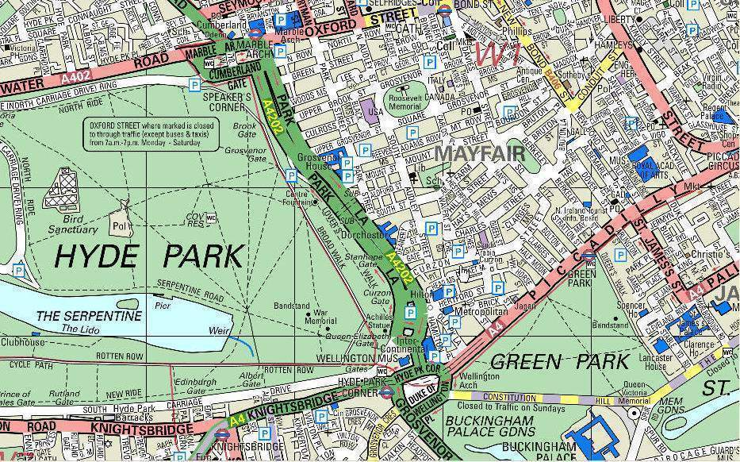
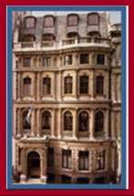
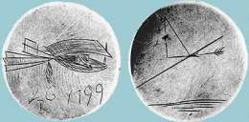
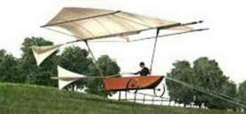
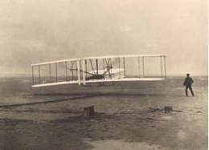
Royal Aeronautical Society From 1866
Formed by Duke of Argyll & a group of "aerial navigation enthusiasts"
40 years before properly controlled powered flight
Aim was to share technical knowledge –
George Cayley’s experiments and theoretical work started in the 1790s
Wright Brothers used RAeS papers in design work
4 Hamilton Place

Slide 3
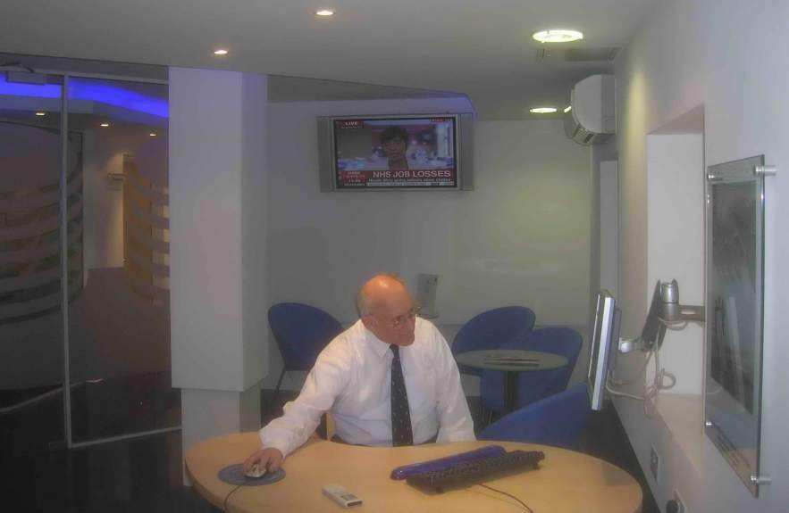
Royal Aeronautical Society From 1866
AIRBUS Business Suite – free for members
Whole building covered by WiFi internet

Slide 4

Royal Aeronautical Society From 1866
Now more 66 branches in 20 countries
Prime aim remains to share knowledge –
Toulouse Branch formed in 1991
Gordon Corps, Airbus Chief Test Pilot, as first Chairman
(application forms online)

Slide 5
Royal Aeronautical Society From 1866
“Friend of the Branch”
Cost : €10 per annum
Support the Toulouse Branch programme
Students have Free Membership to RAeS London
Magazine available electronically
Can pay £13 per year to receive paper copies of magazine
RAeS Members’ Subscriptions Tax Deductable
Fabrice Coletto & Peter Potocki will explain

Slide 6
David COOK
1976 - Graduated from N°1 School of Technical Training, RAF Halton,
Phantom FGR2 aircraft and Chinook helicopters
- BAe Civil Aircraft Division, Hatfield Customer Support
BAe146 and BAe125 programmes.
- Joined Snecma in France, Sales for CFM56 in Scandinavia
CFM Vice President International Sales, Nordic Europe and Middle East
Director, Business Development Aircelle – introduced to Composites
2004 – Independent Consultant
2014 – President RAeS Paris Branch

Slide 7
David COOK
“The Development of Composite Applications
in Commercial Aircraft Engines”

Slide 8
David Cook, President, ASM Consulting
The development of composite applications in commercial aircraft engines.
A presentation to the
Royal Aeronautical Society,
Toulouse Branch,
17th December 2014.
Advise, Support, Motivate.

Slide 9

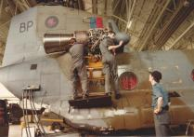

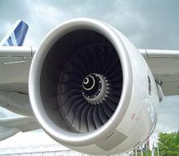
David Cook: a lifetime of working with engines …
Aircraft maintenance technician,
Royal Air Force
Senior Sales Executive,
Safran Group

Slide 10
… with a particular interest in composite applications,
Civil
Business jets
Jet Engines
Airliners
Civil Aircraft Engines
Aerospace composites
Maintenance Costs
Use of composites
in aircraft engines
New engine sales
Military / Government RFPs
Sales
Contracts
Aircraft Sales
Military
Fixed - wing
Repair
Airframer relations
Carbon fibre
Maintenance
Finance / leasing
Helicopters
Fan blades
OEM relations
Casings
Integrated Logistics Support (ILS)
MRO
Ceramics
Ti/Al
Customer Support
Components
Maintenance
Spares and Tooling
Contractor Logistics Support (CLS)
Metal / metal
Manufacturing
Engine trading
Warranty
Training
Piston Engines

Slide 11
How to earn a living as a Consultant,
W
P =
Knowledge is Power!
T
but
and
Time is Money!
W
W
K =
hence
M =
M
K
As knowledge (K) tends towards zero money (M) tends towards infinity !

Slide 12
Contents:
A historical review of the use of composites in aerospace,
The use of composites in commercial aircraft engines,
MRO issues,
The future of composites in aircraft engine design,
Future aircraft concepts

Slide 13

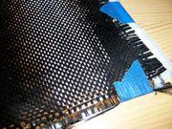
What is a ‘composite’?
Composite materials (or composites for short) are engineered materials
made from two or more constituent materials with significantly different physical or chemical properties and which remain separate and distinct on a macroscopic level within the finished structure.
Source: Wikipedia
Examples:
Straw and mud bricks
Re-enforced concrete
Fibre glass
Carbon fibre re-inforced plastics (CFRP)
Notes:
Matrix with fibre re-inforcement
Orthotropic – strength dependent on the direction of the load (metals – isotropic)
Easy to manufacture (cold molding)
Strength tailored by the size, number, and direction of fibres

Slide 14
The advantages and disadvantages of organic composites,
Advantages:
Weight savings vs equivalent metal part,
Ease of production?
Corrosion resistance,
Damage tolerance,
Limited consequential damage,
Repairability,
Disadvantages:
Cost (per equivalent metal part),
Temperature resistance,
Electrical insulation,
Inspectability,

Slide 15




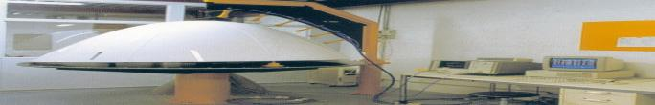
Major aircraft components (1),
1948: Boeing B-36 used fuel cell support panels
made from ‘reinforced plastics’
1953: Sud Aviation Vautour used ‘significant quantities’ of
fibreglass and composite sandwich panels . . .
1974: Boeing F-15 speedbrake made
entirely from carbon composite and tailplane
from boron/epoxy composite
1975: Boeing tests a solid carbon composite
laminate 737-200 stabilator. The programme
was certified in August 1982

Slide 16
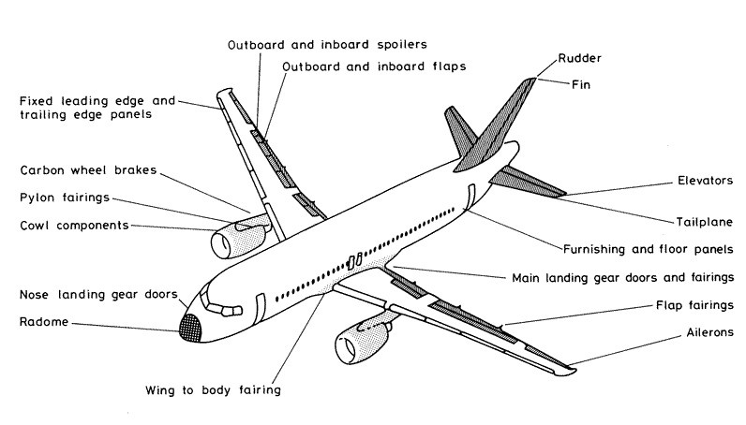
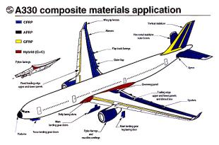
Major aircraft components (2),
Typical CFRP applications for aircraft flight control surfaces and other components
Composite applications on the A33O
Most commercial aircraft now using composites for non-critical structural components

Slide 17
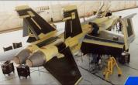
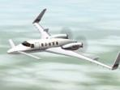

Major aircraft structures,
Boeing F18: Carbon composite wing centre box, tail fins and elevators. EIS 1983
Beech Starship: first all carbon composite fuselage. EIS 1989
Beech Premier 1: first Business Jet with an all composite fuselage, certified in October 2005

Slide 18
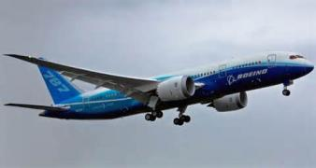
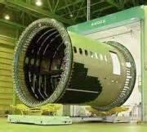
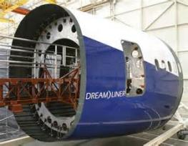
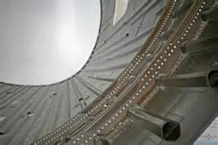
Major aircraft structures – Boeing 787,
Boeing 787
Boeing 787 fuselage section manufactured by automated fibre placement
Boeing 787 rear fuselage ready for delivery
Boeing 787 fuselage skin with integrally moulded longerons and riveted frames
Boeing 787 – the first commercial airliner with composite wings and fuselage

Slide 19
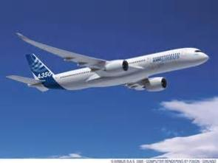
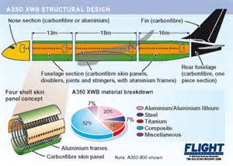
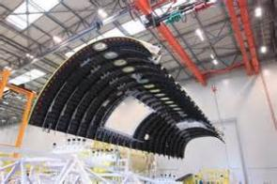
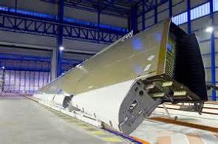
Major aircraft structures - Airbus A350 XWB,
Airbus A350 XWB
Composite fuselage panel
Composite wing
Airbus A350 XWB – composite major structures but a slightly different strategy

Slide 20
The use of composites in aircraft engines …

Slide 21
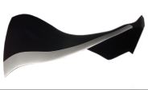
Engine applications,
1948: Boeing B-36 used fuel cell support panels
made from ‘reinforced plastics’
Early 1970’s: first use of composite parts in nacelles and non-critical engine components.
47 years of development
September 1995: GE90 enters service on Boeing 777 with first use of CFRP fan blades.

Slide 22
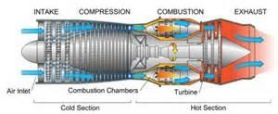
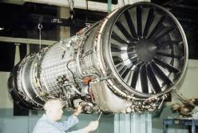
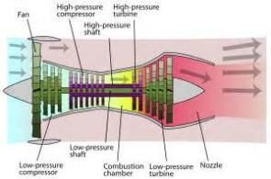
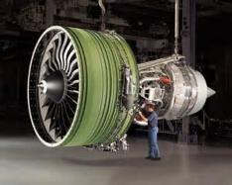
How an engine works 1.0.1:
A simple turbo-jet engine
Predominantly used in military applications
Turbo-fan engine
Predominantly used in civil applications
Different engine concepts for different performance requirements and aircraft applications

Slide 23
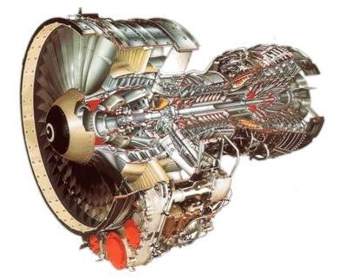
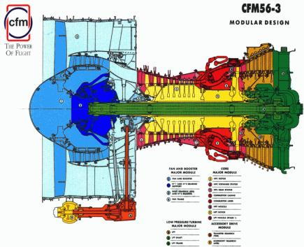
How an engine works 1.0.2:
Very high rotational speeds (15,000 rpm) and very high temperatures (1,700°c) ensure that many engine parts are safety critical,
Engine design must resolve a number of engineering contradictions:
Fan and turbine speeds,
Compressor ratio and surge margin,
Combustion temperatures and NOx pollution,
Aircraft noise and engine weight,

Slide 24
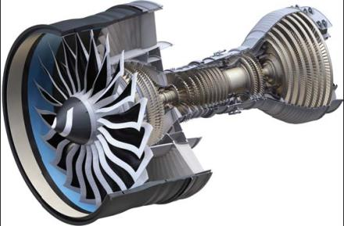
Multiple applications for composites already identified,
Carbon composite
fan frame
Shafts?
Hot Section casings?
Ti/Al LPT blades
Carbon composite
fan blades
3D weave, RTM
Ceramic composite
Exhaust plug
Ceramic composite
HPT nozzles, blades
Carbon composite
fan case
Ceramic composite
combustor casing
Ti/Al HP compressor
blisks
Carbon composite
OGVs
Carbon composite
HP compressor
stator vanes

Slide 25
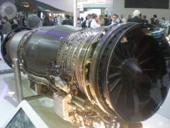
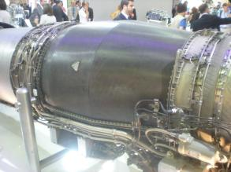
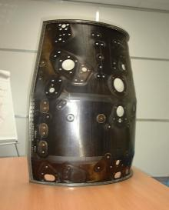
Carbon composite outer bypass duct,
Snecma M88 engine for the Dassault Rafale aircraft
M88 composite outer bypass duct saves 4kg (20%) relative to titanium duct

Slide 26
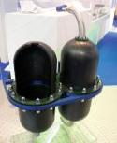
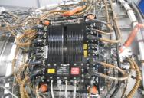

Composite applications for engine components,
Components
Component manufacturers looking at composite materials for housings, casings, etc
Potential 25% weight reduction ?
Issues:
High pressure hydraulic systems (3,000 psi to 5,000 psi),
Long term porosity resistance,
All electric NGSA aircraft?
Composite filter
housings
Source: Green Tweed
Carbon fibre FADEC housing for Rolls-Royce engine
Source: ASM
Systems
Fibre glass and carbon composite low pressure pipes and ducting already in use,

Slide 27
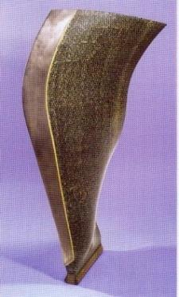
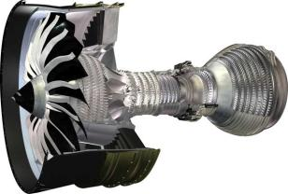
Applications for CFRP materials: CFM LEAP engine family,
Classic high BPR engine architecture,
Two shafts, direct drive fan,
12:1 BPR, 45:1 OPR
Incorporates key technology developments vs CFM56,
Composite ‘3D weave’ RTM fan blade and case,
Blisks,
New ceramic temperature-resistant coatings,
Objectives: 16% improvement in fuel burn with reduced noise and emissions,
EIS on A320neo and Comac C919 in 2016, EIS on 737max in 2017,
CFM LEAP fan blade
Photo: CFM

Slide 28
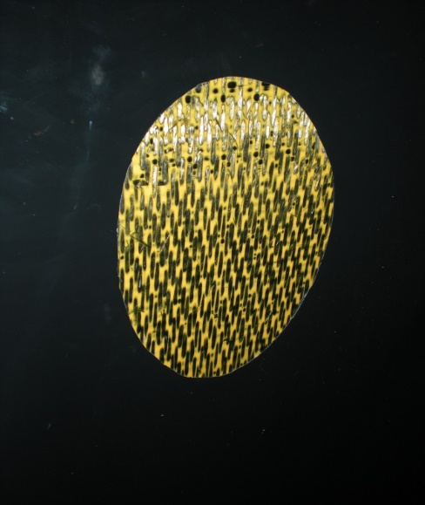
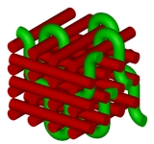
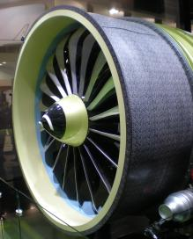
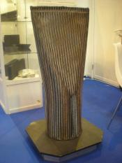
Demystifying the 3D weave …
Complex weave pattern
CFM LEAP 3D weave fan case
Photo: ASM
CFM LEAP 3D weave fan blade
Photos: ASM
3D weave fibre insert
Photo: ASM

Slide 29

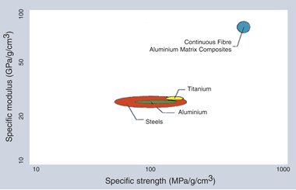
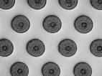
Metal composites (1),
Source: CMT
Most suitable for high temperature, high stress parts like compressor disks and LP turbine blades
Typical metal composites:
Titanium/Aluminides (Ti/Al)
Aluminium, magnesium or titanium
re-inforced with boron, silicon or carbon fibres
60% weight reduction compared to conventional metal part
Significant (200%?) increase in strength and stiffness
Silicon fibre
re-inforced aluminium

Slide 30
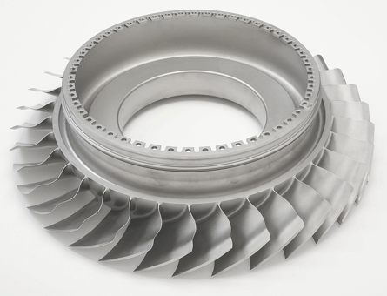
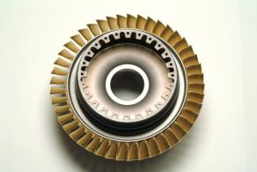
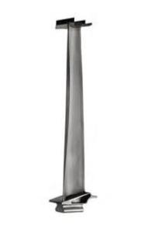
Metal composites (2): some examples …
CFM LEAP Ti/Al compressor blisk
Photo: CFM
PW6000 compressor blisk
Photo: MTU
CFM LEAP
Al/Ti LP Turbine blade
Photo: CFM

Slide 31
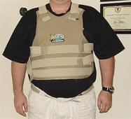
Ceramics (1),
Most suitable for very high temperature, high stress parts like combustion chambers and HP turbine nozzles
Tough and shock
resistant!
Typical ceramic composites:
Silicon Carbide reinforced with silicon carbide fibres (SiC/SiC)
Silicon Carbide reinforced with aluminium filaments (SiC/Al)
50-70% weight reduction compared to equivalent metallic part
Capable of withstanding +1,300°c without cooling
No cooling system = less weight and complexity, increased reliability
full use of ceramics in LEAP engine could save 175 lbs per engine
No cooling air = less NOx

Slide 32
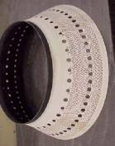
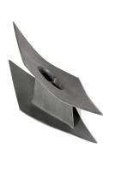
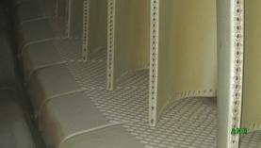


Ceramics (2): some examples …
Prototype ceramic combustion chamber.
Photo: GE
Prototype ceramic HPT nozzle.
Photo: GE
LEAP ceramic HPT shrouds. Photo: CFM
Snecma prototype A340 ceramic exhaust nozzle.
Photo: ASM
Snecma prototype ceramic exhaust plug. Photo: ASM

Slide 33
MRO issues

Slide 34


Composite fan blade maintenance,
Traditional metal blades are resistant to damage and easily repairable
CFM56-7B
61 ins fan diameter
24 blades
260 lbs fan weight
Large diameter, slow turning composite fan blades avoid damage and rarely need repairing
GE90-115B
128 ins fan diameter
22 blades
1,019 lbs fan weight
High speed 3D weave composite blades may not be so resistant to damage, will be difficult to repair (if at all) but may be replaced singly
LEAP-X
71 ins fan diameter
18 blades
168 lbs fan weight

Slide 35



Compressor blades repair - blisks,
Traditional
Blades accessed by opening up Top Case,
Blades are free on the disk:
Minor defects rectified by in-situ grinding,
Major defects rectified by individual blade replacement,
Future
Blades accessed by module breakdown,
Blades are integral part of the blisk:
Minor defects rectified by repair on removed blisk,
Major defects rectified by blisk replacement,
ASM photo of MTU display

Slide 36


Self-healing composites,
Carbon fibre composites can recover 75% of their original strength using self-healing repair techniques,
Ceramics can ‘self-heal’ when the penetration of oxygen into a crack provokes oxidisation of a glassy ‘fuse’ which stops crack progression,

Slide 37
The future of composites in aircraft engine design

Slide 38

Future composite applications,
CFRP use expected to FALL in future generations of civil aircraft
Modern aircraft use high percentages of composites – but will this situation last?

Slide 39
Reasons for composites likely fall from favour,
Cost:
Carbon fiber and resins are products derived from oil – and we expect the price of oil to
rise,
Increasing costs of production,
Revenge of the metals:
If 53% of A350 is CFRP then 47% is still metal!
Metals have reacted to CFRP popularity by getting cheaper – esp Titanium,
New alloys (Al/Li, Al/Mg) are lighter than CFRP – and cheaper,
Metals are cheaper to manufacture into complex shapes,
Additive Manufacturing,
Aircraft manufacturers commercial strategy is changing:
Order books are full,
Only way to make more money is to improve margins,
Manufacturers paying less for weight advantage,
Proportion of composites used in aircraft structures will fall as oil prices rise and alternatives emerge

Slide 40




Composite manufacture: a costly and complex process?
Many complex CFRP structures are laid-up by hand
‘Clean Room’ facilities often required to meet aerospace quality requirements
Automation only suitable for large, regular shapes
Autoclave curing is expensive, time-consuming, and risky
The manufacture of composite parts for the aerospace industry is labour intensive, expensive, and time-consuming

Slide 41



Challenges facing the increased use of CFRP in engines,
Operating
Temperature
400°c
6,000 hrs
30,000 hrs
COST!
300°c
200°c
Prototype HP
compressor stators
Source: Snecma
100°c
Increased operating temperatures,
Epoxy
BMI
Avimid
R
PMR
15
Avimid
N
Photo: ASM
Source: Cytec
A prototype composite fan frame
High volume, cost effective production with acceptable quality and repeatability.
Increasingly complex structures,
Use of composites remain a high-cost option for improving engine efficiency

Slide 42
But composite demand for engines is expected to remain high …
Carbon composites used in aircraft engines was1.49 million lbs in 2007,
This represented a market value at the time of $400-450m,
Demand for carbon composites to be used in aircraft engines is expected
to exceed nearly 3 million lbs by 2016,
Value of carbon composites consumed by engines during this 10 year
period is expected to be around $7-8 bn,
Source: ‘Aviation Outlook Report 2008

Slide 43
Challenges facing the increased use of carbon composites,
Design:
Ensuring optimum ply lay-up for high stress components,
Ensuring optimum mold design for complex shapes,
Materials:
New resins and fibers for greater temperatures / greater strength / greater fatigue resistance,
Develop materials which lend themselves to industrial manufacturing processes,
Manufacturing:
Ability to transform increasingly sophisticated CAD designs into workable production programmes,
Develop more cost-effective industrial manufacturing processes,

Slide 44





Design challenges:
Design
Increasingly sophisticated CAD programmes to determine ply layup in 3D aero, highly stressed engine components,
Sophisticated flow simulation software to ensure correct moulding of complex parts,
Ply orientation simulation
for aerofoil
Source: Snecma
Simulation of resin flow in a complex RTM mold
Source: Snecma
Prediction of dry spots in an RTM molded aerofoil
using ‘Polyworx’ software.
Source: Polyworx

Slide 45


Materials challenges:
Develop materials which lend themselves to industrial manufacturing processes:
Chopped fibre filler for complex RTM molding,
‘non-stick’ resins which facilitate tape layup,
Resin Transfer Molding process
Source: JHM Technologies
Tape lay-up by machine

Slide 46

Carbon Nanotubes (CNT): the wonder material for the future?
First discovered in 1991,
Cylindrical carbon molecules with a l/d ratio greater than
1,000,000,
Exhibit extra-ordinary mechanical properties such as
strength, stiffness, conductivity, flame resistance, wear
resistance, …..
Experiments with CNTs as bulk filler in resin matrix,
Potential engine applications:
structures,
thermal barrier coatings,
high temperature sensors,
Issues:
Ability to bond with matrix and transfer stress,
Uniform distribution and alignment of filaments within the matrix,
Cost currently prohibitive - $1,000 / gm,

Slide 47


Nanotube strength capability:
Tensile strength = 63 gigapascals !

Slide 48


Manufacturing,
Manufacturing
Ability to transform increasingly sophisticated CAD designs into workable production programmes,
Develop cheaper manufacturing processes:
‘Quickstep’ hot oil curing eliminates autoclave,
Achieve high volume production to meet production ramp-up with very high levels of quality,

Slide 49
Future engine concepts

Slide 50



Open Rotor Concepts – geared or ungeared?
Two concepts currently being developed:
Rolls-Royce geared counter-rotating rotor system,
Snecma direct-drive counter-rotating rotor system,
Similar objectives:
25 to 30% reduction in fuel burn relative to today’s technology
engines,
similar reductions in CO2 levels,
Expected EIS – 2025 to 2030?
Challenges:
Noise,
Complexity,
But the ‘Open Rotor’ already exists! Antonov 70 first flew in 1994,
Open Rotor - an expensive ‘knee jerk’ reaction to high fuel prices?
Notes:
Antonov 70 first flight – December 1994
4 x Ivchenko Progress D27 direct drive Open Rotor engines.

Slide 51


Ultra High Bypass ratio engines,
Ultra-high Bypass ratio (UHBPR) engines use
a more conventional architecture,
Simple layout,
Next-generation materials,
Large diameter fan driven by gearbox,
Reverser pitch change mechanism in the fan,
BPR of < 25:1 will achieve significant fuel burn
reductions,
Rolls-Royce have already unveiled their
geared ‘Ultra-Fan’ concept for EIS 2030,
GE have recently unveiled a ‘hybrid’ concept,
UHBPR engine,
Electric motor on LP shaft,
HP core is run at idle, or even shut down,
in cruise,
UHBPR geared fan engines – a much more credible option for high thrust engine development (IMHO)

Slide 52

More electric – or all electric – aeroplanes?
Boeing 787 is the first aircraft with a ‘no bleed’ powerplant
Electrically driven Air Conditioning systems takes 35% less power from engines than
conventional system
Electrically driven hydraulic pumps with one engine-driven pump as back-up
2,000 lbs weight saving
3% fuel burn improvement
1,400 Kva generation capability
Fly-by-wire’ flight controls,
Electric brakes and engine controls,
Elimination of high pressure air bleeds from engines produces significant efficiency improvements

Slide 53




Towards the ‘All Electric’ aircraft?
Airbus ‘E-Fan’ currently under flight test
Electroflight racer concept currently being developed in UK
Airbus and Boeing studying various concepts
A number of concepts are being studied but energy storage considerations are critical to commercial success

Slide 54



The Airbus ‘e-concept’ aircraft
Electrically driven fans integrated into the structure of the aircraft
Distributed propulsion system uses a gas turbine as a source of electrical power to drive propulsion fans and all the other aircraft systems
‘Hybrid’ is the new buzzword in the aerospace industry!

Slide 55
Conclusions:
Carbon fibre composites have an established place in aerospace design bringing a significant number of advantages and some inconveniences,
While carbon fibre usage in aircraft structures may diminish in the future it will remain a key feature of engine design,
New composite materials will continue to be developed to respond to the aircraft engine’s unique design and operational requirements,
Continued attention will need to be paid to MRO and manufacturing processes to keep production and maintenance costs low,
New aircraft propulsion concepts will continue to ensure that materials development will be at the forefront of engine research,

Slide 56
Thank you for your attention.
asmcontact@aol.com
+33 6 1135 4330

Slide 58


Slide 59


Forthcoming Programme
For posters / any changes / updates
www.RAeS-Toulouse.org
and links to
www.Academie-Air-Espace.com
AAAf-MP@sfr.fr

Slide 60
Frohes Fest und ein gutes Neues Jahr
Merry Christmas and Happy New Year
Bonnes Fêtes / Meilleurs Voeux
Feliz Navidad & Feliz Aňo Nuevo
God Jul och Gott Nytt År

