Slide 1
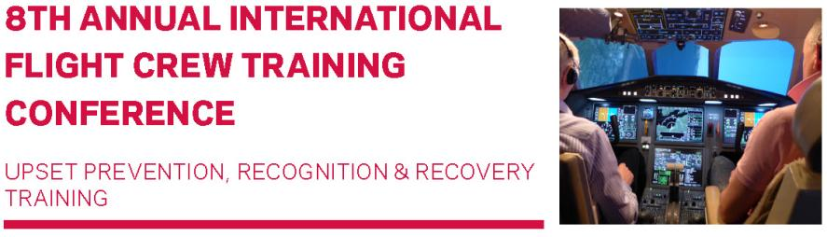
“Instructor Operating Station Improvements”
Hugh DIBLEY FRAeS, FRIN, CMILT
formerly BOAC/BAW Airbus Toulouse
RAeS: Flight Simulation Group, ICATEE,
Flight Operations Group, Chairman Toulouse Branch

Slide 2
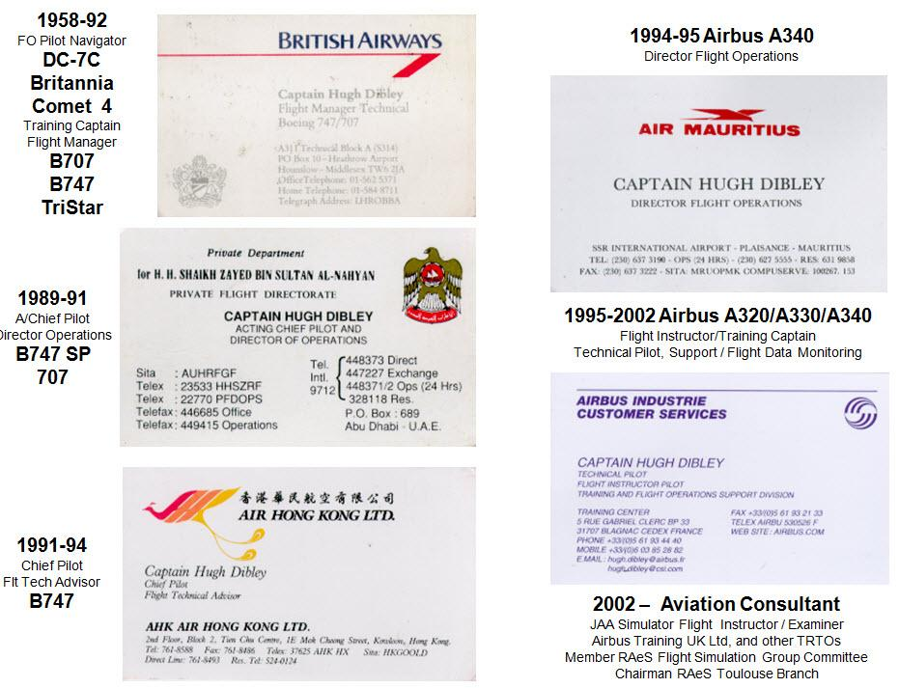

Slide 3
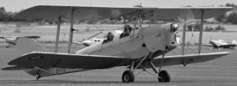
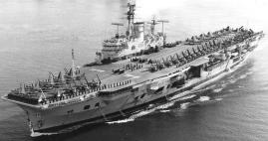

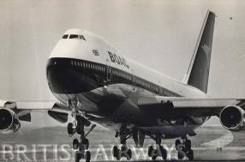
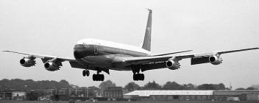
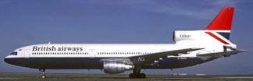
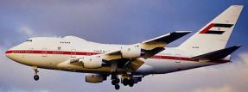
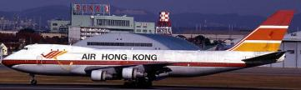
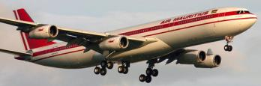
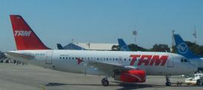
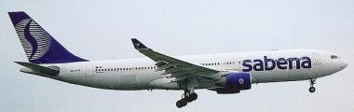
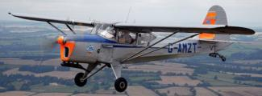
Hugh Dibley’s Main Aviation Activities

Slide 4
IOS Improvements
Reminder that: A competent Instructor essential for successful training outcome & the IOS must allow this to be achieved most easily/effectively.
Summary of general IOS improvements & changes.
Reminder of upset accidents due poor training/simulation.
Instructor awareness & extra IOS facilities needed following requirement for stall/upset training.
Recommendation for display of actual aircraft acceleration and that felt by the crew in the FSTD.
Example of crews pitching down in service - due to sensing G not experienced in an FSTD?
Summary – 3 prime suggestions/requests.

Slide 5
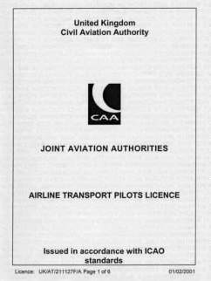
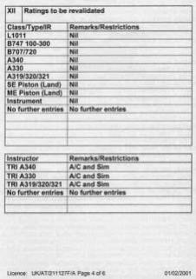
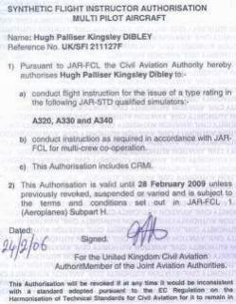
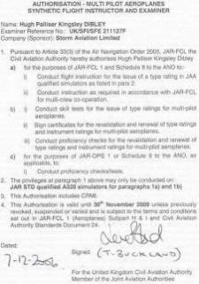
Reminder that: A competent Instructor Fundamental
A training device cannot function without a properly qualified instructor
who holds:
Renewal more complex under EASA rules!
a professional pilot’s licence
the aircraft type &
an instructor Rating
a current instructor Rating /
Authorisation
a current Examiner
Authorisation if applicable

Slide 6
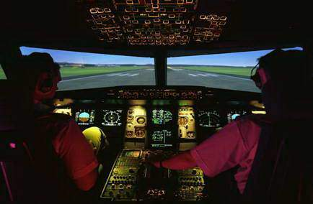
Dr Ed Cook of the FAA emphasised the need for instructors
to sit between the pilots to watch their eyes / body language.
Position of IOS is important
Good instructor seating position between pilots

Slide 7
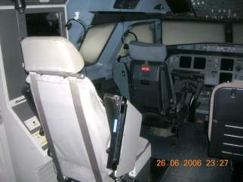
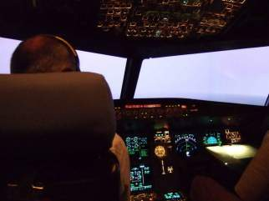
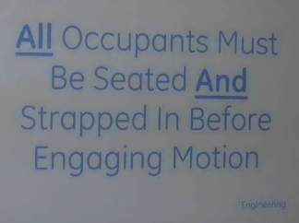
Dr Ed Cook of the FAA emphasised the need for
instructors to sit between the pilots
to watch their eyes / body language.
Position of IOS is important
A basic requirement is to see the students’ flight instruments
Impossible on some side mounted IOS
Instructor’s seat directly
behind the captain
Unable to see captain’s instruments without moving from IOS seat
Health & Safety regulations require instructor to be strapped in
Impossible to instruct properly

Slide 8
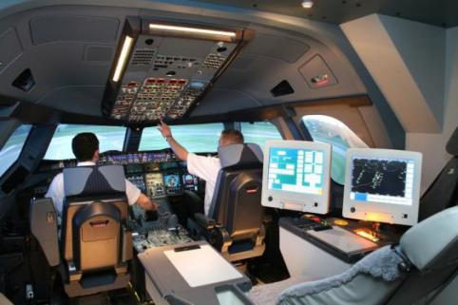
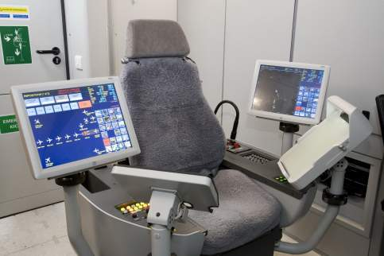
Dr Ed Cook of the FAA emphasised the need for
instructors to sit between the pilots
to watch their eyes / body language.
Forward facing IOS improved instructors’ vision and access
Screens on either side of seat can be difficult to monitor / used less

Slide 9
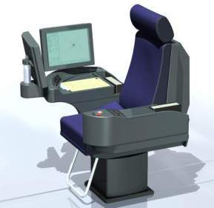
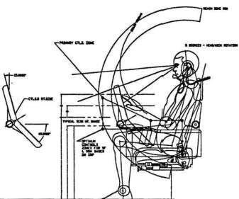
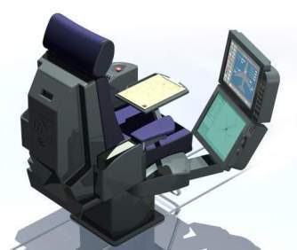
Dr Ed Cook of the FAA emphasised the need for
instructors to sit between the pilots
to watch their eyes / body language.
Forward facing IOS improved instructors’ vision and access
Development of forward facing IOS for new FSTD
Concept for Airbus A340-500/600 IOS produced from survey of Airbus instructors
Concept revised by IOS manufacturer created by expert ergonomist
IOS concept agreed for
Airbus A340-500/600 FFS

Slide 10
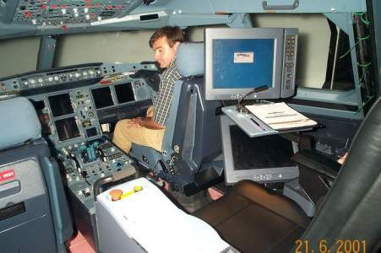
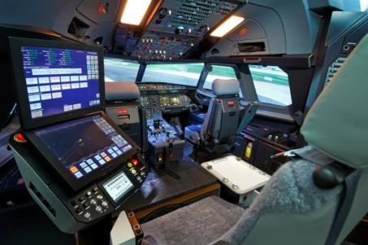
Dr Ed Cook of the FAA emphasised the need for
instructors to sit between the pilots
to watch their eyes / body language.
Forward facing IOS improved instructors’ vision and access
Screens mounted vertically easier to monitor / use
On A340-500/600 FFS in 2000, still used in 2013 and beyond
Option on current FFS

Slide 11
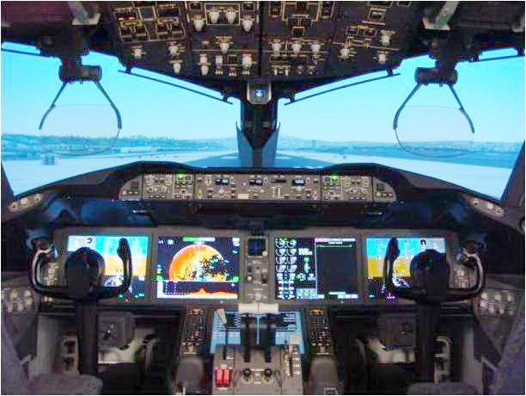
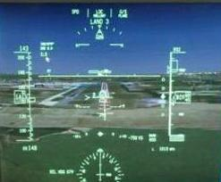
The pilots’ displays on latest aircraft can be selected on the IOS.
Essential for Head Up Displays – otherwise unable to be monitored*.
*The HUD indications change during an upset to assist recovery
Boeing 787 HUD

Slide 12
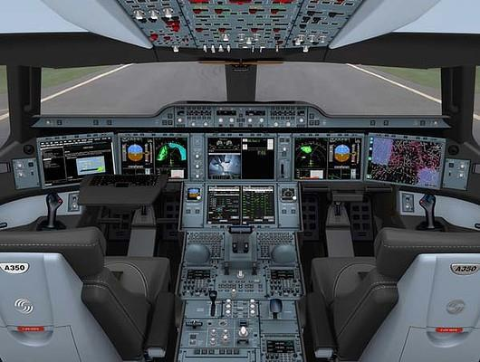
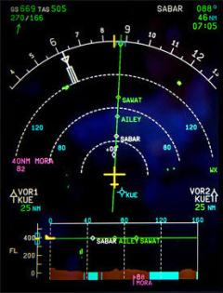
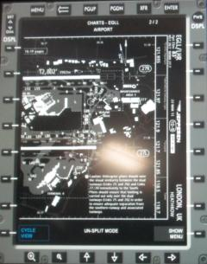
The pilots’ displays on latest aircraft can be selected on the IOS.
Airbus A350 Flight Deck
example of IOS selecting Nav Display &
Electronic Flight Bag / Jeppesen charts

Slide 13
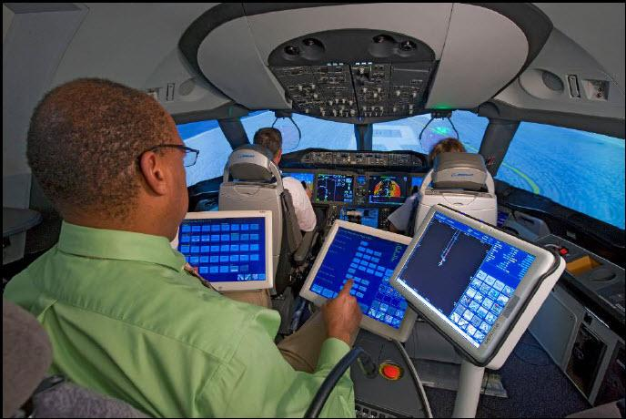
Many Screens may make Instructor remote from Students
Still need to get between students especially for instruction

Slide 14
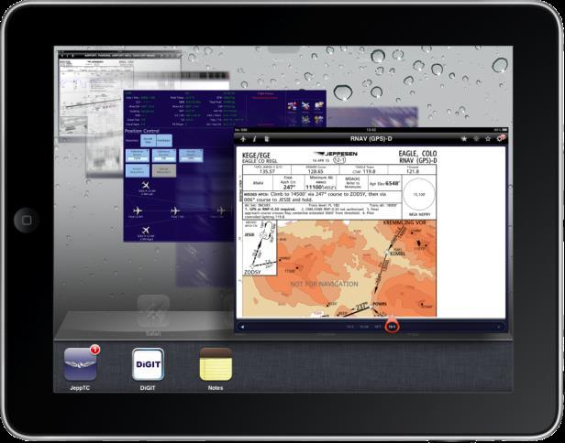
Instructors may use own devices in an IOS iPad holder
In future a tablet could be used as a personalised IOS

Slide 15
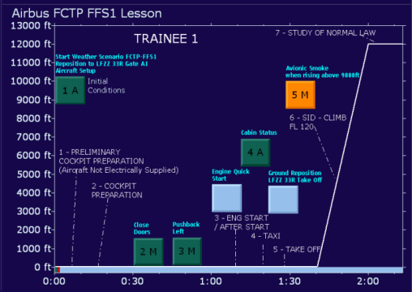
Lesson Plans & Monitoring Data are all part of the IOS Toolkit

Slide 16
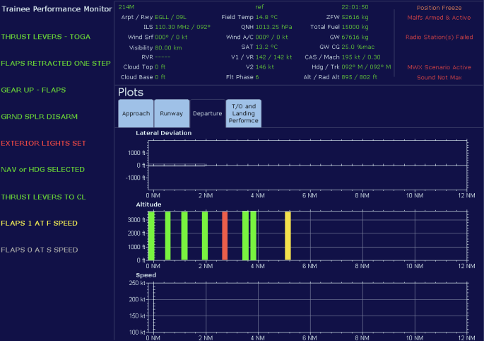
Lesson Plans & Monitoring Data are all part of the IOS Toolkit

Slide 17
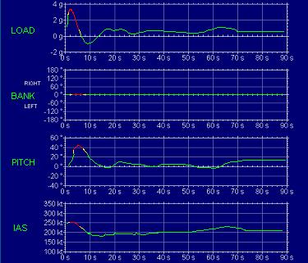
Lesson Plans & Monitoring Data are all part of the IOS Toolkit

Slide 18
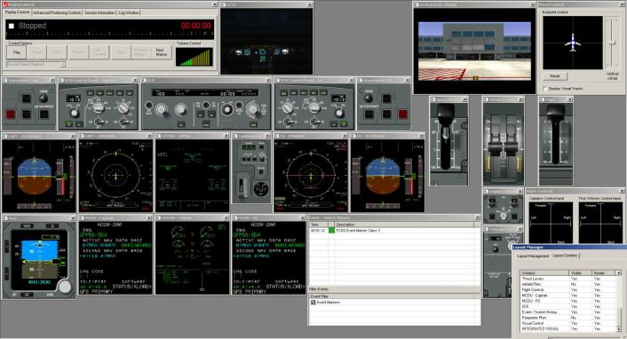
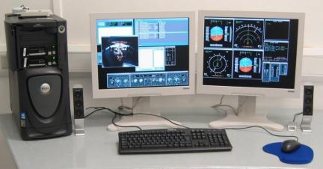
All Information available off IOS for De-Briefing
Could be used as an off board IOS

Slide 19

Reminder of Upset Accident due to Poor Training
and misuse of flight simulation
American 587 – Airbus A300-600
ex JFK October 2001
AA had modified the flight simulator reaction in roll so only rudder was effective to counteract roll in an upset.
Crews had thus been trained to use rudder in an upset against the advice of the three major aircraft manufacturers.
The copilot applied full rudder travel both ways after passing through a B747 wake vortex, thus exceeding the designed loads of the vertical stabiliser/fin which broke off.
Indicates the need for upset recovery training to be according to the manufacturer’s recommendations.
The large lateral accelerations felt in flight which could not have been experienced in the simulator must have startled the crew.
Crews must be made aware of the limitations of the simulator motion system – achieved by a reminder in the IOS/debriefing?

Slide 20
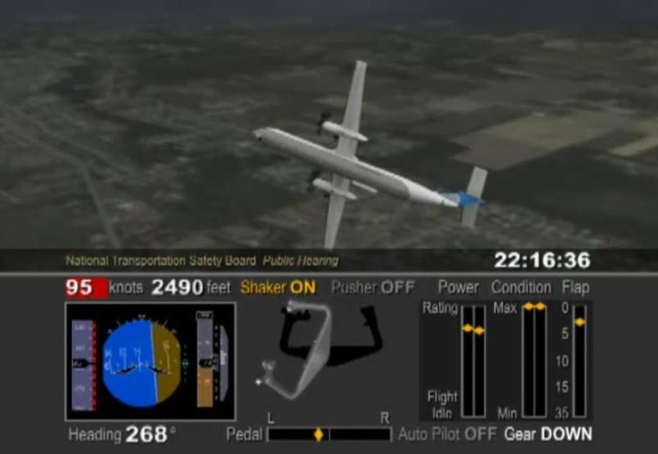
Most Significant LOC-I Accident
Colgan Air - Bombardier DHC-8-400
12th February 2009

Slide 21
Most Significant LOC-I Accident
Colgan Air - Bombardier DHC-8-400
12th February 2009
Families formed focus group & lobbied congress

Slide 22
Most Significant LOC-I Accident
Colgan Air - Bombardier DHC-8-400
12th February 2009
Families formed focus group & lobbied congress
(Possible confusion over training for tail plane rather than main wing icing which specifies flap retraction and pulling back on stick.)

Slide 23
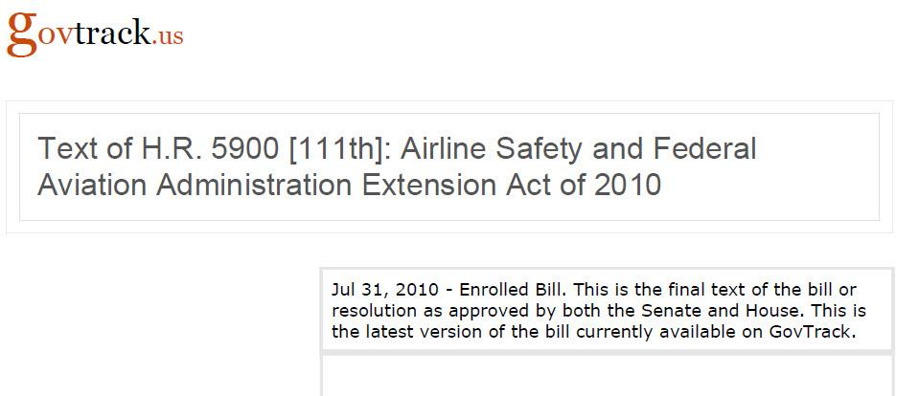
Requirement for Stall & Upset Training in US Law

Slide 24
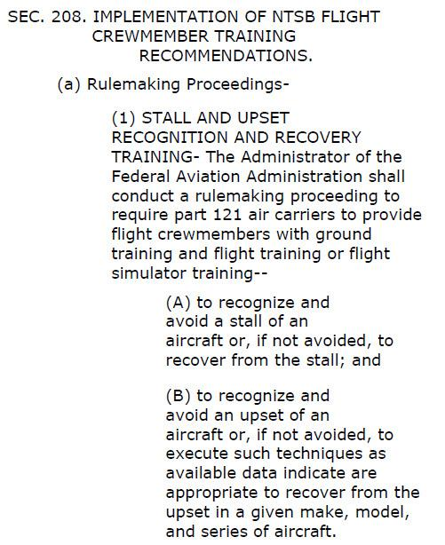
Requirement for Stall & Upset Training in US Law

Slide 25
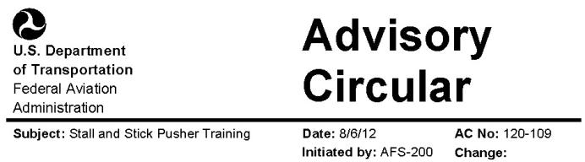
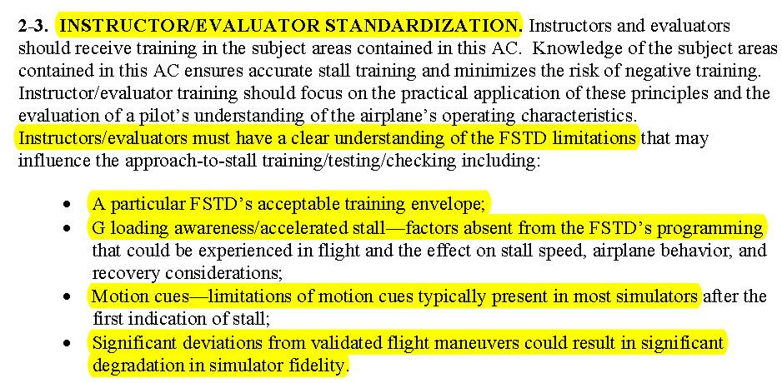

Slide 26
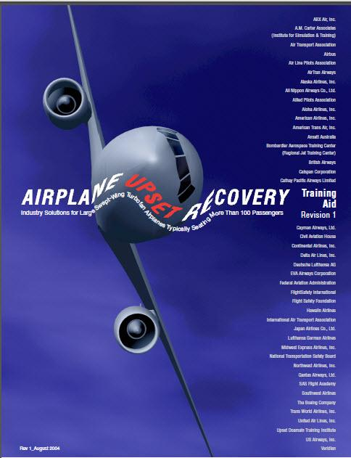
Most requirements are covered by the monitoring needs of
Upset Prevention and Recovery Training exercises.
First -
IOS selections are required to enter the upset -
by flying to a preset pitch and roll angle,
or by generating an extreme atmospheric event, aircraft system failure, etc.

Slide 27
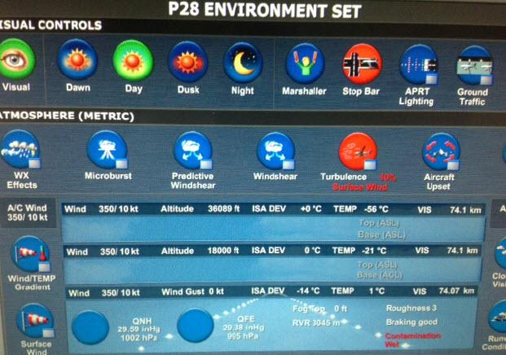
IOS Selection for Initiating an Upset

Slide 28
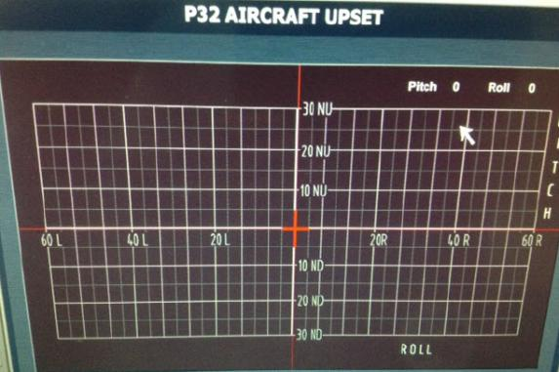
IOS Selection for Initiating an Upset

Slide 29
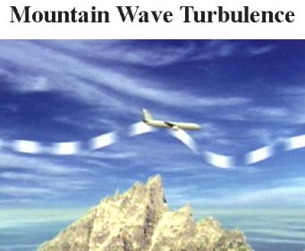
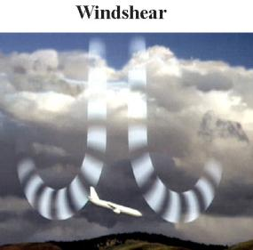





AURTA Suggestions for Initiating an Upset
?
Horizontal wind shears of over 100 kts have been recorded potentially causing aircraft to stall

Slide 30
Alpha-Beta & Vn diagrams
Alpha-Beta & Vn diagrams

Slide 31

FSTD Alpha-Beta Diagram Showing Envelope defined by
Flight Test, Wind Tunnel & Extrapolated Data
For Angle of Attack and Sideslip angle

Slide 32

Vn/Vg Diagram in AURTA Shows Aircraft Operational Limits

Slide 33

Vn/Vg Diagram in AURTA Shows Aircraft Operational Limits
will need explanation to most airline crews
Aircraft can exceed straight line structural limits unless prevented by Fly By Wire controls
Aircraft limited by aerodynamic stall so cannot exceed the curved line

Slide 34

IOS Information Available for Upset Recovery Analysis
Control positions
& G indication

Slide 35
Vn & Alpha-Beta diagrams
Display of aircraft G ....& G sensed by crew?
Vn & Alpha-Beta diagrams

Slide 36

Peter Grant’s Video Example of Aircraft versus Crew/FSTD sensed Acceleration
Aircraft 1.1G (0.1G positive)
Crew sensed -/+ 0.1G
Aircraft 0.0G
(1.0 G negative)

Slide 37
Peter Grant’s Video Example of Aircraft versus Crew/FSTD sensed Acceleration
Aircraft 1.1G (0.1G positive)
Crew sensed -/+ 0.1G
Aircraft 0.0G
(1.0 G negative)
As FSTD motion unrealistic beyond
accelerations normally experienced in line service
Upset Recovery trained with Motion Neutral or Off?

Slide 38


Example of continuous G experienced in training
Aircraft in 60º Bank Turn
Pulls 2.0 G

Slide 39

Airbus ECAM pop up
indicates when acceleration
over 1.4 G.
2.0 G

Slide 40
Airbus ECAM pop up
indicates when acceleration
over 1.4 G.
But crew have sensation
of being in an arm chair!
2.0 G

Slide 41
Many / Most Crews are unaware
of the limitations of FSTDs -
Airline managements have heard the comment:
“The aircraft’s not correct -
It’s not like the simulator!”

Slide 42
Many / Most Crews are unaware
of the limitations of FSTDs -
Airline managements have heard the comment:
“The aircraft’s not correct -
It’s not like the simulator!”
A test pilot once was asked by an engineer during an aircraft’s development –
“There is a difference between the aircraft and the simulator, can you advise which is correct?”

Slide 43

Following GPWS Pull Up Training on an FSTD, during an actual aircraft Pull Up, crews back off when sensing small amounts of acceleration – such as 1.4G

Slide 44
Following GPWS Pull Up Training on an FSTD, during an actual aircraft Pull Up, crews back off when sensing small amounts of acceleration – such as 1.4G
Similar crew behaviour has occurred in incidents, some leading to accidents and attributed to somatogravic illusion.

Slide 45
Following GPWS Pull Up Training on an FSTD, during an actual aircraft Pull Up, crews back off when sensing small amounts of acceleration – such as 1.4G
Similar crew behaviour has occurred in incidents, some leading to accidents and attributed to somatogravic illusion.
Surely the startling effect of G not experienced in a simulator should also be considered as an accident cause?

Slide 46
Incident on 16th November 2011 - Where Crews
Pitched Up & Back Down after Sensing 1.8G
INVESTIGATION DAVID KAMINSKI-MORROW LONDON
Inquiry finds go-around pilots lost control of 777
Flight International 2-8 April 2013
The captain and first officer "almost simultaneously" gave a pitch-up input, says the inquiry. It says the autopilot disengaged and the pilots then applied opposite inputs — the captain's nose-down effectively cancelling the first officer's nose-up — and the aircraft pitched rapidly to 7°, at 1.8g, then lowered to 4°. The BEA says this pitch was "insufficient" for a go-around.
The captain then relaxed hi nose-down input and the aircraft pitched up again, at 1.7g, reach­ing 11° in 2s and 19° during the next 10s. BEA says the aircraft descended to a minimum of 63ft, and accelerated to 180kt, before the 777 climbed. It subsequently returned to land safely.

Slide 47

FSTD motion is sufficiently realistic to be required for training and evaluation.
However crews should be aware that unusual long term accelerations are not realistic and will be stronger in the aircraft.
Best reminded by a display in the IOS?
Dynamic indication, or maximum value for the session?
Time line of aircraft and FSTD G values
Aircraft G
Crew G

Slide 48

FSTD motion is sufficiently realistic to be required for training and evaluation.
However crews should be aware that unusual long term accelerations are not realistic and will be stronger in the aircraft.
Best reminded by a display in the IOS?
Dynamic indication, or maximum value for the session?
Time line of aircraft and FSTD G values
Aircraft G
Crew G

Slide 49

FSTD motion is sufficiently realistic to be required for training and evaluation.
However crews should be aware that unusual long term accelerations are not realistic and will be stronger in the aircraft.
Best reminded by a display in the IOS?
Possibly include crew sensed / FSTD G in the Vn monitor
together with actual aircraft G already being shown?

Slide 50
FSTD motion is sufficiently realistic to be required for training and evaluation.
However crews should be aware that unusual long term accelerations are not realistic and will be stronger in the aircraft.
Best reminded by a display in the IOS?
Crew sensed lateral acceleration should also be displayed? (AA587)

Slide 51



Something learned from UPRT IOS Displays
Airbus side sticks are not visible from the IOS seat -
Some instructors might be tempted to leave the IOS seat & look around the side of the pilot to see their side stick inputs.
(Against health & safety!)
Display of side stick position should be selectable on an IOS screen for all training sessions.
Side stick position display should be selectable on the IOS.

Slide 52

Maybe we should use more energetic FSTD motion systems?

Slide 53


Slide 54


Slide 55


Slide 56
Unlikely to be a suitable platform for FSTDs in the foreseeable future?

Slide 57
“Instructor Operating Station Improvements”
Three main messages/requests:
Instructors’ direct access to students,
IOS reminder of motion limitations.
Airbus side stick display on the IOS.
Thank you.....

