Slide 1

ROYAL
AERONAUTICAL
SOCIETY
SOLENT BRANCH
13th November 2013
“Operational Fuel Savings
and Noise Reduction –
Do We Still Need a Pilot”
Hugh DIBLEY FRAeS, FRIN, CMILT
formerly BOAC/BA Airbus Toulouse
(Busy slides for reading without audio!)

Slide 2
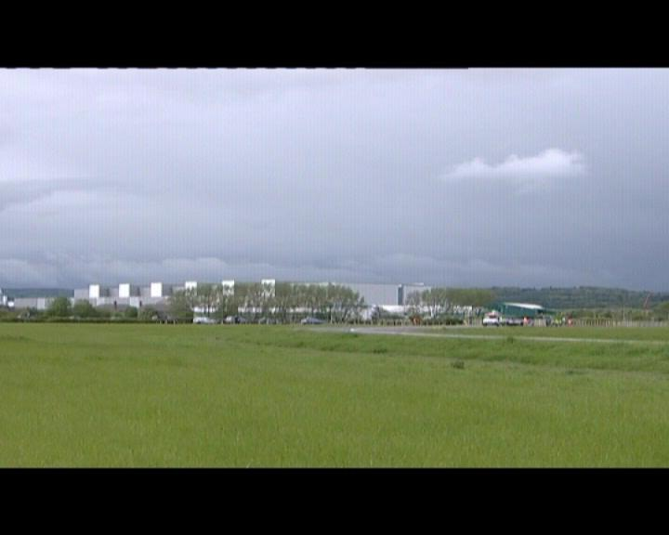
1st Airbus A380 – Transport of Components & Final Assembly

Slide 3
ROYAL
AERONAUTICAL
SOCIETY
SOLENT BRANCH
13th November 2013
“Operational Fuel Savings
and Noise Reduction –
Do We Still Need a Pilot”
Hugh DIBLEY FRAeS, FRIN, CMILT
formerly BOAC/BA Airbus Toulouse
(Busy slides for reading without audio!)

Slide 4
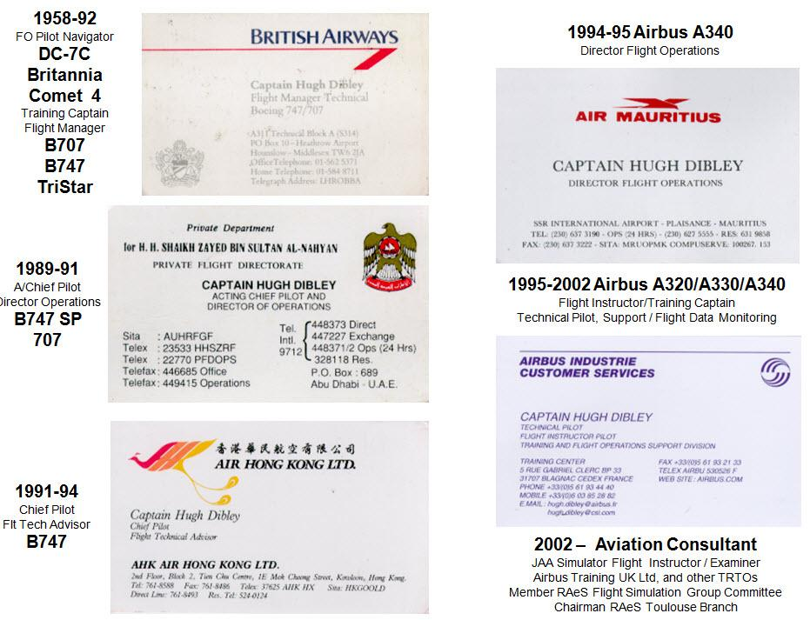

Slide 5
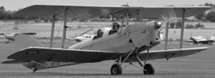
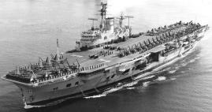

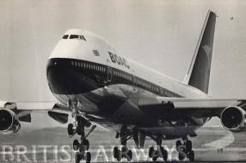
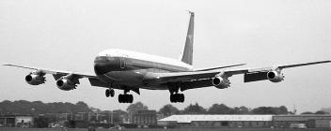
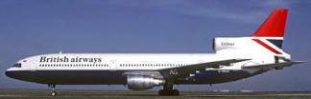
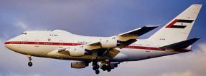
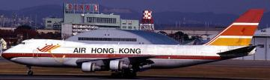
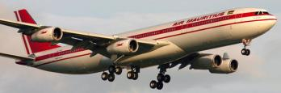
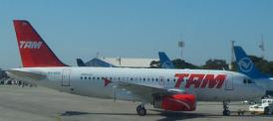
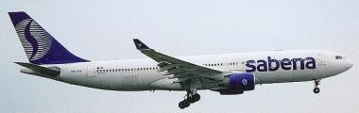
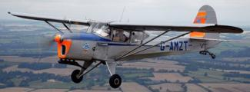
Hugh Dibley’s Main Aviation Activities

Slide 6
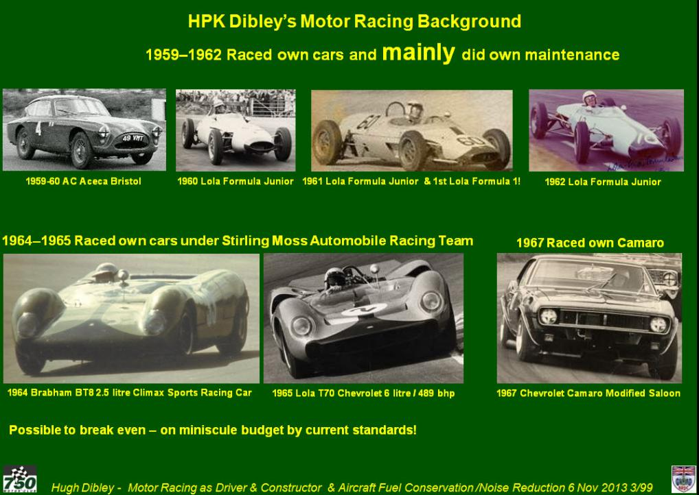

Slide 7
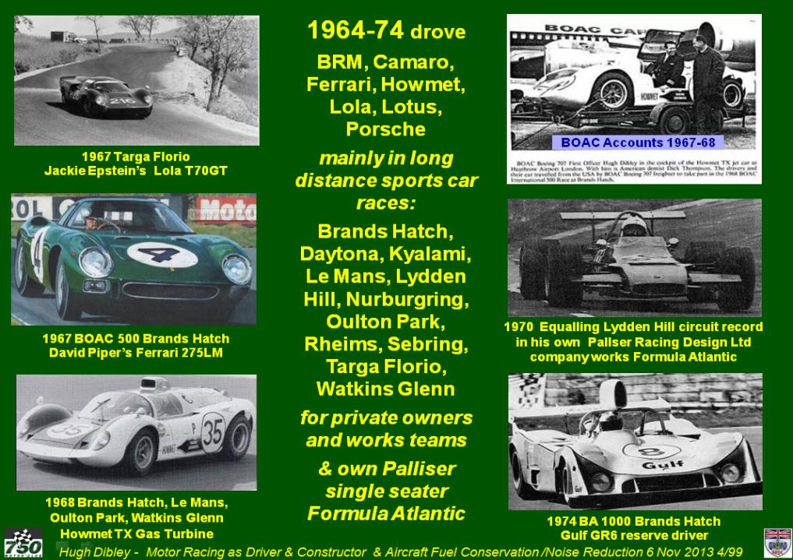

Slide 8

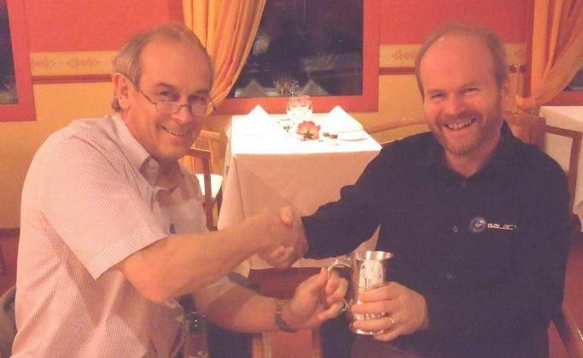
Graduates/
Associates of
Who have given lecture to the RAeS Toulouse Branch
David Baxter
Kenji Takeda
Peter Chandler
Airbus Chief Test Pilot
Commanded 1st Flight
of Airbus A350
14 June 2013
Dave MacKay
Chief Test Pilot
Virgin Galactic

Slide 9
Background to Presentation
  2003 Branches Conference RAeS President Prof Ian POLL,
  “100 Years of Manned Flight“ – Remove pilot to improve safety!
. 2009 CEAS Manchester – H Dibley lecture, chaired by Ian Poll:
“Aircraft Operational Fuel Savings & Noise Reduction - Past & Future”
Ian Poll’s reaction:
“I never realised pilots did so much I must change my view.”
  RAeS 2010 Aerospace
  Statement: – “Pilots will go as we have led with driverless trains”
  Extra section added related to safety – Do we need a pilot?

Slide 10
Operational Fuel Savings & Noise Reduction – Past & Future
Simplified Aircraft Flight Profile – for a Single Aircraft
Efficiency Loss as ATC must Separate Aircraft then Merge to Land
Pre-Flight Planning – Cost of Carrying Extra Fuel on the Sector
Departure Noise Abatement Procedures
Cruise - Fuel Savings & Crew Situational Awareness
Descent – Large opportunity for Fuel Savings – and safety in approach
Approach – Large opportunity for Fuel Savings & Noise Reduction
Steep Approaches – to reduce noise?
Crews’ Ability to Save Fuel/Time by Choosing Approach & Runway
Past Examples of Operational Fuel Savings
Possible Future Operational Fuel Savings
“Future” ATM Fuel Savings Being Achieved NOW – USA
“Future” ATM Fuel Savings Being Achieved NOW - Europe

Slide 11
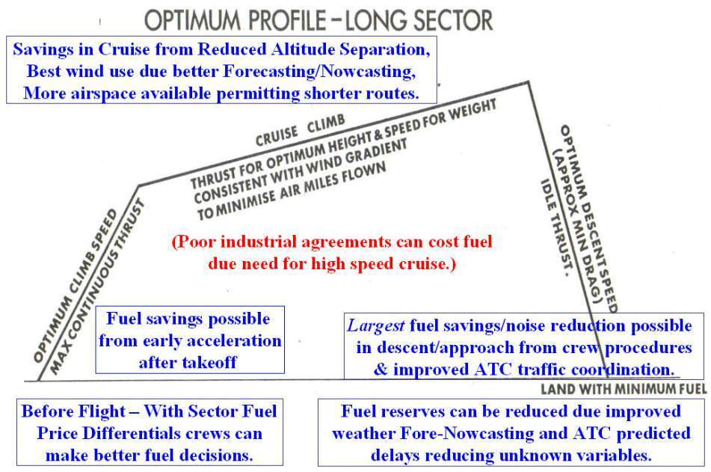
Simplified Aircraft Flight Profile – for a Single Aircraft
Single aircraft
Efficiency is reduced by the need for ATC to separate aircraft to avoid conflicts then merge again for landing

Slide 12
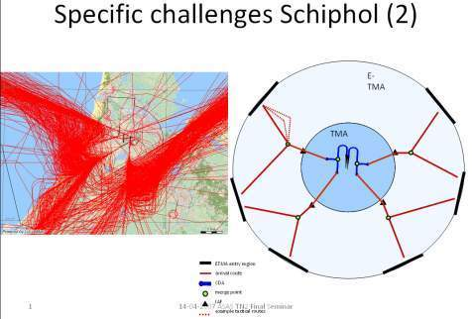
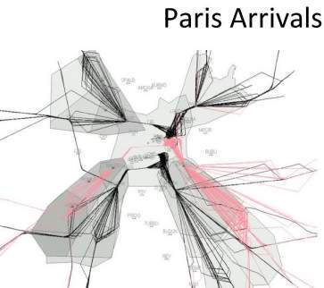
2. Efficiency Loss as ATC must Separate Aircraft then Merge to Land
As aircraft approach their destination, ATC must merge aircraft into a stream to the runway to achieve the most efficient landing rate.
At present this is usually achieved by ATC giving aircraft headings and speeds to fly at low levels which stretch the approach path while aircraft are placed in sequence at the required spacing for the type causing extra fuel consumption and noise over the ground.
New Air Traffic Management Systems will merge aircraft into their landing sequence earlier in the flight, and allow more efficient descents with idle thrust leading to quieter Constant Descent Approaches with no periods of level flight.
The complexity of the process to merge traffic efficiently can be seen from the aircraft tracks into Schiphol airport at Amsterdam and simulations of the Paris arrival routes.
Simulation of Paris Arrivals

Slide 13
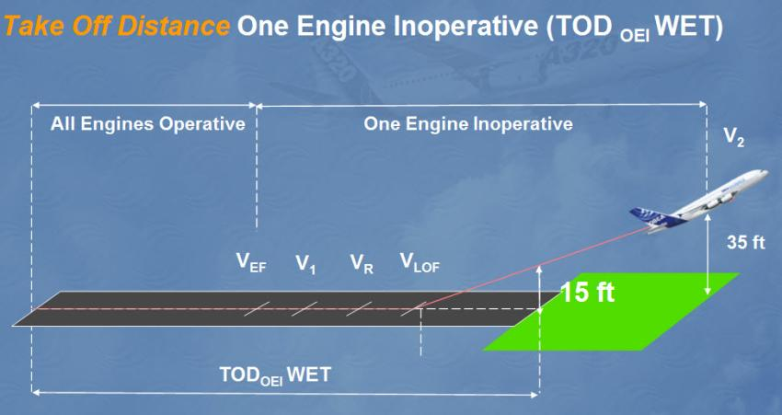
Maximize Take-off Weight
Prime Requirement –
Sound Knowledge of Take-off Performance Principles
To Take-off at the Maximum Allowable Weight for the Conditions

Slide 14
3 Pre-Flight Planning – Fuel Uplift Must Kept to Minimum
Extra weight increases fuel consumption by app 3% per hour
Aircraft weight minimised for fuel efficiency – composites etc
Fuel adds weight so must exactly planned & kept to minimum
Extra fuel can be required for expected delays due to:
ATC congestion, weather, disasters, industrial action, etc
If Fuel Price Much Cheaper at Departure than Destination
Carrying in the fuel can be the most efficient means of delivering the fuel.
Most often simply commercial differences.

Slide 15
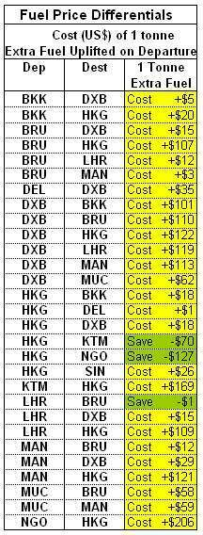
3 Pre-Flight Planning – Cost of carrying extra fuel
Carrying extra fuel over the minimum flight plan fuel always involves as penalty due to the extra weight burnt at 3% per hour.
The actual cost of extra fuel depends on the relative cost of fuel between the departure and destination airfields.
If the fuel is cheap enough at the departure airfield it can be worthwhile carrying/tankering extra fuel into the destination.
However the effect of the extra weight on the aircraft must be considered – extra landing distance, possible extra brake wear and use of reverse thrust, reduced maximum cruise altitude, etc.
This decision is best made by the crew on the day who need to know the cost of extra fuel for the most economic judgement. For example:
HKG-NGO Save $127/tonne – definitely worth tankering.
LHR-BRU Save $1/tonne – not worth tanking for fuel price alone.
HKG-DEL Cost £1/tonne – extra fuel could be cheap insurance if delays en route were likely.
NGO-HKG Cost £206 – cost of extra fuel prohibitive.
Many companies do not publish Fuel Price Differentials but just tell crews when to “tanker” fuel, which may not be efficient.

Slide 16
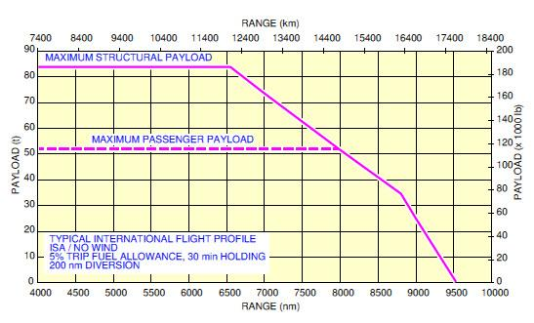
Airbus A380 Payload-Range Diagram
Essential Information for Selecting Correct Aircraft

Slide 17
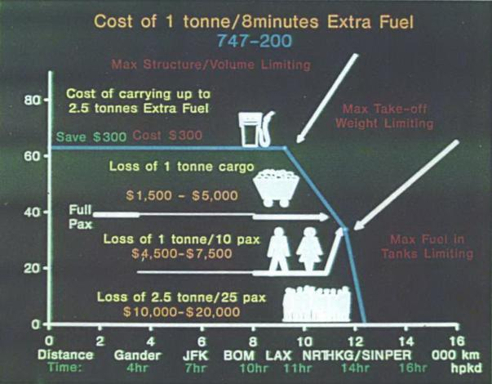
3 Pre-Flight Planning – Cost of Extra Fuel reducing Payload
Flight Operations’ job is to carry Maximum Payload at Minimum Cost
Primarily - Uplift minimum fuel and burn the minimum amount in flight
On long sectors extra fuel displaces payload thus losing revenue -
Loss is extreme on very long sectors when the tanks are already full and the only way to fly further is to reduce the passenger load/weight.

Slide 18
Flight Operations’ job is to
Carry Maximum Payload at Minimum Cost.
Having Uplifted the Minimum amount of Fuel
now
Operate the aircraft efficiently and
Cost effectively to
Burn the Minimum Fuel in flight
consistent with minimum environmental pollution.

Slide 19
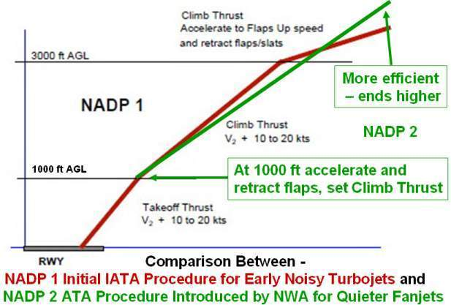
4. Noise Abatement Departure Procedures 1 & 2
Early turbojet powered aircraft were extremely noisy on takeoff so had to climb steeply to 3,000ft before accelerating to retract flaps and climb at the most efficient speed, shown as NADP 1 in red.
Later fan jet engines with colder/slower exhaust streams made less noise so could accelerate sooner and climb more efficiently shown as NADP 2 in green.
Noise close to the airport could be increased but was less than from turbojet aircraft, and noise further out is reduced as the aircraft is higher than with NADP 1.

Slide 20
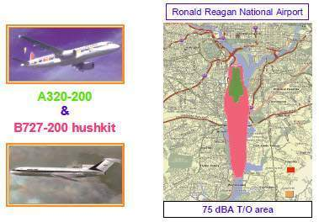
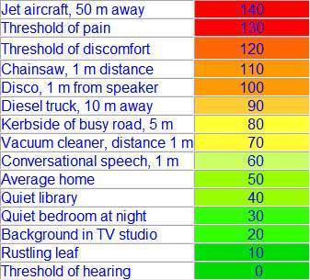
4. Noise Abatement Departure Procedures 1 & 2
The noise foot print from current large fan jet aircraft is some 75% less than from the early fan jet aircraft, therefore NADP 2 can be used at most airports without causing significant noise disturbance close to the runway.
Yet some states specify that the less efficient NADP 1 be followed at airports where urban noise reduction is not a factor.
This is causing significant amounts of unnecessary amounts of extra fuel to be burnt and emissions released into the atmosphere at low level.

Slide 21
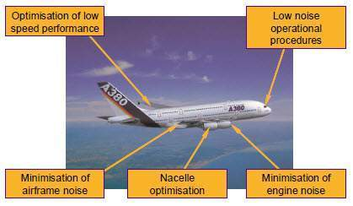
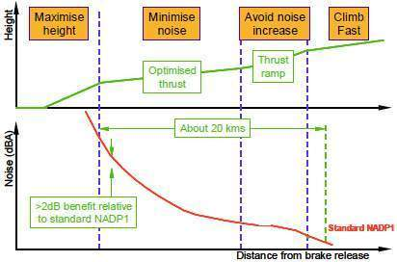
4. A380 Aircraft & Engines Optimised for Low Departure Noise
Minimising aircraft departure noise is considered to be a critical factor in aircraft design.
Rolls-Royce increased the fan size of the Trent 900 for the Airbus A380 to comply with the London Heathrow airport departure noise limits at the highest takeoff weight.
Airbus optimised the low speed performance of the aircraft and engine nacelle design and minimised the airframe noise to make the A380 currently the quietest large jet aircraft.
After takeoff engine thrust is selected automatically for minimum noise on the designed climb profile which produces the best compromise between climb rate and acceleration as the aircraft gains altitude to create the minimum overall noise disturbance.
A380 airframe & engine designed to minimize noise
A380 Optimised Engine Thrust & Climb Profile

Slide 22
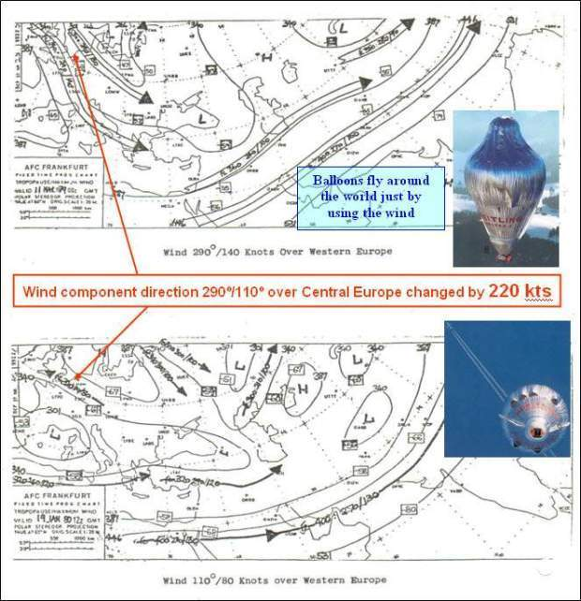
5. Cruise - Fuel Savings by Making Maximum Use of Winds
The flight profile must make maximum benefit of the considerable energy in the atmosphere.
The example shows times when the wind component over Western Europe changed by 220 kts.
Flight planning systems are fed with winds direct from the forecast weather models which can be updated by information from aircraft in flight and fed back by AMDAR.
Aircraft Meteorological DAta Relay was started by the Australian Bureau of Meteorology in the mid 1980s

Slide 23
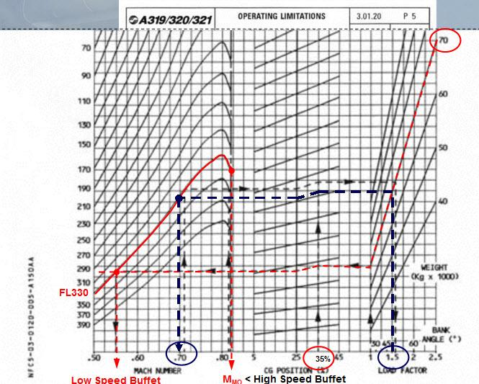
Cruise – Crews Need to be Aware of Aircraft Performance
Aircraft have been stalled and control lost by climbing too high.
Some aircraft can climb to “Coffin Corner”
[not A320] DON’T GO THERE
FMGC Max Buffet Limit 1.3 G
[A320 300 fpm Climb limited]
Speed range at 1.5 G in Steep turn
Speed range at 1 G in level flight

Slide 24
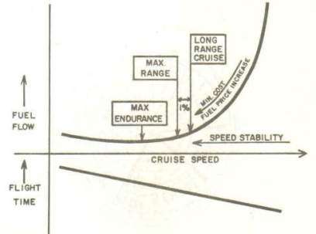
5. Cruise – Crews Need to be Aware of Aircraft Performance
Crews should be have a good knowledge of the performance of their aircraft such as:
Optimum speeds for minimum cost, minimum fuel, etc and the penalties for flying away from the normal/recommended speeds.
Flying too fast can be expensive/uneconomic – can be justified by curfews/connections
The optimum speed curve can be flat so slowing down absorbs delays economically...
Aircraft can be unstable at low/efficient speeds – can now fly automatically
Cruise Speed & Fuel Consumption Relationship

Slide 25
Linear Versus Circular Holding for Delays
Why Regular Circular Holding At LHR
(10-20 mins holding considered normal to UK ATC?)
Primarily due to Shortage of Runway Capacity
Approach controllers need a reserve of aircraft to be able to sequence aircraft in efficiently to maximise LHR’s single runway landing rate.
If Cruising at Normal Speed En Route then Circling at Destination –
Fuel burnt while circling/holding is wasted – 50% on a short flight??
Reducing Speed En Route to Lose the Time Spent Circling –
Can eliminate fuel wastage. Lockheed demoed 4D navigation in 1977!
Passenger delays in immigration due bunching in abnormal weather –
Can be due to shortage of runway capacity....
We need more capacity else business will go to AMS, CDG, FRA , MUC

Slide 26
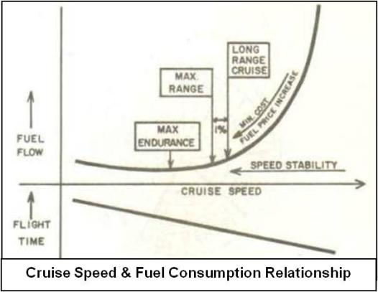
Linear Versus Circular Holding for Delays
Why Regular Circular Holding At LHR
(10-20 mins holding considered normal to UK ATC?)
Primarily due to Shortage of Runway Capacity
Approach controllers need a reserve of aircraft to be able to sequence aircraft in efficiently to maximise LHR’s single runway landing rate.
If Cruising at Normal Speed En Route then Circling at Destination –
Fuel burnt while circling/holding is wasted – 50% on a short flight??
Reducing Speed En Route to Lose the Time Spent Circling –
Can eliminate fuel wastage. Lockheed demoed 4D navigation in 1977!
Passenger delays in immigration due bunching in abnormal weather –
Can be due to shortage of runway capacity....
We need more capacity else business will go to AMS, CDG, FRA , MUC

Slide 27
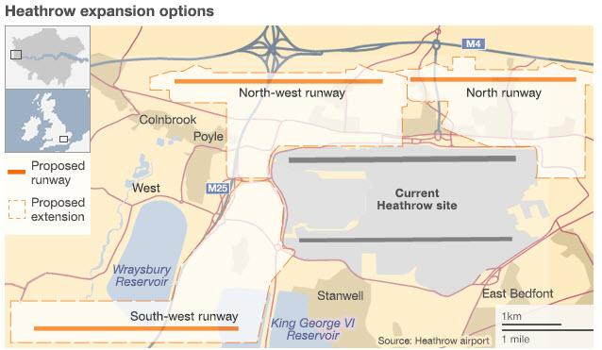
More runways required somewhere!

Slide 28
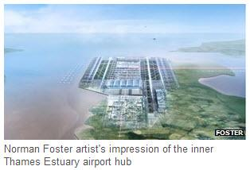
More runways required somewhere!

Slide 29
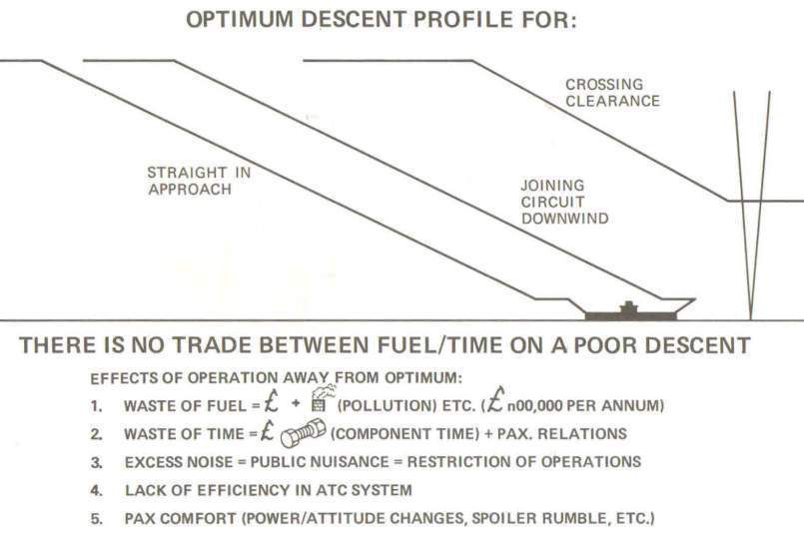
6. Descent – Large opportunity for Fuel Savings – or Wastage
THERE IS NO TRADE BETWEEN FUEL & TIME DUE TO A POOR DESCENT
Summary of Penalties Cause by Poorly Executed Descents:
(Written in 1973 – some of us were worried about the environment then….)

Slide 30
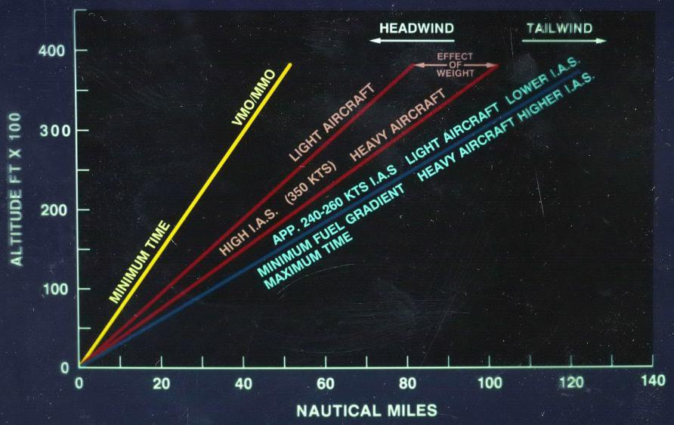
Aircraft Most Efficient at their Optimum Altitude
for Weight, Wind Component, Cruise Speed, etc
Correct descent essential for fuel efficiency.

Slide 31
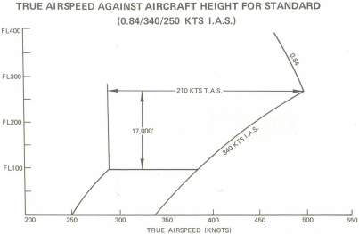
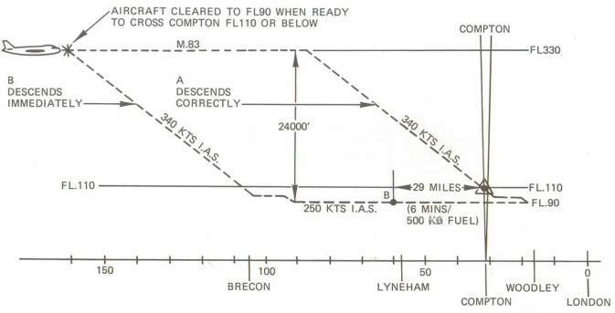
6. Descent – Large opportunity for Fuel Savings – or Wastage
Reduction of True Air Speed at Low Altitude at the same Indicated Air Speed causes increase in fuel consumption and flight time
Descending early wastes fuel and time, can expose aircraft to icing conditions and more aircraft traffic, makes more noise, etc

Slide 32
Before Distance Measuring Equipment available
with No Ground Radar, Descents Made in Steps,
Continuing Descent Passing Radio Beacons
Radio Beacon
Mountain
The same principle
had to apply for
Non Precision Approaches
(perhaps more later)

Slide 33
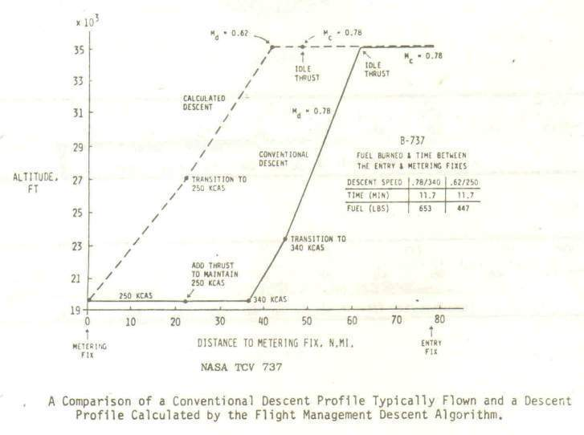
6. Descent – Large opportunity for Fuel Savings – or Wastage
NASA B737 Descent Trials showed that a typically flown profile in line operation which descended early burnt 40% more fuel than the NASA 737 while taking the same time.

Slide 34
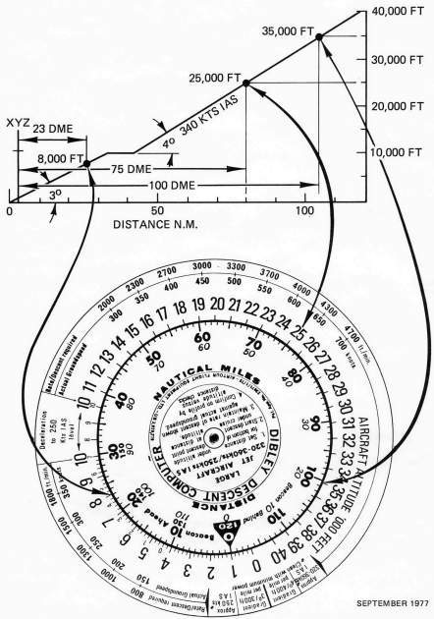
6. Descent – Large opportunity for Fuel Savings – or Wastage
Circular slide rule primarily designed to help crews follow an efficient flight idle descent profile to comply with an ATC clearance such as to cross 23 DME XYZ at 8,000ft at 250kts.
Direct DME-Altitude checks are available throughout to verify on the profile. A fixed gradient of 400ft per mile above 10,000ft is suitable for IAS of 300-340kts according to aircraft weight, and 300ft per below 10,000ft for 250kts IAS after an 8 mile nm deceleration.
Checking the profile mentally, normally by 300ft per mile, requires regular computation of an equation, such as at 50 DME:
(50-8-23) x 300 = 5,700 + 8,000 = 13,700ft
In a survey BOAC B747 pilots estimated their efficiency was improved by at least 10 miles when using the computer, covering the cost of the 2 provided on each aircraft in 1 flight.
Besides minimising fuel burn and noise, following this profile improves safety by keeping the aircraft well clear of the ground into nearly all airfields.

Slide 35
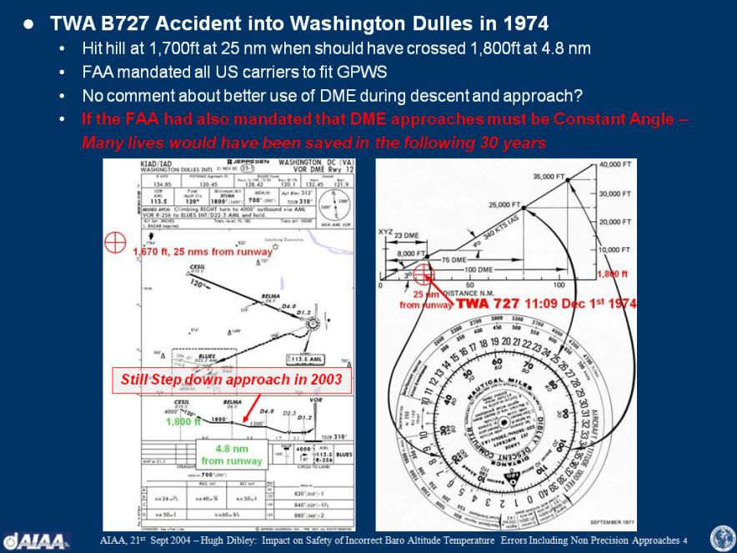
14. Accidents That Need Not Have Happened

Slide 36
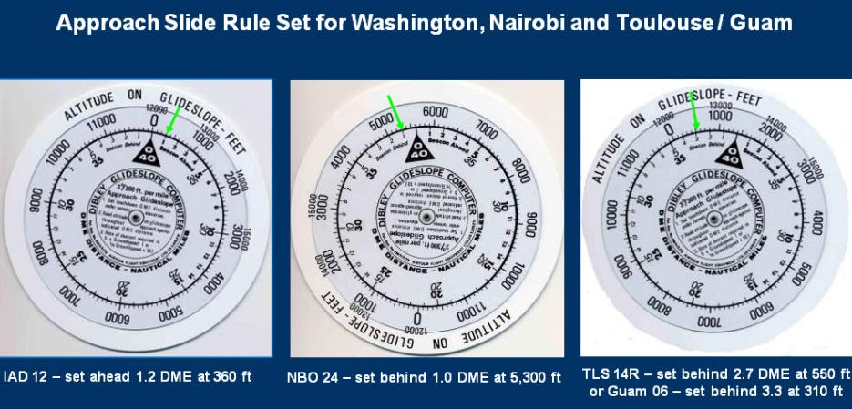
Expanded Scale Can Show Glidepath on Approach to 30ft.
(more later)

Slide 37
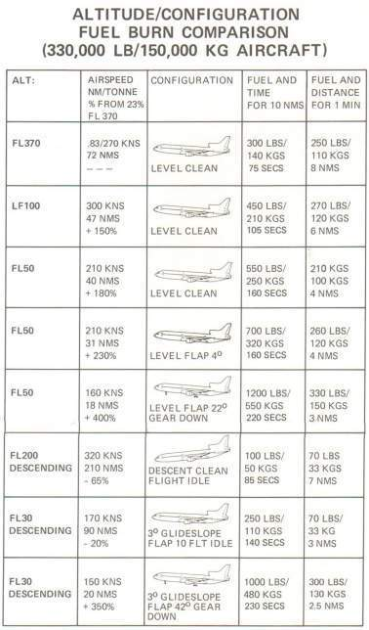
7. Approach – Critical for Fuel Savings & Noise Reduction
Approach is the phase of flight after descent when the aircraft is decelerated and configured by extending flaps for the final approach.
Ideally it is a short period of continuous descent.
ATC may need to give headings and speeds while aircraft are merged into a landing stream, when flaps and landing gear must be extended as late as possible to minimise the extra fuel burnt.
The baseline of the table giving comparative fuel consumption is when cruising at FL370/37,000ft.
Minimum fuel is consumed while descending which shows that long slow descents with idle thrust are the most fuel efficient.
Maximum noise and fuel consumption, 400% more than at cruise altitude, is when flying level with flaps and gear extended (500% on a B747), but reduced when descending on the final glidepath even with the extra drag of full landing flap.
This demonstrates that level flight should be resisted if possible and that level flight with flaps and gear extended should avoided at all costs.
Baseline Cruising at 37,000ft
Maximum Fuel Consumption
Minimum Fuel Consumption

Slide 38
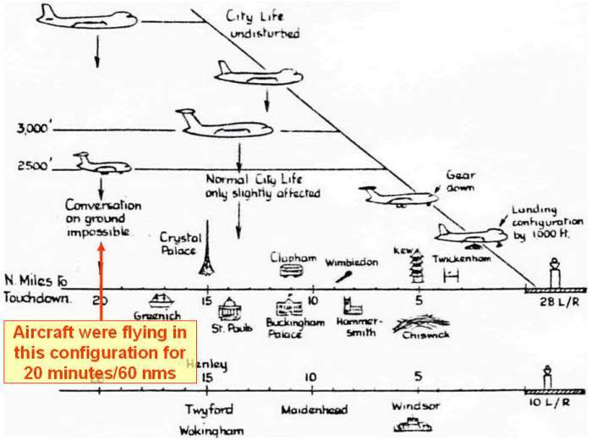
7. Approach – Critical for Fuel Savings & Noise Reduction
This shows that city life need not be disturbed significantly if aircraft are flown level with minimum flap setting above 3,000ft, preferably at least 5,000ft, before descending on the glideslope to the runway with gear up until about 1,500ft to be established for landing by 1,000ft. (On Airbus aircraft the gear can be extended at 800ft, like the Space Shuttle, but this is not the approved procedure.)

Slide 39
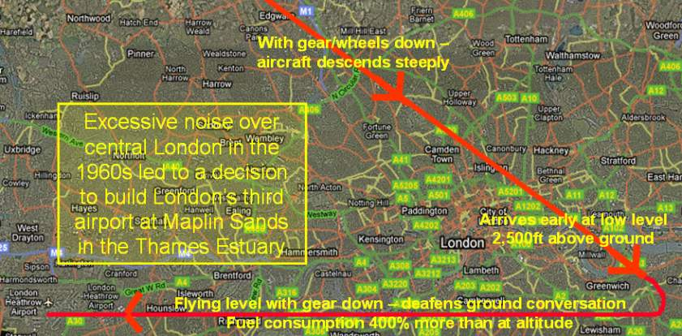
7. Approach – Critical for Fuel Savings & Noise Reduction
One operator into London Heathrow required the flaps and gear extension to be confirmed in the Initial Approach Checklist which was completed when leaving the entry points to the London area, so the aircraft could fly with the gear extended for up to 60 miles.
With the extra drag of the gear and flaps the aircraft would descend steeply and then fly at low altitude across central London making conversation impossible when over flying.
Aircraft noise disturbance over central London was a significant factor in the 1971 decision that the third London airport should be built 100km East of London on the Essex/North Sea coast, but this project was terminated after the 1973-4 fuel crisis.

Slide 40
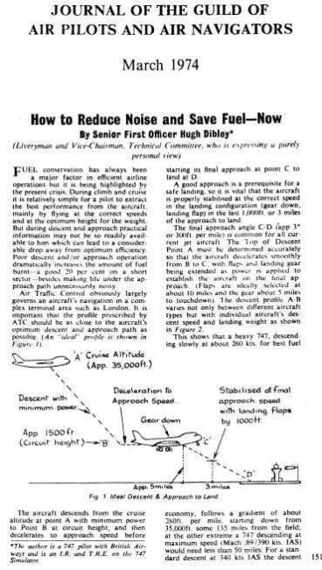
7. Approach – Critical for Fuel Savings & Noise Reduction
To try and reduce the extreme levels of noise over central London this article was published in the GAPAN Journal of March 1974 (Appendix A in the CEAS paper and at www.Dibley.eu.com.) Suggesting that crews should ideally fly a continuous descent from the entry point to intercept the runway glideslope and extend the landing at about 1,500ft to be stabilised in the landing configuration by 1,000ft.
The idea was accepted by UK NATS and after input from Lufthansa who were proposing their similar Managed Drag Procedure, Constant Descent Approaches were started into LHR in 1975. DMEs were installed to give crews continuous distance to the runway paid for by the Department of Trade who was responsible for Noise Abatement.
However CDAs into LHR were not implemented as well as hoped as the procedure has yet to be included in the manufacturers operating manuals. While local operators are proficient less regular visitors will tend to descent early to intercept the glideslope from below.
Similar CDAs can be flown into airports like JFK - immediately reducing noise on the approach.

Slide 41
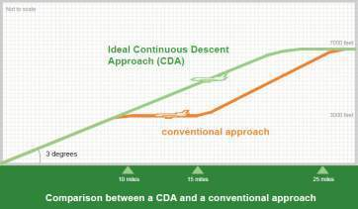
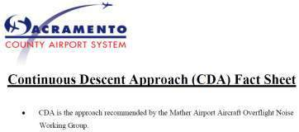
7. Approach – Critical for Fuel Savings & Noise Reduction
The type of CDA introduced into London and the Netherlands can give worthwhile noise reductions from 10 to 25 miles from the runway with no additional technology, and are being implemented in other airports such as Sacramento.
However at busy airports merging aircraft into an efficient sequence for the approach can be more difficult with aircraft trying to fly CDAs.
Future ATM systems due in service by about 2010 will allow efficient CDAs from cruise altitude, but procedures using parts of this system are already operating in some areas as described later.
UPS have been integrating their own aircraft flying CDAs into Louisville, which is possible because UPS is the only operator there at night.
Similarly because of their relatively low level of traffic the Swedish aviation authority LFV have been developing “Green” 4D trajectories flying CDAs into Stockholm Arlanda, both locally from and across the Atlantic.
However crews can still make savings using their own initiative.

Slide 42
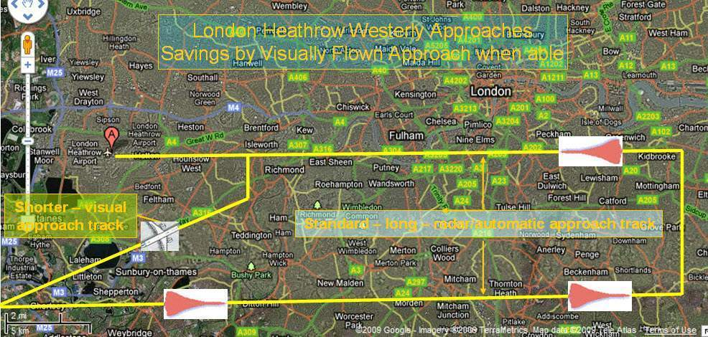
8. Crews Can Save Fuel/Time by Choosing Approach/Runway
Approach tracks into busy airports can be structured with a long lead in for bad weather, and some are flown automatically to follow agreed noise routes.
When traffic and weather permits, crews should be allowed to fly shorter visual approaches

Slide 43
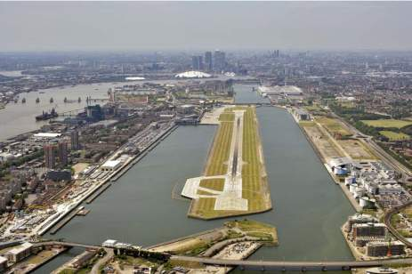



9. Steep Approaches – to reduce noise?
Steep approaches were mainly operated by quiet STOL turboprop aircraft which were cleared to operate into short runway airports close to city downtown areas.
Airbus have obtained approval for their smallest aircraft the A318 to fly the 5.5º approach into London City Airport.
To fly a steep approach on jet aircraft requires extra drag and a switch on the A318 changes the flight control laws to extend some speedbrakes during the final descent, and gives the pilot aural warnings when to start the flare to land which is made about 40ft sooner than normal.
The autopilot must be disconnected before reaching the minimum altitude when the runway must be in sight which is higher than for the normal 3 degree approach.
Steep approaches are not expected to be possible by larger Airbus aircraft, but work will concentrate on reduction of aerodynamic noise during approach.
London City Airport
Dame Ann Dowling & Tom Hynes
found for the Silent Aircraft Initiative
Optimum Approach Glide Slope Angle = 3.9º

Slide 44

10. Past Examples of Operational Fuel Savings
Example of 8% Immediate Fuel Saving by Crews
Flight data recording showed that an aircraft fleet was not operating efficiently.
A fuel economy newsletter listed the flight segments and what how much extra fuel was being burnt / could be saved by a better operation.
The total extra burn was possibly 26% but this was unlikely to be saved as not all items would occur on one leg.
After crews were made aware of the penalties and some changes in procedures an 8% saving was achieved immediately.
Departure/arrival procedures in italics are not optimised in current operations.
1979 prices
Potential Fuel Saving 26%

Slide 45

10. Past Examples of Operational Fuel Savings
Example of 8% Immediate Fuel Saving by Crews
Flight data recording showed that an aircraft fleet was not operating efficiently.
A fuel economy newsletter listed the flight segments and what how much extra fuel was being burnt / could be saved by a better operation.
The total extra burn was possibly 26% but this was unlikely to be saved as not all items would occur on one leg.
After crews were made aware of the penalties and some changes in procedures an 8% saving was achieved immediately.
Departure/arrival procedures in italics are not optimised in current operations.
1979 prices
Every little improvement helps
Potential Fuel Saving 26%

Slide 46
10. Past Examples of Operational Fuel Savings
Example of 8% Immediate Fuel Saving by Crews
Flight data recording showed that an aircraft fleet was not operating efficiently.
A fuel economy newsletter listed the flight segments and what how much extra fuel was being burnt / could be saved by a better operation.
The total extra burn was possibly 26% but this was unlikely to be saved as not all items would occur on one leg.
After crews were made aware of the penalties and some changes in procedures an 8% saving was achieved immediately.
Departure/arrival procedures in italics are not optimised in current operations.
1979 prices
Every little improvement helps
Rolls-Royce spends £800M per year on Research & Development to achieve 1% improvment in fuel efficiency
Potential Fuel Saving 26%

Slide 47

10. Past Examples of Operational Fuel Savings
A contract was secured because the crews’ more efficient operation saved 13% fuel compared to the previous operator which covered the crews’ cost.
A cargo operator became profitable by, amongst other savings, increasing payloads by reduced fuel reserves and improved fuel consumption.
The Fuel Monitoring Graphs show how individual crew performance can vary and affect the profitability of an airline.
The top graph shows the cost of carrying extra fuel based on the Sector Fuel Price Differential.
The centre graph shows the cost of extra fuel burnt in flight, perhaps by non optimum operation of the aircraft – descending early, configuring for approach too soon, etc.
The bottom graph shows the total of the two. The difference between the extremes is over U$400 per sector which for a year could total U$100Ks.
Such information must obviously be used sensitively and only be used for encouragement.
Crew Fuel Monitoring Graphs
Top – Cost of Extra Fuel Uplifted
Centre – Cost of Extra Fuel Burnt
Bottom – Crew’sTotal Extra Cost

Slide 48

Fuel Efficiency by Improved Procedures?
Flying in Formation.....

Slide 49

Fuel Efficiency by Improved Procedures?
Flying in Formation.....
Perhaps 10% improvement by “Surfing” US C17s?

Slide 50

Fuel Efficiency by Improved Aircraft Types

Slide 51

Fuel Efficiency by Improved Aircraft Types

Slide 52

Fuel Efficiency by Optimising Aircraft Size
A380 Range Capability
Can fly 14,500km/9,000miles
7,800 nautical miles
Southampton to Perth Australia

Slide 53
Fuel Efficiency by Optimising Aircraft Size
Southampton-Perth

Slide 54
Fuel Efficiency by Optimising Aircraft Size
Flight Southampton – Perth Australia
14,500km/9,000 statute miles
Flying Close to Colombo – about half way
Flight Time approx 18 hours
Fuel carried for Colombo–Perth is burnt at 3% per hour Sot’on-Colombo
Therefore about an extra 35% fuel can be required for a non-stop flight on a high take-off weight aircraft capable of flying the 9,000 miles non stop.
A lighter aircraft designed to fly with the same payload but with a range of only 4,500 miles will save more fuel.
Illustrated in the next slides by Dr John Green’s 2008 paper for Greener By Design, presented to the RAeS Toulouse Branch -

Slide 55
Options for reducing fuel burn per passenger-km

Slide 56
Effect of design range on fuel burn
for long-distance travel
Design range km | Payload tonne | Mission fuel tonne | Reserve fuel tonne | Max TOW tonne | OEW tonne | Fuel for 15,000km tonne
15,000 | 25.9 | 120.3 | 13.5 | 300.0 | 140.3 | 120.3
5,000 | 25.9 | 20.4 | 5.4 | 120.0 | 68.4 | 61.1
Travelling 15,000km in one hop or three
Revision of earlier GBD estimates:
Correction published in August 2006 issue of the Aeronautical Journal
Recent research shows the value of building an efficient 4,000nm aircraft
Raj Nangia further suggests refuelling rather than landing en route.

Slide 57

Gliding descents are regularly re-invented – here in New Zealand in 2007
And by Richard Branson whose crews were then being trained for CDAs.....
Also exploring efficiency by towing aircraft to a starting grid before starting engines!

Slide 58





  Electric Taxi might reduce jet engines pollution on ground
  WheelTug assess the main advantages in time savings

Slide 59


  Electric Taxi might reduce pollution from jet engines Ground
  WheelTug assess the main advantages in time savings

Slide 60

Fuel Efficiency by Improved Navigation
GPS Systems Available Worldwide
RNP AR (Authorization Required) Procedures introduced

Slide 61

Fuel Efficiency by Improved Navigation
Example of RNP AR (Authorization Required) Approach – low traffic environment
Departure from Lhasa, Tibet, altitude 9,670ft, Surrounding terrain up to 20,000ft, Minimum Safe Altitude 27,700ft. Considered World’s Most Challenging airfield.

Slide 62




Fuel Efficiency by Improved Navigation
High Traffic Environment
Example of Improvements in Accuracy from RNP Approaches into Kelowna BC
However the full benefits of Required Navigation Performance needs the route structure to be reorganised to make use of the reduced separation.

Slide 63

Fuel Efficiency by Improved Air Traffic Management
Europe

Slide 64

Fuel Efficiency by Improved Air Traffic Management
USA

Slide 65

Fuel Efficiency by Improved Air Traffic Management
USA

Slide 66

Fuel Efficiency by Improved Air Traffic Management
USA
Doing efficient visual approaches – but need to be integrated!

Slide 67

Fuel Efficiency by Improved Air Traffic Management
Airbus’ Progress towards Incorporating the Various Aircraft Systems

Slide 68

11. Possible Future Operational Fuel Savings
Example of Aircraft Navigational Display showing Other Aircraft, which can be used for Separation Assistance by the crew.

Slide 69

Fuel Efficiency by Improved Air Traffic Management
Future SESAR plan for “Reference Business Trajectories”
RPTs will be stored in the airlines’ schedule, authorised by the Air Navigation Service Provider and executed by the crew to comply with the Controlled Time of Arrival

Slide 70

12. “Future” ATM Fuel Savings Achieved NOW - USA
UPS are already using their own ABESS (Airline Based En-Route Sequencing and Spacing) system to enable their crews to fly efficient CDAs into Louisville.

Slide 71

12. “Future” ATM Fuel Savings Achieved NOW - USA
UPS Operations Control uses ABESS to Sequence & Merge aircraft during Cruise
Communication systems & Displays in UPS aircraft then allow crews to manage their own FDMS (Flight Deck Merging & Spacing) during an idle thrust descent.

Slide 72

12. “Future” ATM Fuel Savings Achieved NOW - USA
Considerable reductions in Noise and Fuel have made by the UPS ABESS & FDMS systems, enabling their crews to fly efficient CDAs into Louisville.

Slide 73

Fuel Efficiency by Improved Air Traffic Management
In Sweden flights have been flying “Green” 4D trajectories

Slide 74

Fuel Efficiency by Improved Air Traffic Management
Technology being implemented.... in 2012 .... but takes time....
Lockheed demoed 4D navigation on the TriStar in 1976!

Slide 75

Fuel Efficiency by Improved Air Traffic Management
Pilot input and decisions still required –
But for how much longer?

Slide 76

Need for Pilots?
Opinion of Experts from Europe and USA
Plans for Future European Aircraft – ACARE –
Advisory Council for Aeronautical Research in Europe
“It is not possible to automate all the possible functions required in future systems (like autoland was in the past), nor to forecast the nature of unexpected events.
Therefore pilots must be retained in the aircraft and systems will be designed to keep them in the loop.”
Recent Comments from the FAA -
“Numerous events are on record where pilots have avoided disaster by keeping control of aircraft when systems failed in unexpected ways.”
Flight Safety Foundation:
“The greatest aid to flight safety is a well trained Flight Crew”

Slide 77
Need for Pilots?
Comparisons with Other Endeavours
Very Approximate Fatalities:
Airlines – 1K per year
Roads – 40K per year
Medical accidents – 200K per year?
Medical Industry’s Adoption of Aviation Methods
  Checklists to avoid basic errors – wrong limbs/tools left in patients
  Resource Management to establish team work & reduce autocracy
  Error Monitoring?
When asked engineer friend, if wanted to reduce accidents, why not work on automatic cars replied “That’s not so much fun!”
Google cars have now driven automatically for thousands of miles!

Slide 78


Slide 79

Safety so far with Pilots
2 pilots & Flight Engineer
2 pilots
Entry of 2nd general aircraft with 2 pilots & Flight Engineer
appears to have been smoother than later 2 pilot aircraft

Slide 80

Airbus has developed landing performance guidance system

Slide 81
What Happens when Technology goes Wrong
Joe Morrall Chief Scientist –
“Statistics do not show the accidents pilots have saved”
Crew Actions in Emergency and Abnormal Operations
  How Often are Emergency and Abnormal Procedures Required?
Aviation Authorities are required to operate a
“Mandatory Occurrence Reporting Scheme” - when
“Any incident which endangers or which, if not corrected, would endanger an aircraft, its occupants or any other person.”
must be reported.
The UK CAA receives 2,631 MORs last year,
1,237 were related to weather, wake vortex, ATC, etc, so over 1,000 involved aircraft systems.

Slide 82

Crew Actions in Emergency and Abnormal Operations
  Crew Emergency and Abnormal Procedures
    Dealing with Expected Failures by Prioritising/Following Procedures
    About 40% of training in aircraft type rating Transition Courses involve emergency and abnormal procedures – through the ECAM
ECAM
Electronic Centralised Aircraft Monitor

Slide 83

Crew Actions in Emergency and Abnormal Operations
ECAM

Slide 84


Crew Actions in Emergency and Abnormal Operations
  Ideally all Failures are managed by following ECAM Actions :
ECAM Actions – To do as shown
Status – What is wrong / How to fly

Slide 85



Crew Actions in Emergency and Abnormal Operations
  But some Emergency & Abnormal Failures Need Paper Checklists

Slide 86


Crew Actions in Emergency and Abnormal Operations
  Basic flying skills are still required, such as using just pitch and thrust when airspeed indications fail, together with some Memory Items like Loss of Braking.
  Later developments make aircraft such as the A350 and A380 easier to operate with less need for paper checklists, but new systems being introduced will bring their own specific procedures.

Slide 87
Effects of Changing Technology
- More challenges for pilots
Early aircraft –
Input/sensor failures affected single systems
Current aircraft –
Input/sensor failures affect multiple systems –
With perhaps..... (AFR 447)
multiple consequences .....
disconnections .....
multiple warnings.....
possibly startling –
But if crews understand the systems and are prepared –
Need not be quite so startling – hopefully!

Slide 88

Airbus A320 – Flight Control Laws Reconfiguration after failures

Slide 89
Effects of Changing Technology
- More challenges for pilots
Table assumes failed systems are flagged invalid
Inputs/data can “fail” in different ways –
Erroneous/incorrect and flagged as Invalid –
Inputs to systems switched off.
Reconfigurations made as per design.
Erroneous/incorrect but NOT flagged as invalid –
Bad information fed to systems, perhaps causing anomalies
(Like 737 into AMS when Radio Altimeter fed 0 ft so autothrust reduced to idle as if had landed.)
Unreliable – incorrect but may return to normal

Slide 90



After Accidents like AFR 447 -
Upset Recovery Training in an Aircraft is Recommended
To be part of a Commercial Pilot’s Initial Qualification

Slide 91

Prime Aim is to Prevent Crew Losing their Awareness

Slide 92

Simpler to keep Situational Awareness in latest aircraft
Airbus A350 Flight Deck

Slide 93


Simpler to keep Situational Awareness in latest aircraft

Slide 94

But if systems fail - could be to back flying manually and find position by interpreting needle & dials

Slide 95

Pilots must be able to retain “stick and rudder” flying skills & ability to keep Situational Awareness by interpreting basic instruments ....
until new technology reliable to current safety levels

Slide 96

Is a Pilot a Commander
or Technician just complying with procedures?
We need a technically competent Commander who is capable
of fulfilling the basic Flight Operations task to
Carry Maximum Payload at Minimum Cost
(safe, fuel efficient, quiet, kind to aircraft-engines, good service, etc)
and is capable of handling a Black Swan Event
Discovered in Australia, not accepted as Swan for decades
Theory by
Nassim Nicholas Taleb
Work focuses on problems of randomness and probability.
Criticized the risk management methods used by the finance industry and warned about financial crises
Beyond 10⁻⁹

Slide 97

How to Prepare for Black Swans?
09 April 2014
97
Notes:
97
Less relevant events based on legacy – First Officer flying a single engine missed approach, without an autopilot, dead captain, sanitised runway etc……..
Training courses traditionally focus on exposure, ticking off all systems/procedures rather than mastering the process to deal with them all
Management require/expect strict adherence with policy/regulation. But……Warren Bennis said “managers do things right leaders do the right thing”; we need crew leaders
Increasingly in accidents we see pilots retained that have poor training histories but meet the regulations, TRTOs get paid to pass. In the past ‘aircraft killed pilots’ and back then some good pilots died. With better more reliable aircraft and better training that should not be acceptable now!

Slide 98

Considered by many to be a major Black Swan Event

Slide 99




Crew Actions in Emergency and Abnormal Operations
  Examples of Crew actions saving loss of life :
Eric Gennotte’s crew landed a A300 B4 with no hydraulics after hit by missile at Baghdad
Captain Peter Burkill retracted the 777 flaps to reduce drag thus avoiding fences before the runway when engines lost thrust on final approach into LHR
Captain Sullenberger started the APU out of sequence to keep the A320 powered normally when ditching in the Hudson

Slide 100

Crew Actions in Emergency and Abnormal Operations
  Examples of Failures requiring Considerable Crew Activity :
After an A380 engine 2 uncontained failure, while the aircraft was being flown manually, Richard de Crespigny’s crew had to action 53 ECAM messages taking some 50 minutes to complete.
It took the 5 man crew some 2 hours to prepare the aircraft for landing. When on the ground they still had matters to resolve – engine 2 could not be shut down, wheels brakes reached 900°C.
(Possible to automate in the foreseable future?)

Slide 101

  Another Example when the crew judged that the
  aircraft automatic ECAM System
  (Electronic Centralised Aircraft Monitor)
  was better to be ignored as they had more information – a burning smell

Slide 102

  Another Example when the crew judged that the
  aircraft automatic ECAM System
  (Electronic Centralised Aircraft Monitor)
  was better to be ignored as they had more information – a burning smell
  Feed into burner can failed,
  Fuel sprayed into nacelle.

Slide 103
Crew Actions in Emergency and Abnormal Operations
  Delta B767 Captain’s Account of Arrival after Japanese Earthquake
The Japanese controller's anxiety level seemed quite high and he said expect "indefinite" holding time. No one would commit to a time frame on that so I got my copilot and relief pilot busy looking at divert stations and our fuel situation, which, after an ocean crossing is typically low.........
With more planes piling in from both east and west, all needing a place to land and several now fuel critical ATC was getting over-whelmed. In the scramble, and without waiting for my fuel to get critical, I got my flight a clearance to head for Nagoya, fuel situation still okay........ few minutes into heading that way, I was "ordered" by ATC to reverse course. Nagoya was saturated with traffic and unable to handle more planes (read- airport full). Ditto for Osaka............
Planes started to heading for air force bases. The nearest to Tokyo was Yokoda AFB. I threw my hat in the ring for that initially. The answer - Yokoda closed! no more space...............
"Sapparo Control - Delta XX requesting immediate clearance direct to Chitose, minimum fuel, unable hold. "Negative the Pattern is full“.
"Sapparo Control - make that - Delta XX declaring emergency, low fuel, proceeding direct Chitose“ "Roger Delta XX, understood, you are cleared direct to Chitose, contact Chitose approach....etc...."
In the end, Delta had two 747s, my 767 and another 767 and a 777 all on the ramp at Chitose. We saw two American airlines planes, a United and two Air Canada as well. Not to mention several extra Al Nippon and Japan Air Lines planes - 9 hours later, Japan air lines finally got around to getting a boarding ladder to the plane......

Slide 104
Main Reasons for Improvement in Aviation Safety
Technical – Aircraft Hardware and Software
  Knowledge of aircraft position: Late 1960s - DME (reliable distance from a VHF radio beacon) – eliminated need for Step Down Descents and Approaches; Electronic maps; Mid 1990s – GPS (Global Positioning System) maybe disrupted by Broadband in the US!
  Dealing with the symptoms of poor 3 D navigation/CFIT (Controlled Flight Into Terrain) : 1970s – GPWS (Ground Proximity Warning System); 1990s - Enhanced GPWS with terrain database/TAWS.
  Windshear: 1970s – Reactive to fly out of, 1990s – Detection to avoid
  Automatic Airborne Collision Avoidance Guidance: 1980s – Traffic Alert & Collision Avoidance System, 2007 ACAS.
  Digital Flight Simulators: 1970s – progressive improvement to be able train above devices as well as crew manual flying & system handling.
  Digital Flight Data Monitoring – Europe1960s, US 1990s allowing expanded Flight Operations Monitoring to help assess crew performance, and human factors.
  Improved maintenance / reliability of systems

Slide 105
Main Reasons for Improvement in Aviation Safety
Human Ware.
  Selection to recruit suitable candidates
  Crew Resource Management – 1960s (some airlines)
    Equally competent crew members working together,
    Correct command gradient between captain and co-pilot
    Routines to agree decisions, manage abnormal circumstances
    Line Operations Monitoring to obtain honest feedback
    Management of errors
  Flight Time Limitations
Good/Clear Operational Documentation
  Checklists
  Procedures
  Safety record of UAVs is many orders worse that crewed aircraft

Slide 106




Recent Accidents –
Asiana B777 Visual Approach San Francisco
Fight from Korea, became low on visual approach and hit sea wall. Confusion over use of automatic thrust. Despite hard ground contact accident all but 2 survived
SFO visual approaches have always been used to keep high landing rates on both runways.
Now banned for foreign operators.

Slide 107

Recent Accidents –
UPS Airbus A300-600F Instrument Non Precision Approach into Birmingham Alabama – 14th August 2013

Slide 108
Lecture re Constant Angle Approaches April 2013
Let us never have to say –
that accident need not have happened.
............but only 4 months later...

Slide 109

Lecture at WATS April 2013
Before DME / reliable distance information
NPAs Had to be Step Down or “Dive and Drive
“Dive” to next Minimum Altitude
Fix
such as
NDB
Beacon
Fix
such as
Flashing Light

Slide 110
Back to Benefits of a Constant Angle NPA Profile
Stable Approach – established as many orders safer
Stable approach, landing configuration, no pitch/thrust changes
NPA Minima may be reduced
DME-Altitude Tables can provide regular checks to confirm aircraft on the correct profile to 30ft accuracy.
Rather than checks at single points which might be interrupted by ATC request, crew action etc.

Slide 111


FAA LOC-DME Chart without table & Possible Table

Slide 112

FAA LOC-DME Chart without table & Possible Table
14.1-5070
9.5-3500
The chart profile is a linear path from 3500ft at 14.1D.
The table shows on a 3.2º GS 5070’ at 14.1D & 3500’ at 9.5D.
The profile is not realistic.

Slide 113

BHM LOC-DME Chart - Correct Distances for Profile
9.5
3.5 NM

Slide 114
BHM LOC-DME Chart Correct Profile for Distances 1
9.5
X
3.5 NM
4.6 NM

Slide 115

BHM LOC-DME Chart Correct Profile for Distances 2

Slide 116


Essential Info for Monitoring LOC-DME Approach
If no chart table available – Use another system

Slide 117

8. Save Fuel/Time Flying Constant Angle VOR-DME Approach
Continued Need for DME-Altitude Tables
DME (Distance Measuring Equipment) reads to 0.1 n mile, therefore:
Altitudes on a 3 degree glidepath can be checked / flown to within 30ft (300 x .1)
(It is important to use the correct DME - ILS or VOR if both are available!)
A DME in line with a runway can show an accurate glidepath on a Non Precision Approach by a simple DME-Altitude table for a Constant Descent Angle approach.
Step Down NPAs and many accidents could have been avoided 30 years ago.

Slide 118
14. Accidents That Need Not Have Happened

Slide 119
Hope this has given some idea why competent pilots will be needed for efficient, safe operations into the foreseeable future......but
There is an imminent shortage of pilots.
The supply from the military is no more.
Sufficient suitable candidates
with the necessary finance of up to €100, 000.00
are not coming forward.

Slide 120

Conclusion
….Flight Decks and pilots’ roles are unlikely to change in the foreseeable future
We must continue to recruit best standard of candidate to maintain our high levels of safety and efficiency
A380 Flight Deck

Slide 121


Conclusion
…or do you still believe it is like driving a train –
in one dimension rather that 3?
French TGV driver on record 575kph/357mph run

Slide 122

We must recruit competent & motivated pilots

Slide 123

Remember...

Slide 124
MCC Courses
All airline pilots must pass a
Multi-Crew Cooperation Course
These concentrate on the fact that:
We all make mistakes,
We should admit our mistakes/we were wrong
We must help each other work together for the common good – of not having an accident.
MCC Courses should be
compulsory for bankers
and most of us!

Slide 125
Thank you!

Slide 127

Need for Distance-Altitude Tables in Future Aircraft
Latest Airbus aircraft can fly FLS – ILS Look-alike
Fms generated Landing System
(other manufacturers have similar systems)

Slide 128

Need for Distance-Altitude Tables in Future Aircraft
Latest Airbus aircraft can fly FLS – ILS Look-alike
Fms generated Landing System
(other manufacturers have similar systems)

Slide 129

Need for Distance-Altitude Tables in Future Aircraft
Latest Airbus aircraft can fly FLS – ILS Look-alike
(Fms generated Landing System)
Altitude Minima based
on Barometric Altitude

