Slide 1

750 Motor Club, North Herts Centre
Hugh Dibley’s
Life as Racing Driver & Constructor
Work in Aircraft Fuel Conservation &
Noise Reduction – started into London Heathrow in 1975
Racing Driver 1959 - 1974
Racing Car Constructor 1967-72
(Palliser Racing Design Limited)
1979 Awarded Guild of Air Pilots Brackley Memorial Trophy
For work on Fuel Conversation started in 1973

Slide 2
Hugh Dibley’s talk to 750 Motor Club, North Herts Centre
Racing Driver – privateer and semi-professional – Howmet TX Gas Turbine sports racer
1967-1972 Palliser Racing Design Limited
Development of a new model by a small constructor
Practical effects of aerodynamics
Reason for end racing as racing driver
Work on aircraft Fuel Conservation and Approach Noise Reduction and to Improve Safety on Non Precision Approaches – where unnecessary accidents still happen.
Video of First BOAC 500 Sports Car Race, Brands Hatch, 1967

Slide 3
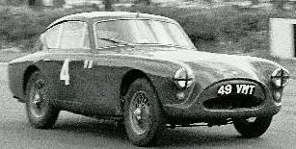
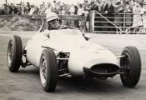

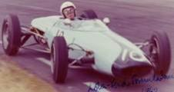
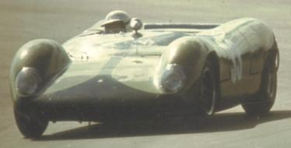
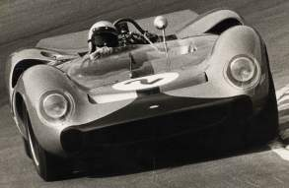
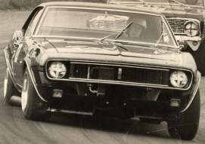
HPK Dibley’s Motor Racing Background
1959–1962 Raced own cars and mainly did own maintenance
1959-60 AC Aceca Bristol
1960 Lola Formula Junior
1961 Lola Formula Junior
& 1st Lola Formula 1!
1962 Lola Formula Junior
1964–1965 Raced own cars under Stirling Moss Automobile Racing Team
1967 Raced own Camaro
1964 Brabham BT8 2.5 litre Climax Sports Racing Car
1965 Lola T70 Chevrolet 6 litre / 489 bhp
1967 Chevrolet Camaro Modified Saloon
Possible to break even – on miniscule budget by current standards!

Slide 4
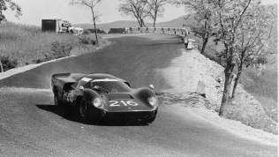
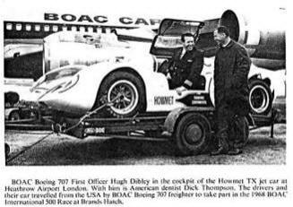
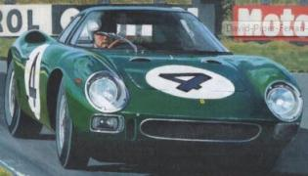
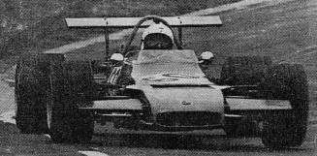
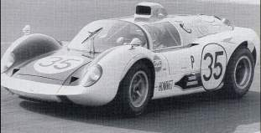
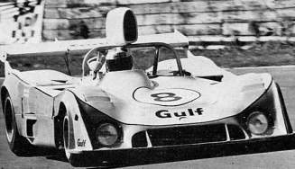
1964-74 drove
BRM, Camaro, Ferrari, Howmet, Lola, Lotus, Porsche
mainly in long distance sports car races:
Brands Hatch, Daytona, Kyalami, Le Mans, Lydden Hill, Nurburgring, Oulton Park, Rheims, Sebring, Targa Florio, Watkins Glenn
for private owners and works teams
& own Palliser single seater Formula Atlantic
1967 Targa Florio
Jackie Epstein’s Lola T70GT
BOAC Accounts 1967-68
1970 Equalling Lydden Hill circuit record in his own Pallser Racing Design Ltd company works Formula Atlantic
1967 BOAC 500 Brands Hatch
David Piper’s Ferrari 275LM
1968 Brands Hatch, Le Mans, Oulton Park, Watkins Glenn
Howmet TX Gas Turbine
1974 BA 1000 Brands Hatch
Gulf GR6 reserve driver

Slide 5
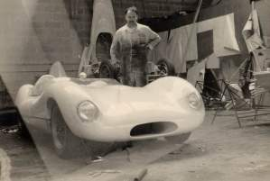
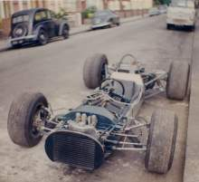
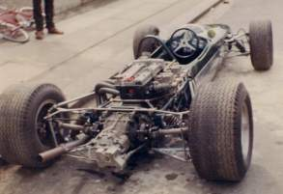
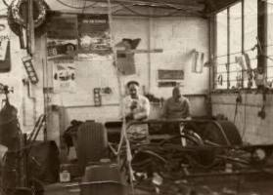
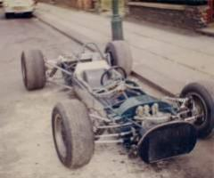
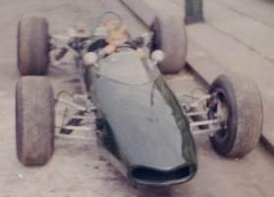
Formation of Palliser Racing Design 1967-72
Len Whimhurst, toolmaker,
after leaving Lola & Brabham…..
Built his own car at his home in Catford, Southeast London
Lola Cars, Bromley, Kent
Brabhams, Woking
Whimhurst asked Dibley to provide and engine and test drive
At first test session the car came close to the outside lap at Brands Hatch short circuit…….
…..on the latest Goodyear tyres - used by Jack Brabham’s Formula 2 team

Slide 6
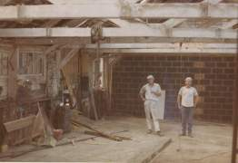
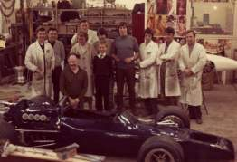
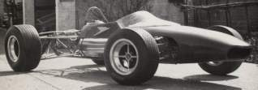
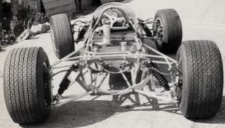
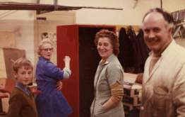
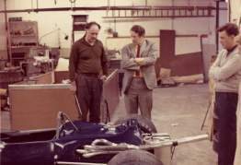
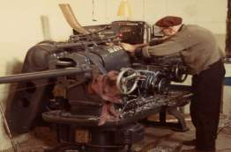
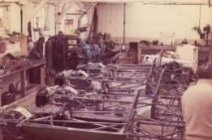
Formation of Palliser Racing Design 1967-72
Factory set up at North Street, Clapham, Central London
Bob Winkelmann, San Francisco
in 1968 bought and paid for
3 US Formula B Cars
In 1969 Bob Winkelmann
ordered 20 Formula Fords
Marketing strategy was to export cars to one outlet in the US
UK market supplied when US demand disappeared
Nearly 100 cars produced. Championships won in UK, USA and South Africa. Wound up in 1972
H Dibley concentrated on aircraft fuel conservation and environmental noise reduction

Slide 7
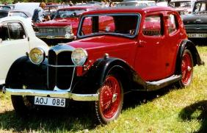
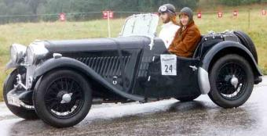
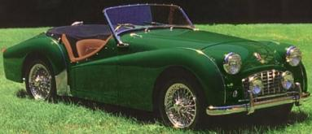
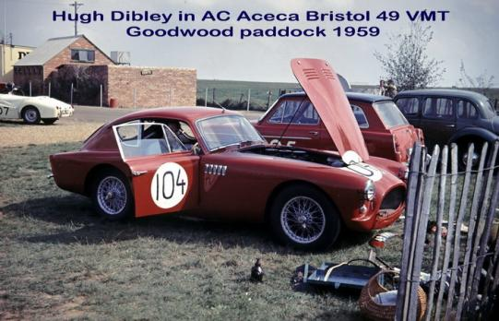
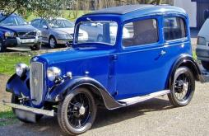
Hugh Dibley’s first cars – most routinely rebuilt!
Bought from scrap dealer for £25 when on RN/RAF Flying Training RAF Syerston near Newark
Riley 9
Singer Le Mans
Triumph TR 3
AC Aceca Bristol (Ex Ron Brightman)
Borrowed Sister’s Austin 7!

Slide 8
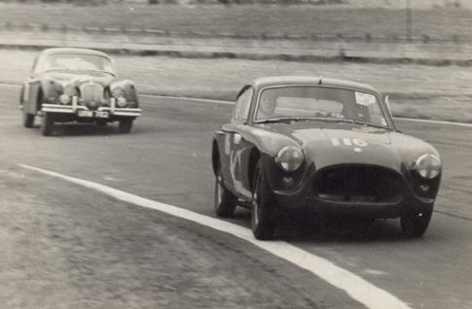
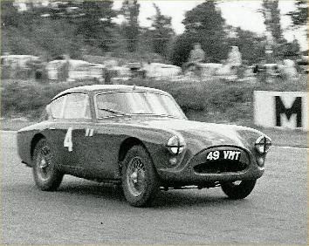
1959 - Started Racing with AC Aceca Bristol
AC Aceca Bristol Goodwood (Madgwick corner)
AC Aceca Bristol Snetteron
At BARC Goodwood Members’ Day – Clerk of the Course Dixon Cade, on behalf of the Duke of Richmond,
implored me to stop driving so fast before killed myself!

Slide 9
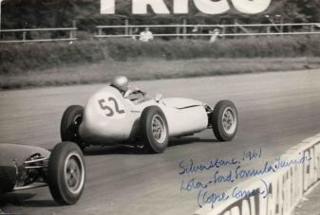
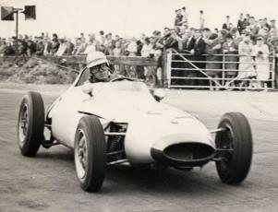
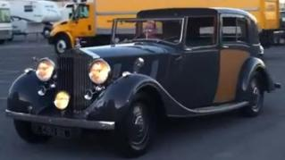
1960 continued with AC Aceca and eventually
First Race with Lola FJ Mk 2 –
at First Race Meeting at Brands Hatch Long Circuit
Lola Mk 2 FJ Silverstone Copse
Lola Mk 2 FJ Snetterton
Towed Lola FJ by AC Aceca until
dropped valve when also racing at Goodwood
Then towed by late father’s 1934 R-R 20/25
Done for speeding – limit 30 mph with trailer

Slide 10
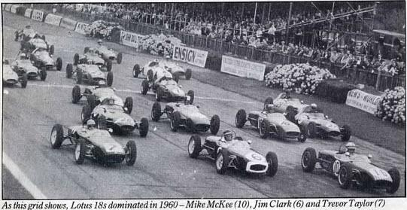
1960 continued with AC Aceca and Lola Mk 2 FJ
HD about to make up several places!
Formula Junior Race Goodwood August 1960 - winner Jim Clark!

Slide 11
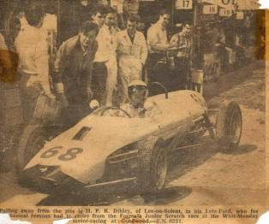
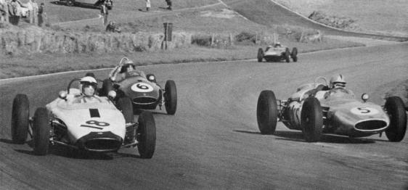
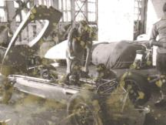
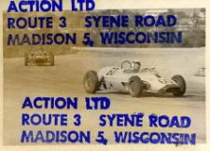
1961 - continued Lola Mk 2 FJ – the Lola Mk 3 FJ
Ran Lola Mk 3 as Formula 1 at Brands Hatch in October
Competed at Nassau Speed Week, Bahamas
Lola Mk 3 FJ Goodwood Whitson
First Lola in Formula 1 Race! – Lola fitted 1.3 Ford engine and added lead ballast to bring up weight. Led Mike Spence in Emerson F1 team car who agreed could not have overtaken if had not retired.
Nassau Speed Week, Bahamas. Was regularly flying to Nassau with BOAC on Boeing 707s.

Slide 12
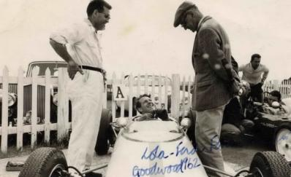
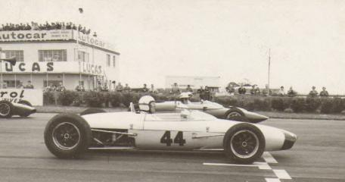
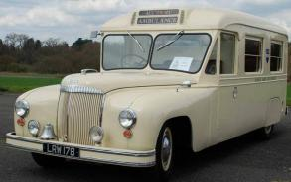
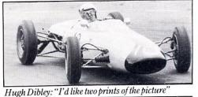
1962 - Lola Mk 5 FJ
Several Wins at Goodwood Club and National Races –
Most disappointing – At International Dunlop gave New Tyres 2 seconds Slower
Converted old Daimler Ambulance as to
take FJ to avoid 30 mph trailer speed limit
Lola Mk 5 FJ at Snetterton
Second at Nassau Speed Week Formula Junior Race

Slide 13
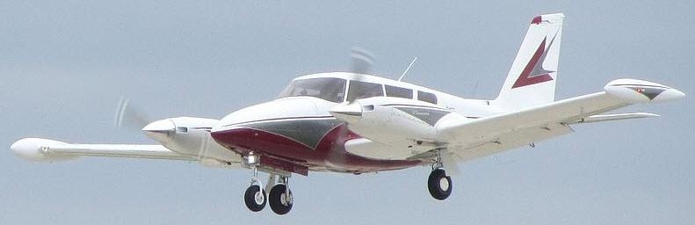
After Winning 1962 Indianapolis –
Jim Clark suggested we could Ferry His New Twin Comanche from Boston to Gatwick together.....
The BOAC 707 Flight Manager George Lace would not give me the time off – fortunately......
The ferry crew Jim employed took off from Boston and were never heard of again......

Slide 14
1963
Planned to order Lola Mk 6 Sports Car
but late and commandeered by Ford for GT40.
Cut 2 tendons in right forefinger –
10 days in hospital for tendon graft
10 weeks physiotherapy at Hedley Court.
In Hong Kong for 3 months posting with BOAC operation to Delhi, Tokyo and Honolulu.
Previous photographs left with a friend were lost.

Slide 15
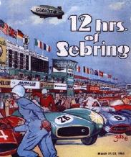
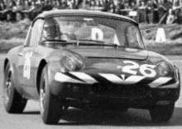
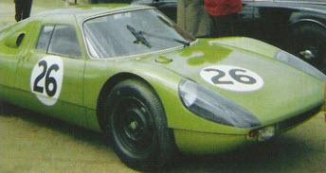
1964 – Drove for SMART
Stirling Moss Automobile Racing Team
Own Brabham BT8 2.5 litre Sports Racing Car –
Raced throughout UK season & at CanAm in Canada/USA
(Stirling initially assessed as undriveable at Silverstone!)
SMART Lotus Elan at Sebring 12 hour Sports Car Race
SMART Porsche 904 – Practised at Silverstone!
Raced at Mosport, Canada
Lotus Elan – lightened by SMART. Did not finish at Sebring due brake failure!
SMART Porsche 904 – after restoration in Germany!

Slide 16
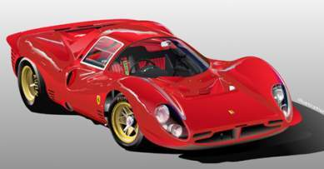



1963-4 Attention starts to be Paid to the Effects of Aerodynamics
Rear Spoilers Start to be Developed
1964 Le Mans Ford GT 40 developed from Lola GT
Ferrari Protype Sports Car
but not cars come equipped………
1963 Lola GT ran at Le Mans - eventually
1964 Bruce McLaren new Sports Racing Car

Slide 17

1964 Brabham BT8 Sports Car Delivered Without Rear Spoiler
Assessed as “undriveable” by S. Moss……….
Until self-designed primitive spoiler attached by owner’s team!
Then the car went very well ……….

Slide 18


With Simple Rear Spoiler BT8 Became Very Competitive – 2.5 ltre F1 times
Many Class Records and Outright Circuit Record at Aintree & Castle Combe
On 31 May 1964 Established New Sports Car Lap Record at Goodwood
Awarded Goodwood Ton – as First 100 mph Sports Car Lap.
Assisted to became Legend of Goodwood in 2008.

Slide 19

Won 1964 Guards Trophy Brands Hatch – Supporting Race to British F1 Grand Prix
Second Denny Hulme in 2 litre BT8, Roy Salvadori in Cooper Maserati
Jackie Stewart was driving a slow Tojiero-Jag with zero rear vision – and kindly took the trouble to apologize for not seeing me when I lapped him!

Slide 20

With Jackie Stewart and Jimmy Clark before the 1964 Guards Race at Brands
(Jimmy Clark and I knew the same girl friends!)

Slide 21

Personality Parade in Motoring News 1964

Slide 22


1964 Tourist Trophy at Goodwood
3rd Equal on Grid – without clutch and failing engine – expired in race
5 F1 World Champions

Slide 23


Won 1964 CanAm 2 litre Class at Mosport and Riverside, ahead of Jack Brabham , Frank Gardner, Trevor Taylor, etc.
But was on Goodyear tyres! – Jack Brabham switched to Goodyear for his 1965 Formula 1 season!
Was leading at Laguna Seca when worn fuel line caused a fire – drove to fire guard station & asked him to extinguish the fire.
(Unlike in David Piper’s Ferrari in practice for the BOAC 500!)

Slide 24

On 27th February 1965 Married Doris Lockhart in Scarsdale, New York
Very competent copywriter working for top advertising agencies
In due course objected to coming third behind racing and flying.
Separated quite equably in 1967 – Doris married Charles Saatchi in 1973.

Slide 25


1965 – Drove for SMART
In own Lola T70 Spyder Sports Racing Car
with 364cu inch/6 litre Tracor Chev Engine giving 487 bhp.
Maintained by SMART at America Street Garage SE1.
Third at Silverstone behind Bruce McLaren and John Surtees
In Lola green before repainted in SMART green.
Ran on Firestones rather than the previous universal Dunlops.

Slide 26
June 1965 – Players 200 Mosport Canada
Lying second and catching John Surtees on Dunlops at end of second heat, when lapping a Lotus 19 up the back straight this suddenly pulled out to overtake a Lotus 23 and pushed me of the road backwards into a tree.
Foolish error on my behalf as the Lotus 19 had not seen me coming before when I had lapped him many times before. Car had to be returned to Lola for repair.
1965 Guards Trophy at British GP Meeting at Silverstone
Fastest in practice and leading when Tracor Chev engine disintegrated. Lost £500 import duty!
Bought a Chev engine from garage in Montreal and brought as crew bags on a 707 flight but not the same as a Tracor!
Running Firestones requiring 2 sets of wheels etc also made life more difficult for a privateer!

Slide 27

August 1965 Guards Trophy Brand Hatch – Druids Bend

Slide 28

August 1965 Guards Trophy Brand Hatch – Bottom Bend

Slide 29

After 1965 Tourist Trophy at Oulton Park
“Commanded” Jack Brabham’s Queen Air from Gatwick to Rome
for Jack Brabham to drive at a F1 Race in Sicily

Slide 30

Drove in 1965 CanAm
St Jovite Montreal, Mosport Toronto, Riverside Los Angeles, Laguna Seca nr SFO, Kent Washington, Las Vegas.
(Assessed physiologically – found unusual as lacked raw aggression!)
Riverside Drivers’ Briefing – names for mother!

Slide 31



1966 Drove Tony Sargeants Lola T70 in major races while Tony drove in club events
Won 1966 Guards Trophy
at Brands supporting British GP

Slide 32

1966 At TT in Oulton Park Doubled for Steve McQueen
Driving repainted Lola T70 in Day of the Champion
Organised by Stirling Moss & Valerie Pirie
Camera Car driven by John Whitmore

Slide 33
1966 Drove Tony Sargeants Lola T70 in major races while Tony drove in club events
Won 1966 Guards Trophy
at Brands supporting British GP
Then took Tony Sargeant’s Lola 70 to the 1966 CanAm........

Slide 34

Chaparral 2E Chevrolet – First Car with Moveable Wing
Highlighted importance of aerodynamics
1966 Jim Hall, Developer and Driver, of Midland Texas
Wing Set for Braking / Cornering

Slide 35




A Personal Aerodynamic Experience at St Jovite
All Cars Became Light at Top of Hill on Straight-Away
Expected View At Top of Hill
View at Top of Hill seen by H Dibley
Car ended upside down on hill
above spectator barrier,
with engine on tree stump
Car Setup before “Flight”
About this time, Tony Southgate started working with London City University Aerodynamics Department
Front Spoiler Evidently Not Effective!
Car after “Donald Campbell” Flight

Slide 36

After Personal Aerodynamic Experience at St Jovite
Flew to Los Angeles/Riverside on Monday.
Bought 1955 Chev Pickup Truck & Trailer drove back with own 1965 Lola T70 – Tuesday to Sunday.
Continued CanAm at Mosport using Tony Sargeant’s engine
Over 3,000 miles.
Left Tuesday evening arrived Sunday morning.
2 night/day stops only. Done for speeding with trailer!

Slide 37

Car sold & later lovingly restored by aerospace engineer Phil Schmitt

Slide 38

1967 Drove Chevrolet Camaro at Daytona 500
with Craig Fisher – while canvassing for BOAC 500.
Then brought own Camaro to run in the UK.

Slide 39

Chaparral 2F Chevrolet GT Prototype – BOAC 500 Brands Hatch
1967 Mike Spence, with Phil Hill, Winners of BOAC 500
Wing Faired on Straight

Slide 40


1967 Drove David Piper’s Ferrari 275 LM in the 1st BOAC 500
Brands Hatch with Roy Pierpoint, won the Over 2 litre Class
Also drove the CanAm camera car borrowed from Bruce McLaren, for short film shown worldwide – video can be seen later.
Shortly after going out for first practice smelt petrol and then saw flames by right rear window / fuel cap. Stopped immediately at back of circuit rather than drive to marshal's post as at Laguna Seca. so fire marshal had to run to extinguish. Graham Hill stopped to assist.
Ferrari 275 LM with Mike de Udi’s Lola T70 behind

Slide 41

1967 Also Drove Lolas in Targa Florio & Kyalami 9 hrs
Kyalami 9 hours with Mike de Udy in his Lola T70GT
1967 Targa Florio
Jackie Epstein’s Lola T70GT

Slide 42

1968 Drove Howmet TX Gas Turbine Sports Racing Car
at BOAC 500 Brands Hatch, Oulton Park, Watkins Glenn Le Mans

Slide 43

1968 Drove Howmet TX Gas Turbine Sports Racing Car
at BOAC 500 Brands Hatch, Oulton Park, Watkins Glenn Le Mans

Slide 44

1968 Drove Howmet TX Gas Turbine Sports Racing Car
As John Cooper said - Came across on the on the transporter

Slide 45


1968 Drove Howmet TX Gas Turbine Sports Racing Car
at BOAC 500 Brands Hatch, Oulton Park, Watkins Glenn Le Mans
Qualified 2nd at Oulton Park behind Brian Redmond’s Lola T70. Lying 4th when stopped for fuel but engine would not restart.
Drove at Watkins Glenn with Bob Tullius – lying 4th when differential drive to rear wheels failed .

Slide 46

1968 Drove Howmet TX Gas Turbine Sports Racing Car
Drove at Le Mans with Bob Tullius
After 2 hours at Le Mans at end of Mulsanne straight brake pedal went to floor to right rear wheel bearing failure.
Prolonged pit stop to change upright – twice! - caused retirement at midnight.
In final session could see Dick Thompson’s race times – established fasted lap for Gas Turbine car at Le Mans!

Slide 47

1968 Drove Howmet TX Gas Turbine Sports Racing Car
at BOAC 500 Brands Hatch, Oulton Park, Watkins Glenn Le Mans

Slide 48
Formation of Palliser Racing Design 1967-72
Len Whimhurst, toolmaker,
after leaving Lola & Brabham…..
Built his own car at his home in Catford, Southeast London
Lola Cars, Bromley, Kent
Brabhams, Woking
Whimhurst asked Dibley to provide and engine and test drive
At first test session the car came close to the outside lap at Brands Hatch short circuit…….
…..on the latest Goodyear tyres - used by Jack Brabham’s Formula 2 team

Slide 49
Formation of Palliser Racing Design 1967-72
Factory set up at North Street, Clapham, Central London
Bob Winkelmann, San Francisco
in 1968 bought and paid for
3 US Formula B Cars
In 1969 Bob Winkelmann
ordered 20 Formula Fords
Marketing strategy was to export cars to one outlet in the US
UK market supplied when US demand disappeared
Nearly 100 cars produced. Championships won in UK, USA and South Africa. Wound up in 1972
H Dibley concentrated on aircraft fuel conservation and environmental noise reduction

Slide 50





1969 - Palliser WDB2 Formula Atlantic / B Car
Body Shape Developed at Specialised Mouldings
Models and full size mock up to produce body mould looked promising……….

Slide 51




Palliser WDB2 Formula Atlantic / B Car
Body Shape Developed at Specialised Mouldings
Cars looked nice and ran well……
but radiator cooling ineffective and engine overheated so surgery required……..

Slide 52




Revision to Cooling intake – Formula Ford

Slide 53




Final Palliser Shape for 1970 – example Formula 3

Slide 54

Palliser Won 3 Formula Ford Championships
In USA, UK and South Africa - won by Peter Hull

Slide 55


Equalling Circuit Record for Lydden Hill – 1970
In prototype Palliser Formula Atlantic

Slide 56

Equalling Circuit Record for Lydden Hill – 1970
Vern Schuppan won UK 1972 Formula Atlantic Championship in a Palliser
Vern later drove for the Gulf Team that won Le Mans

Slide 57

22 January 1971 Married Marianne Ahlborn
Initially quite happy with idea of motor racing –
As bilingual in French assisted with Palliser sales at Nice Racing Car Show

Slide 58



1970 Nice Racing Car Show
As bilingual in French assisted with Palliser sales at Nice Racing Car Show

Slide 59


But after became pregnant became unacceptably nervous for me to continue driving.
Swedish drivers Ronnie Pedersen & Jo Bonnier killed

Slide 60


Sadly now (2013) paralysed in bed after suffering from hydrocephalus and a stroke in July 2010,
but mentally alert to keep in order!
(Died quietly at home on 29th December 2014)

Slide 61

https://goo.gl/nTVpAK

Slide 62

https://goo.gl/nTVpAK

Slide 63


Some local Palliser Advertising

Slide 64

In February 1971 on BOAC Boeing 747 Nucleus/1st Course as Instructor. So had to wind up Palliser or give up BOAC.
(Seen here on the first BOAC B747 Flight Simulator.)

Slide 65

Palliser Racing Design Ltd Advertised in Autosport 1972
Reply to advert – to meet at BMW dealership in Holland Park Road, Kensington.....
Was Bernie Eccleston who thought was for Brabhams, which he later bought.
During a pleasant conversation Bernie remarked:
“I seem to be able to put deals together quite easily!”
PRDL wound up in spring 1972.

Slide 66


1974 - At recommendation of Jackie Stewart who was consulting for British Airways – Asked John Wyer if could be a Reserve Driver for the Gulf Mirage Team. Allowed to practice at Brands in the dry. Last time drove a racing car.

Slide 67

2008 Goodwood Revival – Legends of Goodwood
with Marc Devis, owner after beauful restoration.

Slide 68

2008 Goodwood Revival – Legends of Goodwood

Slide 69

2008 Goodwood Revival – Legends of Goodwood

Slide 70

2008 Goodwood Revival – Legends of Goodwood

Slide 71

2008 Goodwood Revival – Legends of Goodwood

Slide 72

2008 Goodwood Revival – Legends of Goodwood

Slide 73

2008 50 Years of Lola, Huntingdon Parade, 12th October 2008

Slide 74

2008 50 Years of Lola, Huntingdon Parade, 12th October 2008

Slide 75

2008 50 Years of Lola, Huntingdon Parade, 12th October 2008

Slide 76


Slide 77












Hugh Dibley’s Main Aviation Activities

Slide 78

6. Descent – Large opportunity for Fuel Savings – or Wastage
THERE IS NO TRADE BETWEEN FUEL & TIME DUE TO A POOR DESCENT
Summary of Penalties Cause by Poorly Executed Descents:
(Written in 1973 – some of us were worried about the environment then….)

Slide 79

6. Descent – Large opportunity for Fuel Savings – or Wastage
Circular slide rule primarily designed to help crews follow an efficient flight idle descent profile to comply with an ATC clearance such as to cross 23 DME XYZ at 8,000ft at 250kts.
Direct DME-Altitude checks are available throughout to verify on the profile. A fixed gradient of 400ft per mile above 10,000ft is suitable for IAS of 300-340kts according to aircraft weight, and 300ft per below 10,000ft for 250kts IAS after an 8 mile nm deceleration.
Checking the profile mentally, normally by 300ft per mile, requires regular computation of an equation, such as at 50 DME:
(50-8-23) x 300 = 5,700 + 8,000 = 13,700ft
In a survey BOAC B747 pilots estimated their efficiency was improved by at least 10 miles when using the computer, covering the cost of the 2 provided on each aircraft in 1 flight.
Besides minimising fuel burn and noise, following this profile improves safety by keeping the aircraft well clear of the ground into nearly all airfields.

Slide 80

7. Approach – Critical for Fuel Savings & Noise Reduction
This shows that city life need not be disturbed significantly if aircraft are flown level with minimum flap setting above 3,000ft, preferably at least 5,000ft, before descending on the glideslope to the runway with gear up until about 1,500ft to be established for landing by 1,000ft. (On Airbus aircraft the gear can be extended at 800ft, like the Space Shuttle, but this is not the approved procedure.)

Slide 81

7. Approach – Critical for Fuel Savings & Noise Reduction
One operator into London Heathrow required the flaps and gear extension to be confirmed in the Initial Approach Checklist which was completed when leaving the entry points to the London area, so the aircraft could fly with the gear extended for up to 60 miles.
With the extra drag of the gear and flaps the aircraft would descend steeply and then fly at low altitude across central London making conversation impossible when over flying.
Aircraft noise disturbance over central London was a significant factor in the 1971 decision that the third London airport should be built 100km East of London on the Essex/North Sea coast, but this project was terminated after the 1973-4 fuel crisis.

Slide 82

8. Crews Can Save Fuel/Time by Choosing Approach/Runway
Approach tracks into busy airports can be structured with a long lead in for bad weather, and some are flown automatically to follow agreed noise routes.
When traffic and weather permits, crews should be allowed to fly shorter visual approaches

Slide 83

10. Past Examples of Operational Fuel Savings
Example of 8% Immediate Fuel Saving by Crews
Flight data recording showed that an aircraft fleet was not operating efficiently.
A fuel economy newsletter listed the flight segments and what how much extra fuel was being burnt / could be saved by a better operation.
The total extra burn was possibly 26% but this was unlikely to be saved as not all items would occur on one leg.
After crews were made aware of the penalties and some changes in procedures an 8% saving was achieved immediately.
Departure/arrival procedures in italics are not optimised in current operations.
1979 prices
Potential Fuel Saving 26%

Slide 84

10. Past Examples of Operational Fuel Savings
Example of 8% Immediate Fuel Saving by Crews
Flight data recording showed that an aircraft fleet was not operating efficiently.
A fuel economy newsletter listed the flight segments and what how much extra fuel was being burnt / could be saved by a better operation.
The total extra burn was possibly 26% but this was unlikely to be saved as not all items would occur on one leg.
After crews were made aware of the penalties and some changes in procedures an 8% saving was achieved immediately.
Departure/arrival procedures in italics are not optimised in current operations.
1979 prices
Every little improvement helps
Rolls-Royce spends £800M per year on Research & Development to achieve 1% improvment in fuel efficiency
Potential Fuel Saving 26%

Slide 85

10. Past Examples of Operational Fuel Savings
A contract was secured because the crews’ more efficient operation saved 13% fuel compared to the previous operator which covered the crews’ cost.
A cargo operator became profitable by, amongst other savings, increasing payloads by reduced fuel reserves and improved fuel consumption.
The Fuel Monitoring Graphs show how individual crew performance can vary and affect the profitability of an airline.
The top graph shows the cost of carrying extra fuel based on the Sector Fuel Price Differential.
The centre graph shows the cost of extra fuel burnt in flight, perhaps by non optimum operation of the aircraft – descending early, configuring for approach too soon, etc.
The bottom graph shows the total of the two. The difference between the extremes is over U$400 per sector which for a year could total U$100Ks.
Such information must obviously be used sensitively and only be used for encouragement.
Crew Fuel Monitoring Graphs:
Top – Cost of Extra Fuel Uplifted
Centre – Cost of Extra Fuel Burnt
Bottom – Crew’s Total Extra Cost

Slide 86

The circular Descent Computer was on a fixed gradient,
which varies with aircraft weight, indicated airspeed & wind.
Descent Gradient set by Speed/Weight/Wind shown on Elastic -

Slide 87

The circular aid should have saved TWA Flight 514 accident in 1974 -
The B727 descended early into a hill 25 nm from Washington Dulles.
Controlled Flight Into Terrain remained the highest cause of accidents,
many avoidable by a clear cross check of Distance v Approach Altitude.

Slide 88

An expanded scale can show a
3º Constant Angle Approach glide path
Table on approach chart can give similar guidance

Slide 89

In 1976 Close Call to BAOD 747 flying NPA with 1.5º glidepath
Published Approach started at 2000ft at 12.5nm, 2000ft below 3º glide path

Slide 90
In 1976 Close Call to BAOD 747 flying NPA with 1.5º glidepath
The “Black Hole” approach, over a forest with no visual cues, started from the VOR DME at 2000ft,
12.5nm from runway 2000ft below a 3º glide path.
Aircraft brushed trees Going Around from MDA.
The approach procedure was revised to
follow 3º path with DME-Altitude checks tables,
being incorporated on all BA Aerad charts.
BA had no similar NPA incidents thereafter.

Slide 91


BA/Aerad Provided DME-Altitude Tables
Permitting Constant Angle NPAs starting in 1975
Constant Angle Approach with DME-Altitude table
Constant Angle Approach with DME-Altitudes & table

Slide 92

At the World Airline Training Symposium in Orlando in April 2013, I ended a lecture by saying -
Let us never have to say that this Controlled Flight Into Terrain accident need not have happened.
............but only 4 months later...

Slide 93


On 14 Aug 2013 UPS 5X-1354 Airbus A300-600F N155UP freighter crashed short of the runway on a LOC-DME approach to R/W 18 Birmingham AL.
The FAA LOC-DME chart does not include a DME-Altitude table, such as on the right showing that the straight line profile is not realistic.

Slide 94


BHM LOC-DME Chart - Correct Distances for Profile
9.5
3.5 NM

Slide 95
BHM LOC-DME Chart Correct Profile for Distances 1
9.5
X
3.5 NM
4.6 NM

Slide 96

BHM LOC-DME Chart Correct Profile for Distances 2

Slide 97
Essential Info for Monitoring LOC-DME Approach
It is impossible to know the cause(s) of the accident without further information from the NTSB...but
If the Monitoring Pilot had:
A realistic vertical profile shown on the chart,
A DME-Altitude table allowing accurate monitoring of the glideslope at times suitable to the crew -
The crew would then have
the best capability to monitor & maintain
the correct glideslope to the runway.

Slide 98


Essential Info for Monitoring LOC-DME Approach
If no chart table available – Use another system

Slide 99
Since the 1970s some operators have NOT provided clear Distance-Altitude checks and failed to train crews to fly Constant Angle Final Approaches with regular/accurate checks to confirm on the glideslope –
as Avionics/GPS/EPGWS will provide the solution.
Continuing NPA Accidents show this to be incorrect.
By whatever means,
we must make sure that
Non Precision Approaches
with DME/GPS Distance available
do not continue to occur.
End

