Slide 1

Significant Parts of my life
“40 Years Helping Crews to Navigate Vertically so
Reduce Fuel Consumption, Noise on the Ground
and Approach Accidents – with Mixed Success.”
Hugh DIBLEY FRAeS, FRIN, CMILT
formerly BOAC/BAW Airbus Toulouse
Chairman Royal Aeronautical Society Toulouse Branch

Slide 2
1959-72 Involved motor racing as well as flying.
1973 - Started work in BOAC for fuel conservation
1974 – Developed Circular Descent Calculator, patented 1976
1975 - Instrumental in starting quiet and fuel efficient
Constant Descent Approaches into LHR.
1975 - After TWA 727 CFIT accident into Washington the FAA
mandated GPWS - surprised did not require airlines to
fly Constant Angle Approaches when DME available.
2014 – Frustrated that CAAs not implemented in the US –
Accident to DHL A300-600F in August 2013.
FAA Human Factors expert – “Crews must not use
Vertical Speed mode as they don’t understand it.”
Accident Reports may not always find improvements in procedures and/or training that could have assisted the crew.

Slide 3
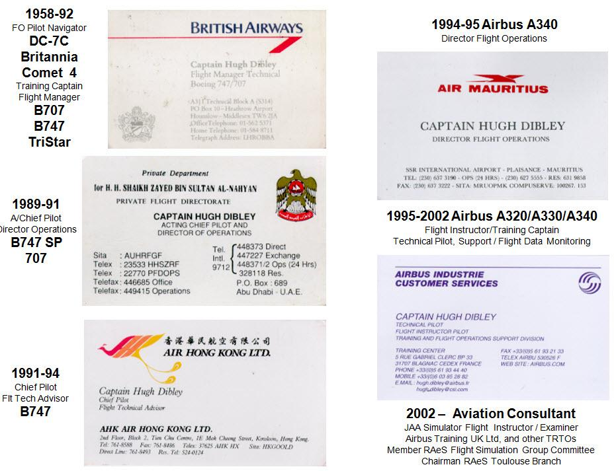

Slide 4
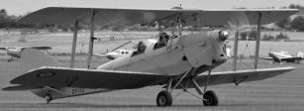
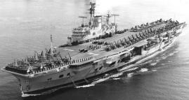

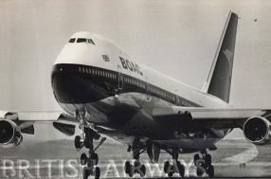
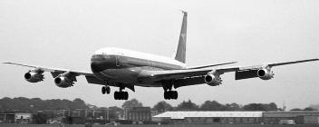
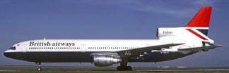

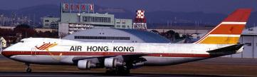
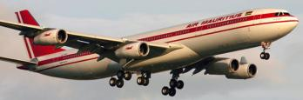
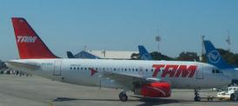

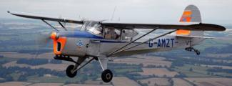
Hugh Dibley’s Main Aviation Activities

Slide 5
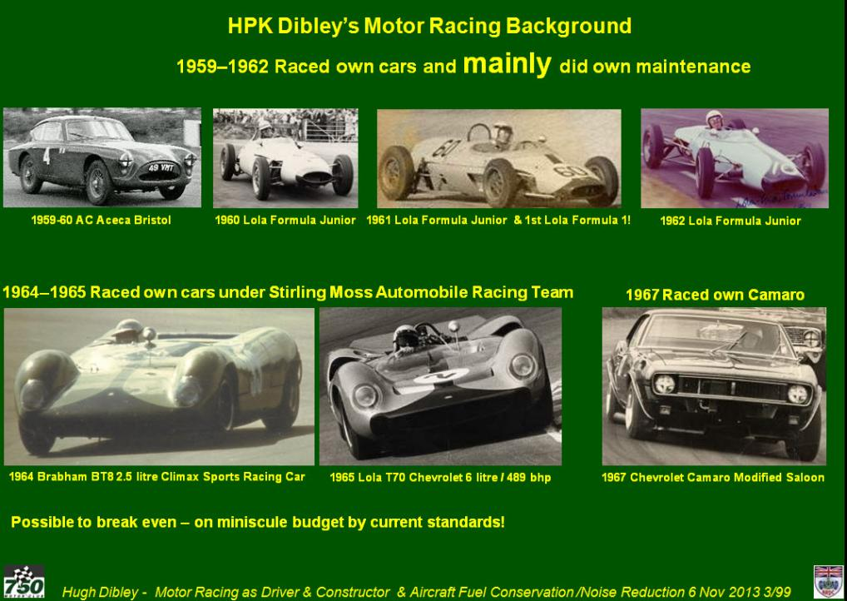

Slide 6
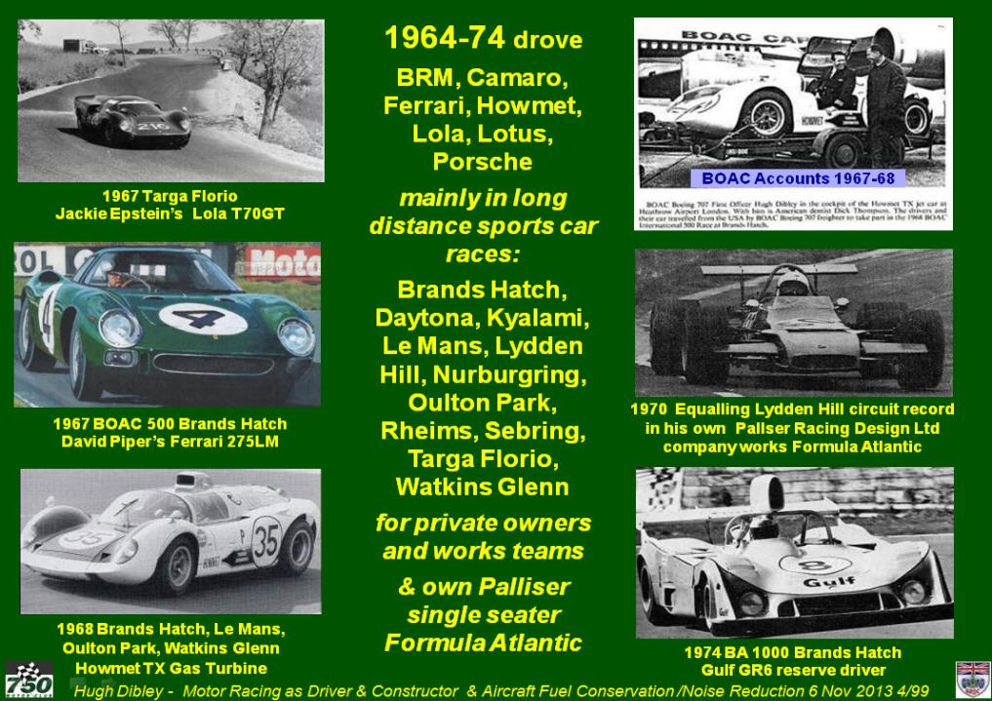

Slide 7
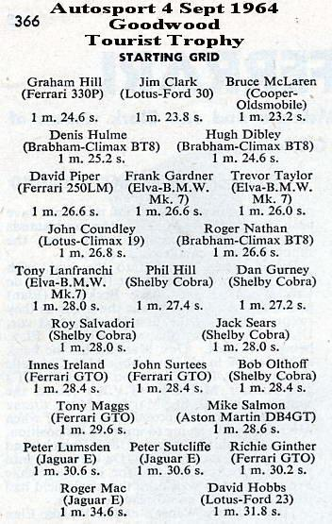
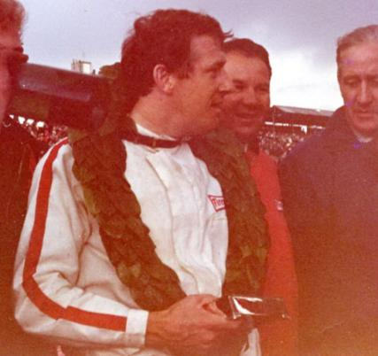
Drove against International competitors
And did win some races!
5 F1 World Champions

Slide 8
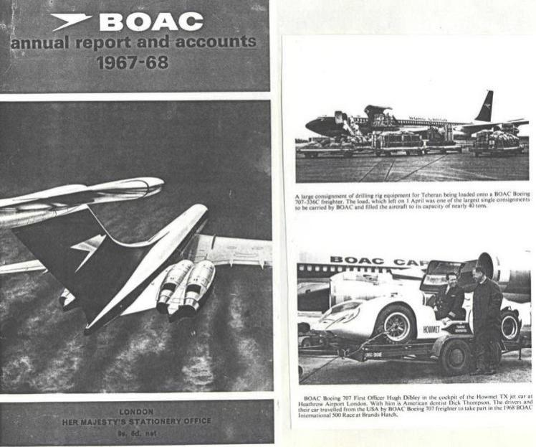
Motor Racing fitted well with BOAC. 1967-1974 entered in all BOAC International Sports Car Races at Brands Hatch

Slide 9
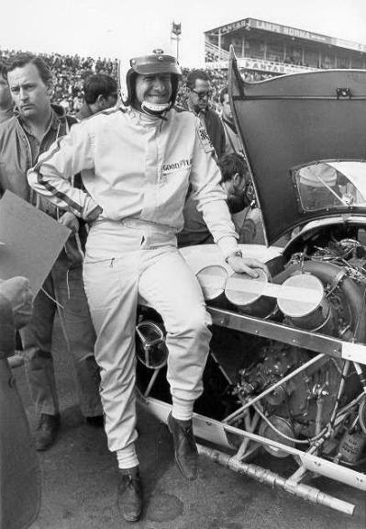
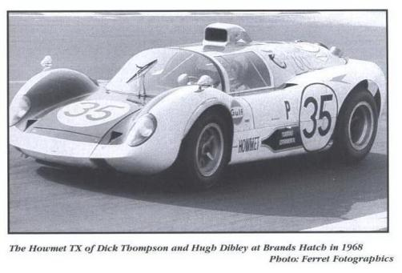
Motor Racing fitted well with BOAC. 1967-1974 entered in all BOAC International Sports Car Races at Brands Hatch
Including the Howmet TX Gas Turbine car at the BOAC 500 at Brands Hatch, then at Oulton Park, Watkins Glenn & in September 1968 Le Mans

Slide 10
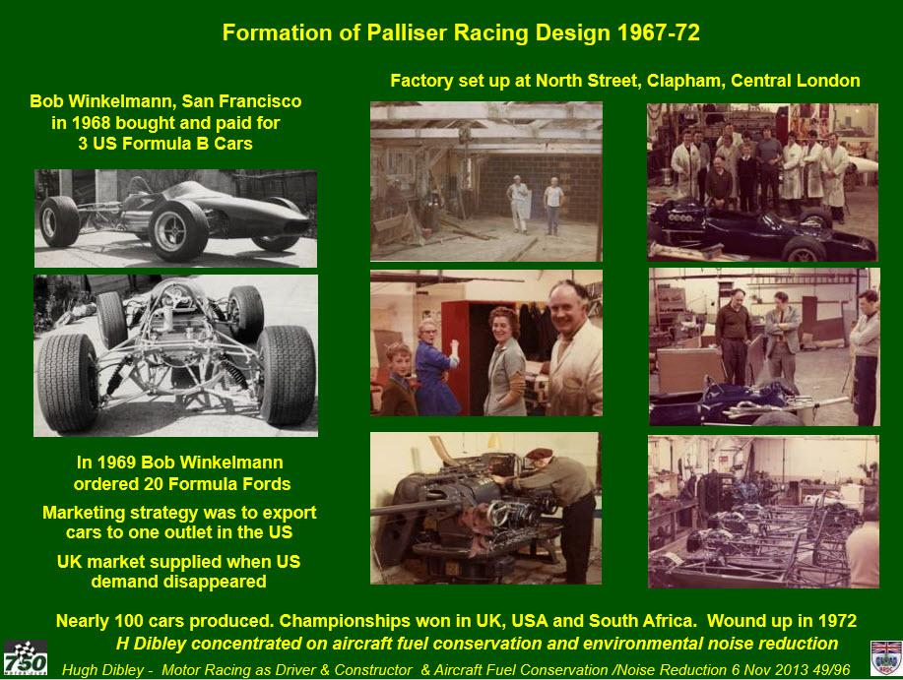

Slide 11
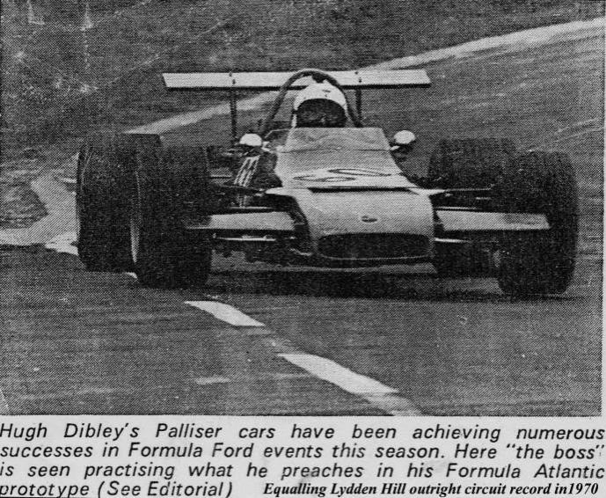
Equalling Lydden Hill outright circuit lap record in 1970

Slide 12
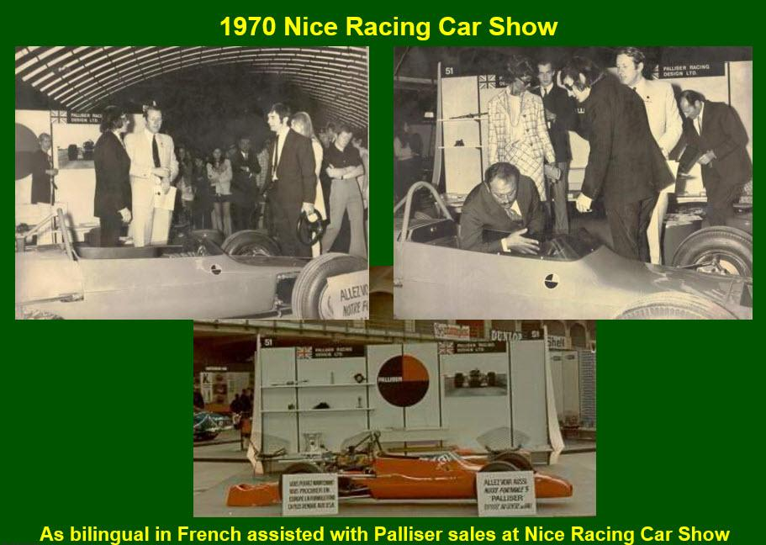

Slide 13
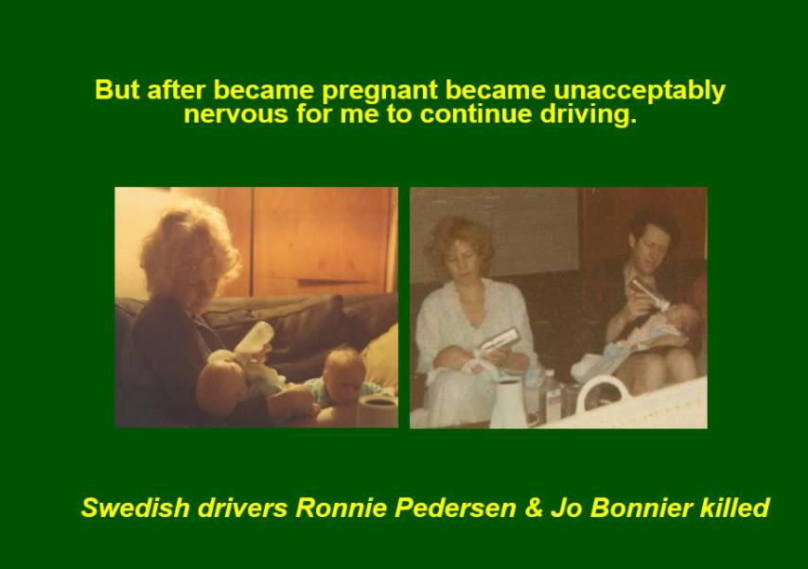
But the domestic situation changed –
Especially after our twins were born in 1971

Slide 14
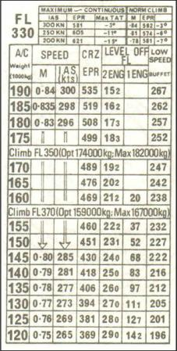
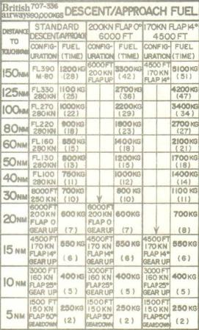
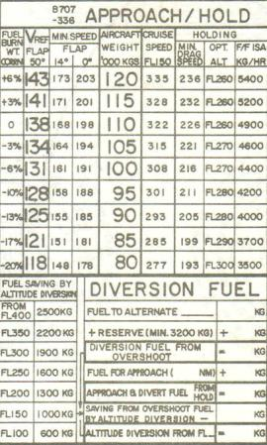
After the first “Fuel Crisis” in 1973
assisted in BOAC’s Fuel Conservation Campaign
(helped BOAC to remain profitable until 1977!)
Changed from Fixed to variable Long Range Cruise Speeds, etc
Pre-Flight Management Systems – produced manual Flight Data Cards:
TriStar
707
707

Slide 15
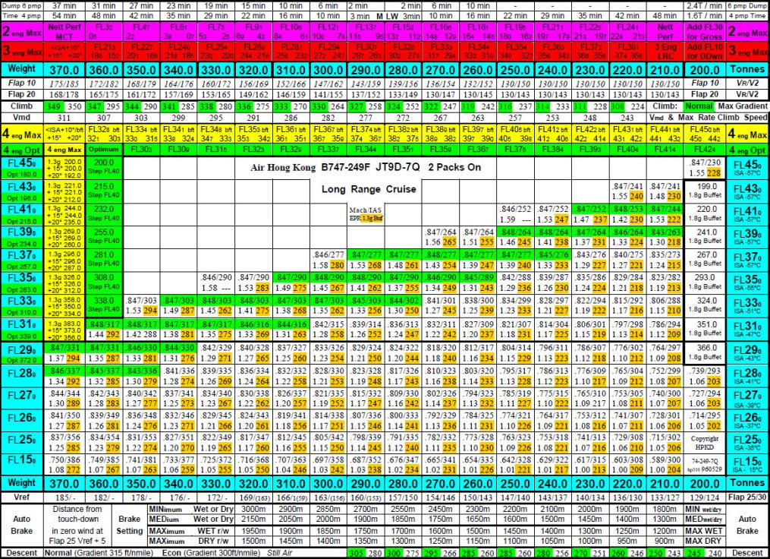
Word Processors & Colour printers allowed total performance on 1 sheet
Data taken from aircraft flight manuals displayed clearly to crews provided most of the savings claimed by
Flight Management Systems

Slide 16
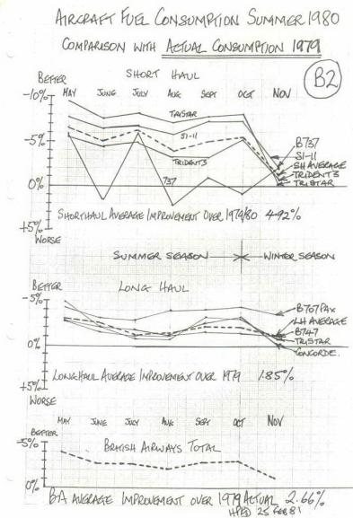
After re-merger with BEA to form BA –
in 1979 became Head of Operational Fuel Conservation –
these measures instantly saved 8% on similar types
Immediate fuel saving of 8% on short-haul TriStars
(Rolls-Rolls spends approximately 1B€ per year on research for a 1% improvement in fuel efficiency.)

Slide 17
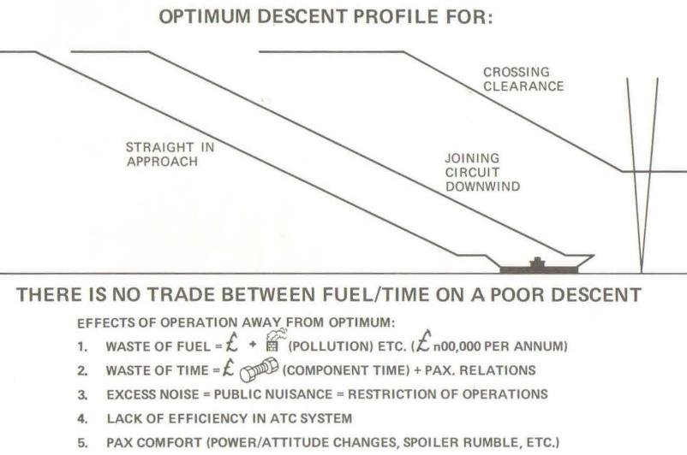
Despite Aircraft being most efficient at Altitude
Guidance for Fuel Efficient Descents was lacking
Relying on the Crews’ Mental Arithmetic -
(Article written in 1973)

Slide 18
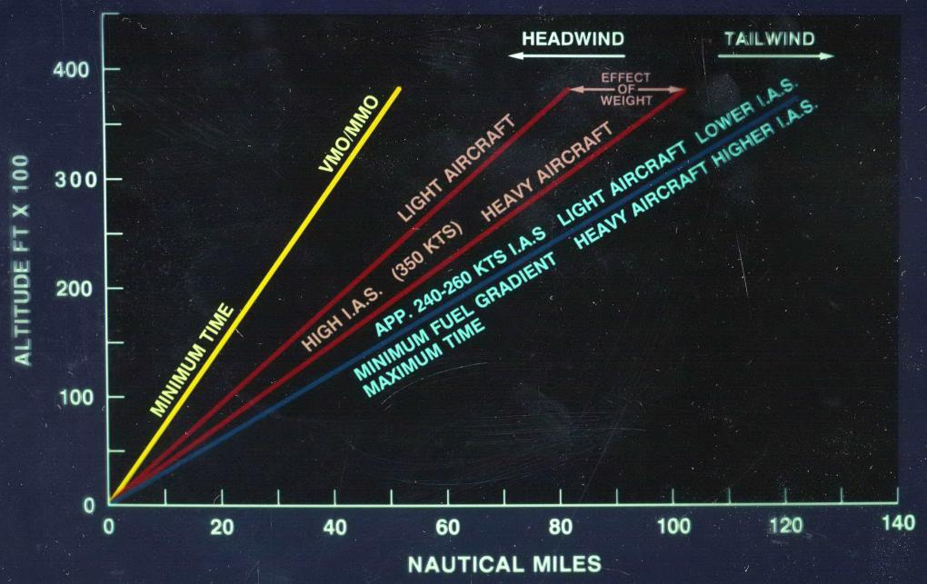
Crews’ Profiles Could be Grossly Inefficient -
Engines in reverse thrust
Early descent at Max Speed/Vmo
with high engine thrust (used in the US)

Slide 19
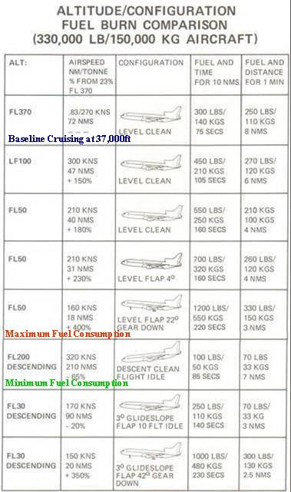
Education - Best Descents at Optimum Speed & Idle Thrust

Slide 20
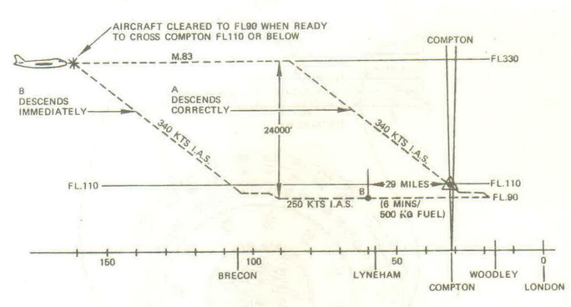
Crews’ Technique for Following the Correct Profile
Using Mental Arithmetic was Usually Inefficient –
Descending Early when cleared to be Sure of Compliance
Article written in 1974)

Slide 21
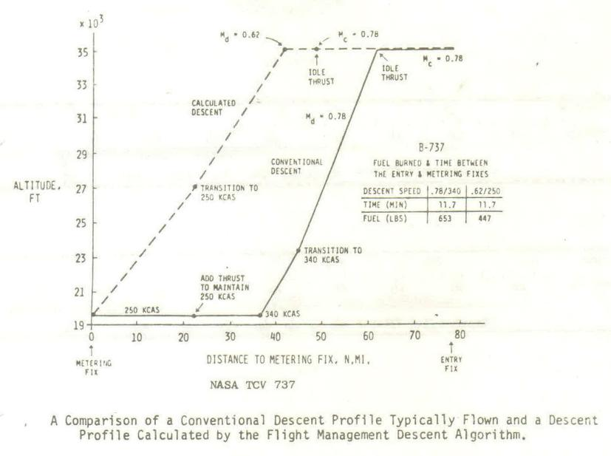
Confirmed by NASA when Introducing Profile Descents
NASA 737 Trial in 1979)

Slide 22

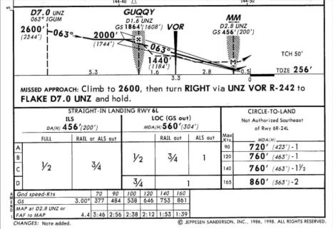
Most Aircrafts’ Optimum Descent Gradient is about 3°
From Altitude and During Final Instrument Approach
Due to Anglo-Saxon Units –
Distance in Nautical miles and Height in Feet
Height (feet) on approx 3° Profile = Distance (nm) x 300
ILS Approaches 2.5° to 4°
300ft/1 nm or 2.8°
3 Times Table used mentally for Rough Descent Guidance
“I can do that in my head”

Slide 23
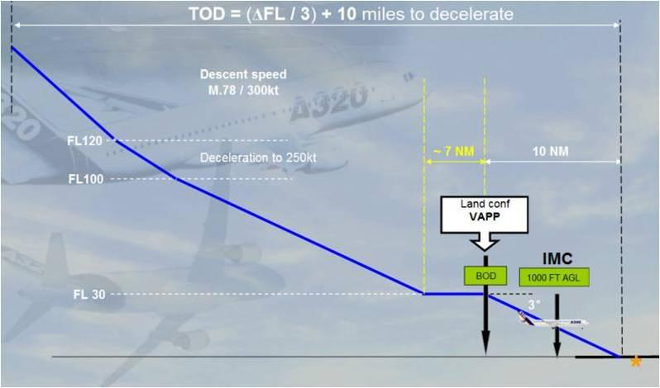
Airbus Training slide - Entry Level Training Pilots’ Course

Slide 24
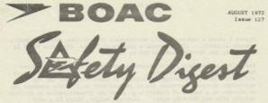
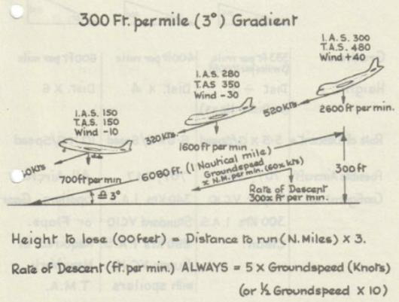
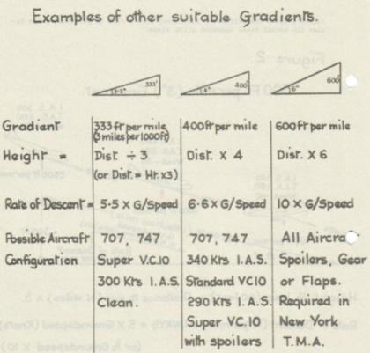
(Article written in 1973)
On 3°Slope: Height (Feet) = Distance nm x 300
Vertical Speed fpm = 5 x Groundspeed Knots
Should always know VS for aircraft configurations

Slide 25
Many crews still descended on Steps as before
distance information available - when could now navigate to 30ft using distance shown to 0.1nm
Radio Beacon
Mountain
This still applies to
Step Down, Dive & Drive
Non Precision Approaches,
the major cause of
CFIT accidents

Slide 26

Descents Flown Accurately with Mental Arithmetic
Distance to Start Descent at 340kts at 400ft per mile gradient =
(Height to Descend / 4) + Distance to Decelerate + Distance at Bottom of Descent
Example: From 35,000ft descend to cross 23 nm at 8,000ft at 250kts
(27000/400) + 9 + 23 = 68 + 32 = 100
Start descent at 100 nm, with Vertical Speed for actual Groundspeed
Make regular checks to confirm on the profile
Example at 75 nm: (75-9-23) x 400 + 8000 = 43 x 400 + 8,000 = 25,200ft
Example at 50 nm: (50-9-23) x 400 + 8000 = 18 x 400 + 8,000 = 15,200ft
I CAN DO THAT IN MY HEAD!
While still flying the aircraft, etc??
Nobel Prize winner Daniel Kahneman disagrees
Ask someone walking for 2 + 2
Instant reply 4
Ask for 17 x 24
To think will stop walking,
or flying the aircraft?

Slide 27
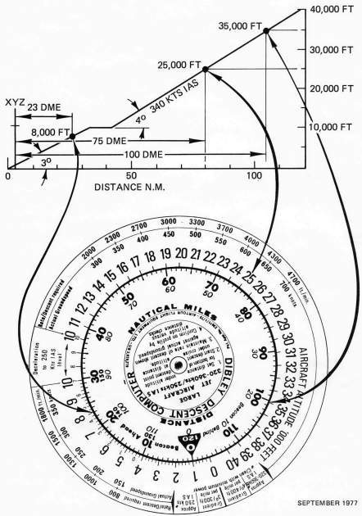
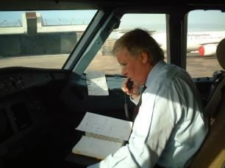
Crews could easily fly efficient descents with simple aids
Descent from 35,000ft to 8,000ft at 23nm Start at:
(27000/400) + 9 + 23 = 68 + 32 = 100 nm
If groundspeed 500kts - Vertical Speed 3300fpm,
Similar to flying Inertial Flight Path Angle
Crosschecks:
75 nm: (75-9-23) x 400 + 8000 = 43 x 400 + 8,000 = 25,200ft
50 nm: (50-9-23) x 400 + 8000 = 18 x 400 + 8,000 = 15,200ft
Pierre Baud agreed –
“This is very good. I know the formulae I should use – but I can never do them in my head….
Why haven’t you marketed this properly!”

Slide 28

Such devices now overtaken by FMGC Managed Descents
But Captain Tom Gasparalo, Training Committee Chairman,
Southwest Airlines – original Low Cost operator of 814 B737s
who attends our RAeS operations conferences -
Took my penultimate copy,
Doesn’t want to give it back,
Thinks I should make/market some more!

Slide 29
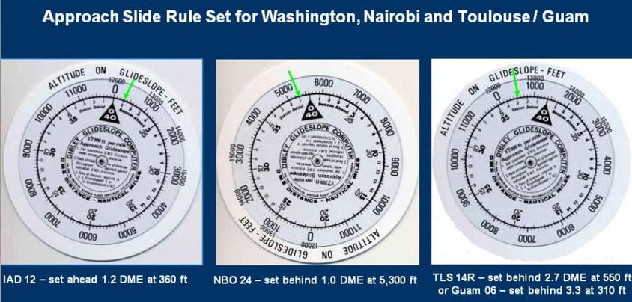
The Reverse Side Showed Expanded Scale
to Fly Non-Precision Constant Angle Final Approaches
with Direct Distance to Altitude Checks
To accuracy of about 30ft
Principle still valid today using Distance-Altitude Tables

Slide 30
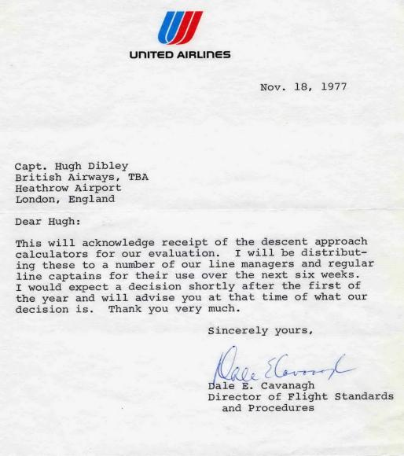
United Airlines Evaluated the Descent Approach Calculator
in 1977-78

Slide 31
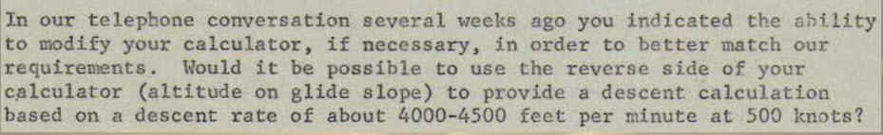
UAL Requested Removal of Expanded Final Approach Scale
Allowing Constant Angle rather than Dive & Drive NPAs
Replaced by Scale for 4000-4500fm Vertical Speed at 500kts
4000-4500 fpm at 500kts gives a descent gradient of over 500 ft per nm which could only be achieved at uneconomically high speeds and thus was not produced.
Made device with variable gradient for high & low speeds.

Slide 32
UAL Request for High Speed Scale (727s?) Not Implemented
Uneconomic gradient requested by United Airlines in place of expanded 3° scale to fly
safe Constant Angle
Non Precision Approaches

Slide 33
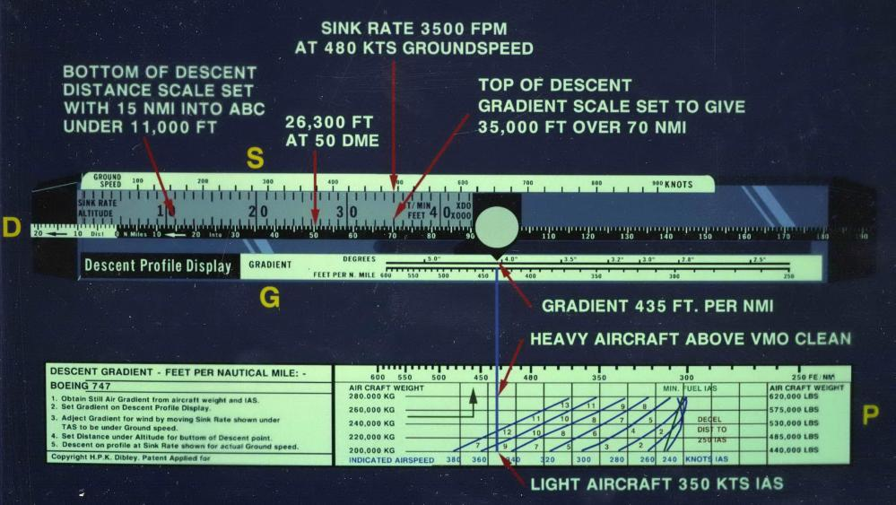
Variable Gradient on Elastic Scale – Labour intensive to produce
Descent gradient set for aircraft weight & Indicated Air Speed, adjusted for wind - Upper scale gave Vertical Speed for Groundspeed, Lower moveable Distance scale checks v Altitude. Extremely effective with light aircraft in strong head winds.

Slide 34
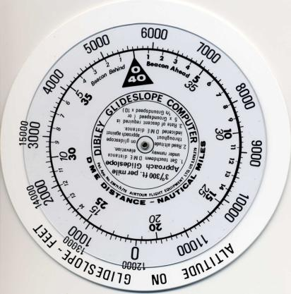
United Airlines saw No Value in the
Expanded 3 degree Scale
to fly accurate Constant Angle
Non Precision Approaches
Set for 5000ft – UAL’s Denver Base
UAL was flying Step-Down / Dive & Drive NPAs 30 years later
(Hong Kong radar warned a 747 which missed a step and was flying into a hill.)

Slide 35
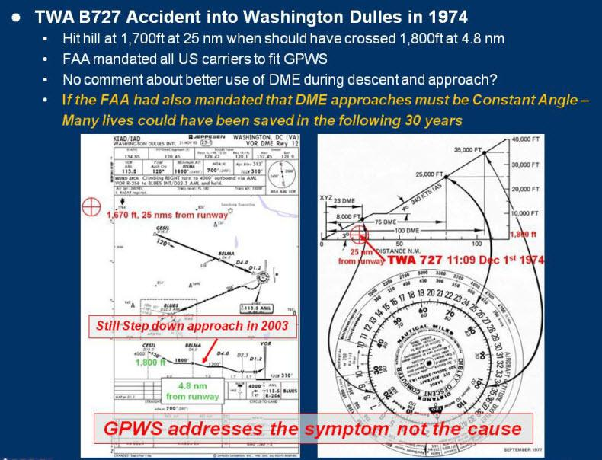
Use of such a device could have saved many CFITs
Make that 40 years

Slide 36
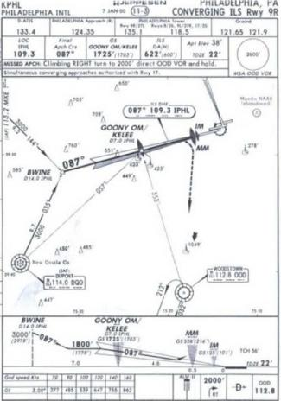

Similar Profiles followed with unfortunate effects
A320 at 3000ft 30nm from runway
Crew armed the ILS approach
3000ft
30 nm from runway

Slide 37

Similar Profiles followed with unfortunate effects
A320 at 3000ft 30nm from runway
Crew armed the ILS approach
Aircraft pitched up to capture false glideslope
(as any aircraft will do)
Speed fell to near low speed protection
Why was the aircraft at 3000ft & 30nm?
Should have been close to 10 000ft
Why did the crew Arm the Approach so far out?
What about the noise over the ground?
Indicates lack of Vertical Navigation knowledge and competence all round….
3000ft
30 nm from runway

Slide 38


Example of poor Vertical Navigation at High Altitude
14 Oct 2004 Pinnacle Bombardier CL-600-2B19
Ferry flight – only 2 pilots on board
Failed to monitor autopilot Vertical Speed Mode climbing to FL410,
Speed reduced to stall which was not recovered.
Should have been prevented by improved knowledge of aerodynamics and thus use of automatics –
(There is an official view that crews must not VS mode as the mode not understood. This indicates a failure in training.
VS has to be used routinely when climbing fast in busy airspace to avoid unnecessary ACAS/collision avoidance warnings, etc.)
Could have been recovered by better knowledge of aerodynamics and if had been given proper stall/stick pusher training..
Avoided by proper crew discipline.

Slide 39
Approaches Flying at Low Level
can cause Major Noise Nuisance
affecting aviation and the whole community
In 1960s-70s the inhabitants of central London were greatly disrupted by aircraft on approach to LHR –
At times normal speech could be impossible.
Because:
The route is over central London

Slide 40
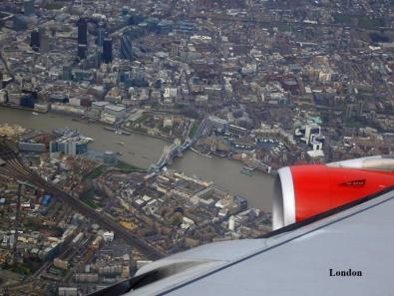
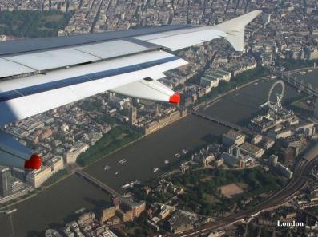
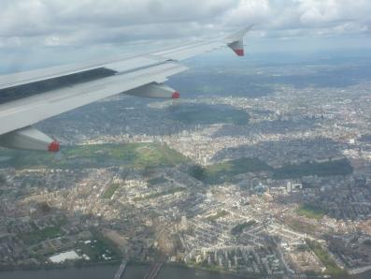
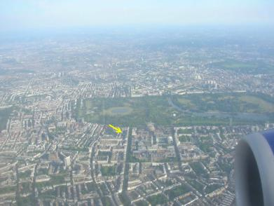
The main route is over central London
City – Tower Bridge
Houses of Parliament
Buckingham Palace / Hyde Park
South Kensington /
Lycée Charles de Gaulle

Slide 41
Approaches Flying at Low Level
can cause Major Noise Nuisance
affecting aviation and the whole community
In 1960s-70s the inhabitants of central London were greatly disrupted by aircraft on approach to LHR –
At times normal speech could be impossible.
Because:
The route is over central London
The largest operator flew in a high drag configuration

Slide 42
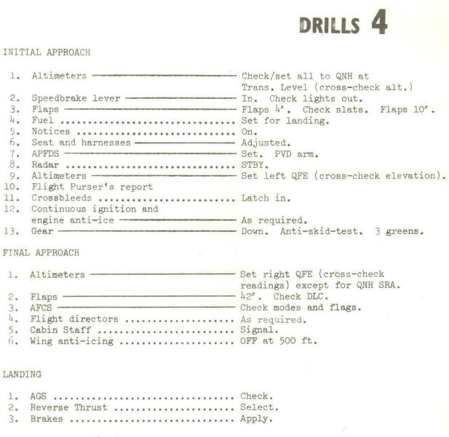
The largest operator flew in a high drag configuration
Initial Approach Drills were completed leaving the Holding fix at the
start of the approach
with
approach flap and gear/wheels extended
could fly like this for
60 nms / 20 minutes

Slide 43
Similar Approaches Flying at Low Level
can cause Major Noise Nuisance
affecting aviation and the whole community
In 1960s-70s the inhabitants of central London were greatly disrupted by aircraft on approach to LHR –
At times normal speech could be impossible.
Because:
The route is over central London
The largest operator flew in a high drag configuration
ATC would clear aircraft down to 2500ft at 170kts
Causing a stream of the noisiest turbojet aircraft to fly overhead a large population at high thrust and low level.

Slide 44

Causing a stream of the noisiest turbojet aircraft to fly overhead a large population at high thrust and low level.

Slide 45
Similar Approaches Flying at Low Level
can cause Major Noise Nuisance
affecting aviation and the whole community
In 1960s-70s the inhabitants of central London were greatly disrupted by aircraft on approach to LHR –
At times normal speech could be impossible.
Because:
The route is over central London
The largest operator flew in a high drag configuration
ATC would clear aircraft down to 2500ft at 170kts
Causing a stream of noisey turbojet aircraft to fly overhead a large population at high thrust at low level.
Pressure to move LHR to the coast Northeast of London
SOMETHING HAD TO BE DONE!

Slide 46



Article in the Journal of the
Guild of Air Pilots and Air Navigators
in March 1974
Suggested that crews be provided with some form of Vertical Guidance to permit them to fly Quiet, Fuel Efficient Descending Approaches.

Slide 47

The suggestions in the Article
were recommended to operators in May 1974 by the head of NATS
Air Marshal Sir Ivor Broom RAF
The main local airline replied that such procedures were not possible or worthwhile because:
High thrust and thus high drag was needed for aircraft air-conditioning and for option use of autothrust,
Long stable approaches needed for autoland,
The fuel savings by flying clean at a higher speeds would be minimal,
The extra noise generated was not considered as an operational factor.
No immediate action was taken

Slide 48


In September 1975 DLH proposed their Managed Drag Approach to NATS,
were almost exactly the same as the GAPAN article recommendations.
Using similar graphics, these were publicised in the national press.
NATS introduced Continuous Descent Approaches into LHR in late 1975.

Slide 49
Recommendations of Hugh Dibley’s March 1974 GAPAN Journal Article
Airlines should be encouraged if not actually required to adopt some form of vertical navigation aid as soon as possible.
ATC should give the point where lowest altitude is to be crossed. Whenever possible likely crossing clearances to be published with standard routings
(NB: The US plans to introduce vertical navigation in 1977-82. New York already has routes tentatively drawn up.)
3. Intermediate approach speed for radar vectoring to be 200 kts minimum.
Whenever possible pilots should be allowed to control their own navigation - including speed - for an approach.

Slide 50

Whenever possible pilots should be allowed to control
their own navigation - including speed - for an approach.
Like when traffic and weather permits, flying shorter visual approaches

Slide 51
Recommendations of Hugh Dibley’s March 1974 GAPAN Journal Article
Airlines should be encouraged if not actually required to adopt some form of vertical navigation aid as soon as possible.
ATC should give the point where lowest altitude is to be crossed. Whenever possible likely crossing clearances to be published with standard routings
(NB: The US plans to introduce vertical navigation in 1977-82. New York already has routes tentatively drawn up.)
3. Intermediate approach speed for radar vectoring to be 200 kts minimum.
Whenever possible pilots should be allowed to control their own navigation - including speed - for an approach.
Minimum height for intercepting the glideslope, especially over London. to be 3,000 ft preferably higher.
DMEs to radiate from all ILS. Pilots to be encouraged to keep aircraft clean for as long as possible, and not to lower gear before about 5 miles DME unless precluded by weather.
Continuous Descent Approaches (CDA) from stack level of FL 70 were introduced into LHR in 1975, initial approach speed 210 kts. ATC gave track miles to runway.
DMEs were installed on the ILS in 1978 - funded by the Department of the Environment for noise abatement.

Slide 52


UK CAA Paper for the Department of Trade in 1978
Showed average Reduction of 3 to 4 DB
with up to 15 DB Reduction at 15 nm from runway

Slide 53


Continuous Descent Approaches are often Re-Invented
and Introduced to many other airports worldwide
August 2003
2009

Slide 54


Now I just monitor progress from where we live in London
Emirates A380 with wheels down early
BA 747 flying level, not on a Continuous Descent

Slide 55

Reggie (Registration) Spotters Now Take Videos!
Can show crews’ performance in Continuous Descents

Slide 56

Considerable Variation – Room for improvement -
In Training – none at present, Technology / Guidance?

Slide 57

Reminder that Controlled Flight Into Terrain
is still a major accident cause
Although LOC-I (Loss of Control – Inflight) currently main accident cause

Slide 58

Main cause of accidents
Similar fatalities as CFIT -
Airbus has developed landing
over-run prevention system
Main causes of fatalities
Same number of accidents

Slide 59

The Majority of CFIT Accidents have involved
Non Precision Approaches

Slide 60

Reasons for CFIT Now Well Understood?
NO! Some airlines are still flying
Step-Down / Dive & Drive Non Precision Approaches
(Discouraged if not banned for UK operators)
Saudia Crew on A320 Transition Course June 2011
After flying 2 Airbus standard CDAs “This is very easy!”

Slide 61

Therefore asked to give presentation at WATS 2013
Modified after UPS A300-600F CFIT accident 4 months later

Slide 62
Reason for Frequent CFIT Accidents up to 1970s -
Where No Ground Radar, Descents Made in Steps,
Continuing Descent Passing Radio Beacons
Radio Beacon
Mountain
The same principle
had to apply for
Non Precision Approaches

Slide 63

Before DME / reliable distance information
NPAs Had to be Step Down or “Dive and Drive
“Dive” to next Minimum Altitude
Fix
such as
NDB
Beacon
Fix
such as
Flashing Light

Slide 64

Lateral Navigation was not the Main Problem
Accidents sites were mainly in line with runway

Slide 65

The Difficulty was in Vertical Navigation - Flying below the 3º glide path to crash short of the runway

Slide 66
Hazards of a “Dive & Drive” NPA Profile
Unstable profile
Approach Unstable – needing pitch, thrust & flap changes
Unstable profile leading to unstable approaches

Slide 67
Hazards of a “Dive & Drive” NPA Profile
Missed step or late stabilisation causes accidents
Crew missed a step, stabilised late, or failed to monitor DME-Altitude glideslope
01 Dec 1974 TWA 727 VOR DME approach into Washington Dulles
08 Feb 1989 Flying Tigers 747 VOR DME approach accident into Kuala Lumpur
12 Nov 1995 American MD82 VOR DME approach into Windsor Locks Conn, USA
06 Aug 1997 Korean 747 LOC No Glidepath DME approach accident into Guam
24 Nov 2001 Crossair RJ 100 VOR DME approach accident into Zurich R/W 28 14 Aug 2013 UPS A300-600F LOC-DME into Birmingham Alabama?
Above a small sample – many other accidents/near misses, eg at old HKG Kai Tak IGS Glidepath out approach, a 747 missed a step and descended early towards a hill, but error advised by Hong Kong Approach Radar.

Slide 68
Hazards of a “Dive & Drive” NPA Profile
Chance of hard landing or runway over-run
Approach Unstable – needing pitch, thrust & flap changes
Flying level pitched up at MDA obtaining visual reference causes late “dive” at the runway with hard or deep landing and runway over-run.
Runway safety related accidents are ICAO’s highest accident cause
Late final configuration means checklists being read at low altitude

Slide 69

Start of 747 in 1971 BOAC’s Policy was Constant Angle NPA*
In 1976 Close Call to BAOD 747 flying NPA with 1.5º glidepath
Chart instruction – Descend to Minima.
“Black Hole” approach
with no visual reference,
aircraft brushed palm
trees on a small hill during Go Around.
Published Approach started at 2000ft at 12.5nm, 2000ft below 3º glide path
*Using vertical speed & time to runway, but not always practicable.

Slide 70


A colleague kindly requested to the 747 Flight Management
that Dibley Descent Computers be issued to 747 Crews
(1 computer had been on each BOAC aircraft for descent guidance.)

Slide 71

This request was based on the publicity showing the event.
(Was not actioned due to the BOAC-BEA operational re-merger)
Shows descent from 35000ft to 3800ft
over VOR DME approach beacon,
& approach on expanded 3° scale to runway
Published Approach started at 2000ft at 12.5nm, 2000ft below 3º glide path

Slide 72


The Approach was Re-Drawn Starting at 4000ft
BA/Aerad Provided DME-Altitude Tables in 1975
which gave similar information as the slide-rule.
No more Step-Down / Drive & Drive Approaches ANYWHERE
BA did not have another Non Precision Approach incident
Constant Angle Approach with DME-Altitude table
Constant Angle Approach with DME-Altitudes & table

Slide 73


By the 1980s Most European Authorities provided DME-Altitude Information for Constant Angle NPAs,
DME-Altitude checks
Jeppesen will only print tables if published by the state

Slide 74

ILS/LOC DME Approach
NDB DME Approach

Slide 75


In 1989 Flying Tigers B747 Crashed with the FO
flying a VOR-DME Approach in to Kuala Lumpur
Hit hill at 427ft - Final Approach Fix Altitude 2400ft
GPWS “Pull Up, Pull Up” ignored for 25 seconds
(13 years after BAOD’s close call into same airfield)

Slide 76

12 November 1995 American Airlines 1572 MD 82
Hit trees on VOR DME Approach into Bradley Connecticut
``

Slide 77

12 November 1995 American Airlines 1572 MD 82
Hit trees on VOR DME Approach into Bradley Connecticut
``
Step Down Profile
No DME Altitude table

Slide 78

NTSB Analysis AA 1572 MD82 12 Nov 95

Slide 79

NTSB Analysis AA 1572 MD82 12 Nov 95
Example given of British Airways chart showing terrain information –
But why no emphasis given to the Constant Angle Approach checked by DME-Altitude table which keeps the aircraft above terrain?
Constant Angle Approach
DME –Altitude Tables to fly
Constant Angle Approach
of primary assistance

Slide 80


NTSB Conclusions AA 1572 MD82 12 Nov 95
No additional avionics required.
Just DME-Altitude Cross checks on 3º profile
by tables or slide rule –
as used on hand flown CANPAs since 1970s
on aircraft such as B707s with no FD or autopilot.

Slide 81

NTSB Recommendations - 13 Nov 1996
Required descent angle can be followed by flying sink rate for indicated groundspeed – allowing for airspeed wind component changes –
adjusted if checks show deviation from profile.

Slide 82

KAL B747-300 CFIT Accident into Guam 6 Aug 1997

Slide 83

KAL B747-300 CFIT Accident into Guam 6 Aug 1997

Slide 84

KAL B747-300 CFIT Accident into Guam 6 Aug 1997

Slide 85
KAL B747-300 CFIT Accident into Guam 6 Aug 1997
Constant angle from 2600ft

Slide 86

KAL B747-300 CFIT Accident into Guam 6 Aug 1997

Slide 87
KAL B747-300 CFIT Accident into Guam 6 Aug 1997
Compared to step down from 7.0 DME UNZ at 2600ft
to fly level at 2000ft until 1.6 DME before UNZ,
step down to fly level at 1440ft until the VOR/0 DME,
step to fly level at MDA 560ft to 2.8 DME after UNZ

Slide 88
KAL B747-300 CFIT Accident into Guam 6 Aug 1997
If the LOC GS out approach profile has been a Constant Angle like the normal ILS glideslope,
with a clear DME-Altitude table for the crew to check the aircraft to be on the correct profile,
and the crew trained to use this procedure, being stabilised in the landing configuration before starting the final descent.....
would the accident have still occurred?

Slide 89

NTSB Report of KAL 747 Accident Guam 8 Aug 1997

Slide 90
NTSB Report of KAL 747 Accident Guam 8 Aug 1997
NTSB report in FSF May-Jul 2000 FS Digest made 12 recommendations – Aircraft with suitable systems required to provide vertical flightpath guidance for constant angle nonprecision approaches, and all air carriers’ aircraft to be so equipped in 10 years.
– “Tabular information to allow Constant Angle of Descent by cross referencing distance from the airport and barometric altitude.”
But distance from airport is only available from FMS/GPS equipped aircraft so the distance reference must be the local DME when FMS/GPS is not available.

Slide 91

Ability to fly DME-Altitude CANPAs not stressed

Slide 92
Ability to fly DME-Altitude CANPAs not stressed
FSF 278 page Nov-Dec 1998 CFIT Task Force Report
only reference?
Aircraft Equipment Working Group Page 93
“Operators should furnish crews with charts depicting
constant-angle profiles and recommended altitudes along the glide path for nonprecision approaches;”

Slide 93

CFIT NPA Accidents Continued –
In 2002 Don Bateman, father of GPWS/EGPWS,
published 9 NPA CFIT accidents which could have been saved if EGPWS had been fitted
Described on following slides
But 5 had DME available but no DME-Altitude tables on the charts which could have avoided an accident.

Slide 94

Crossair RJ 100 CFIT Accident Zurich 24 Nov 2001

Slide 95

Crossair RJ 100 CFIT Accident Zurich 24 Nov 2001

Slide 96
Crossair RJ 100 CFIT Accident Zurich 24 Nov 2001
The FO had no way of monitoring the descent path.
The Pilot Monitoring must have
something clear to monitor with.
Pilot Cross-Checking might be a better job requirement?

Slide 97

Crossair RJ 100 CFIT Accident Zurich 24 Nov 2001

Slide 98
Crossair RJ 100 CFIT Accident Zurich 24 Nov 2001
The FO could have easily checked the aircraft was low from the tables and advised the captain.

Slide 99

In a recent accident crew responded to EGPWS but then lost control during the Go Around
On 12 May 2010 Afriqiyah A330 Crashed during Go Around after an incorrectly flown NDB Approach

Slide 100

On 12 May 2010 Afriqiyah A330 Crashed during Go Around after an incorrectly flown NDB Approach

Slide 101
On 12 May 2010 Afriqiyah A330 Crashed during Go Around after an incorrectly flown NDB Approach
The FO selected the correct Flight Path Angle
for the final approach but about 1.8 nm early.
Perhaps because confused with the DME distance to descend on a separate VOR DME approach.

Slide 102

NDB Approach Chart Used by crew

Slide 103
NDB Approach Chart Used by crew
Final Report
of AFRIQIYAH Airways Aircraft
Airbus A330-202, 5A-ONG Crash
Occurred at Tripoli (LIBYA) on 12/05/2010
1.17.2.1.5 Documentation on board
“The Jeppesen chart did not provide any glide path after the FAF and did not include the table
in the official map identifying crossing altitudes in relation the distance to the runway threshold
09 and rates of descent in relation the speed of the aircraft.”

Slide 104


Need for Distance-Altitude Tables in Future Aircraft

Slide 105

Need for Distance-Altitude Tables in Future Aircraft
Airbus A350 Flight Deck

Slide 106

Need for Distance-Altitude Tables in Future Aircraft
Latest Airbus aircraft can fly FLS – ILS Look-alike
Fms generated Landing System
(other manufacturers have similar systems)

Slide 107

Need for Distance-Altitude Tables in Future Aircraft
Latest Airbus aircraft can fly FLS – ILS Look-alike
Fms generated Landing System
(other manufacturers have similar systems)

Slide 108

Need for Distance-Altitude Tables in Future Aircraft
Latest Airbus aircraft can fly FLS – ILS Look-alike
(Fms generated Landing System)
Altitude Minima based
on Barometric Altitude

Slide 109
Need for Distance-Altitude Tables in Future Aircraft
Latest Airbus aircraft can fly FLS – ILS Look-alike
(Fms generated Landing System)
Based on GPS and independent of any ground aid.
If “GPS Primary” no accuracy checks required. But
As Minima based on Barometric Altitude a
Distance-Altitude check required on the glideslope to confirm the correct QNH/altimeter setting has been set....remember
Events show incorrect QNH values are still passed by ATC
therefore Distance to Runway-Altitude info required.
If systems are downgraded due to aircraft or GPS failures navigation may revert to raw data, therefore
DME-Altitude distance info may occasionally be required.
Chart tables will be required for the foreseeable future!

Slide 110

Need for Distance-Altitude Tables in Future Aircraft
All aircraft should progressively be equipped with SBAS (Space Based Augmented System) to fly CAT1 precision approaches and eliminate Non Precision Approaches, but
altitudes will still be based on Barometric Altitude.
This will take time so current NPAs will continue...

Slide 111
Back to Benefits of a Constant Angle NPA Profile
Stable Approach – established as many orders safer
Stable approach, landing configuration, no pitch/thrust changes
NPA Minima may be reduced
DME-Altitude Tables can provide regular checks to confirm aircraft on the correct profile to 30ft accuracy.
Rather than checks at single points which might be interrupted by ATC request, crew action etc.

Slide 112


Slide 113
FAA AC 120-108 January 20th 2011
Introduced the CDFA
Continuous Descent Final Approach,
flown using sink rate calculated from the published glideslope angle and current groundspeed, or by Flight Path Angle.
Examples starting from FAF 1900ft & 1500ft aal.
But when possible should be CAFA
Constant Angle Final Approach
using Distance-Altitude Tables
(DME or FMS distance to runway)
to monitor final glideslope like an ILS.
Charts must incorporate Distance-Altitude tables.
To allow early stabilisation profiles should include CAFA from at least 2500ft with option to intercept the glideslope from a lower altitude if required.

Slide 114

DME-Altitude Constant Angle NPAs remain a good backup

Slide 115

DME-Altitude Constant Angle NPAs remain a good backup
DME-Altitude Table for
LOC-DME R/W 18
Birmingham Alabama

Slide 116
Let us never have to say –
that accident need not have happened.
............but

Slide 117

Let us never have to say –
that accident need not have happened.
............but only 4 months later...

Slide 118

On 14 Aug 2013 UPS 5X-1354 Airbus A300-600F N155UP freighter crashed short of the runway on a LOC-DME approach to R/W 18 Birmingham AL.
The FAA approach chart shows a straight line approach profile from 3500ft which is not coherent with the DME distances shown

Slide 119

FAA LOC-DME Chart without table & Possible Table
14.1-5070
9.5-3500
The chart profile is a linear path from 3500ft at 14.1D.
The table shows on a 3.2º GS 5070’ at 14.1D & 3500’ at 9.5D.
The profile is not realistic.

Slide 120

BHM LOC-DME Chart - Correct Distances for Profile
9.5
3.5 NM

Slide 121
BHM LOC-DME Chart Correct Profile for Distances 1
9.5
X
3.5 NM
4.6 NM

Slide 122

BHM LOC-DME Chart Correct Profile for Distances 2

Slide 123



Essential Info for Monitoring LOC-DME Approach
If no chart table available – Use another system

Slide 124

The NTSB Report published the Jeppesen LOC Rwy 18 approach chart used by the UPS Crew, rather than the FAA chart in previous slides.
The Jeppesen chart tailored for UPS was an improvement on the FAA chart using the Step Down profile 2
in the modified FAA chart shown in the previous slide,
however without the table recommended by many agencies – but not published by the state.

Slide 125
A recommended table would have allowed the First Officer easily to monitor the aircraft’s position relative to the profile and advise the captain –
helping to resolve the captain’s apparent confusion that the aircraft was higher than it actually was.

Slide 126
A constant angle descent from 3500ft would give the crew more time to be stabilised on the profile besides reducing noise over the ground.
D 9.5

Slide 127

UPS Flight 1354’s Actual Descent & Altitudes
A constant angle descent from 3500ft would give the crew more time to be stabilised on the profile besides reducing noise over the ground.
Crew would not need to select high sink rates at low level.

Slide 128

Training for Airbus Standard Constant Angle Non Precision Approach
Step-Down / Dive and Drive is not taught

Slide 129

Reversion from Automatic to Manually controlled approach
is simple as both following the same Constant Angle profile
Profile monitored using
Distance-Altitude tables

Slide 130

Airbus/airlines consider that Ground Based DME Distance
gives some Vertical Flight Path Guidance/Fixes from Tables
but still not accepted in the US.
NTSB report on UPS A300-600F Accident 14 Aug 13 – Page xiii
DME distance can give regular “Altitude Fixes” to accuracy of 30ft.
Using tables makes constant Angle approaches less challenging that Dive & Drive.
Reaction of Saudia Crew – “This is very easy!”
Long letter to FSF AeroSafety World June 2014 arguing for Dive & Drive
Enforce states to publish tables on all charts – as recommended by authorities

Slide 131
Airbus/airlines consider that Ground Based DME Distance
gives Vertical Flight Path Guidance/Fixes from Tables
but still not accepted in the US.
Comment by FAA official reference AC 120-08 Continuous Descent Approach
“I don’t need Distance-Altitude Tables – I can do that in my head!”
Remember Daniel Kahneman
Nobel Prize winner Daniel Kahneman disagrees
Ask someone walking for 2 + 2
Instant reply 4
Ask for 17 x 24
To think will stop walking,
or flying the aircraft?
and Pierre Baud!

Slide 132

Final Comment re UPS A300-600F Accident at BHM
The crew made mistakes - not cleaning up the flight plan waypoints so the FMS could not capture the vertical profile for final approach nor indicate the Vertical Deviation on the flight instruments.
They were fatigued and at times it appears confused
However a Total Flight Safety System must try to allow for such errors if possible.
Having the unstable Dive & Drive as an option at the back of a crews' mind cannot help their wellbeing.
The FO might or might not have made use of a DME-Altitude table to alert the captain of his vertical deviation. But if the information did not exist there was no chance.
If the crew are trained to the standard Airbus procedure of a Constant Angle Approach whether automatic or manual cross checked by vertical distance-altitude fixes this type of accident is less likely to recur.
The challenge is to persuade the US pilots and establishment to accept this truth.

Slide 133

Looking back on my life -
The most important decision I never made - was my wife's to decide I needed looking after and to make a family, then giving me over 45 years of undeserved support. Sadly she is now in hospital.
It was gratifying to start the introduction of quieter approaches into LHR with the help of Lufthansa - more training is needed for consistency.
I failed to make use of the Anglo-Saxon link properly to export the European elimination of Dive and Drive Approaches to the US.
A most rewarding part of my life was certainly my 7 years with Airbus Training working for Pierre Baud.
Leading to being invited to become a Member of the Académie which one of the greatest honours I have been granted. I thank everyone who made this possible.
I hope to be able to make a contribution to justify your faith in me.

Slide 137

Most Significant LOC-I Accident
Colgan Air - Bombardier DHC-8-400
12th February 2009
Crew airspeed monitoring lapsed – due to fatigue?
Speed reduced after flap selected & stick shaker activated
FO had discussed icing several times during flight –
Had seen NASA tailplane icing video instructing flap retraction
Reacted as per training video to retract flaps & pull aft stick?
Should have been prevented by type training on mainplane icing
Could have been recovered by training/knowledge for type.

Slide 138

Most Significant LOC-I Accident
Colgan Air - Bombardier DHC-8-400
12th February 2009
NASA Tailplane Icing Video

Slide 139

Colgan Air Cockpit Voice Recorder
Captain pulled back on stick as per NASA video?
FO Retracted the flaps

Slide 140
Colgan Air Cockpit Voice Recorder
Captain pulled back on control wheel
Crew incompetence
or lack of experience?
or
Reacting to what they believed
to be the correct procedure
having seen the
NASA Tail Plane Icing Video?
FO Retracted the flaps

Slide 141

Video of Colgan Air Bombardier Accident into Buffalo

Slide 142

Colgan Air Bombardier Accident into Buffalo

Slide 143

Colgan Air Bombardier Accident into Buffalo
Conclusion of NTSB –
Crew were Incompetent
Although known their training included the NASA tail-plane icing video which did not apply to their aircraft

Slide 144

NASA Icing Video showed aircraft with a similar configuration
to Colgan Air – High wing turboprop with high T tailplane

Slide 145

Most Significant LOC-I Accident
Families of those lost formed a focus group & website

Slide 146
Most Significant LOC-I Accident
Families of passengers killed
In the Colgan Airways Accident into Buffalo
Lobbied congress to
Pass a Law
Requiring Stall Training
For All Airline Pilots
and more hours’ experience.
(New president & administration)

Slide 147
Bill Wainwright’s Advice
Prevention is Prime
If the AA 587, the Pinacle and the Colgan crews
had been given the correct training
in Knowledge Skills and Attitude …..

