Slide 1

Royal Aeronautical Society Heathrow Branch
The Sir Richard Fairey Lecture
“Training to Avoid Loss of Control Accidents”
:
Hugh DIBLEY FRAeS, FRIN, CMILT
formerly BOAC/BA, AUH, AHK, MAU, Airbus Toulouse
  (Busy slides for reading without audio!)

Slide 2
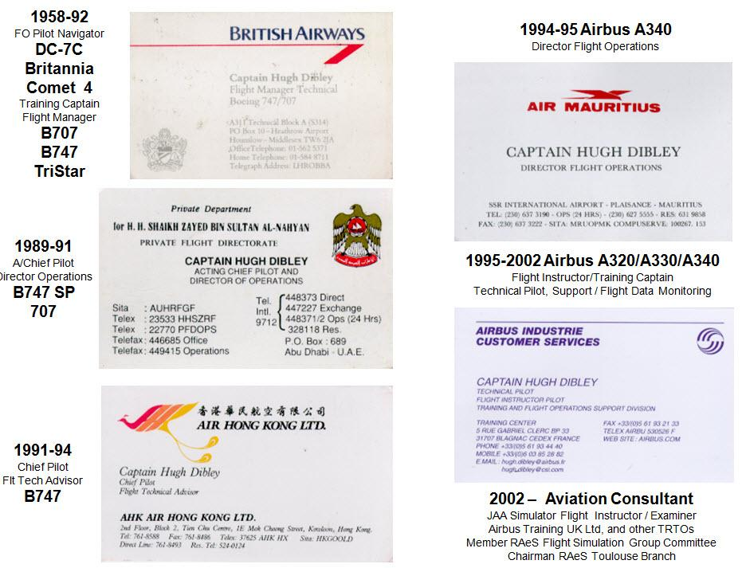

Slide 3
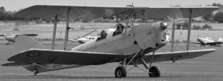
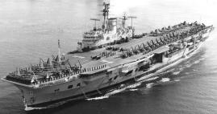

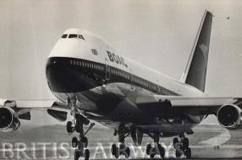
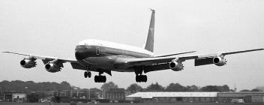


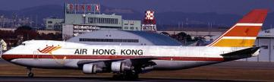



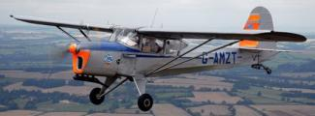
Hugh Dibley’s Main Aviation Activities

Slide 4
Training to Avoid to Loss Of Control Accidents
Main Accident Causes – CFIT (Controlled Flight in Terrain)
LoC-I (Loss of Control In Flight)
CFIT now reduced – Read across to LoC-I prevention
Symptoms and Causes
Examples of LOC-I - Instrument/system failure mis-handled
Crew induced on serviceable aircraft
Extreme weather – icing, windshear
Control/system failure causing upset
Examples of Negative Training
Work across the Industry to Prevent LOC-I

Slide 5
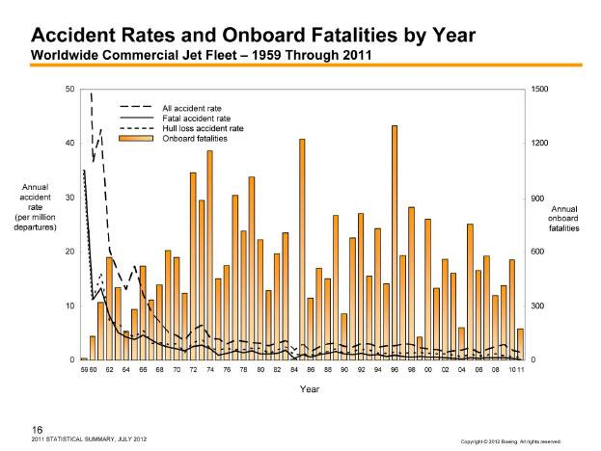

Slide 6
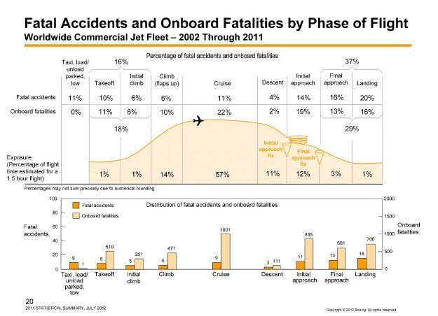

Slide 7
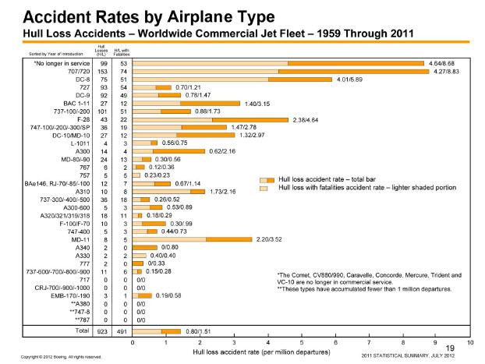

Slide 8
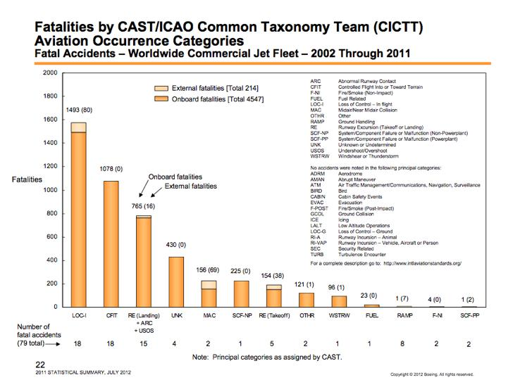
Same number of accidents

Slide 9
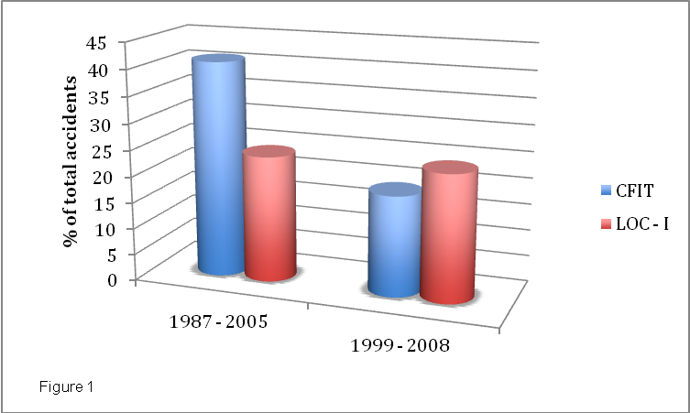
Why did CFIT decrease? Could have been reduced sooner?

Slide 10
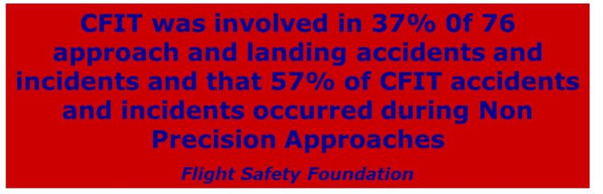
What Have Been the Prime Causes of CFIT?
What Have Been the Reasons for CFIT Reduction?

Slide 11
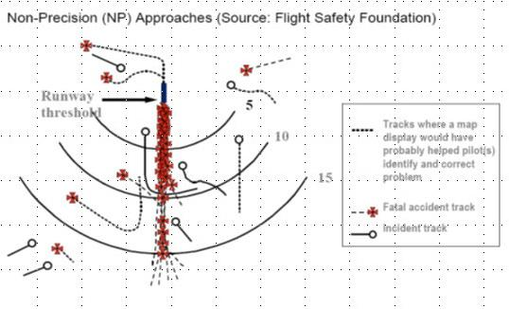
What Have Been the Prime Causes of CFIT?
What Have Been the Reasons for CFIT Reduction?

Slide 12
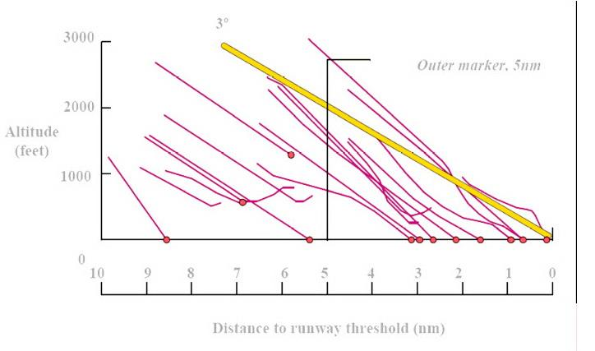
What Have Been the Prime Causes of CFIT?
What Have Been the Reasons for CFIT Reduction?
3°glidepath to runway

Slide 13
What Have Been the Prime Causes of CFIT?
What Have Been the Reasons for CFIT Reduction?
Since 1970s with DME in line with the Runway,
NO excuse for NOT following
Constant 3°path to runway threshold –
Using DME – Altitude Display
or by Altitude regularly calculated mentally -
eg at 5 nm DME at Guam –
Approach Altitude = (5+3.3) x 300 + 310 = 2,800ft

Slide 14
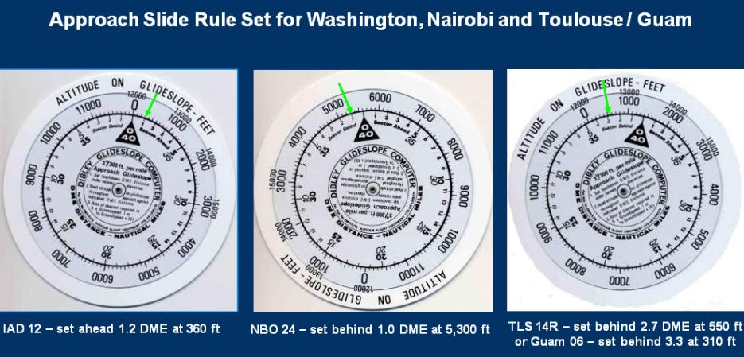
What Have Been the Prime Causes of CFIT?
What Have Been the Reasons for CFIT Reduction?
Aids existed for crews not skilled in mental arithmetic – like bookmakers’ clerks calculating betting odds

Slide 15
What Have Been the Prime Causes of CFIT?
What Have Been the Reasons for CFIT Reduction?
Aids existed for crews not skilled in mental arithmetic – like bookmakers’ clerks calculating betting odds
Similar to using the improved
ADF RMI (Radio Magnetic Indicator) versus an old
RBI (Relative Bearing Indicator)
to which Magnetic Heading must be added to calculate the Magnetic course to the beacon – no longer in use!

Slide 16
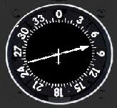
What Have Been the Prime Causes of CFIT?
What Have Been the Reasons for CFIT Reduction?
Aids existed for crews not skilled in mental arithmetic – like bookmakers’ clerks calculating betting odds
RBI – Fixed Card
Heading
345° Magnet
What is QDM
(Direction M)
to the NDB?
= 075+345=420
-360 = 60°M
Similar to using the improved
ADF RMI (Radio Magnetic Indicator) versus an old
RBI (Relative Bearing Indicator)
to which Magnetic Heading must be added to calculate the Magnetic course to the beacon – no longer in use!

Slide 17
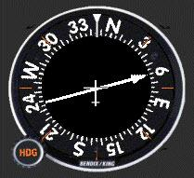
What Have Been the Prime Causes of CFIT?
What Have Been the Reasons for CFIT Reduction?
Aids existed for crews not skilled in mental arithmetic – like bookmakers’ clerks calculating betting odds
RBI – Fixed Card
RMI Heading Mag
Similar to using the improved
ADF RMI (Radio Magnetic Indicator) versus an old
RBI (Relative Bearing Indicator)
to which Magnetic Heading must be added to calculate the Magnetic course to the beacon – no longer in use!

Slide 18
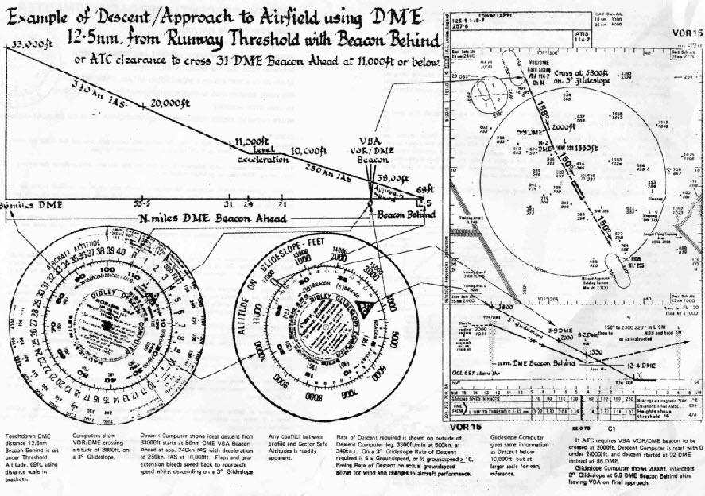
What Have Been the Prime Causes of CFIT?
What Have Been the Reasons for CFIT Reduction?

Slide 19
What Have Been the Prime Causes of CFIT?
What Have Been the Reasons for CFIT Reduction?
Published VOR-DME approach into Kuala Lumpur in 1976 was about 1.5°thus not sensible as drawn.
Circular slide rule defines a 3°final approach based on the DME 12.5 nm from the runway.

Slide 20
What Have Been the Prime Causes of CFIT?
What Have Been the Reasons for CFIT Reduction?
In1976 a BAOD 747-136 brushed trees
during a Go Around from a VOR-DME approach to KUL 16 –
The approach procedure started 2,000ft below a 3°glide path with no DME-Altitude checks. The approach was a “Black Hole” over forest with no visual cues
The approach procedure was revised to follow a 3°path with DME-Altitude checks, which were being incorporated on all BA Aerad charts and no similar NPA incidents occurred afterwards in BA.

Slide 21
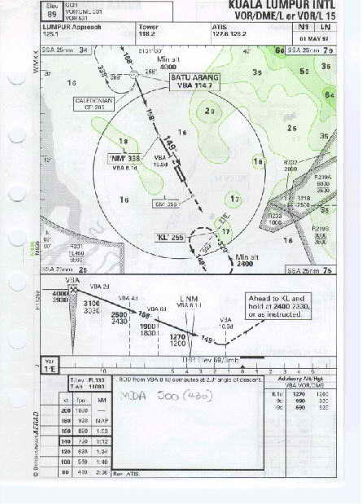
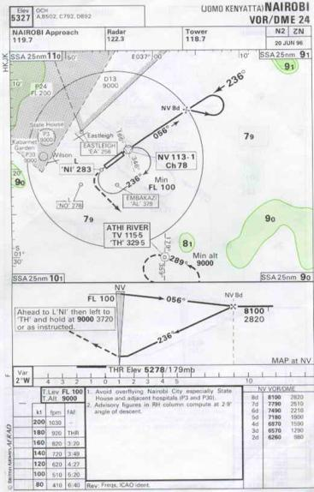
BA/Aerad Provided DME-Altitude Tables
Permitting Constant Angle NPAs starting in 1975

Slide 22
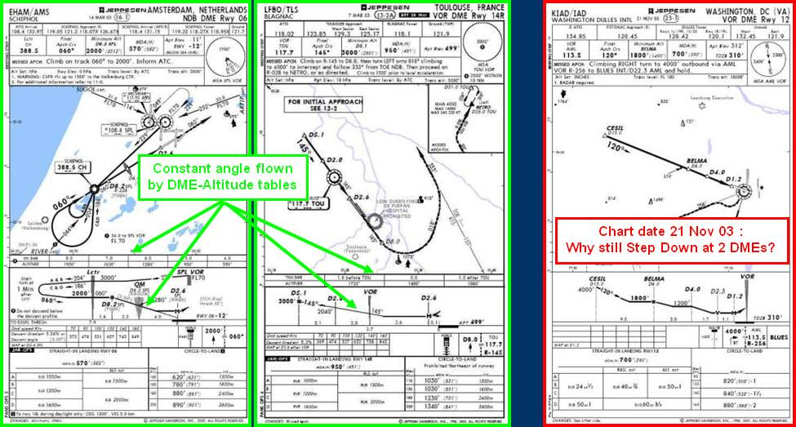
By the 1980s Most European Authorities provided DME-Altitude Information for Constant Angle NPAs,
But information not universally available.....

Slide 23
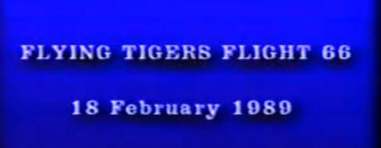
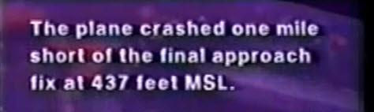
In 1989 Flying Tigers B747 Crashed with the FO
flying a VOR-DME Approach in to Kuala Lumpur
Final Approach Fix Altitude 2,400ft
GPWS “Pull Up, Pull Up” ignored for 25 seconds

Slide 24
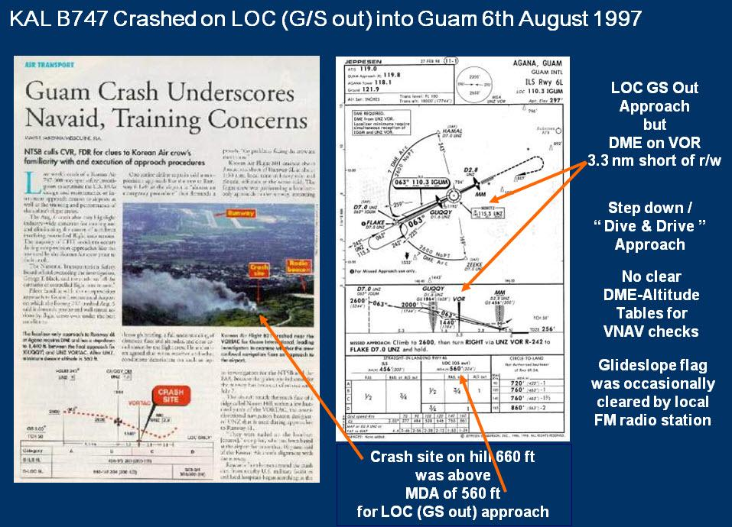

Slide 25
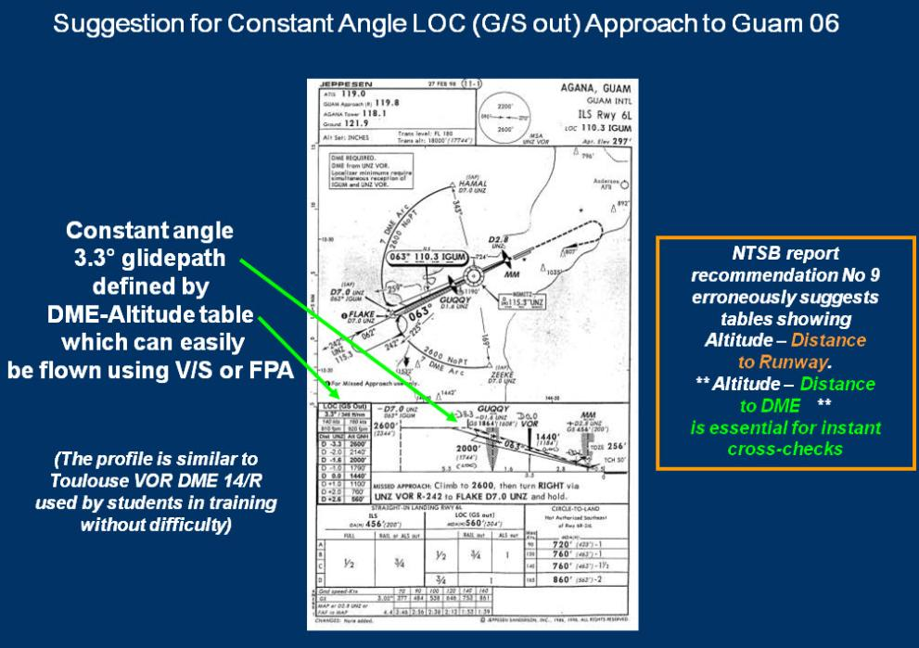

Slide 26
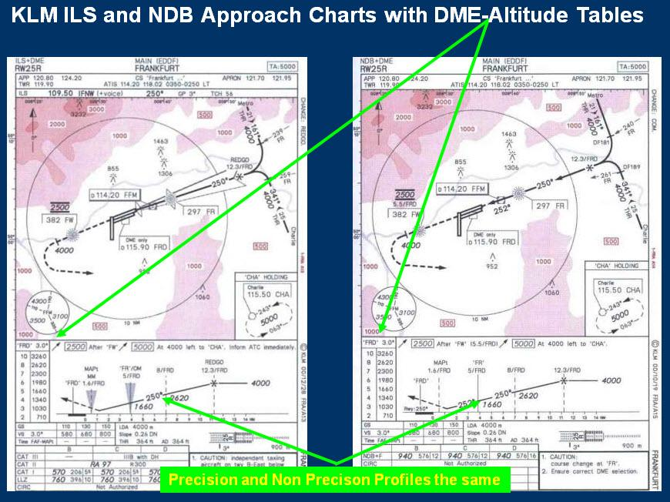

Slide 27
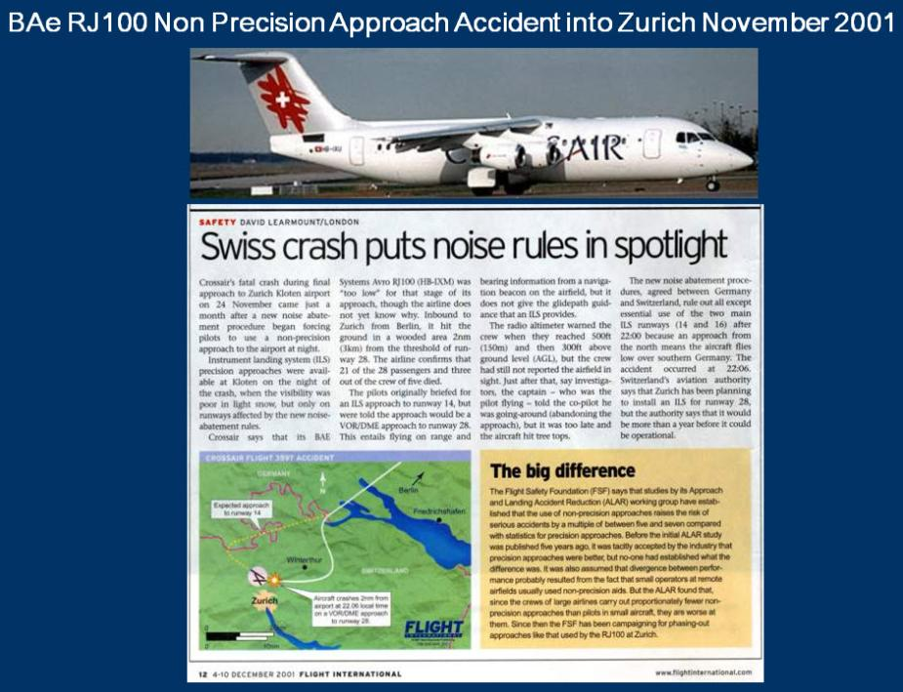

Slide 28
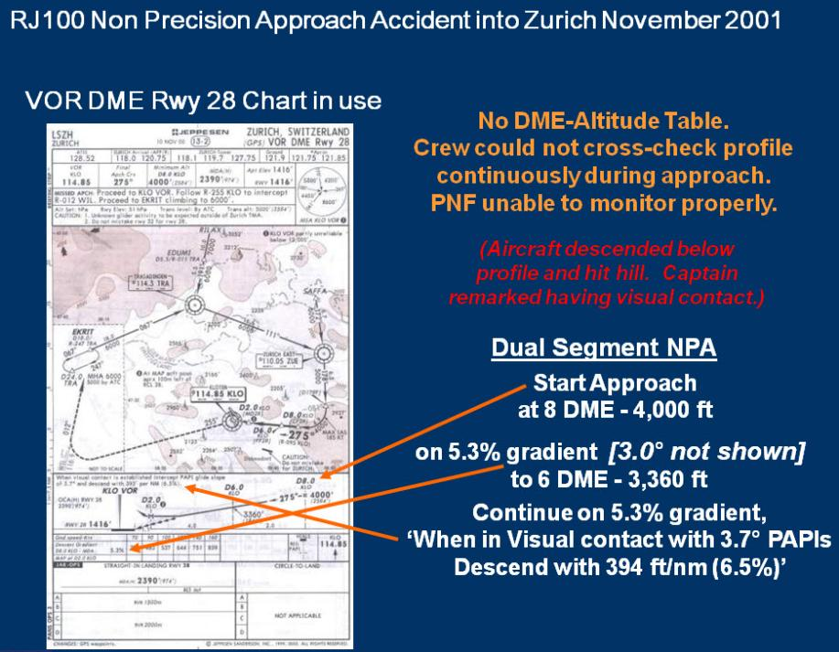

Slide 29
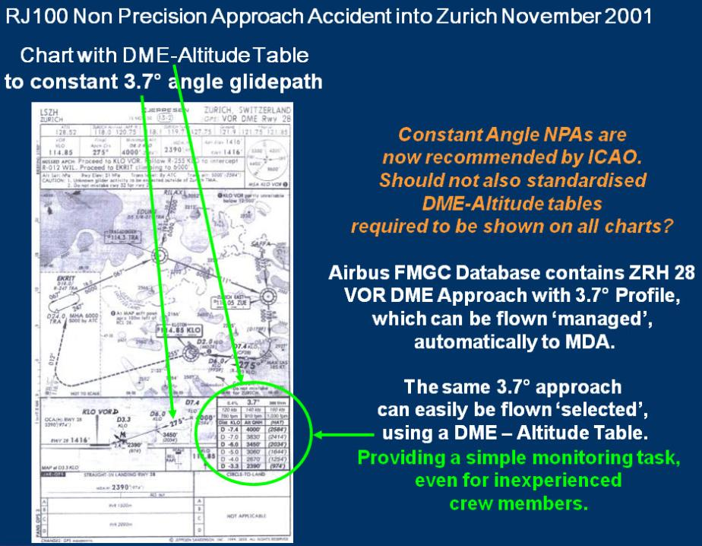

Slide 30
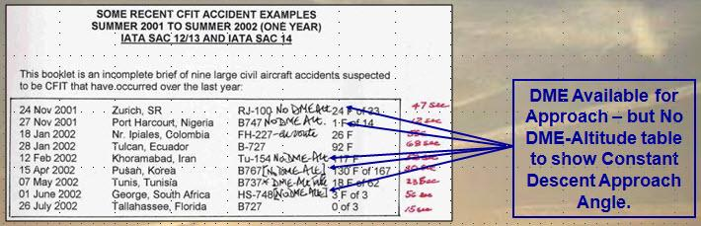
CFIT NPAs Continued –
In 2002 Don Bateman, father of GPWS/EGPW,
published 9 NPA CFIT accidents which could have been saved if EGPWS had been fitted
But 5 had DME available but no DME-Altitude tables on the charts which could have avoided an accident.

Slide 31
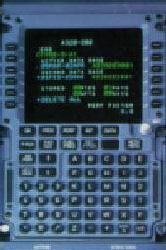
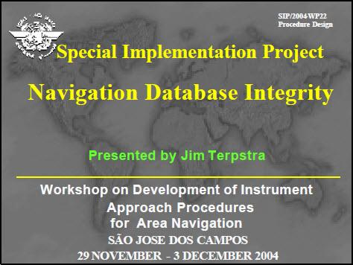
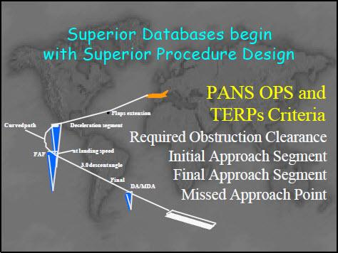
FMS navigation started in the 1970s and navigation database integrity improved during the 2000s to allow RNP (Required Navigation Performance) ILS type approaches without need for ground based navigation aids

Slide 32
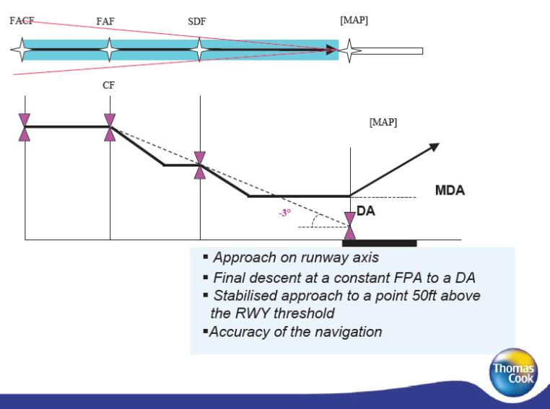
RNP Approaches particularly help Charter Operators with many NPAs – CFIT accidents should be reduced
Capt Steve Solomon DFO Thompson Ltd 7 Oct 2010

Slide 33
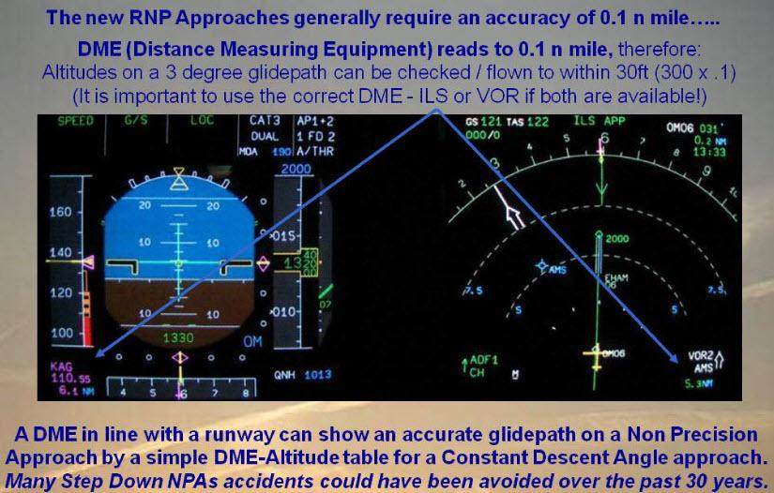
DME-Altitude Constant Angle NPAs remain a good backup

Slide 34
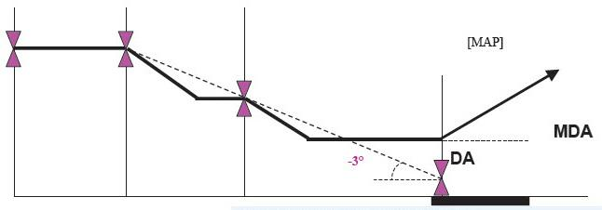
Hazards of a “Dive & Drive” NPA Profile

Slide 35
Hazards of a “Dive & Drive” NPA Profile
Unstable profile
Approach Unstable – needing pitch, thrust & flap changes

Slide 36
Hazards of a “Dive & Drive” NPA Profile
Chance of hard landing or runway over-run
Approach Unstable – needing pitch, thrust & flap changes
Experience shows that flying level at MDA while obtaining visual reference, especially in poor visibility, can lead to a late “dive” at the runway and chances of a hard landing or deep landing with over-run off the end of the runway.

Slide 37
Hazards of a “Dive & Drive” NPA Profile
Missed step can cause terrain accident
It is easy to misread the chart and miss a step possibly flying into an obstacle.
28 Sep 1992 PIA A300 accident VOR DME approach into Kathmandu.
06 Aug 1997 KAL 747 accident LOC No Glidepath DME approach into Guam.
(During an old HKG Kai Tak IGS No Glidepath approach, a UA 747 missed a step and descended early towards the hill on the approach, but the error was advised by Hong Kong Approach Radar and the aircraft stopped the descent.)

Slide 38
Benefits of a Constant Angle NPA Profile
Stable Approach – established as many orders safer
Stable approach, landing configuration, no pitch/thrust changes
NPA Minima may be reduced
DME-Altitude Tables can provide regular checks to confirm aircraft on the correct profile to 30ft accuracy.
Rather than checks at single points which might be interrupted by ATC request, crew action etc.

Slide 39
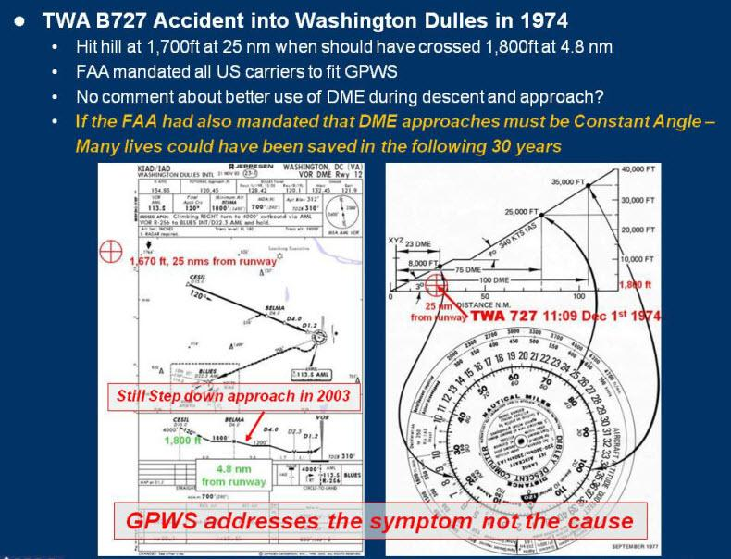
A final Comment about Use/Underuse of DME!
Indicates Prevention of an event is Prime

Slide 40
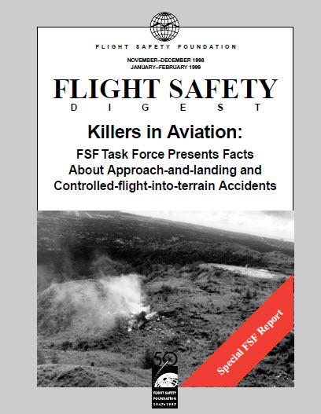
and One More!
Interesting that the recommendations
In the FSF 1998-99 CFIT Task Force
made No mention of DME-Altitude Tables
To Fly
Constant Angle Non Precision Approaches
although known to be a prime safety aid.
A proposal that “At night and IMC the FO shall fly the approach and the captain shall land” was not included.

Slide 41
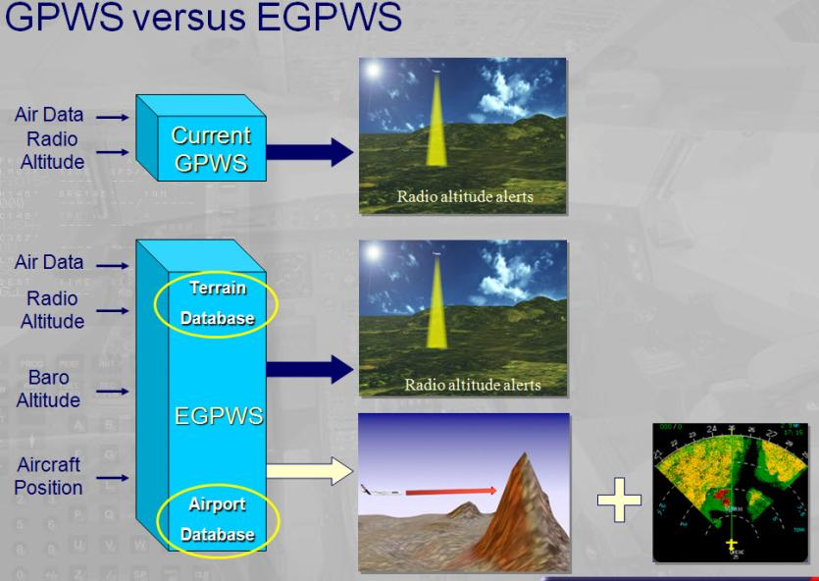
Don Bateman’s EGPWS is certainly a marvellous aid which has contributed incomparably to flight safety.
A B747-400 out of Mauritius which turned North to fly straight over Lion Rock as cleared by ATC was saved by the EGPWS warning

Slide 42
CFIT remains an accident cause as frequent as LOC-I,
and remains a high priority of authorities such as ICAO

Slide 43
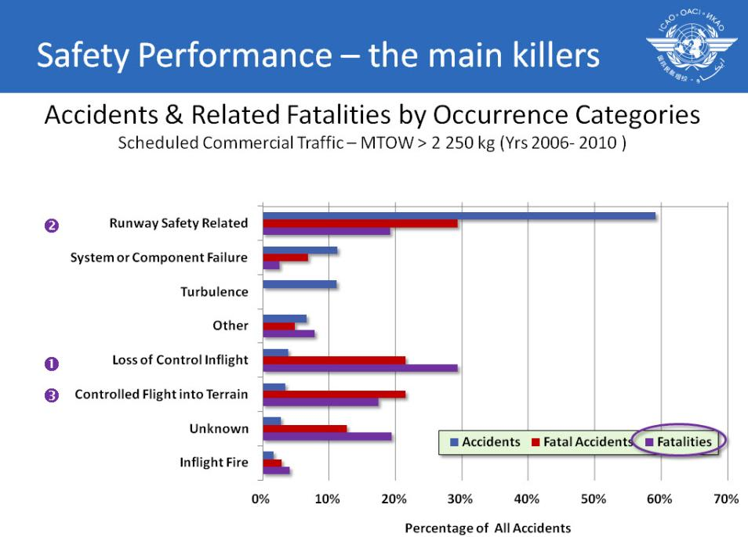

Slide 44
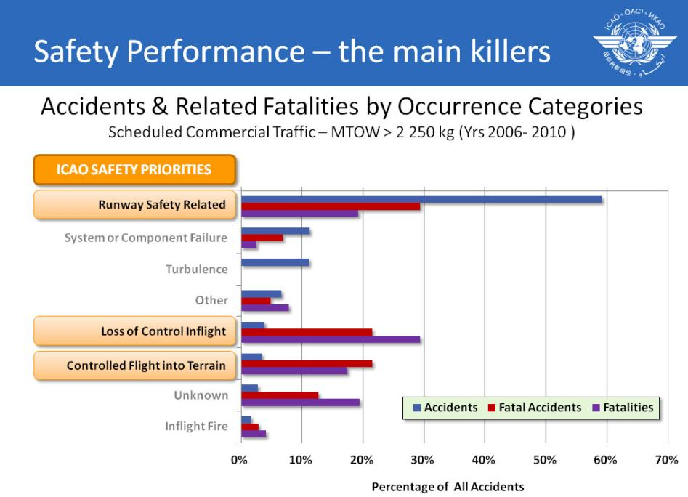

Slide 45
During 3 recent accidents crews have ignored or even cancelled EGPWS warnings
10 April 2010 Polish Air Force Tu-154 continued
after Terrain Ahead & Pull Up warnings
20 Apr 2012 Bhoja Air Boeing 737 into Islamabad.
Captain continued downwind despite EGPWS warning and advice from FO.
10 May 2012 Sukhoi Superjet-100 descended below
MSA and into side of volcano
Behaviour can be read across to LOC-I events

Slide 46
Examples of LOC-I
Instrument/system failure Mis-handled
Disorientation after Single/Simple Failure
21 Dec 1962 BEA Comet 4B Ankara. After rotation on
takeoff pitched up to 45°& stalled.
Captain’s Flight Director was stuck.
01 Jan 1978 Air India B747 Bombay. After takeoff
captain rolled to the left into the sea
after his horizon “toppled” in right bank.
22 Dec 1999 Korean Air Cargo Stansted. After
takeoff captain rolled left into the
ground after his horizon failed.

Slide 47
Examples of LOC-I
Instrument/system failure Mis-handled
Disorientation after Single/Simple Failure
Solved by improved training and
CRM (Crew Resource Management)
(The co-pilot of the Korean B747 could have been preoccupied with trying to change to a radio frequency which was not displayed as cleared.
The aircraft had an 833Mhz frequency selector required in Europe while the UK was still using/giving frequencies in the older spacing.)

Slide 48
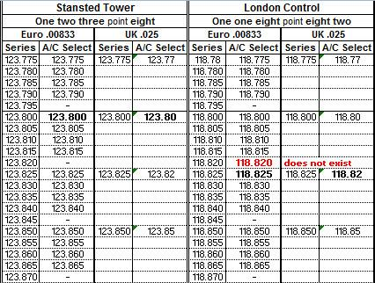
Examples of LOC-I
Instrument/system failure Mis-handled
Disorientation after Single/Simple Failure

Slide 49
Examples of LOC-I
Disorientation with No apparent Failures
Confusion with Automatics
Manual Handling Skills
03 Jan 04 Flash Airlines B737-300 Sharm el-Sheikh. After
take off the aircraft rolled right instead of turning
left reaching 110°bank and crashing into the
sea. The (ex military) captain was engaging and disconnecting the autopilot in different modes.
25 Jan 10 Ethiopian Airlines B737-800 Beirut. Aircraft took
off out of trim which the captain did not correct
& lost control of the aircraft reacting incorrectly to
prolonged stall warning stick shakers. The captain
and co-pilot were both relatively inexperienced.

Slide 50
Examples of LOC-I
Stalls due to Flap/Slat Mis-Handling?
27 Oct 1965 BEA Vanguard London Heathrow. During a
Go Around after the 3rd approach the aircraft
pitched up then crashed on the runway in a
steep dive. Flaps had been retracted to zero.
Flight’s comment: FDRs are Pilot’s Training aids.
18 Jun 1972 BEA Trident London Heathrow. Aircraft stalled
after the co-pilot retracted the droop/slats
prematurely.
12 Feb 2009 Colgan Air Bombardier DHC-8-400 Buffalo. On
approach after flap selection with speed
decreasing the stall warning sounded. The
co-pilot retracted the flaps & the aircraft stalled.
More about this later.

Slide 51
Examples of LOC-I
Stalls due Excess Thrust Causing Pitch Up at Low Level
26 Apr 1994 China Airlines A300-600 Nagoya. During the
approach the FO applied TOGA thrust in error &
pushed forward on the control column while the
autopilot trimmed back. The aircraft pitched up,
stalled, pitched down & crashed on the runway.
The captain tried to arrest the descent by pulling back.
11 Dec 1998 Thai Airways Int A310 Surat Thani. During 2 Go
Arounds the captain slowly applied TOGA thrust
and controlled the pitch up, but on the 3rd GA
for a diversion TOGA was applied rapidly by the
autothrust, the aircraft pitched to 45°& crashed.
23 Sep 2007 Thomson Fly B737-300 Bournemouth. After the autothrust
disconnected without warning the autopilot trimmed back
to maintain the glideslope. During Go Around the
aircraft pitched up with full foward stick and stalled. The captain recovered by reducing thrust & trimming forward.

Slide 52
Examples of LOC-I
Extreme Weather – Turbulence Windshear, Icing,
5 Mar 1966 BOAC 707-436 near Mt Fuji. The aircraft encountered severe clear-air turbulence causing
a sudden structural failure. Acceleration +9/-4G.
02 Aug 1985 Delta Air Lines L1011 Dallas. Crashed after
encountering a microburst-induced, severe windshear from a developing thunderstorm
located on the final approach course. Windshear
detection/recovery systems were developed.
12 Feb 2009 American Eagle ATR 72 near Chicago. Control
was lost when holding due to icing causing
sudden aileron hinge moment reversal.

Slide 53
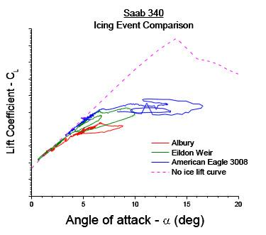
Icing – Aircraft may Stall
Before the Stall Warning/Stick Pusher

Slide 54
Examples of LOC-I
Loss of Normal Pressure Instruments
6 Feb 1996 Birgenair B757 Puerto Plata. Continued takeoff
with captain’s pitot blocked, control was lost
due to confusion between flight instruments.
01 Oct 1996 AeroPerú B757 Lima. Took off with static vents
covered causing multiple warnings - rudder
ratio, mach trim, overspeed, underspeed and
flying too low. With no reliable barometric
altimeter and airspeed readings & experiencing
several stalls the aircraft crashed into the sea.
This spurred manufacturers/operators to introduce unreliable
airspeed procedures for all aircraft types.
.

Slide 55
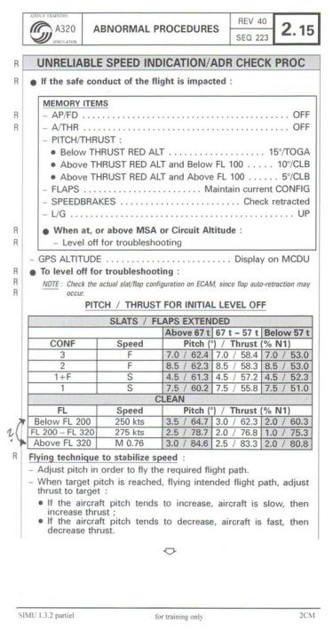
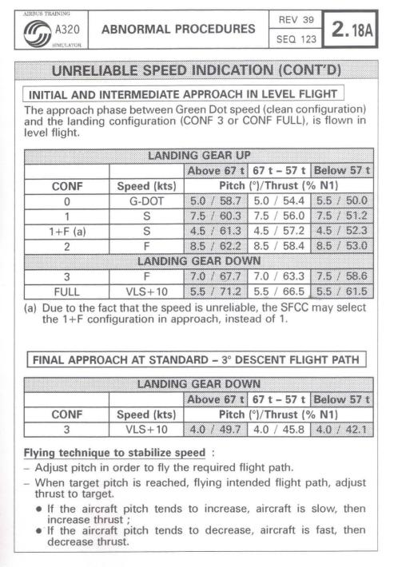

Slide 56
Examples of LOC-I
Control/System Failure Causing Upset
Early aircraft –
Input/sensor failures affected single systems
Current aircraft –
Input/sensor failures affect multiple systems –
With perhaps.....
multiple consequences .....
disconnections .....
multiple warnings.....
possibly startling –
But if crews understand the systems and are prepared –
Need not be quite so startling – hopefully!

Slide 57
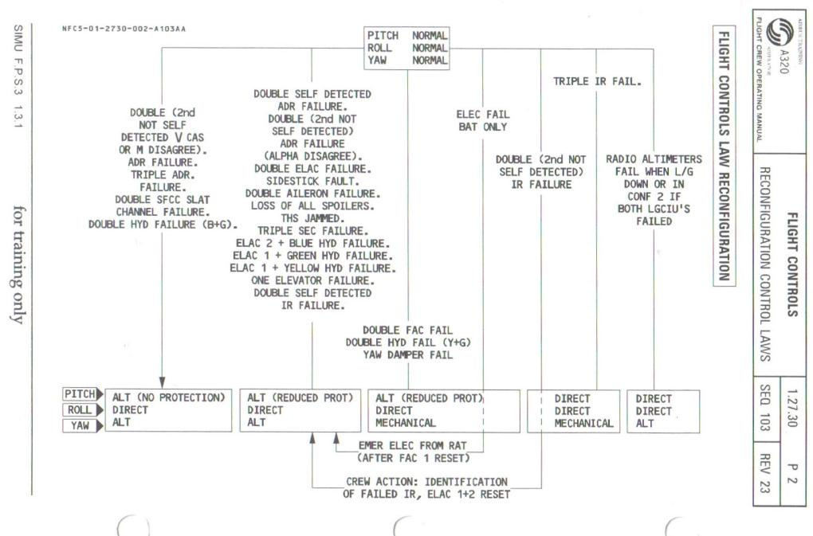
Airbus A320 – Flight Control Laws Reconfiguration after failures

Slide 58
Examples of LOC-I
Control/System Failure Causing Upset
Table assumes failed systems are flagged invalid
Inputs/data can “fail” in different ways –
Erroneous/incorrect and flagged as Invalid –
Inputs to systems switched off.
Reconfigurations made as per design.
Erroneous/incorrect but not flagged as invalid –
Bad information fed to systems, perhaps causing anomalies
(Like 737 into AMS when Radio Altimeter fed 0 ft so autothrust reduced to idle as if landed.)
Unreliable – incorrect but may return to normal

Slide 59
Examples of LOC-I
Fly By Wire Control/System Failure Causing Upset
1 Aug 2005 Malaysian 777-200 from Perth. When climbing
through FL380 the airspeed indicated near the
overspeed and stall speed limits. The aircraft
pitched up, climbed to FL410 with the airspeed
dropping to 158 kt and the stall warning/stick
shaker activated. The crew took control and
returned to Perth flying manually throughout.
One of several accelerometers had failed
another accelerometer had failed in June 2001.
7 Oct 2008 Qantas A330 from Perth. ADIRU #1 fed very
high false AoA values to the flight control
computers commanding a nose-down aircraft
pitch of about 8.5 degrees. The aircraft diverted
to Learmonth.

Slide 60
Examples of LOC-I
Classic Aircraft Control/System Failure Causing Upset
03 Mar 1991 United Airlines 737-200 Colorado Springs.
08 Sep 1994 USAir 737-300, near Pittsburgh.
Both aircraft crashed due rudder PCU jamming
which could reverse the pilots inputs.
The FAA ordered that the servo valves be replaced and that new training protocol for pilots to handle unexpected movement of flight controls be developed.
Some airlines implemented upset training procedures which were not approved by the manufacturers therefore in 1998 Airbus, Boeing and McDonnell Douglas published the Airplane Upset Recovery Aid
remains “bible” for Upset Prevention & Upset Training

Slide 61
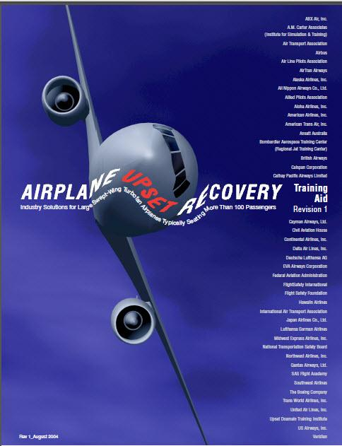

Slide 62
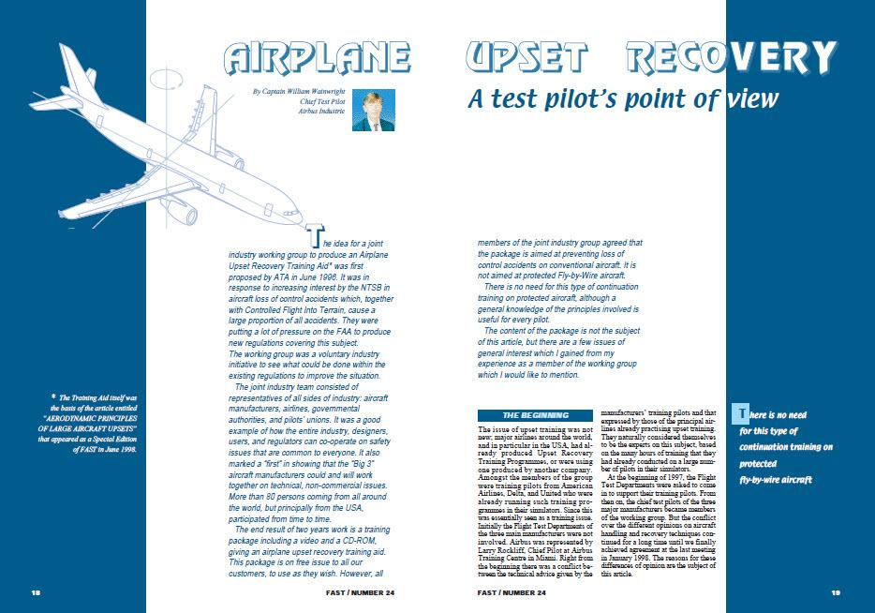
Bill Wainwright, Airbus Chief Test Pilot,
one of the 3 signatories to the AURTA manual,
gave more advice in an Upset Recovery article in the June 1998 Airbus FAST magazine

Slide 63
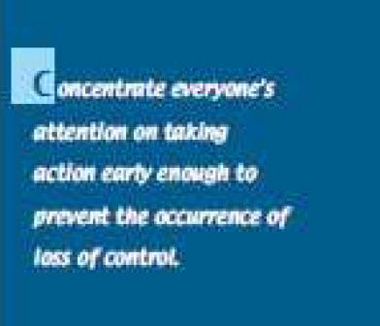
Bill Wainwright’s Advice
Prevention is Prime

Slide 64



Bill Wainwright’s Advice
Together with Boeing & McDonnell Douglas
Do NOT use Rudder in an Upset
But AA persisted with their Upset Recovery policy of using rudder

Slide 65

LOC Accidents –
American 587 – Airbus A300-600
ex JFK October 2001
Copilot applied full rudder travel both ways after passing through B747 wake vortex, thus exceeding the designed loads of the vertical stabiliser/fin which broke off.
Crews had been trained to use rudder in an upset and flight simulators’ roll control response modified to require this – against the advice of both major aircraft manufacturers.
Indicates the need for upset recovery training to be according to the manufacturer’s recommendations, otherwise negative training can result.
AA had modified the flight simulator reaction in roll so only rudder was effective

Slide 66


Recent LOC-I Accidents –
14 Oct 2004 Pinnacle Bombardier CL-600-2B19
Ferry flight – only 2 pilots on board
Failed to monitor autopilot Vertical Speed Mode climbing to FL410,
Speed reduced to stall which was not recovered.
Should have been prevented by improved knowledge of aerodynamics and thus use of automatics –
(There is an official view that crews must not VS mode as the mode not understood. This indicates a failure in training.
VS has to be used routinely when climbing fast in busy airspace to avoid unnecessary ACAS/collision avoidance warnings, etc.)
Could have been recovered by better knowledge of aerodynamics and if had been given proper stall/stick pusher training..
Avoided by proper crew discipline.

Slide 67

Most Significant LOC-I Accident
Colgan Air - Bombardier DHC-8-400
12th February 2009
Crew airspeed monitoring lapsed – due to fatigue?
Speed reduced after flap selected & stick shaker activated
FO had discussed icing several times during flight –
Had seen NASA tailplane icing video instructing flap retraction
Reacted as per training video to retract flaps & pull aft stick?
Should have been prevented by type training on tailplane icing
Could have been recovered by training/knowledge for type.

Slide 68

Most Significant LOC-I Accident
Colgan Air - Bombardier DHC-8-400
12th February 2009
NASA Tailplane Icing Video

Slide 69

Colgan Air Cockpit Voice Recorder
Captain pulled back on stick as per NASA video?
FO Retracted the flaps

Slide 70

Video of Colgan Air Bombardier Accident into Buffalo

Slide 71

Colgan Air Bombardier Accident into Buffalo

Slide 72

Colgan Air Bombardier Accident into Buffalo

Slide 73

NASA Icing Video showed aircraft with a similar configuration
to Colgan Air – High wing turboprop with high T tailplane

Slide 74

Most Significant LOC-I Accident
Families of those lost formed a focus group & website

Slide 75
Most Significant LOC-I Accident
Families of passengers killed
In the Colgan Airways Accident into Buffalo
Lobbied congress to
Pass a Law
Requiring Stall Training
For All Airline Pilots
and more hours’ experience.
(New president & administration)

Slide 76

US Law

Slide 77

US Law

Slide 78
Large Number of
Loss Of Control / Stall-Stick Pusher Related Groups
Set Up/Existing in the Industry
FAA Stall and Sticker Pusher Group
RAeS ICATEE
ICAO LOCART etc etc
Other activities:
ITQI (IATA Training & Quality Initiative) leading to
EBT (Evidence Based Training)
MPL (Multi-Crew Pilot’s Licence)
ICAO NGAP (Next Group of Aviation Professionals)
RAeS FSG IWG (International [Flt Sim Stds] Working Group)
RAeS IPTC (International Pilot Training Consortium)
EASA Rule Making Tasks

Slide 79

FAA Advisory Circular 6th August 2012
...to provide best practices and guidance for training, testing, and checking for pilots, within existing regulations, to ensure correct and consistent responses to unexpected stall warnings and stick pusher activations

Slide 80

FAA Stall Training AC
Requirement for Instructors to Highlight
Full Flight Simulator Motion Limitations

Slide 81

Development of Simulation
5. Motion Systems
Angular motions are sensed in humans by canals in the inner ear

Slide 82


Development of Simulation
5. Motion Systems
Angular motions are sensed in humans by canals in the inner ear

Slide 83
Development of Simulation
5. Motion Systems
The inputs to the motion platform are calculated by the Equations of Motion
Xs,Ys,Zs
U,V,W
compute
Xb,Yb,Zb
U',V',W'
aerodynamic
convert axes
Vc,
α,β
forces
stability to body
compute linear
∫
compute
Vc,
α,β
accelerations
Ps,Qs,Rs
'
'
ρ
,M
α,α ,β,β
compute
Xp,Zp
Vc
aerodynamic
engine forces
P,Q,R
ρ
,M
and moment
inceptors
and moments
coefficients
Lp,Mp,Np
P',Q',R'
inceptors
Ls,Ms,Ns
compute angular
convert axes
Ps,Qs,Rs
compute
convert axes
L,M,N
accelerations
∫
body to stability
aerodynamic
stability to body
moments
e0,e1,
Vx,Vy,Vz
P,Q,R
compute
e2,e3
θ,φ,ψ
Pn,Pe,h
Euler
compute DCM
ρ
parameters
convert axes
∫
atmospheric
, M
U,V,W
body to Euler
model

Slide 84

Development of Simulation
5. Motion Systems
As movement is limited, platform motion must be washed out ready for next event
Centrifuges are needed for high G acceleration (seen only in civil aircraft rejected takeoffs)

Slide 85
Development of Simulation
5. Motion Systems
Acceleration sense available from motion platform
1g

Slide 86
Development of Simulation
5. Motion Systems
Acceleration sense available from motion platform
1g

Slide 87
Development of Simulation
5. Motion Systems
Acceleration sense available from motion platform
1g

Slide 88
Development of Simulation
5. Motion Systems
Acceleration sense available from motion platform
1g

Slide 89
Development of Simulation
5. Motion Systems
Acceleration sense available from motion platform
1g * Sin 20° = 0,34 g
1g
20°
1g * Cos 20° = 0,94g

Slide 90



Maintaining Control
The ICATEE Approach
RAeS Flight Crew Training Conference
27 September 2012
Dr. Sunjoo Advani, Chairman of ICATEE
90
1
Royal Aeronautical Society
Flight Simulation Group

Slide 91


ICATEE
International Committee for Aviation Training in Extended Envelopes
Initiated by RAeS Flight Simulation Group in June 2009
MISSION: To deliver a comprehensive long-term strategy to reduce the rate of Loss of Control In-Flight accidents and incidents through enhanced UPRT
Approach: Upset Prevention and Recovery Training
Provide recommendations to ICAO, FAA and industry
91
Notes:
International Committee for Aviation Training in Extended Envelopes was initiated by Flight Simulation Group after successful RAeS Conference (June 2009)
AIM: Upset Prevention and Recovery Training (UPRT)
MISSION: To deliver a complete and comprehensive long-term strategy to reduce the rate of Loss of Control In-Flight accidents and incidents through enhanced UPRT

Slide 92
ICATEE Participants
Category | Participants
Organization | RAeS-FSG, ICAO
Airframe Manufacturer | Boeing, Airbus, Bombardier
Regulator/Government | FAA, NTSB, IATA (ITQI/EBT), Transport Canada, EASA, Russian CAA
Training Provider | CAE, FlightSafety, Boeing Flight Training, APS, CALSPAN, Embry-Riddle
Simulation Provider | CAE, FlightSafety, Thales, Opinicus, ETC, Bihrle
Industry Body | ALPA, IFALPA, ATA, BBGA
Airline | KLM, Alaska, Flybe, FedEx, Air Canada, Lufthansa, several airlines
Research | AIAA MSTC, NASA, UTIAS, NLR, TNO, IDT, DLR, U Liverpool, SOS, Volpe
45 organizations, over 80 individuals
92

Slide 93

ICATEE Meetings to Date
1 | 11-09 | London
2 | 03-10 | Washington
3 | 04-10 | Orlando
4 | 06-10 | London
5 | 11-10 | Oklahoma
6 | 03-11 | Mesa
7 | 04-11 | Daytona
8 | 04-11 | Orlando
9 | 06-11 | Amsterdam
10 | 08-11 | Seattle
11 | 09-11 | Montreal
12 | 11-11 | London
13 | 04-12 | Lutz
14 | 09-12 | Cologne
93

Slide 94


ICATEE Team
94
ICAO, Montreal - September 2011

Slide 95
Loss-of-Control In-Flight
Normal flight
Upset
Loss-of-Control
Prevention
Recovery
95

Slide 96
Today’s Training Assumptions
Aircraft is within normal operational envelope and in a non-agitated flight condition
Situational awareness and information can be accurately correlated by the pilot with respect to observed flight condition
Airplane handling skills and strategies established by regulatory licensing can directly resolve an escalating condition
Human psychophysical response is predictable and reliable.
96

Slide 97
All-Attitude Knowledge Deficiencies
Pitch (+up)
+ 90º
All-Attitude Daily Threat
+ 50º
+ 30º
+ 25º
Roll (Left)
+ 10º
60º
Roll (Right)
180º
135º
90º
45º
- 10º
135º
180º
- 50º
- 90º
Upset Definition
Airplane Upset Recovery Training Aid
Pitch (-down)
4.9 %
Upset Definition (45 AOB, +25 & -10 Pitch)
11.1 %
Max Licensing Limits (60 AOB, +/-30 Pitch)
100 %
All-Attitude Training (180 AOB, +/- 90 Pitch)
97
Notes:
Pilots are experts in the blue region; outside, skill sets do not exist.
Getting outside can be caused by several factors:
- Wake Turbulence
- Stall Over-response
- Control Systems Failure
- PIO
If I am an expert in the blue region, am I an expert everywhere? MANY SKILLS OF THE LICENSING MAKE THE SITUATION WORSE
Atypical expertise required to train, because PILOTS don’t have it!
RED is HIGH-STRESS, threatening environment

Slide 98
All-Attitude Knowledge Deficiencies
Pitch (+up)
+ 90º
All-Attitude Daily Threat
+ 50º
+ 30º
+ 25º
Roll (Left)
+ 10º
60º
Roll (Right)
180º
135º
90º
45º
- 10º
135º
180º
- 50º
Approximate limits, Colgan 3407
- 90º
Upset Definition
Airplane Upset Recovery Training Aid
Pitch (-down)
4.9 %
Upset Definition (45 AOB, +25 & -10 Pitch)
11.1 %
Max Licensing Limits (60 AOB, +/-30 Pitch)
100 %
All-Attitude Training (180 AOB, +/- 90 Pitch)
98
Notes:
Pilots are experts in the blue region (4.9% of total envelope), but beyond this, their skill sets do not exist.
Getting outside can be caused by several factors:
- Wake Turbulence
- Stall Over-response
- Control Systems Failure
- PIO
If I am an expert in the blue region, am I an expert everywhere? MANY SKILLS OF THE LICENSING MAKE THE SITUATION WORSE
Atypical expertise required to train, because PILOTS don’t have it!
RED is HIGH-STRESS, threatening environment

Slide 99




All-envelope knowledge deficiencies
Full Stall
Stall Warning
L/D Max
99
Notes:
INSTABILITY, Control inputs less effective/unpredictable, divergent
NON-INTUITIVE
Beyond the stall, neither instructors or student pilots are exposed. Currently, don’t have the abilities to get out of this.
In STALLED region, we are no longer teaching a skill set, but a fundamental recognition and recovery action
Minimum altitude loss here
HIGH risk of negative training!
This area is extremely lethal! - NEGATIVE stall-spin stability.
Entries:
disregarding first indications
first indications not prominent.
icing,
automation inattention/mismanagement

Slide 100

4-Psychophysical response is predictable & reliable
STARTLE
100
Notes:
When faced with a situation they are not trained to resolve through skill and in actual exposure to the multi-stimulus environment, containing startle has little value.
Cannot contain startle in a situation where you do not have the skills to resolve it.
However, if you can contain the startle through appropriate conditioning, AND pilot has the skill, knowledge and experience to resolve the situation, then you maximize the ability to resolve it.
However, if the training is done ONLY in a simulator, they may intellectually be able to resolve the situation. However, the benign nature of simulation, and the fact you know you are on the ground, may not be sufficient to prepare them for or deal with the startle in the real airplane.
When properly trained, startle becomes surprise.
As airplane approaches the limits of experience, a cascading of events begins to happen:
- as it approaches the upset threshold
- time critical
- fight or flight
- inappropriate reactions due to limitations in the licensing/skills training (e.g. minimum altitude loss)
- lack of experience (no military background with all-attitude exposure)
- required response is counter-intuitive
- several things can happen, often aggravating the situation to a more severe condition:
- overreaction, inaction
- visual, audio, tactile, motion cueing: Have NEVER experienced them all together in a time-critical and threatening situation
- In the normal envelope, the contraction is actually a positive response, improving the situation
NOW, they don’t have a reliable method to get back.
Each of the above in isolation, with licensing limitation, there would be a fair chance they would be resolvable.
However, they may begin individually, the cascade rapidly during an upset, and rapidly in succession. Logarithmic escalation.
NEED TO TRAIN THE DISCIPLINE TO NOT OVERREACT, OTHERWISE IT CANNOT BE CONTAINED.
Startle can be contained within the licensing envelope, but beyond, it will start cascading.
Does it work?
US Army pilot John Bailey underwent the full upset prevention and recovery training. Several months later, his Beech King Air had an engine explosion, hurtling the airplane into a severe upset, at which time he was able to react without startle, and manage the situation. In his personal account, he states that, because of the severity of the training, the actual event was relatively mild and felt like being in “slow motion”. Hopefully, more such positive results will come forward, if any at all.

Slide 101


Training Assumptions
Aircraft is within normal operational envelope and in a non-agitated flight condition
Situational awareness and information can be accurately correlated by the pilot with respect to observed flight condition
Airplane handling skills and strategies established by regulatory licensing can directly resolve an escalating condition
Human psychophysical response is predictable and reliable.
Flight Simulation Group - Royal Aeronautical Society - London, UK
101

Slide 102
Upset Mitigation Levels
Awareness
  Knowledge, Skills and Attitudes to prevent an Upset
Recognition & Avoidance
  mitigation of a developing threat, as early as possible
Recovery skills to regain control
P
R
Prevent undesirable aircraft states
102

Slide 103
Current Training
Loss-of-Control
incapacitation
Upset
Normal flight
awareness
recovery
first recognition
103

Slide 104
Enhanced UPRT
Loss-of-Control
incapacitation
Upset
Normal flight
awareness
first recognition
recovery
104

Slide 105

Learning Elements
Competency-based approach to UPRT
105

Slide 106

Developing Integrated UPRT Skills
aircraft
UPRT Requires Integrated Training Elements
FSTD
Academics
106

Slide 107


Element 1 - Academics
Airplane Upset Recovery Training Aid (1998) is the industry reference
New ICATEE UPRT Manuals
  Pilot Academic Knowledge & Skill Preparation
  Instructor Guidance in UPRT
  Authorized Training Providers
  Regulatory Guidance
107
Notes:
Today’s academics training already benefits from a valuable resource: The Aircraft Upset Recovery Training Aid, a large volume that covers many aspects of aerodynamics, handling, etc. It was developed for, but is therefore also limited to, swept-wing jets with 100-plus seats.
Some say the AURTA is too large to absorb. It is clear, however, that this document is non-regulated and, as a result, highly under-utilized. When you ask pilots today, chances are they will never even have heard of it. This is highly unfortunate.

Slide 108


Element 2 - Airplane
Exposure to
  Psychological component
  Physiological component
  Accurate recovery environment
Require
  qualified aircraft
  qualified instructors
CALSPAN
APS
TTC
TCA
108
Notes:
UPRT requires exposure to an all-attitude all-envelope environment
Psychological component (startle, reality factor)
Physiological component (g-cueing)
Accurate recovery environment
Appropriate placement of airplane-based training into commercial pilot training

Slide 109
Element 2 - Airplane
Upset Prevention & Recovery Training is NOT Aerobatic Training
  Aerobatics focuses on precision maneuvers for aerobatic pilots
UPRT focuses on recovery from dangerous situations, and is designed for commercial pilots
UPRT includes significant surprise elements
Management of startle
Training of instructors
109

Slide 110

Element 3: Appropriate Use of FSTD’s
Better use of today’s devices
Enhanced feedback in today’s sim’s
Improved simulation fidelity in extended envelope
  aero model
  pilot cueing (buffet, motion)
graduated
approach
10
110
Notes:
Full Flight Simulators (FFS) have deficiencies in providing realistic upset recovery training, but are useful in developing the necessary URT pilot KNOWLEDGE for upset avoidance and recognition, and to a lesser extent, recovery SKILLS.
Airlines and training organizations perform various kinds of upset recovery training. In some cases, pilots are allowed to fly anywhere within the flight envelope, even though much of the actual valid data envelope may be exceeded during such flying.
There is no instructor feedback capability, warning pilots if they are inside or outside the aerodynamic or structural envelope of the aircraft in the simulator. As a result, this can lead potentially to negative training.
Furthermore, there is no standardized approach.
In-flight stall training has required demonstration of minimum altitude loss. As a result, pilots may end up continuing to pull, making the condition worse. Again, negative training.

Slide 111
UPRT learning objectives
FSTD
EITHER
A/C
FSTD + All-Envelope All-Attitude A/C skills needed
Current pilot fleet possibly had adequate on-aircraft component
A/C exposure can be very small, if done properly
Despite few training elements, UPRT a/c training is critical
111

Slide 112

UPRT Instruction
112
Notes:
The Research & Technology Group is developing a detailed specification manual, called “Research and Technology Requirements for Training in Extended Envelopes”. Deriving its requirements from the earlier training needs analyses, the R&T document will outline the modifications needed, for example, to existing FSTD infrastructure. This will include the flight models, motion cueing optimization, and instructor station information feedback. The ICATEE approach is to maximize the use of existing infrastructure wherever possible, for cost-saving reasons.
Some issues remain unanswered, and will require additional investigation in order to fully validate. Hence, the R&T group is also identifying the research objectives for other topics.

Slide 113
UPRT Instruction
Instructor Inputs
  upset initiation
  surprise-inducing situations
  LOC training scenarios
Instructor feedback
  Did you stay reasonably within the validated flight envelope?
  Did you over stress the airframe?
  Did you apply incorrect/inappropriate control inputs?
  Did you recover?
113
Notes:
The Research & Technology Group is developing a detailed specification manual, called “Research and Technology Requirements for Training in Extended Envelopes”. Deriving its requirements from the earlier training needs analyses, the R&T document will outline the modifications needed, for example, to existing FSTD infrastructure. This will include the flight models, motion cueing optimization, and instructor station information feedback. The ICATEE approach is to maximize the use of existing infrastructure wherever possible, for cost-saving reasons.
Some issues remain unanswered, and will require additional investigation in order to fully validate. Hence, the R&T group is also identifying the research objectives for other topics.

Slide 114
Instructor Feedback
UPRT is NOT about flying on the edge of the envelope
Bring the aircraft back to the heart of the envelope, THEN maneuver!
Challenge: Provide the right tools for instructor and pilot
114

Slide 115





Slide 116






Slide 117

IOS Feedback
117

Slide 118
Load Factor Envelope Showing Speeds and Load Factors
3
Flaps up
2
Flaps down
V_{S1} = flaps up 1-g stall speed
V_{A} = design maneuver speed, flaps up
V_{C} = design structured cruising speed
V_{D} = design dive speed
Load Factor
1
V_{S1}
V_{A}
V_{C}
V_{D}
0
Airspeed
Flaps up
-1
-2
118

Slide 119

Controls usage
119

Slide 120

AVOID NEGATIVE TRAINING
10
Flight Simulation Group - Royal Aeronautical Society - London, UK
120

Slide 121
UPRT Simulation Requirements
Simulation requirements specify
  Representative stall model characteristics
  Performance tests for high-altitude stalls
  Tighter objective performance standards in approach-to-stall region
  Stall evaluations for additional flight conditions
  Objective stick pusher force tests
  Objective buffet tests for additional flight conditions
  Buffet onset requirements
  Improved icing model
  Wake vortex modelling
121

Slide 122
Simulator-Based UPRT
Learning Objective:
  Managing angle-of-attack / energy
  Recognizing and reacting to signs
    buffet
    reduced lateral control
    reduced stability
Main objective: UNLOADING
  Maneuver-oriented familiarization: Experience a full stall under standardized instruction
  Line-oriented training/checking: Recognize and apply recovery at FIRST SIGNS
122

Slide 123

Training media
123

Slide 124

Training media
124

Slide 125





Deliverables
Recommendations to FAA:
  Stall/Stick-Pusher WG
  Stick Pusher Adverse Weather ARC
ICAO
  Manual of Upset Prevention & Recovery Training
    Regulatory framework for pilot, instructor, training provider
  Simulator technical standards appendix (9625 or other)
RAeS Report
  ICATEE UPRT Research and Technology Report
IATA FSTD Data Document revisions
✓
✓
✓
✓
125

Slide 126
Take-Away
Loss of Control in Flight can be mitigated through integrated Upset Prevention and Recovery Training
  Academics
  In-Flight
  Simulator
Simulator Standards Recommendations
  Improved simulator usage, scenarios, IOS, model
ICATEE is working with industry to improve the training paradigm, effectively.
126

Slide 127

www.icatee.org
Sunjoo Advani
s.advani@idt-engineering.com
+31 655 737 345
127

Slide 128


Slide 129


Slide 130


Slide 131


Slide 132


Slide 133


Slide 134

2 pilots & Flight Engineer
2 pilots

Slide 135


Slide 136


Slide 137


Slide 138


Slide 139

Dealing with Black Swans

Slide 140




Some Black Swans?
  Examples of Crew actions saving loss of life :
Eric Gennotte’s crew landed a A300 B4 with no hydraulics using differential engine thrust alone after hit by missile at Baghdad
Captain Peter Burkill retracted the 777 flaps to reduce drag thus avoiding fences before the runway when engines lost thrust on final approach into LHR
Captain Sullenberger started the APU out of sequence to keep the A320 powered normally when ditching in the Hudson

Slide 141

Other Black Swans?
  Examples of Failures requiring Considerable Crew Activity :
After an A380 engine 2 uncontained failure, while the aircraft was being flown manually, Richard de Crespigny’s crew had to action 53 ECAM messages taking some 50 minutes to complete.
It took the 5 man crew some 2 hours to prepare the aircraft for landing. When on the ground they still had matters to resolve – engine 2 could not be shut down, wheels brakes reached 900°C.

Slide 142


Slide 143


Slide 144

Factors in accidents / 1M TOs - Last 15 years
Prioritization of Training Topics
Notes:
Accident AND Incident study

Slide 145
What % of accidents had each factor - Last 15 years
Prioritization of Training Topics
Notes:
This is the view more important when you are building a training program for one type/generation

Slide 146


Slide 147


Slide 148


Slide 149


Slide 150


Slide 151


Slide 152

EASA’s Rule Making Tasks

Slide 153


Slide 154


Slide 155


Slide 156


Slide 157
Training to
Avoid to Loss Of Control Accidents
Prevention is Prime,
Eliminate the Cause.
Everything is important
Right from the start –
Pre-selection to.....
......retirement....

Slide 158


Cruise – Crews Need to be Aware of Aircraft Performance
Table of Airbus A320 All Engines and Engine Out information – easier to access than FMS. All Engines Max Altitude is always limited by Climb Thrust. Available after FMS failure.
Paper type presentations can still be useful,
giving essentials of aircraft performance
for background knowledge & gross error checks -
Cruise Speeds, Thrust & Attitude,
Max/Optimum Altitudes - all engines & engine out
Takeoff/Landing Speeds & distances

Slide 159
Training to
Avoid to Loss Of Control Accidents
Manual flying practice
versus rigid use of automatics -
Trident, 747, DC10, TriStar
different policies.
FDR event if flown manually?
Whatever system we aim for:

Slide 160

from Capt David Mason of Emirates

Slide 161
Remember

Slide 162


Slide 163
MCC Courses
All airline pilots must pass a
Multi-Crew Cooperation Course
These concentrate on the fact that:
We all make mistakes,
We should admit our mistakes/we were wrong
We must help each other work together for the common good – of not having an accident.
MCC Courses should be
compulsory for bankers!

Slide 164
Thank you

