Slide 1
Royal Aeronautical Society
TOULOUSE BRANCH
15th December 2015
“The Fathers of the Turbojet Engine”
Ian WHITTLE
son of Sir Frank WHITTLE
and
Wolfgang BRIX
former Engine Expert Airbus Deutschland
Download their Presentations from: www.Dibley.eu.com.

Slide 2
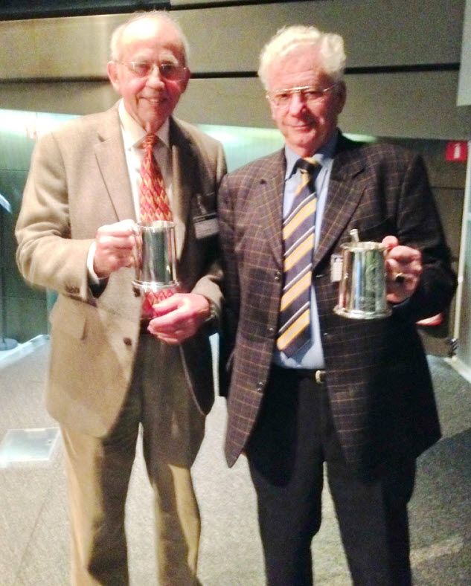
Ian Whittle & Wolfgang Brix with their
RAeS Toulouse Branch Speakers’ Tankards.
Download their Presentations from: www.Dibley.eu.com.

Slide 3
Ian WHITTLE
Son of Sir Frank WHITTLE
Learned fly at school aged 17 through Government Flying Scholarship
5 years in Royal Air Force flying Meteor & Hunter jet fighter aircraft
1958 Kuwait Airways based in Bierut on B707 & Hawker Siddeley Trident
1969 Cathay Pacific in Hong Kong on Convair 880, TriStar & B747
After active flying instructed for Cathay on the B747 Flight Simulator
Fellow of the RAeS, Master Pilot of the Honorable Company of Air Pilots
Still flies his own light aircraft Piper Archer from the UK to France

Slide 4
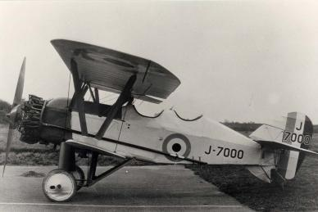
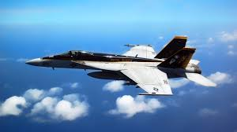
Genesis of the Turbojet

Slide 5
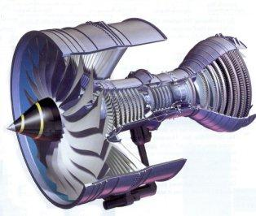
Rolls-Royce Trent 1000 Turbofan

Slide 6
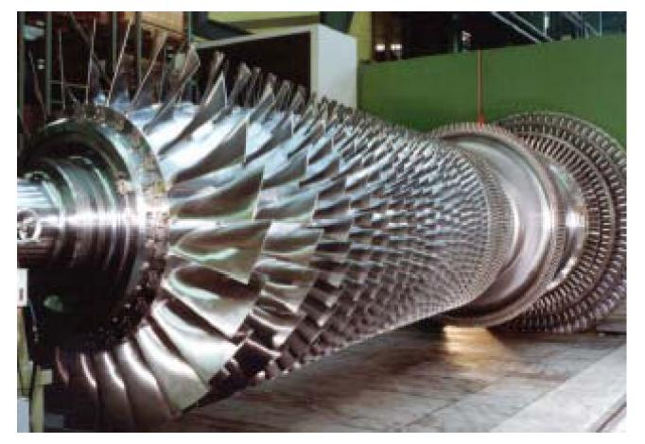

Slide 8
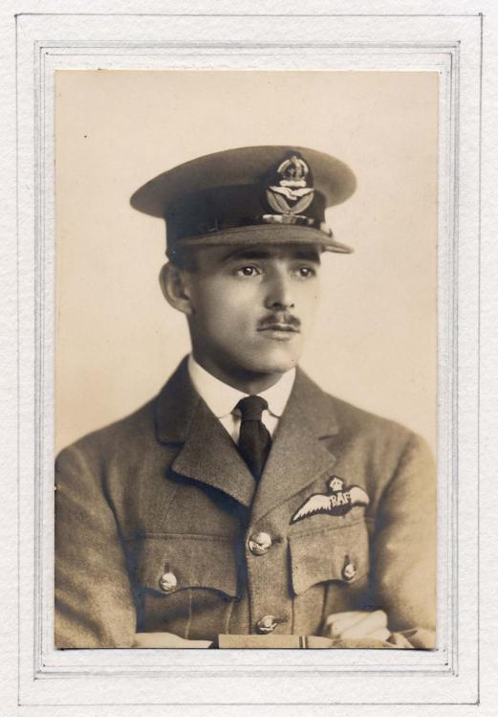

Slide 9
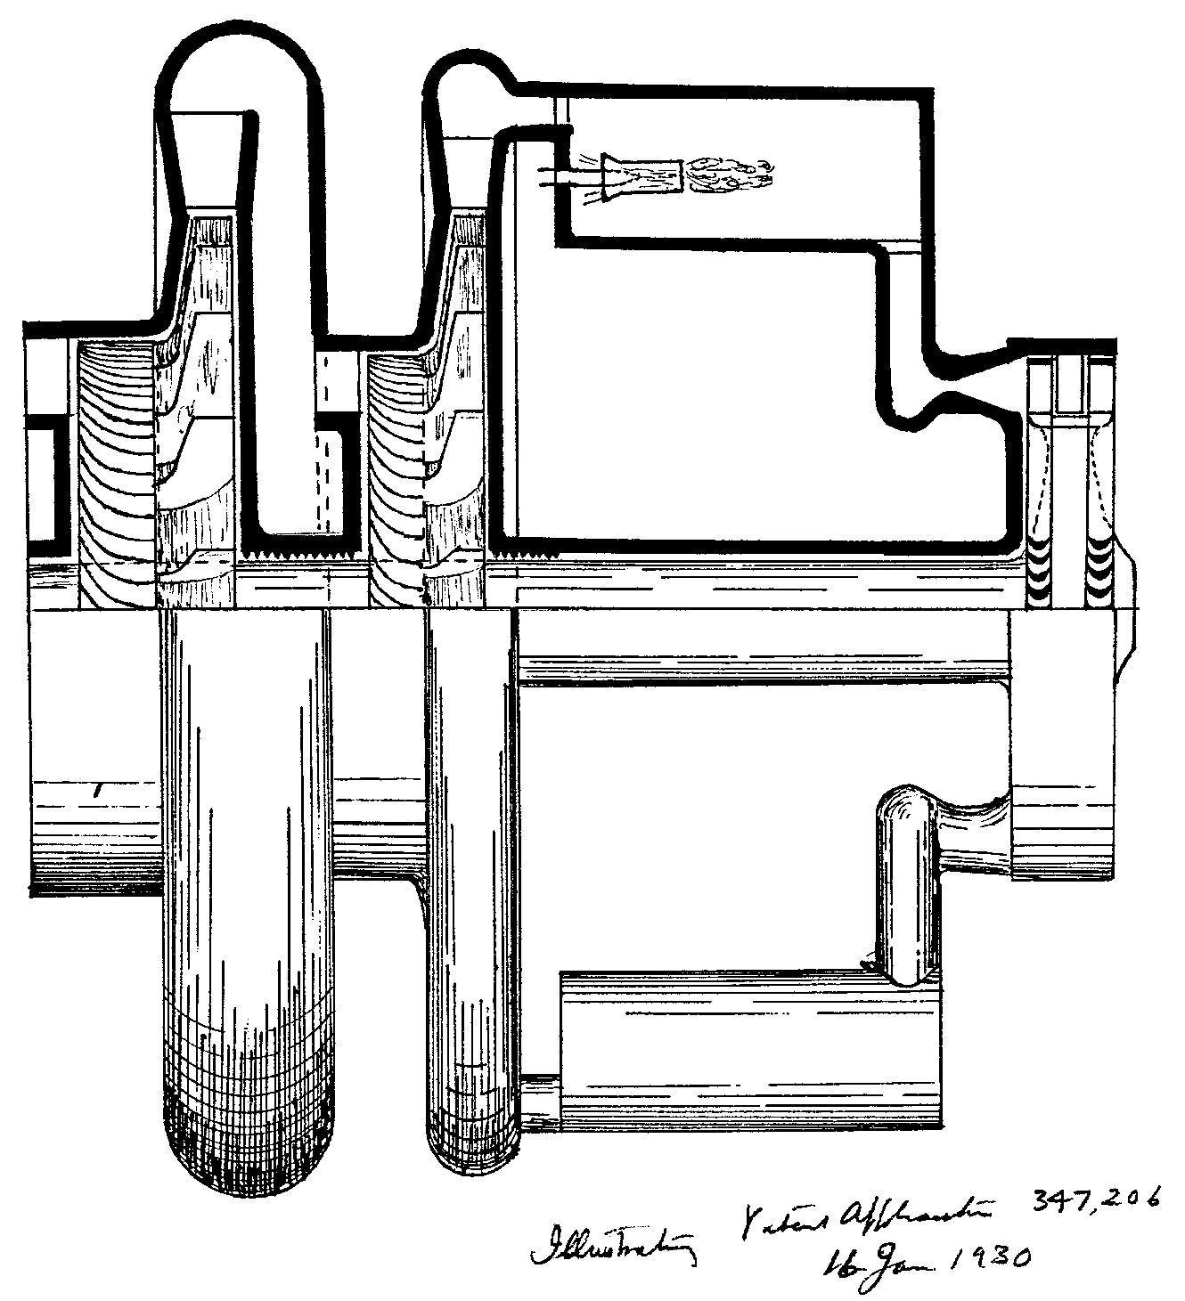

Slide 10
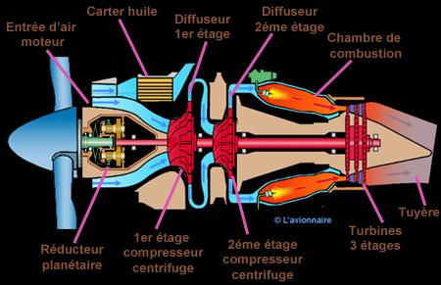

Slide 11
Dr Griffith (RAE) advises
Air Ministry that idea has insufficient merit to warrant further research

Slide 12
1930/31
Turbojet patent
Air Ministry remain disinterested and fail to apply secrecy
Aero gas turbine work at RAE ceases

Slide 13
1931/32 Turbojet enters the public domain
?
?

Slide 14
1930 - 34 Turbofan
Turbofan

Slide 15
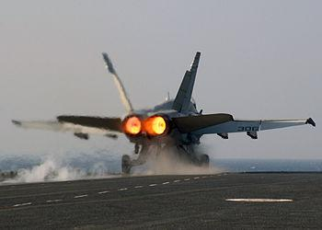
Reheat

Slide 16
1934 - 1936 F.W. at Cambridge (Peterhouse)
May 1935 - turbojet rescued from oblivion

Slide 17
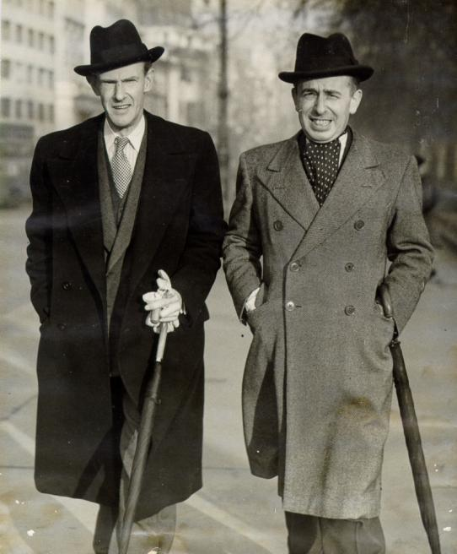
Col Tinling & Rolf Williams c1936
Notes:
Collingwood Tinling and Rolf D Williams who formed a partnership that rescued the turbojet from oblivion in Britain 1936.

Slide 18
1936 - back into the fray
Power Jets Ltd.
Royal Aircraft Establishment

Slide 19
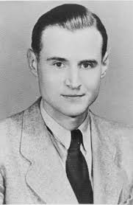
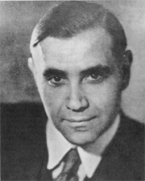
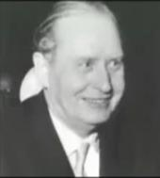
1935-1936 Germany
Hans von Ohain
Herbert Wagner
Hermann Oestrich

Slide 20
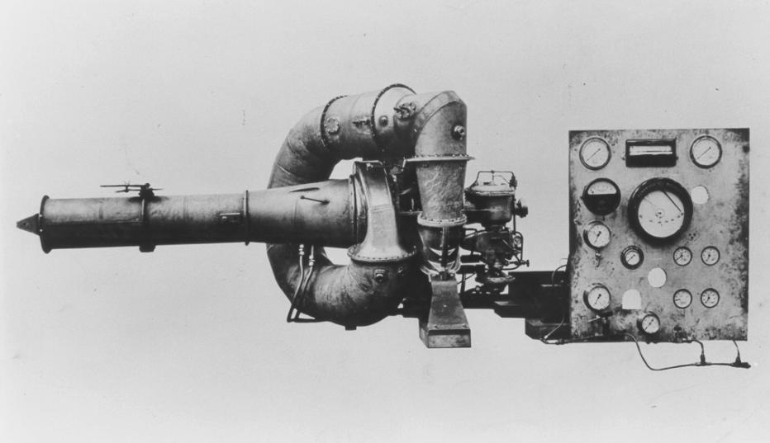

Slide 21
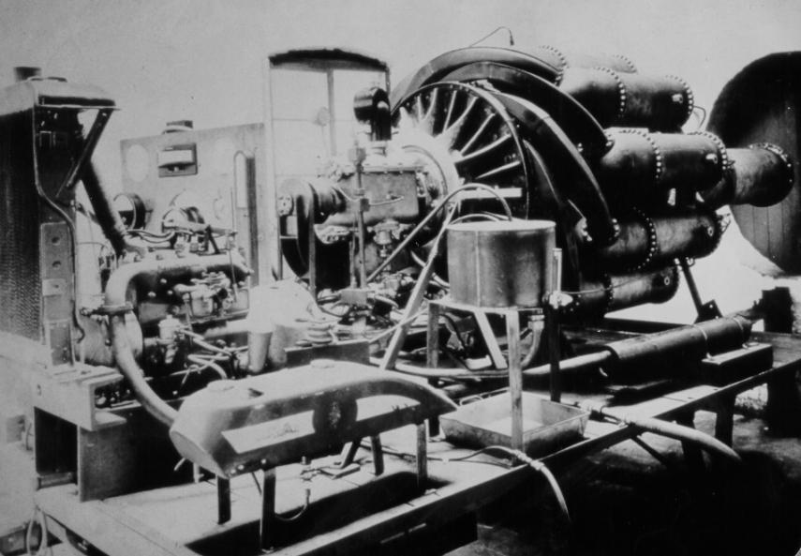

Slide 22
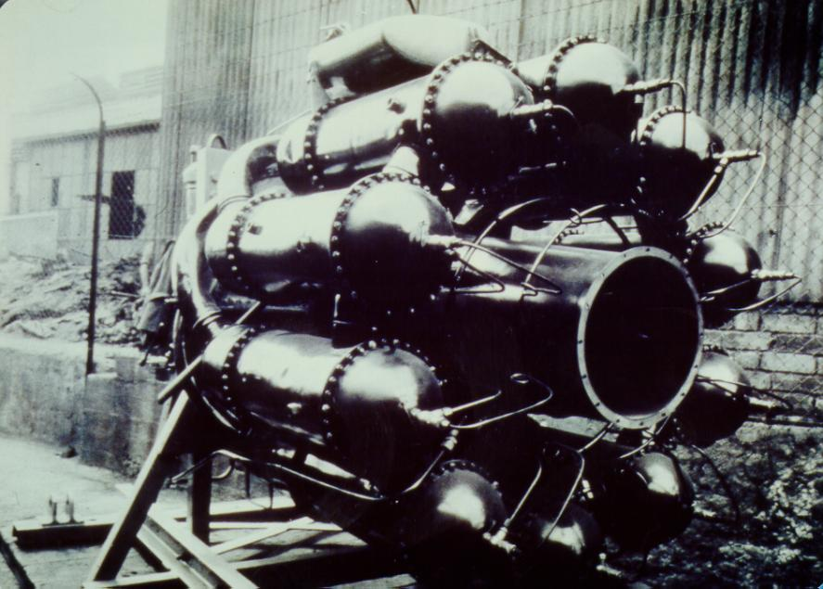

Slide 23
1939 - Germany First Flight of a Turbojet aircraft - He.178
Rocket • Turboprop • Turbojet • Ducted Fan • Pulsejet • Ram Jet

Slide 24
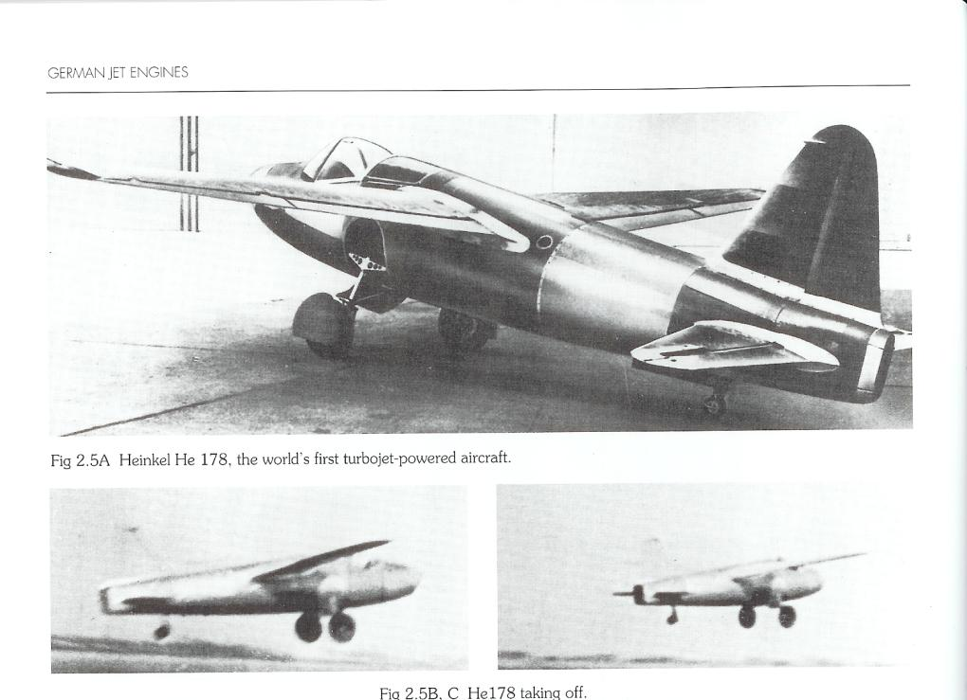

Slide 25
May 15th 1941 First Flight of the Gloster E28/39 Flight duration: 17 minutes Cleared for 10 hours of flight test before engine inspection

Slide 26
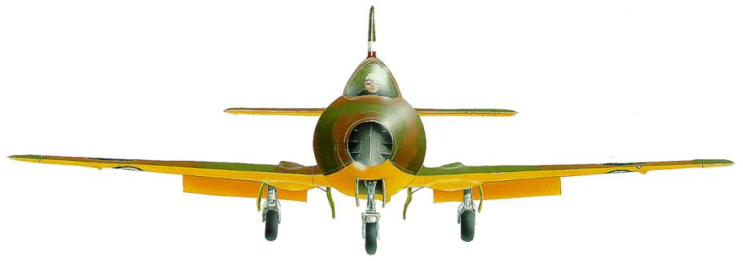

Slide 27
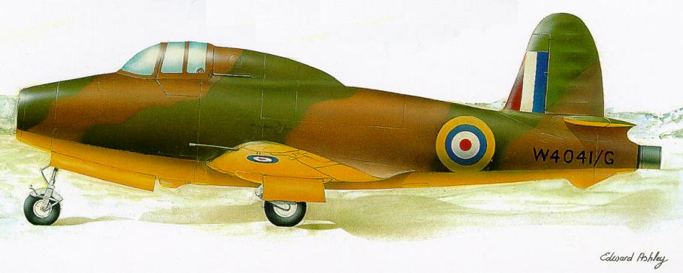
Gloster E28/39

Slide 28
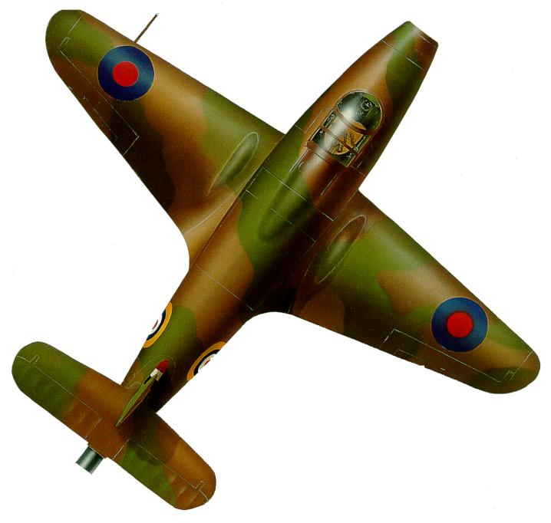

Slide 29
1941 - The W1 sent to the USA
(In 1940, the NAS had condemned the Gas Turbine Engine as unsuitable for aeronautical applications!)

Slide 30
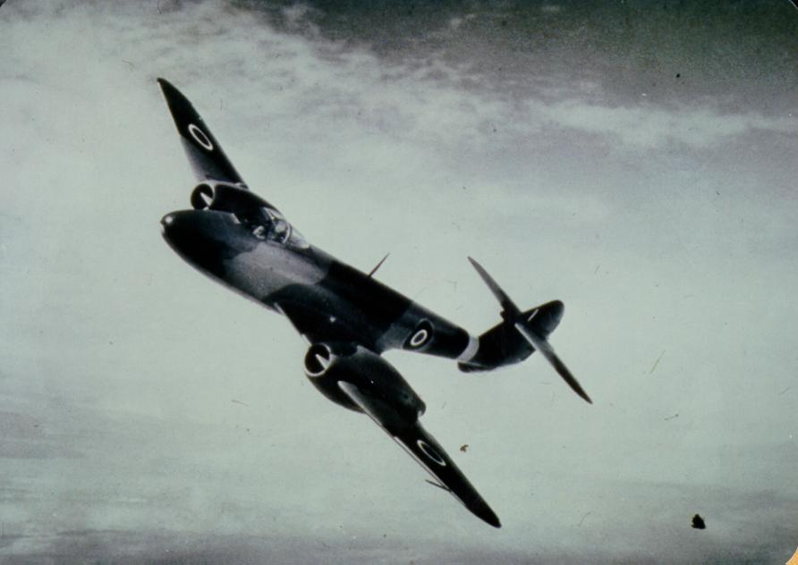

Slide 31
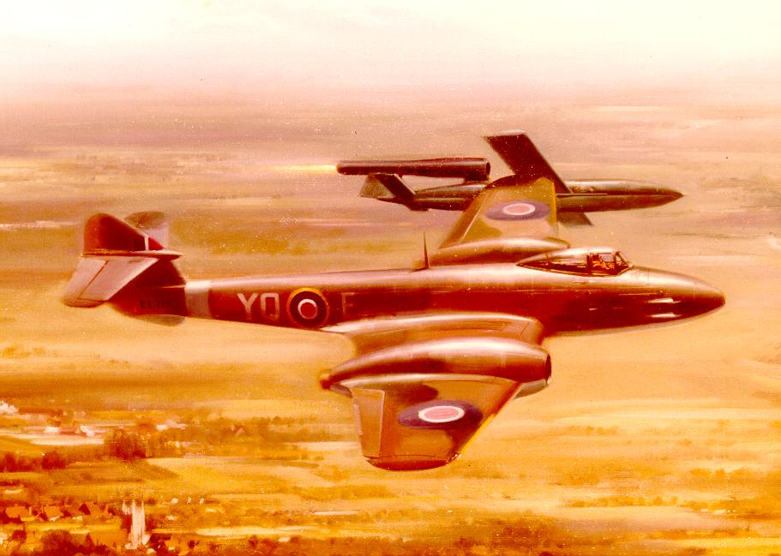

Slide 32
Wolfgang BRIX
Engine expert in Bremen for VFW-Fokker / Airbus Deutschland 36 years
Studied & made calculations for all Airbus engines –
Visited Toulouse more than 70 times
2005 Retired - made an archive of all his material,
2008 Wrote about all the engines in his life.
Presented in 1989 München Symposium “50 Years of Turbojet flight” 1989.

Slide 33
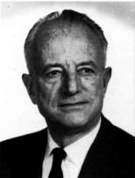
The fathers of the turbo jet engine
A presentation by
Wolfgang Brix (Germany), Engine expert Airbus Deutschland
and
Ian Whittle (Great Britain), Son of Sir Frank Whittle
1

Slide 34
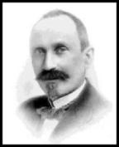
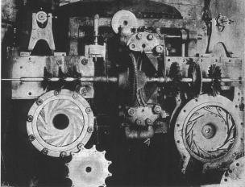
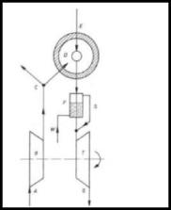
1 The first gasturbine of Aegidius Elling
On June 27th, 1903 the Norwegian Aegidius Elling writes in his diary :
„I have made the worlds first gas turbine which has given
positive (excess) power.“
Ellings gas turbine from 1903 :
Temperature at turbine entry : 400°C
Power : 11 hp
The test installation can still be seen in
the Norwegian Technical Museum in Oslo
2

Slide 35
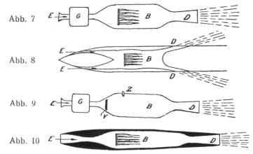
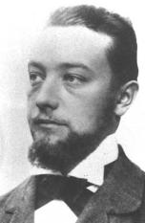
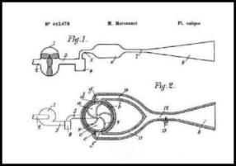
2 The first jet engine ideas
René Lorin (1877–1933)
1913 Patents by Frenchman René Lorin
All patents have in common: They do not show the power unit to drive the compressor.
1909 Patents by Frenchman
M.George Marconnet
3

Slide 36
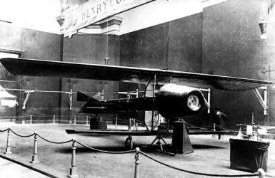
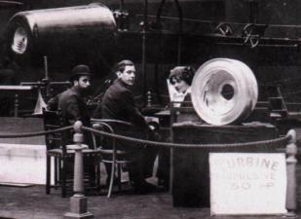
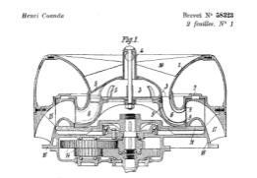
3 The first jet flight of Henri Coanda
1910 Air Exposition in Paris
The Romanian Henri Coanda shows an aircraft
without propeller.
Below: on the table a part of the engine, inscription: Turbine Propulsive 50 hp.
1911 : Coanda gets a patent for a „Propulseur“.
4

Slide 37
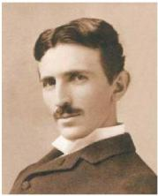
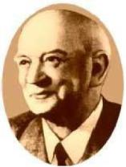
3 The first jet flight of Henri Coanda
Henri Coanda (1886-1972)
"It was on 16 December 1910. I had no intention of flying on that day. My plan was to check the engine on the ground …..I did not realize that the aircraft was rapidly gaining speed. Then I looked up and saw the walls of Paris approaching rapidly. …. I decided to fly instead……The aeroplane seemed to make a sudden steep climb and then landed with a bump. First the left wing hit the ground and then the aircraft crumpled up. I was not strapped in and so was fortunately thrown clear of the burning machine".
This was the first jet flight in history !
5

Slide 38
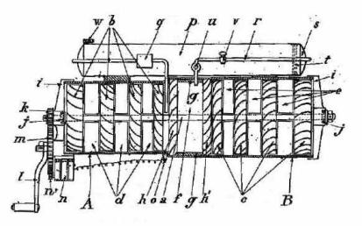
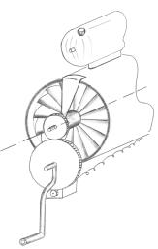
4 The patent of Maxime Guillaume
1922 A first impression of a turbo jet engine is given by patent No 534.801 of Frenchman Maxime Guillaume, filed on 3rd May 1921, granted on 13th January 1922. The title was „Propulseur par reaction sur l’air“ = „Propulsion by reaction on air“.
Guillaumes engine is not complete, inlet and nozzle are missing and he cannot describe exactly how it works. He does not know the words nozzle, jet, jet velocity, mass flow, gross thrust, ram drag, net thrust.
6

Slide 39
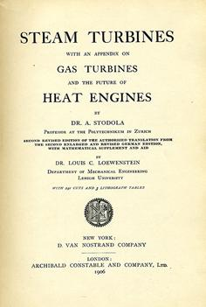
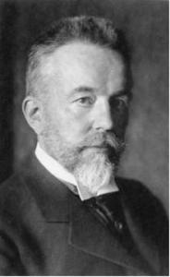
6 The book of Aurel Stodola
Prof. Aurel Boreslav Stodola
born 10.5.1859 in the Slowakei,
died 25.12. 1942 in Zürich
This is Stodolas book about Steam+Gas Turbines. It is published from 1905 to 1927 in 6 editions and in 5 languages, this 1000-pages book becomes the bible of all steam and gas turbine engineers.
7

Slide 40
6 The book of Aurel Stodola
Sir Frank Whittle knows and owns the Stodola book. The Nernst Turbine appears even in Whittles book “Gas Turbine Aero Thermodynamics“ .
Dr. Hans von Ohain knows the Stodola book, as here he finds the Nernst Turbine, which becomes the starting point of his inventions.
Sir Stanley Hooker, later chief of Rolls-Royce and Bristol Engines, starts his career with the study of Stodolas book.
The Nernst turbine
in Whittles book, left
and in Stodolas book, right
These 3 men found their inspiration in this book of Stodola
8

Slide 41
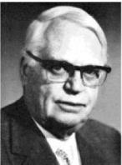
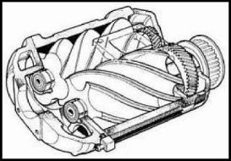
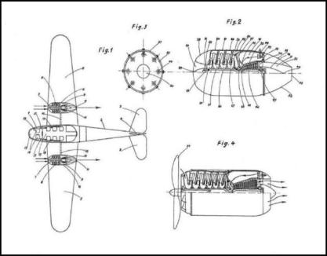
7 Alf Lysholm
Lysholm‘s vita :
1893 December 14 born in Stockholm
Employed by Ljungström
Chief engineer
Main work on screw compressors
Pressure ratio up to 4
Lysholm‘s German patent DE 710,082 from 1933. It covers a version with propeller and a version with pure jet. None of Lysholms ideas has ever been built.
9

Slide 42
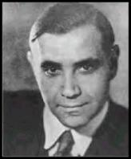
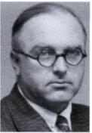
8 Herbert Wagner and team
Wagner’s vita :
1900 Born in Graz/Austria
1934 First idea of a turbo prop engine
1935 At Junkers : Chief of airframe development,
work on long range aircraft
1936 1.April : Wagner presents first idea of a turboprop engine to:
Max Adolf Müller and other engineers
1938 Design and construction of a pure turbo jet engine, but
the Junkers engine department is not informed
1938 Wagner needs better materials (alloyed steels), he contacts the RLM,
Göring and his team are surprised and upset, they demand the work must
be done in the Junkers engine department . Wagner + team refuse
They know that Prof Mader is against jet engines
1938 End of the year the team splits : Wagner + some go back to Berlin,
Max Adolf Müller turns to Heinkel, who hires him and 15 other member s
of the team. They start in October 1939 in Rostock the department of
axial engines and produce the He S 011 with 1333 kp (2939 lb) thrust. This was the highest thrust of all German engines, but only a prototype.
Herbert Wagner
1900-1980
Max Adolf Müller
1901 - 1962
10

Slide 43
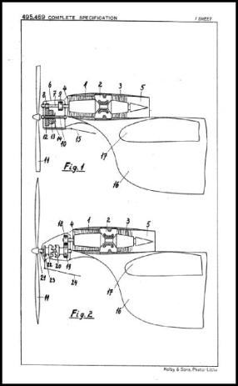
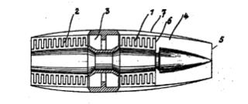
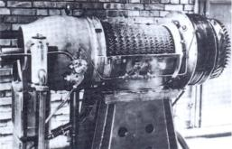
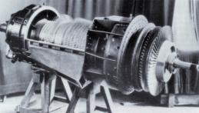
8 Herbert Wagner and team
Patent DE-724091
Patented 14.Aug 1938
The RT0
14-stage axial compressor, annular combustion chamber, 2-stage turbine
No independent run
The RTI 12-stage axial compressor, annular combustion
chamber, 2-stage turbine,
reached only 6500 rpm instead of projected 12900 rpm
Both engines disappear 1939 without trace in history
Patent GB 495,469
British application 8.Feb 1937
German application was 1935
11

Slide 44
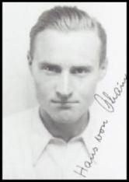
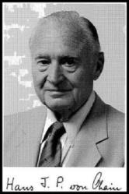
9 Hans Joachim Pabst von Ohain
Von Ohain’s vita :
14.12.1911 Born in Dessau
Studies In Berlin
1934/35 Doctor thesis with Prof Pohl as doctor father :
„An interference Light Relay for White Light“
3.6.1934 First Patent , sold to Siemens for 3500 Mark
9.11.1935 Second patent: a turbo jet engine
Dr.Hans Joachim Pabst von Ohain
1911-1998
12

Slide 45
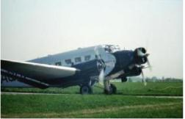
9 Hans Joachim Pabst von Ohain
The idea for elegant flight
1931 Hans von Ohain makes a flight with a Ju52 from Köln to Berlin
His comment:
„The propellers made a horrendous noise. The airplane rattled because
It had piston engines. …So I said, „Well, gee, that isn‘t good“. As an
physicist you can come up with another process.“
The first idea: A process without moving machinery : after some
deeper consideration finds it to be impossible.
The second idea: The Nernst turbine.
He describes the „modified“ Nernst turbine: having a radial
compressor back to back wih a radial turbine ....
“I was aware of employing axial flow compressors and turbines...
but as too complex and expensive for the beginning. “
13

Slide 46
9 Hans Joachim Pabst von Ohain
The first patent (only an application)
The Nernst turbine from
Stodolas book about
Steam- and Gasturbines 1922
Patent No O. 21 822 XI/62b,
Filed 15.Mai 1935,
Never granted
14

Slide 47
9 Hans Joachim Pabst von Ohain
The way to the second patent
Nernst turbine 1 element 2 elements 4 elements 8 elements
8 elements 8 elements The turbo jet engine patent
combined into 1
15

Slide 48
9 Hans Joachim Pabst von Ohain
The second patent
Geheimes Reichspatent 317/38
Filed 9 November 1935
Patent 10 Nov 1935
16

Slide 49
9 Hans Joachim Pabst von Ohain
The garage model
1935 Construction of a demonstration
model in the garage of Bartels & Becker
in Göttingen with the help of Max Hahn,
no self sustained operation,
Prof. Pohl helps with various equipment
and checks the theory,
1936 When von Ohains money is spent,
Pohl says: You need industrial support,
Whom shall I write to ?
Von Ohain decides: to Ernst Heinkel !
The compressor
Max Hahn and the garage model
17

Slide 50
9 Hans Joachim Pabst von Ohain
The letter
3 March 1936 Prof.Pohl writes to Prof.Heinkel
Heinkel invites von Ohain.
On 17th March 1936 they meet in Heinkels Villa in
Warnemünde at the beach of the Baltic Sea.
18

Slide 51
9 Hans Joachim Pabst von Ohain
Ernst Heinkel Siegfried Günter Walter Günter Kurt Matthaes Karl Schwärzler Heinrich Helmbold
Both twins - Project office Test Dept. Chief constructor Aerodynamicist
On the next day they meet again in the company with Heinkels technical team.
The reaction of the engineers:
„The idea of a turbojet is already known, but no one has produced
a practical one. ..perhaps the time has come to have another try on it.“
After a second meeting Hans von Ohain gets a contract with a salary of 300 Mark/month.
Max Hahn is hired, too.
On 15th April 1936 they start working at Heinkel.
19

Slide 52
9 Hans Joachim Pabst von Ohain
The team (left to right): Max Hahn,Hans von Ohain, Wilhelm Gundermann – from Heinkel
First they try again the garage model, again no selfsustained operation
They build a copy of the garage model with the capabilities of the Heinkel company,
again no selfsustained operation
They gain the impression that they need 6-12 months to solve the combustion problem
They decide to proceed in two directions:
Build a hydrogen combustion facility and then a demonstration engine running with hydrogen
Develop a combustion chamber running satisfactorily with fuel
 | The hydrogen model HeS-1, built 1936/37, first run Feb/March 1937, thrust 250 lb = 113 kp at 10000 U/min
20

Slide 53
9 Hans Joachim Pabst von Ohain
The hydrogen model : when did it run first ?
Ernst Heinkel: In his memoirs „Stormy Life“ he mentions : “...in a September night 1937 “
Hans von Ohain : On many occasions he stated:
„ This date (September 1937) is definitely wrong. It was February/March 1937 “
Ian Whittle: There are some serious doubts…..
My comment : We will never find out….
21

Slide 54
9 Hans Joachim Pabst von Ohain
The Hahn patent and the HeS3B
Hahns patent The first drawing of the flight engine The final flight engine HeS3B
Hahn has the idea to increase the size of the combustion chamber and locate it in the large unused space in front of the radial flow compressor. Advantage: the diameter of the engine is kept small. Disadvantage: the flow must change direction twice.
22

Slide 55
9 Hans Joachim Pabst von Ohain
The flight engine HeS3B
First the flight engine HeS3B was built 1938/39, first run was around March1939
Initial thrust was 350 kp (772 lb) ,later 500 kp (1102 lb)
 | In May or July 1939 the first He3B was flight tested under a He118. Because of a fuel leakage it burnt after a landing , destroying engine and aircraft. The pilots Warsitz and Künzel can escape unharmed.
23

Slide 56
9 Hans Joachim Pabst von Ohain
The He178
Above: photos of the second prototype V2 which never flew
Above: this photo is a fake, some details are wrong.
24

Slide 57
9 Hans Joachim Pabst von Ohain
The first flight of the He178
Date Sunday, 27 August 1939
Starting time Around 6:00 (Sunrise 5:08)
Start 300 m rolling
Max speed 600 km/h (?)
Erich Warsitz flies 2 rounds
Total flight time 6 minutes
Both Heinkel and Warsitz later reported
that the raising of the landing gear was attempted, but in vain.
This is nonsense, the landing gear was fixed, they knew it.
It was the first turbo jet flight in history
25

Slide 58
9 Hans Joachim Pabst von Ohain
 | Short celebration after the first flight of the He178
Heinkel von Ohain Warsitz Heinkel von Ohain
The second flight of the He178 : 1 November 1939
High officials from Berlin come : Udet + entourage
During take off roll the fuel pump fails, Heinkel entertains
the visitors with an opulent breakfast, after 2 hours
a second successful take off is made and Warsitz flies
for around15 minutes.
When leaving the visitors seem unimpressed.
26

Slide 59
9 Hans Joachim Pabst von Ohain
But around 2 months later Heinkel receives from the RLM the official assignment to develop a jet plane with 2 jet engines under the wing, the name is He280.
 | One potential engine for the He280 is the HeS8 (right) a derivative of the HeS3B (left) It has a straight flow through combustion chamber, a much longer rotor between compressor and turbine and thus a smaller diameter. The HeS8 never reaches more than 600 kp (1323 lb) thrust.
27

Slide 60
9 Hans Joachim Pabst von Ohain
First flight of the He280 is on 30th March 1941.
For safety reasons the engine cowls are not attached.
The second flight 6 days later is observed by Ernst Udet.
He is excited and allows Heinkel
to buy the Hirth Motoren Company, which means, he is
now an engine manufacturer and may continue with
his engine activities.
Ernst Udet
1896 - 1941
On the second flight the engine cowls are closed. On the right photo Udet makes a seating test.
End of the story: In March 1943 the He 280 is cancelled, the engines remain prototypes.
28

Slide 61
10 Anselm Franz
Franz‘s vita :
1900 1.January born in Schladming, Austria
1918-1924 Studies in Graz
1936 Working on superchargers at Junkers
1939 Chief engineer for the turbo engine development
After 1945 Working for Lycoming
Dr. Anselm Franz
1900 - 1994
Dr. Anselm Franz
1989 in München
Jumo 004 AB Serie for Me262
Thrust 910 kp (2006 lb)
Weight 850 kg
PR 3.1 with 8 stages
First run 6.8.1940
6000 units built
Me 262 First flight 18.7.1942
Top speed over 850 km/h (1004 km/h in one case)
1368 aircraft built
29

Slide 62
11 Hermann Östrich
Östrich‘s vita :
1903 30.December born in Duisburg
Studies in Hannover, Berlin
1926 Working for DVLR
1935 BRAMO in Berlin
1939 Chief engineer for the turbo engine development
After 1945 Working for Snecma (Atar)
Dr.Hermann Östrich
1903 - 1973
BMW 003 A Serie for Ar234, He162
Thrust 800 kp (1764 lb)
Weight 570 kg
PR 3.1 with 7 stages
First run 20.2.1941
700 units built
Arado Ar 234 V6 First flight 8.4.1944
Top speed of 234C 872 km/h
214 aircraft built
30

Slide 63
12 The whole German Story
Thrust in lb
HeS011
withAB
Jumo 004
Serie:6000
BMW 003
Serie:700
HeS8
HeS30
HeS3B
HeS1
1936
1937
1938
1939
1940
1941
1942
1943
1944
1945
First flight
He 178
27.8.1939
First flight
He 280
30.3.1941
First flight
Me 262
18.7.1942
First flight
Ar 234
5.6.1943
First flight
He 162
6.12.1944
At the first day of war : 1 turbojet engine, at the last day : 6700 produced.
31

Slide 64
Ian WHITTLE
son of Sir Frank WHITTLE
and
Wolfgang BRIX
former Engine Expert Airbus Deutschland
Questions?
Notes:
Ian WHITTLE

Slide 66
Frohes Fest und ein gutes Neues Jahr
Merry Christmas and Happy New Year
Bonnes Fêtes / Meilleurs Voeux
Feliz Navidad & Feliz Aňo Nuevo
God Jul och Gott Nytt År

Slide 67
Forthcoming Programme
For posters / any changes / updates
www.RAeS-Toulouse.org
www.Aerosociety.com
and links to
www.Academie-Air-Espace.com
AAAf-MP@sfr.fr

