Slide 1
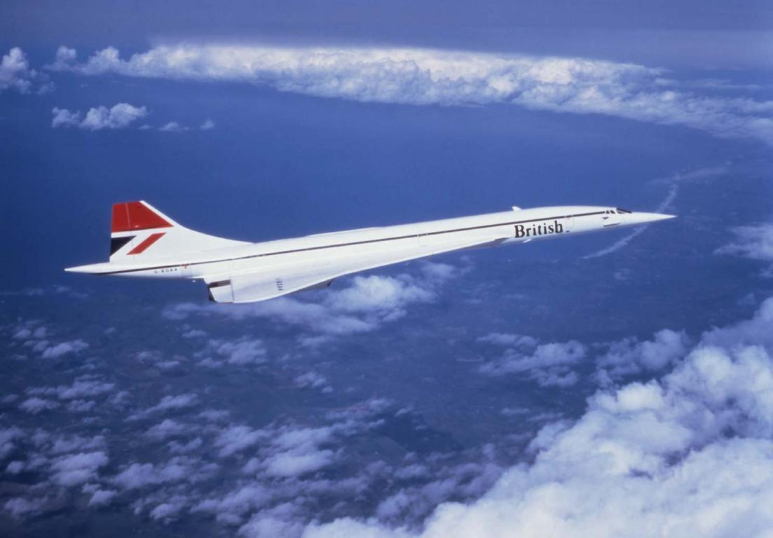
British Airways
100 Years of Airline History
Adrian Constable

Slide 2
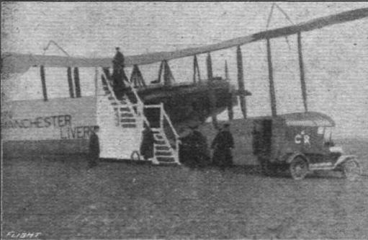
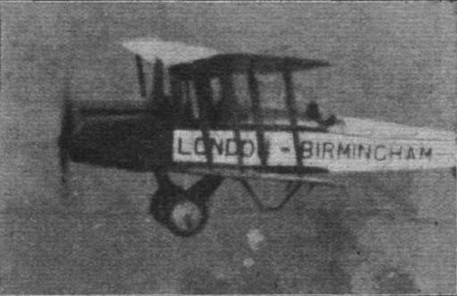
In the Beginning
Aircraft Transport & Travel
  Subsidiary of The Aircraft Manufacturing Company (AirCo)
  Founded 5 October 1916
  Wait until the Great War has finished…

Slide 3
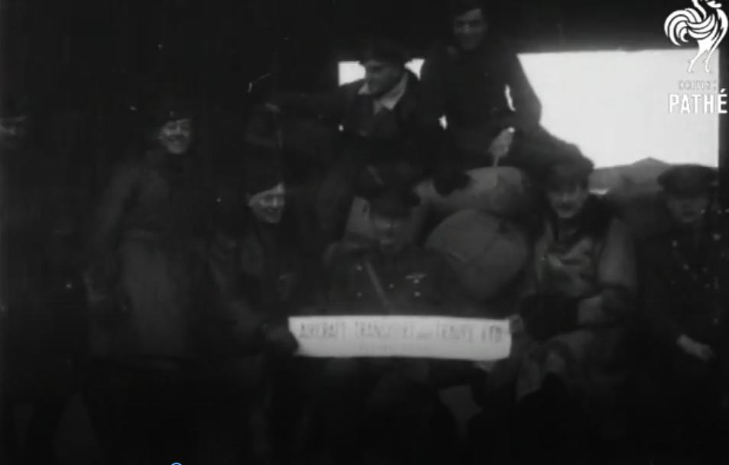
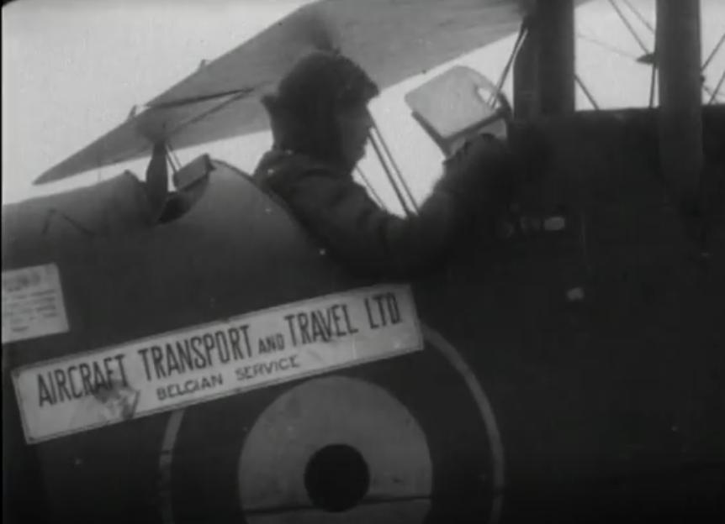

Slide 4
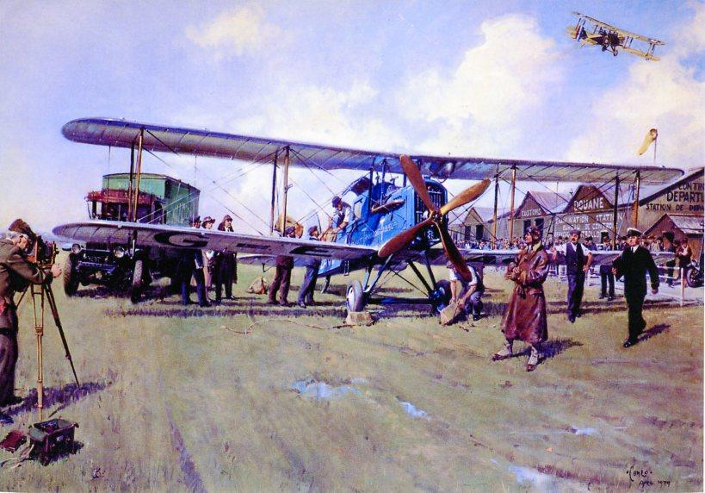
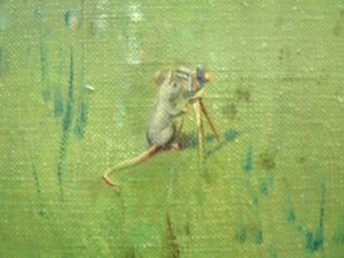
25 August 1919, Hounslow Heath

Slide 5
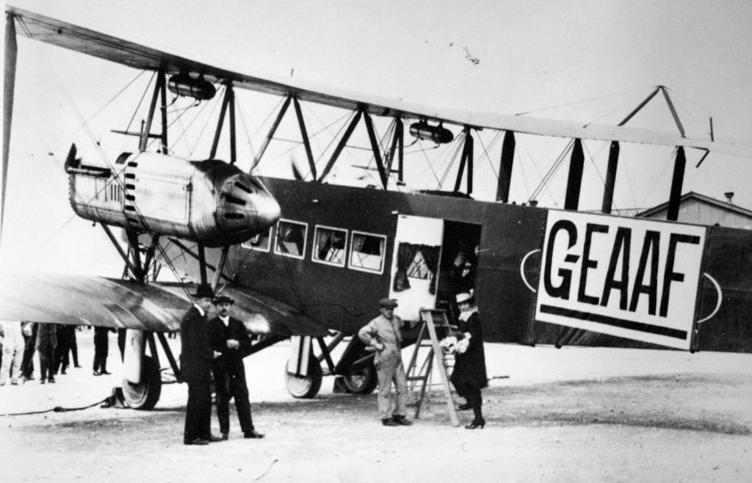
Handley Page Transport

Slide 6
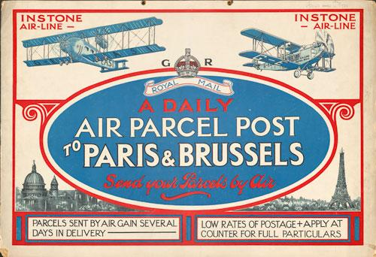
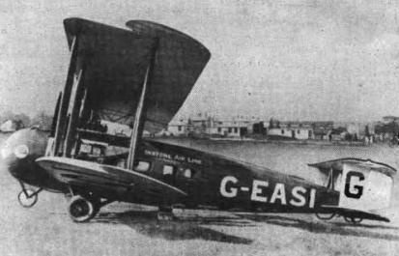
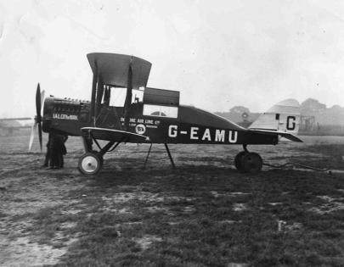

Slide 7
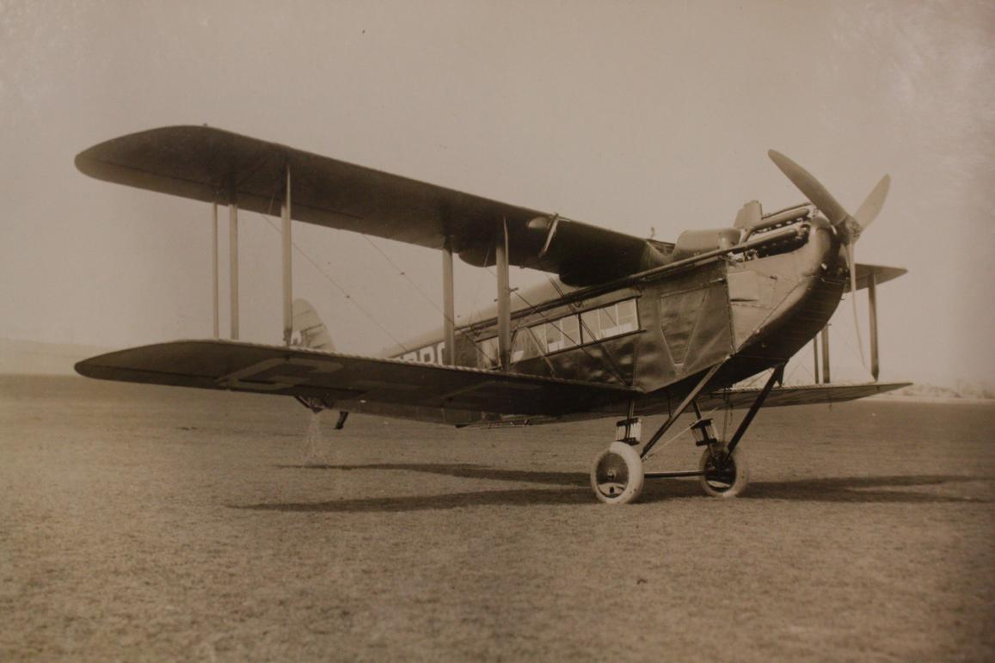
1922 Daimler

Slide 8
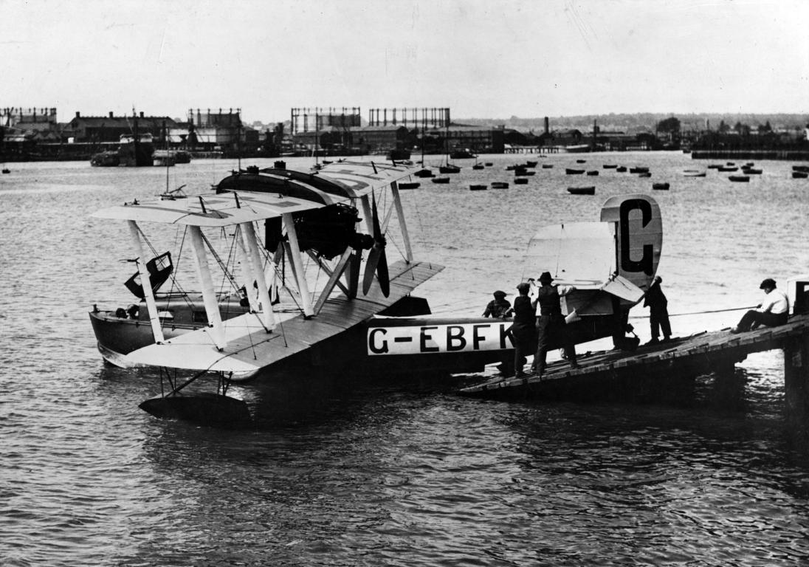
1923 BMAN

Slide 9
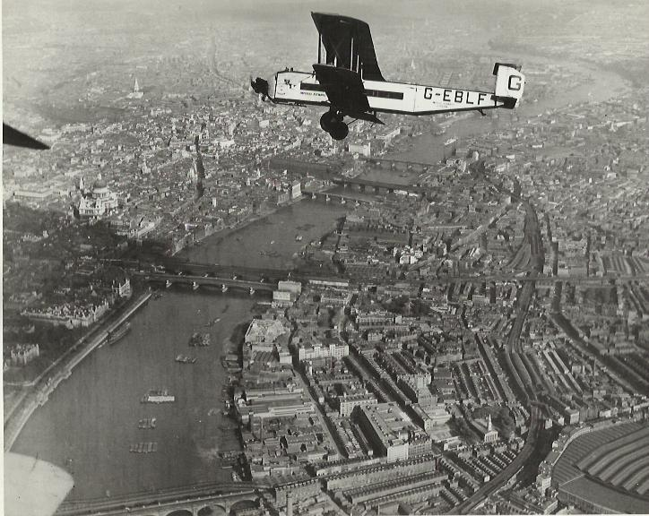
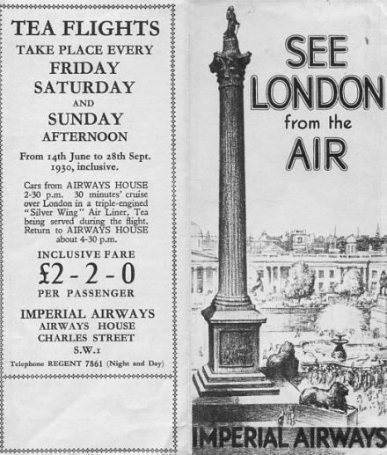
1924 Imperial Airways
British Airways Speedbird Centre 20 June 2013
Notes:
2 September 2013
9
Pictures can fill the whole slide above the ribbed footer bar, please respect the original picture ratios.
If using a heading, ensure the text colour contrasts effectively with the picture shown.

Slide 10
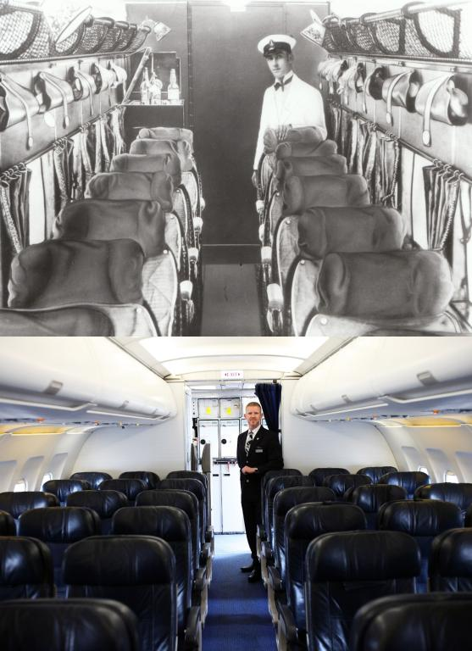

Slide 11
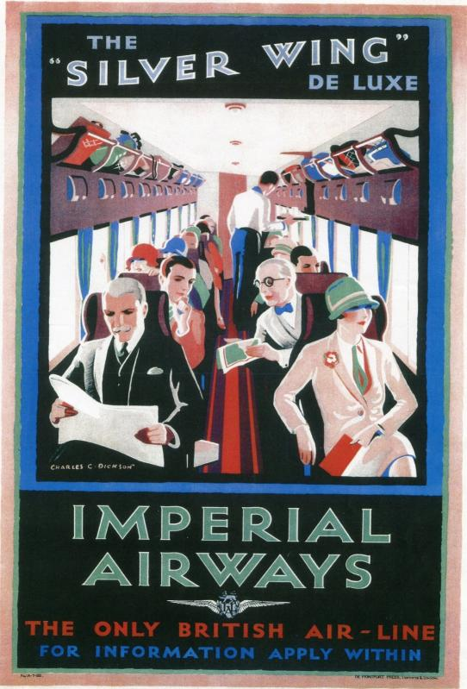
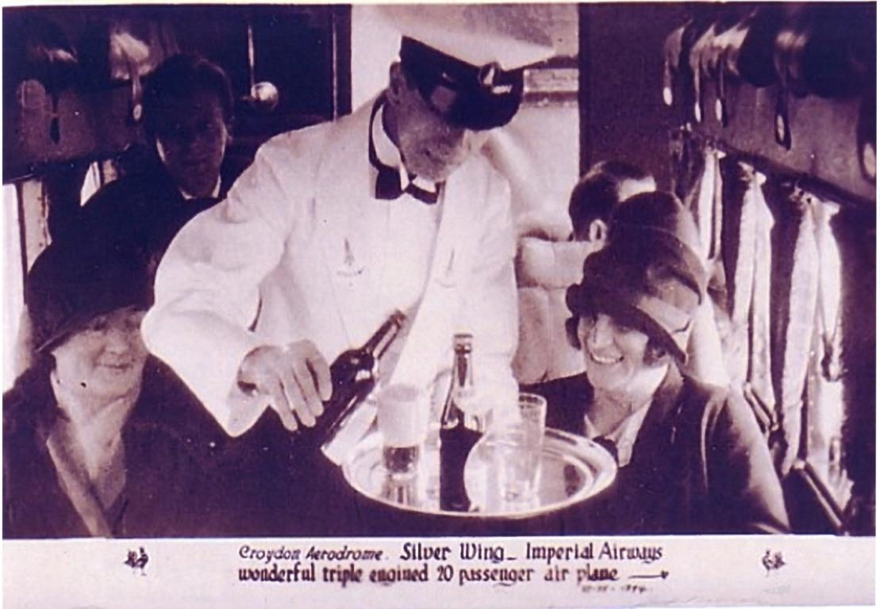

Slide 12
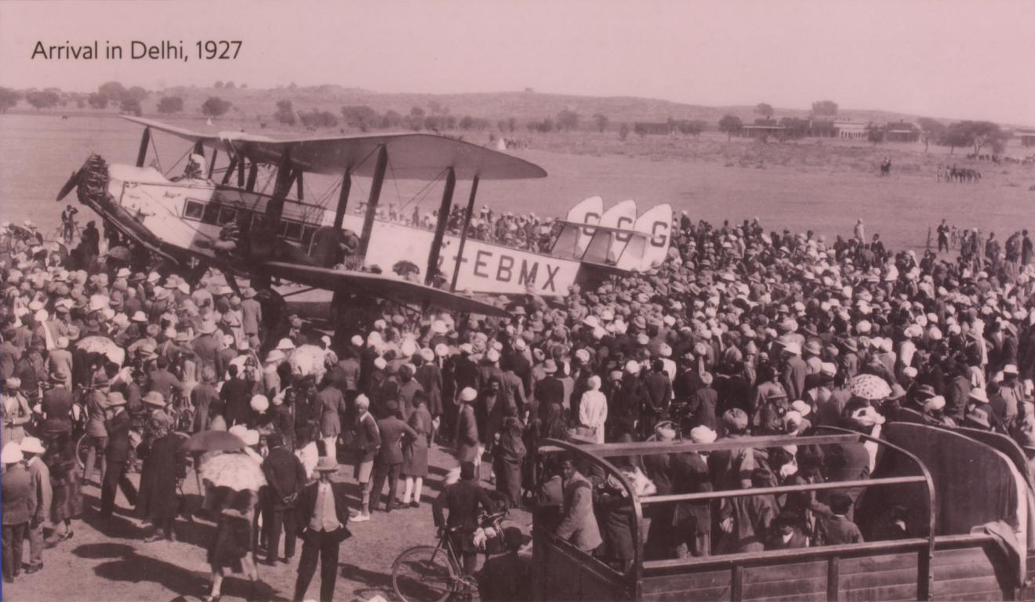

Slide 13
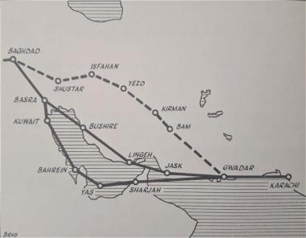
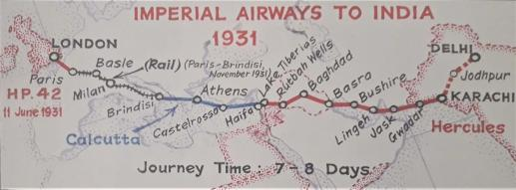
Early 1930s
Politics and depression
Little competition beyond Europe
Airships are no longer the future
Imperial control everything…
…except the local politics
  Persia
  Mussolini
They follow their own path…
1934 MacRobertson Race

Slide 14
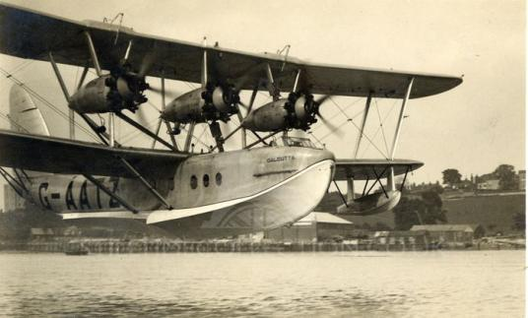
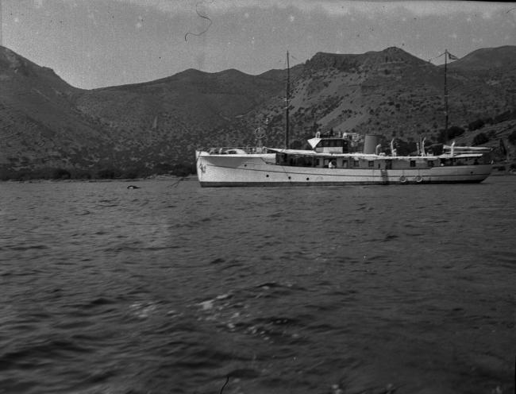
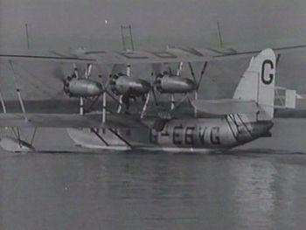
Boats!

Slide 15
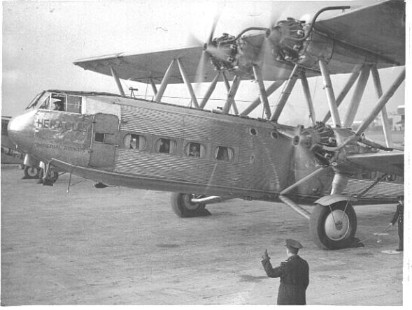
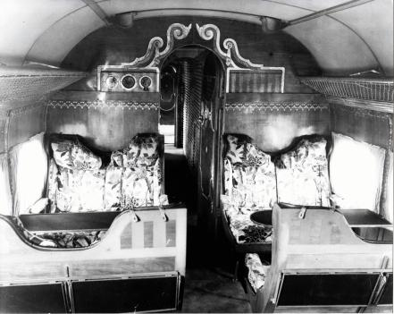

Slide 16
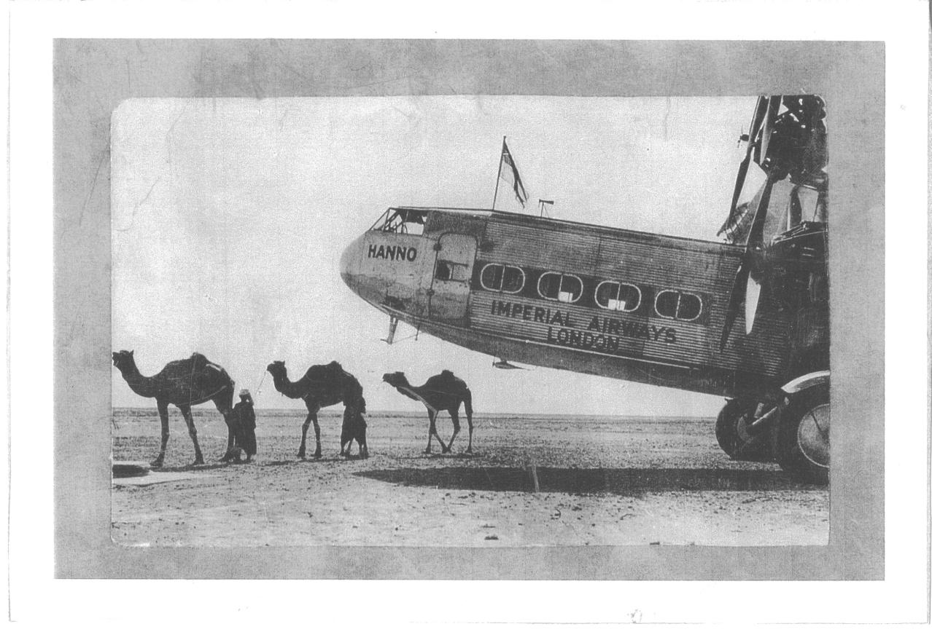
16

Slide 17
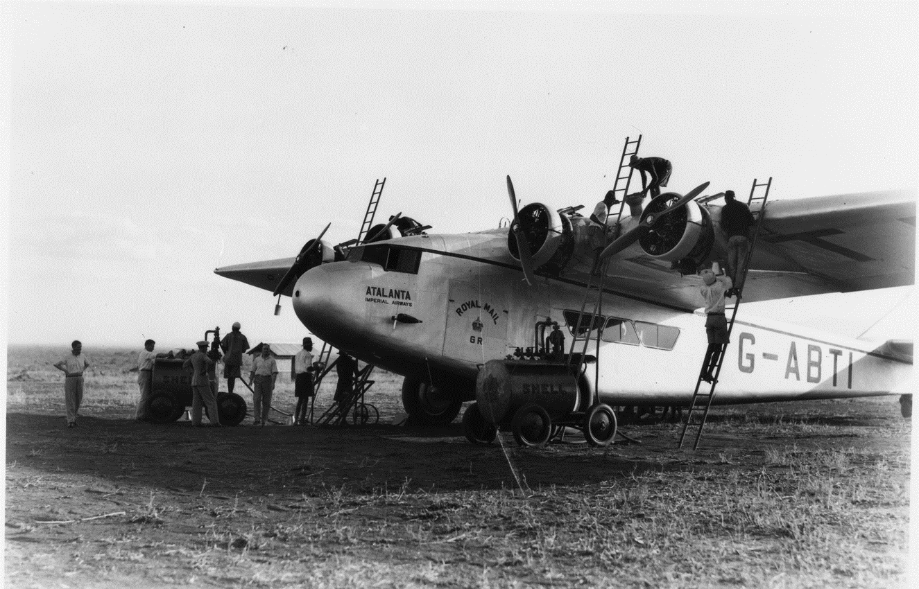
1932 Atalanta

Slide 18
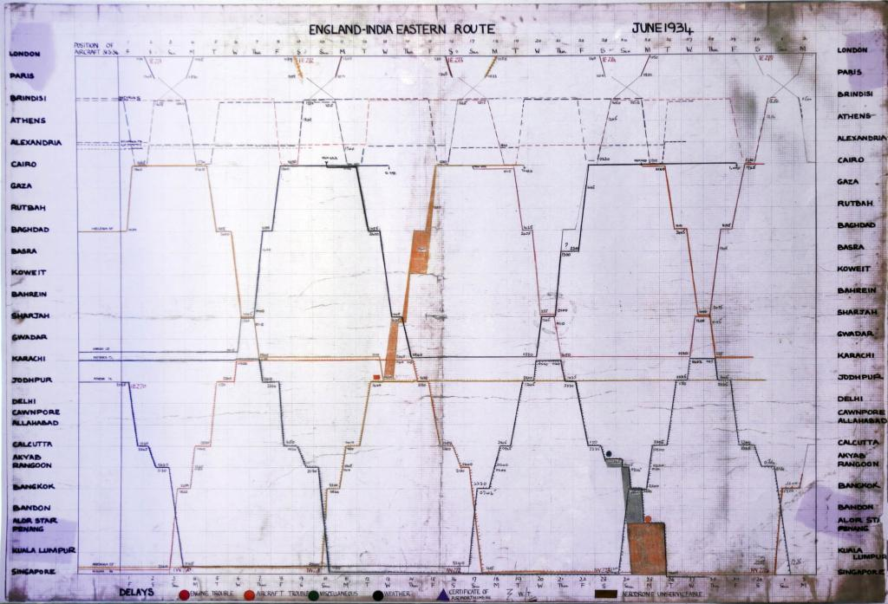
18

Slide 19
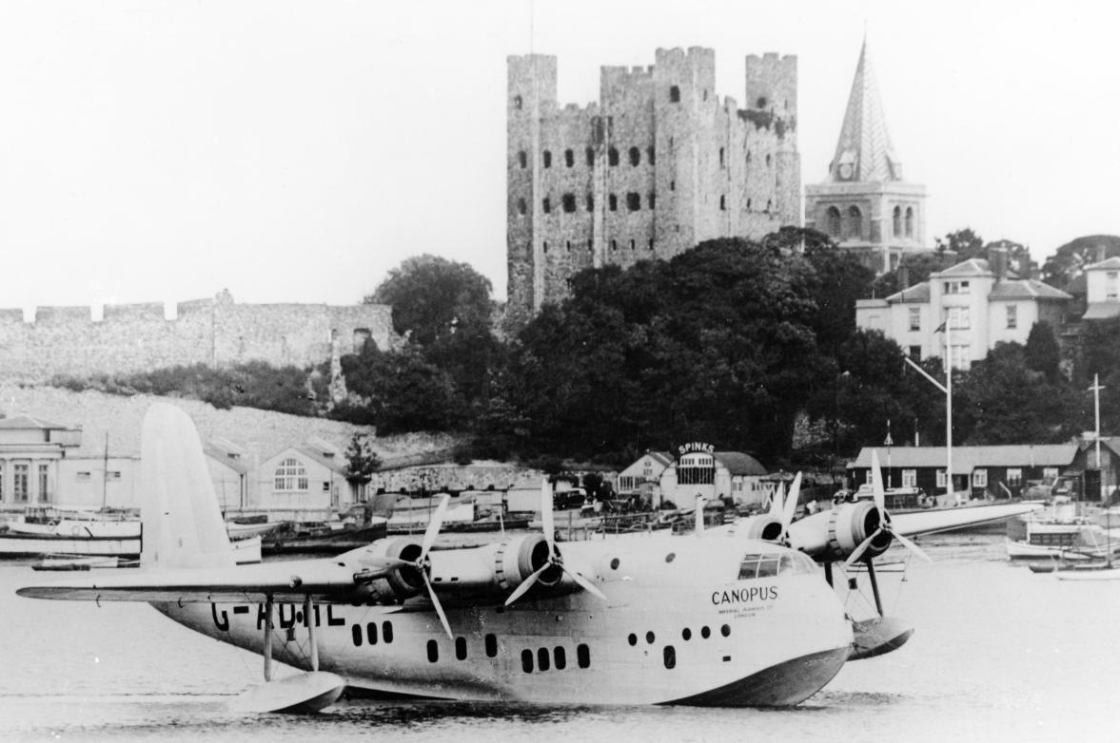

Slide 20
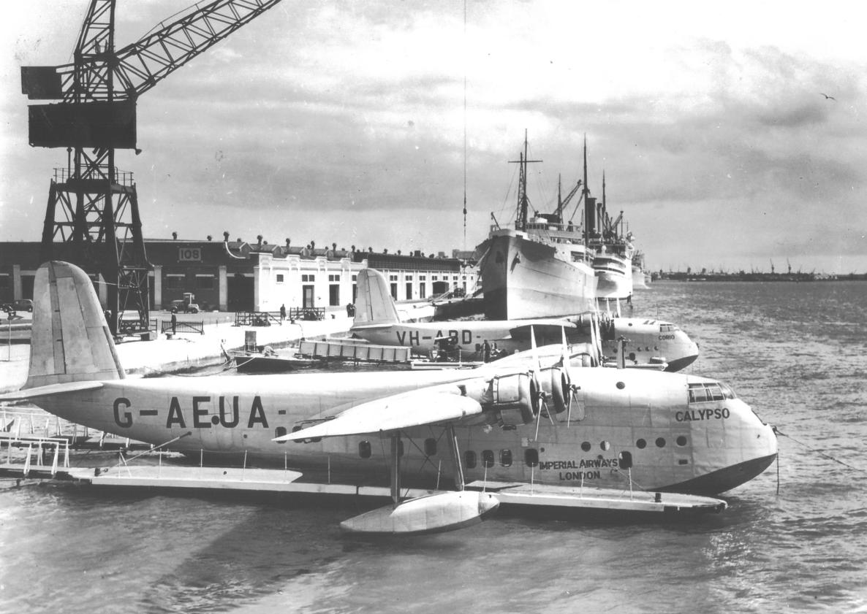
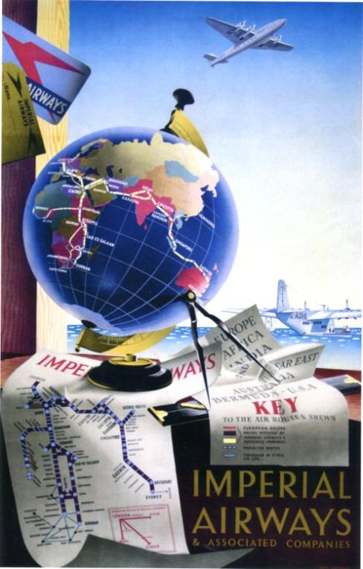
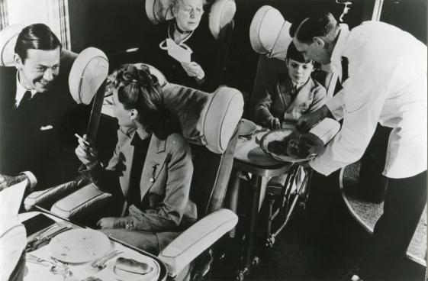

Slide 21
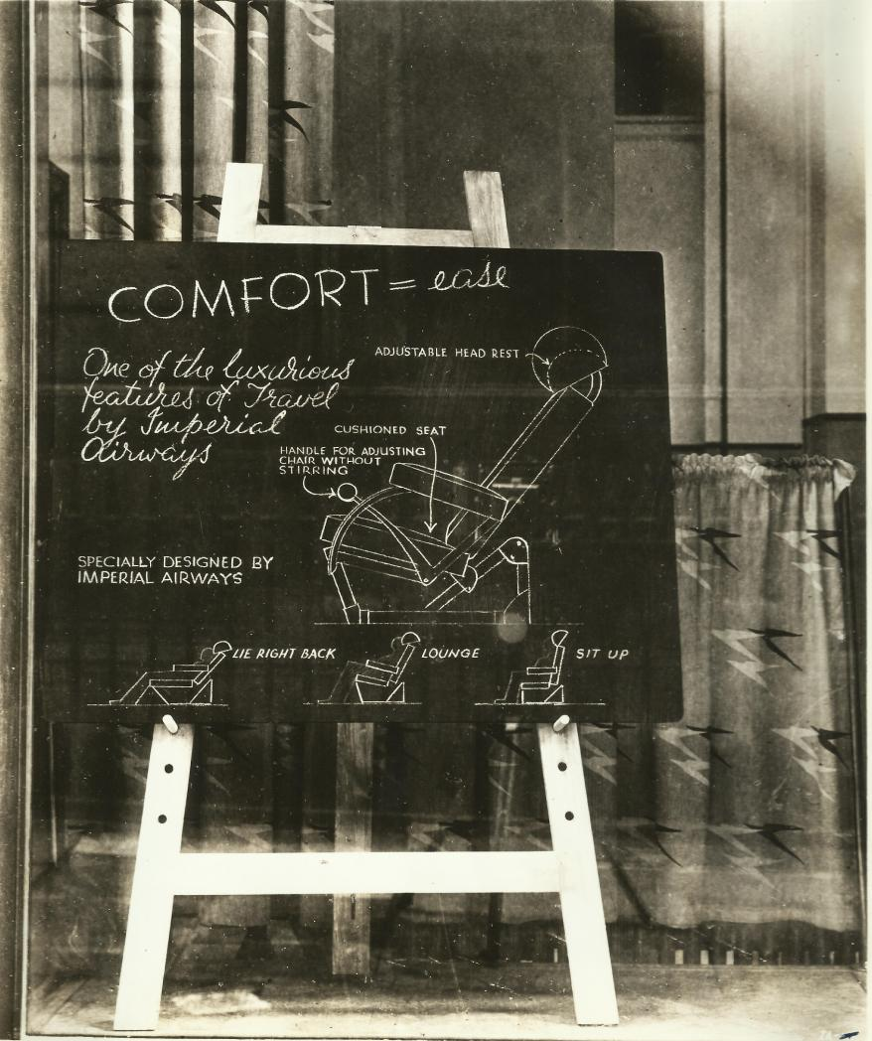
British Airways Speedbird Centre 20 June 2013
Notes:
2 September 2013
21
Pictures can fill the whole slide above the ribbed footer bar, please respect the original picture ratios.
If using a heading, ensure the text colour contrasts effectively with the picture shown.

Slide 22
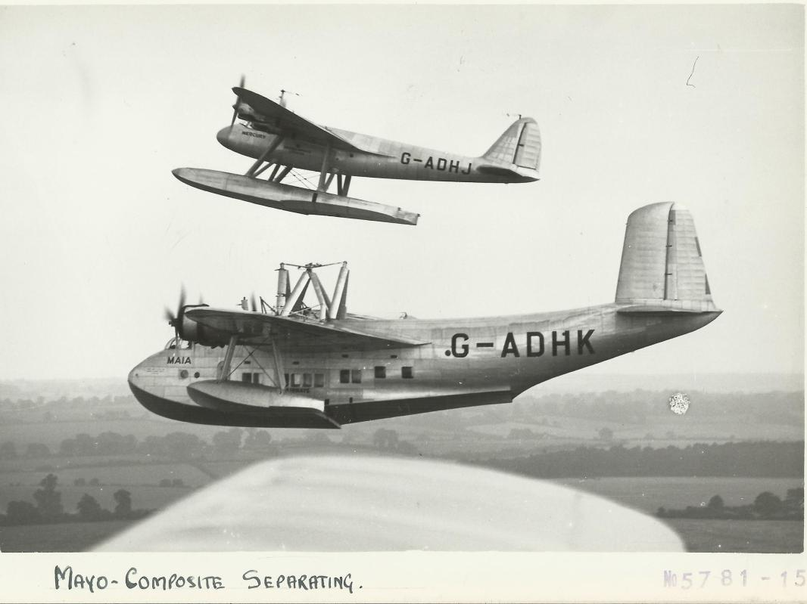
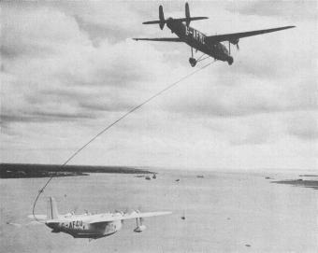
22

Slide 23
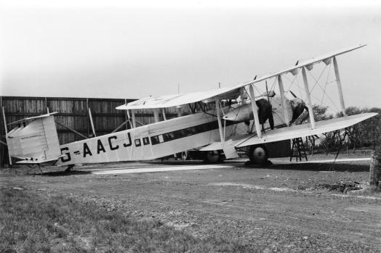
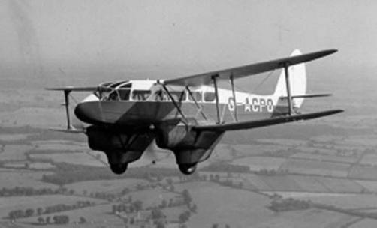
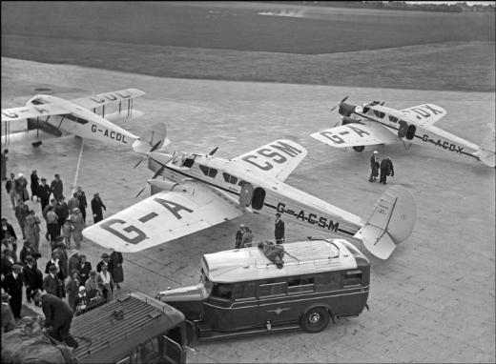
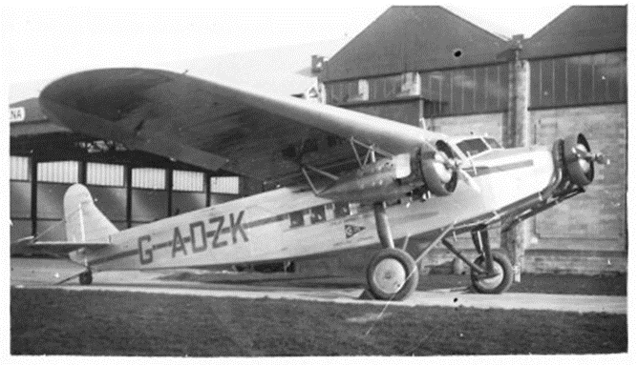
British Airways Ltd

Slide 24
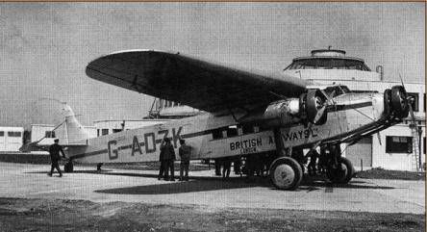
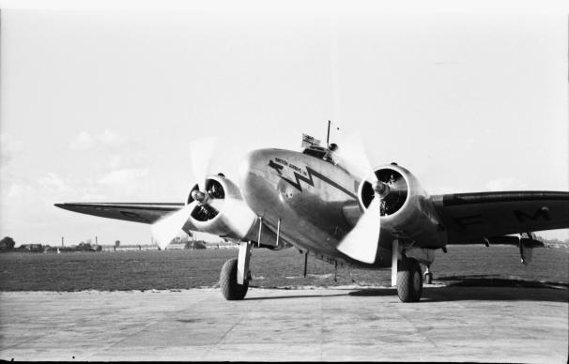
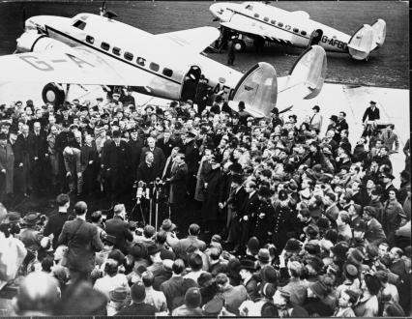
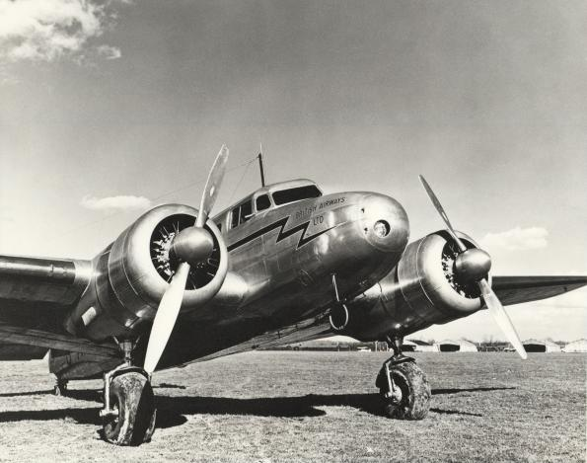
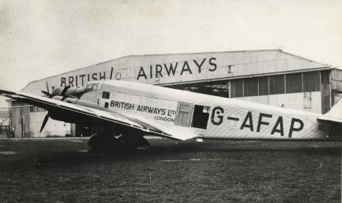

Slide 25
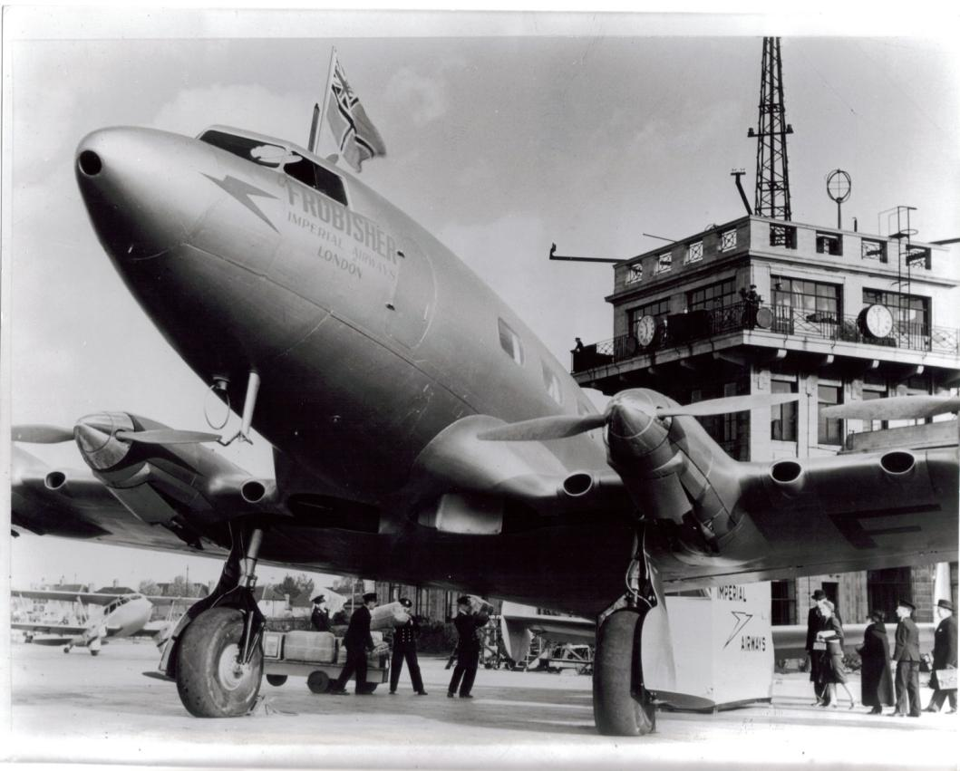
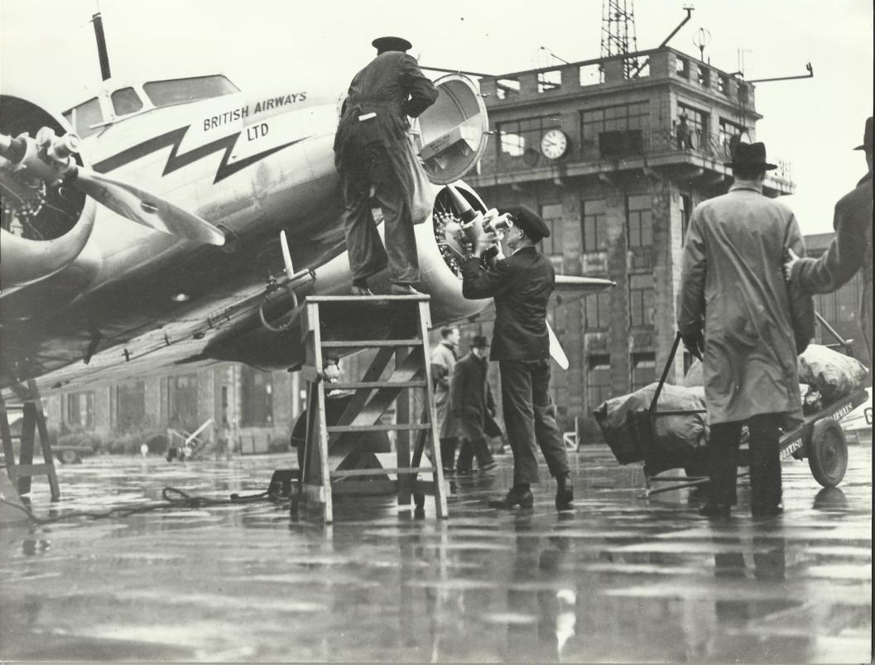
1938
British Airways Limited,
1 January 1936
British Airways Speedbird Centre 20 June 2013
Notes:
Pictures can fill the whole slide above the ribbed footer bar, please respect the original picture ratios.
If using a heading, ensure the text colour contrasts effectively with the picture shown.

Slide 26
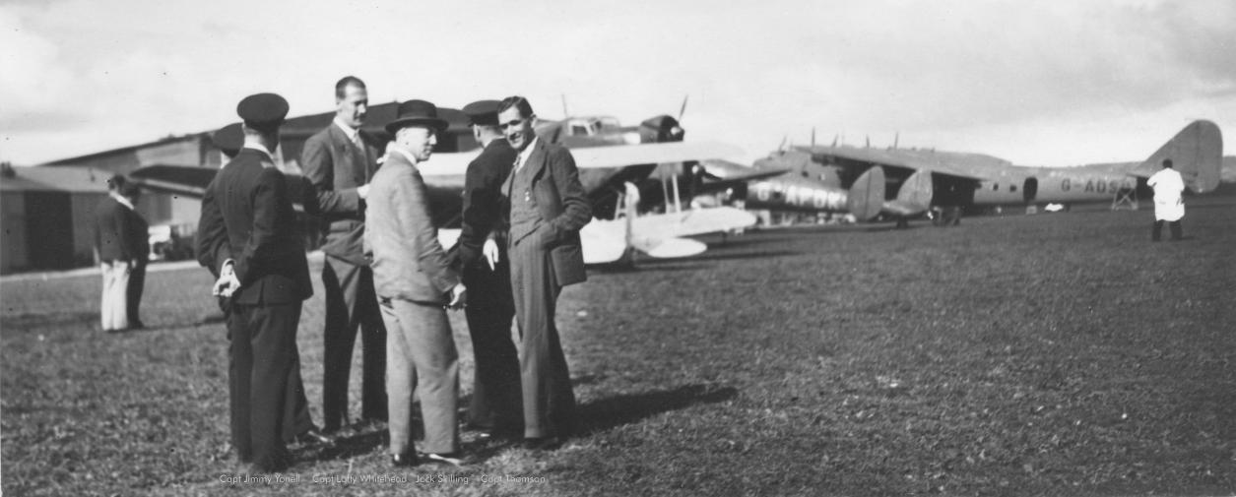
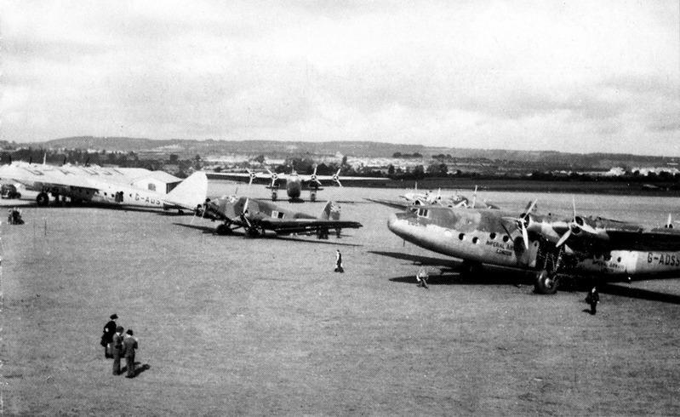
1939
Wartime
Evacuation

Slide 27
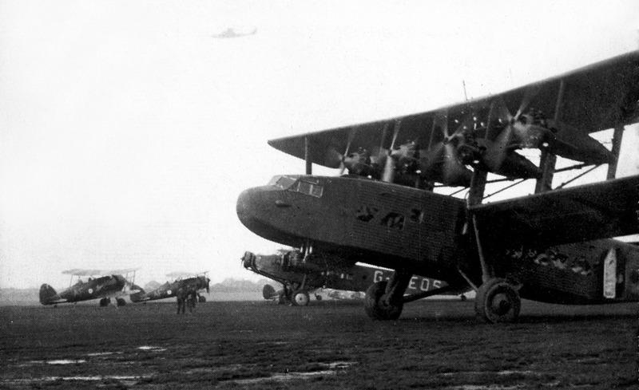

Slide 28
1 April 1940
Imperial Airways Limited
+
British Airways Limited
=
British Overseas Airways Corporation
(BOAC)
Notes:
2 September 2013
28
Pictures can fill the whole slide above the ribbed footer bar, please respect the original picture ratios.
If using a heading, ensure the text colour contrasts effectively with the picture shown.

Slide 29

`
British Airways Speedbird Centre 20 June 2013
Notes:
2 September 2013
29
Pictures can fill the whole slide above the ribbed footer bar, please respect the original picture ratios.
If using a heading, ensure the text colour contrasts effectively with the picture shown.

Slide 30


`
British Airways Speedbird Centre 20 June 2013
Notes:
2 September 2013
30
Pictures can fill the whole slide above the ribbed footer bar, please respect the original picture ratios.
If using a heading, ensure the text colour contrasts effectively with the picture shown.

Slide 31


31
Notes:
2 September 2013
31
Pictures can fill the whole slide above the ribbed footer bar, please respect the original picture ratios.
If using a heading, ensure the text colour contrasts effectively with the picture shown.

Slide 32




32
Notes:
2 September 2013
32
Pictures can fill the whole slide above the ribbed footer bar, please respect the original picture ratios.
If using a heading, ensure the text colour contrasts effectively with the picture shown.

Slide 33

The post-war structure of 1946 … Three state airline corporations
British Overseas Airways Corporation (BOAC)
British European Airways (BEA)
British South American Airways (BSAA)
Notes:
2 September 2013
33
Pictures can fill the whole slide above the ribbed footer bar, please respect the original picture ratios.
If using a heading, ensure the text colour contrasts effectively with the picture shown.

Slide 34

1 January 1946,
British South American Airways at LHR
British Airways Speedbird Centre 20 June 2013

Slide 35



British Airways Speedbird Centre 20 June 2013
Notes:
2 September 2013
35
Pictures can fill the whole slide above the ribbed footer bar, please respect the original picture ratios.
If using a heading, ensure the text colour contrasts effectively with the picture shown.

Slide 36




British Airways Speedbird Centre
Notes:
2 September 2013
36
Pictures can fill the whole slide above the ribbed footer bar, please respect the original picture ratios.
If using a heading, ensure the text colour contrasts effectively with the picture shown.

Slide 37




Heathrow North, 1946
British Airways Speedbird Centre 20 June 2013
Notes:
2 September 2013
37
Pictures can fill the whole slide above the ribbed footer bar, please respect the original picture ratios.
If using a heading, ensure the text colour contrasts effectively with the picture shown.

Slide 38

British Airways Speedbird Centre 20 June 2013
Notes:
2 September 2013
38
Pictures can fill the whole slide above the ribbed footer bar, please respect the original picture ratios.
If using a heading, ensure the text colour contrasts effectively with the picture shown.

Slide 39

British Airways Speedbird Centre 20 June 2013
Notes:
2 September 2013
39
Pictures can fill the whole slide above the ribbed footer bar, please respect the original picture ratios.
If using a heading, ensure the text colour contrasts effectively with the picture shown.

Slide 40

British Airways Speedbird Centre 20 June 2013
Notes:
2 September 2013
40
Pictures can fill the whole slide above the ribbed footer bar, please respect the original picture ratios.
If using a heading, ensure the text colour contrasts effectively with the picture shown.

Slide 41

Notes:
Image is centred between bottom of title text and top of ribbed footer bar, please respect the original picture ratios.

Slide 42


Notes:
2 September 2013
42
Pictures can fill the whole slide above the ribbed footer bar, please respect the original picture ratios.
If using a heading, ensure the text colour contrasts effectively with the picture shown.

Slide 43


British Airways Speedbird Centre 20 June 2013
Notes:
2 September 2013
43
Pictures can fill the whole slide above the ribbed footer bar, please respect the original picture ratios.
If using a heading, ensure the text colour contrasts effectively with the picture shown.

Slide 44


British Airways Speedbird Centre 20 June 2013
Notes:
2 September 2013
44
Pictures can fill the whole slide above the ribbed footer bar, please respect the original picture ratios.
If using a heading, ensure the text colour contrasts effectively with the picture shown.

Slide 45




Notes:
2 September 2013
45
Pictures can fill the whole slide above the ribbed footer bar, please respect the original picture ratios.
If using a heading, ensure the text colour contrasts effectively with the picture shown.

Slide 46




Slide 47




Slide 48



Notes:
Image is centred between bottom of title text and top of ribbed footer bar, please respect the original picture ratios.

Slide 49


1952
British Airways Speedbird Centre 20 June 2013
Notes:
2 September 2013
49
Pictures can fill the whole slide above the ribbed footer bar, please respect the original picture ratios.
If using a heading, ensure the text colour contrasts effectively with the picture shown.

Slide 50

London Airport - Johannesburg,
2 May 1952
50
Notes:
2 September 2013
50
Pictures can fill the whole slide above the ribbed footer bar, please respect the original picture ratios.
If using a heading, ensure the text colour contrasts effectively with the picture shown.

Slide 51

51
Notes:
2 September 2013
51
Pictures can fill the whole slide above the ribbed footer bar, please respect the original picture ratios.
If using a heading, ensure the text colour contrasts effectively with the picture shown.

Slide 52


British Airways Speedbird Centre 20 June 2013
Notes:
2 September 2013
52
Pictures can fill the whole slide above the ribbed footer bar, please respect the original picture ratios.
If using a heading, ensure the text colour contrasts effectively with the picture shown.

Slide 53

British Airways Speedbird Centre 20 June 2013
Notes:
2 September 2013
53
Pictures can fill the whole slide above the ribbed footer bar, please respect the original picture ratios.
If using a heading, ensure the text colour contrasts effectively with the picture shown.

Slide 54


Slide 55

1958

Slide 56


British Airways Speedbird Centre 20 June 2013
Notes:
2 September 2013
56
Pictures can fill the whole slide above the ribbed footer bar, please respect the original picture ratios.
If using a heading, ensure the text colour contrasts effectively with the picture shown.

Slide 57


British Airways Speedbird Centre 20 June 2013
Notes:
2 September 2013
57
Pictures can fill the whole slide above the ribbed footer bar, please respect the original picture ratios.
If using a heading, ensure the text colour contrasts effectively with the picture shown.

Slide 58




Slide 59




Slide 60

1965
1966
1967

Slide 61


61
Notes:
2 September 2013
61
Pictures can fill the whole slide above the ribbed footer bar, please respect the original picture ratios.
If using a heading, ensure the text colour contrasts effectively with the picture shown.

Slide 62
British Airways Speedbird Centre 20 June 2013
Notes:
Pictures can fill the whole slide above the ribbed footer bar, please respect the original picture ratios.
If using a heading, ensure the text colour contrasts effectively with the picture shown.

Slide 63



1 April 1974
+ =

Slide 64





Slide 65




Slide 66



London – Bahrain
21 January 1976

Slide 67




67

Slide 68



1984
The ‘Landor’ livery

Slide 69


Slide 70
1986

Slide 71


Slide 72



Slide 73


Slide 74



Slide 75




June 1997 “World Images” livery
(Project Utopia)

Slide 76

Official opening of BA Waterside
by HRH The Prince of Wales,
20 July 1998
Notes:
2 September 2013
76
Pictures can fill the whole slide above the ribbed footer bar, please respect the original picture ratios.
If using a heading, ensure the text colour contrasts effectively with the picture shown.

Slide 77


Terminal 5, Heathrow opened 27 March 2008
British Airways Speedbird Centre 20 June 2013
Notes:
2 September 2013
77
Pictures can fill the whole slide above the ribbed footer bar, please respect the original picture ratios.
If using a heading, ensure the text colour contrasts effectively with the picture shown.

Slide 78

2009 London City LCY to New York JFK
British Airways Speedbird Centre 20 June 2013
Notes:
2 September 2013
78
Pictures can fill the whole slide above the ribbed footer bar, please respect the original picture ratios.
If using a heading, ensure the text colour contrasts effectively with the picture shown.

Slide 79




2011
British Airways, IBERIA, Vueling, Level and Aer Lingus
Notes:
2 September 2013
79
Pictures can fill the whole slide above the ribbed footer bar, please respect the original picture ratios.
If using a heading, ensure the text colour contrasts effectively with the picture shown.

Slide 80


2012
British Airways Speedbird Centre 20 June 2013
Notes:
2 September 2013
80
Pictures can fill the whole slide above the ribbed footer bar, please respect the original picture ratios.
If using a heading, ensure the text colour contrasts effectively with the picture shown.

Slide 81



Boeing
787
“Dreamliner”
777
747
Boeing 747
Boeing 747

Slide 82




A320 family
Airbus
A380
A350
Notes:
2 September 2013
82
Pictures can fill the whole slide above the ribbed footer bar, please respect the original picture ratios.
If using a heading, ensure the text colour contrasts effectively with the picture shown.

Slide 83



Slide 84

British Airways Speedbird Centre 20 June 2013
Notes:
2 September 2013
84
Pictures can fill the whole slide above the ribbed footer bar, please respect the original picture ratios.
If using a heading, ensure the text colour contrasts effectively with the picture shown.

Slide 85





Vickers Vanguard
Bristol Britannia
Douglas DC-7C
Vickers Viking
British Airways Speedbird Centre 20 June 2013
Notes:
2 September 2013
85
Pictures can fill the whole slide above the ribbed footer bar, please respect the original picture ratios.
If using a heading, ensure the text colour contrasts effectively with the picture shown.

Slide 86

Thank you for your attention!
Any questions?
British Airways Speedbird Centre 20 June 2013
Notes:
2 September 2013
86
Pictures can fill the whole slide above the ribbed footer bar, please respect the original picture ratios.
If using a heading, ensure the text colour contrasts effectively with the picture shown.

Slide 87

Notes:
Use this slide as a placeholder before your presentation starts.

